Slide 1
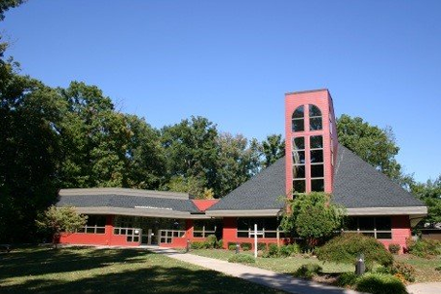
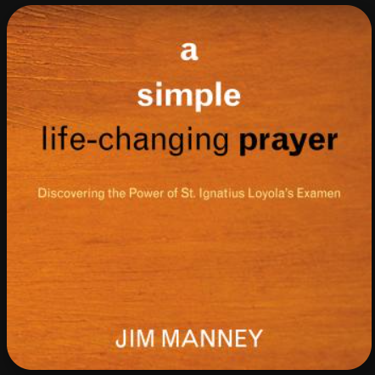
Community Of Faith
United Methodist Church
A Simple, Life-Changing Prayer: The Daily Examen
Finding God in All Things
March 22, 2026
Raj Bartakke
"God is in the details of our lives—not just the big moments, but the quiet ones too." — Jim Manney

Slide 2
What is the Examen?
A 500-Year-Old Practice: Developed by St. Ignatius of Loyola, founder of the Jesuits.
The "Daily Review": It’s a way to look back on your day to see where God was active and where you might have missed Him.
Manney’s Perspective: It isn’t just a "check-list" of sins; it’s a conversation with a friend (God).
Book: a simple life-changing prayer – Discovering the Power of St. Ignatius Loyola’s Examen
Goal: To become more "spiritually sensitive" as we move through our busy lives.

Slide 3
Why This Matters for COF UMC?
Methodist Connection: Like John Wesley’s "Holy Clubs" and "Classes," the Examen is a method for spiritual growth.
A Simple Tool: You don't need a theology degree; you just need 10–15 minutes and a willing heart.
The Result: Moving from "living on autopilot" to living with intention and awareness.

Slide 4
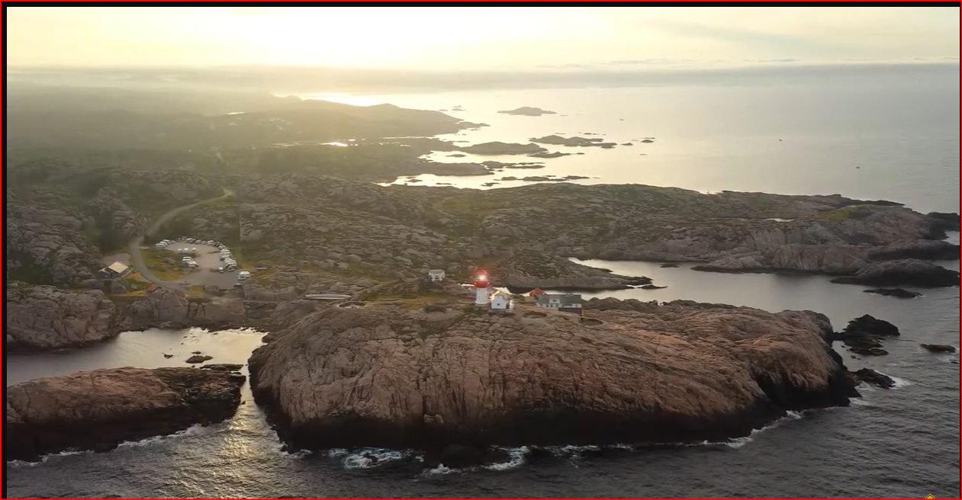
Video
Link%3Fv%3DmVE6UlP8sl0 1:14

Slide 5
A simple life-changing prayer
Jim Manney
Chapter 1 – the examen in a nutshell
  Ask God for light
  Give Thanks
  Review the day
  Face your shortcomings
  Look toward the day to come
Chapter 2 – why is this a good way to pray
  Connects us to God – helps us walk with Christ daily
  Theological answer: God is present in our world
  Down to earth practical answer
  A soldier’s daydreams
  God in our experience – he is in our journey
Chapter 3 – some problems that the examen solves (at least partly)
  Where is God?
  What do I pray about?
  Ben Franklin temptation
  Woe is me – examen makes a balanced accurate appraisal of our experience
  Let’s pretend
  Get acquainted with your feelings
  Solving “the Christian problem”

Slide 6
Point 1 – Quiet and Stillness
Posture: Find a comfortable but attentive position.
Grounding: Feet flat on the floor; hands open to receive.
Breath: Inhale through the nose, hold, exhale through the lips.
The Presence: Savor the "essence of silence.“
Focus: We aren't just sitting in silence; we are sitting in the Presence of God the Spirit.
Notes:
Chapter 4: Step One – pray for light
#1 - Give thanks to God for favors received
Give me the grace to pray
The light is God’s grace and spirit of truth
#2 - Why do we want light? To pray “to know” - relationships
#3 - What do I really want? To be free from sin

Slide 7
Point 2 – Reviewing the Presence
Scanning
Scanning the Day: Look back at the last 24 hours like a movie playing in your head.
Looking
Looking for "God-Sights": * Where did you see God in people?
What places or events felt "charged" with His Spirit?
Savoring
Savoring: Don't just list them; feel them again. Listen to the sounds and picture the faces.

Slide 8
Point 3 – Facing the Disconnected Moments
The Shadow Side: Recall when you felt "aloof," disoriented, or disconnected from the Spirit.
Don't Rush Away: This requires courage. Stay in that memory for a moment.
The Whisper: Ask God to speak to you within that memory.
The Grace: "Be held. Do not squirm and try to break free.
Key Concept: This is about forgiveness and reconnection, not self-shame.

Slide 9
Point 4 – Cultivating Gratitude
Finding the "Smile" Moments: Identify specific points of gratitude from today.
Physical Response: Let a gentle smile come to your face.
The Heart of the Examen: Manney emphasizes that gratitude is the "foundation of the spiritual life.
"Savoring”: Let the feeling of "thankfulness" sink into your being.

Slide 10
Point 5 – Looking Forward
The Day Ahead: Ask for direction for tomorrow’s people, places, and circumstances.
Awareness: "Lord, help me see You before I miss You.“
Connection: Pray for the Holy Spirit to stay "tethered" to your heart as you navigate your schedule..

Slide 11

Discussion – Making it a Discipline
When? (Bedtime is traditional, but mid-day or morning-after works too!)
Where? A consistent chair, a porch swing, or even during a quiet commute.
How Long? Start with 10 minutes. Consistency beats intensity.
Group Question: Which of these five points feels most difficult for you to practice?

Slide 12
Closing
Read the group in a 2-minute "Mini-Examen" using Point 1 and Point 4.
Closing words: "Amen. Go in peace to find God in all things."

