Slide 1
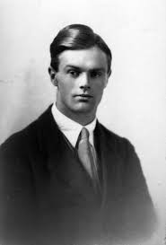
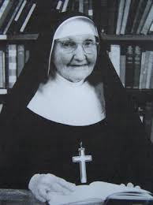
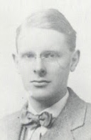
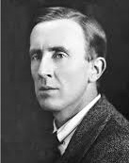
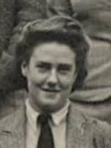
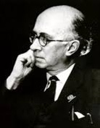
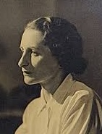
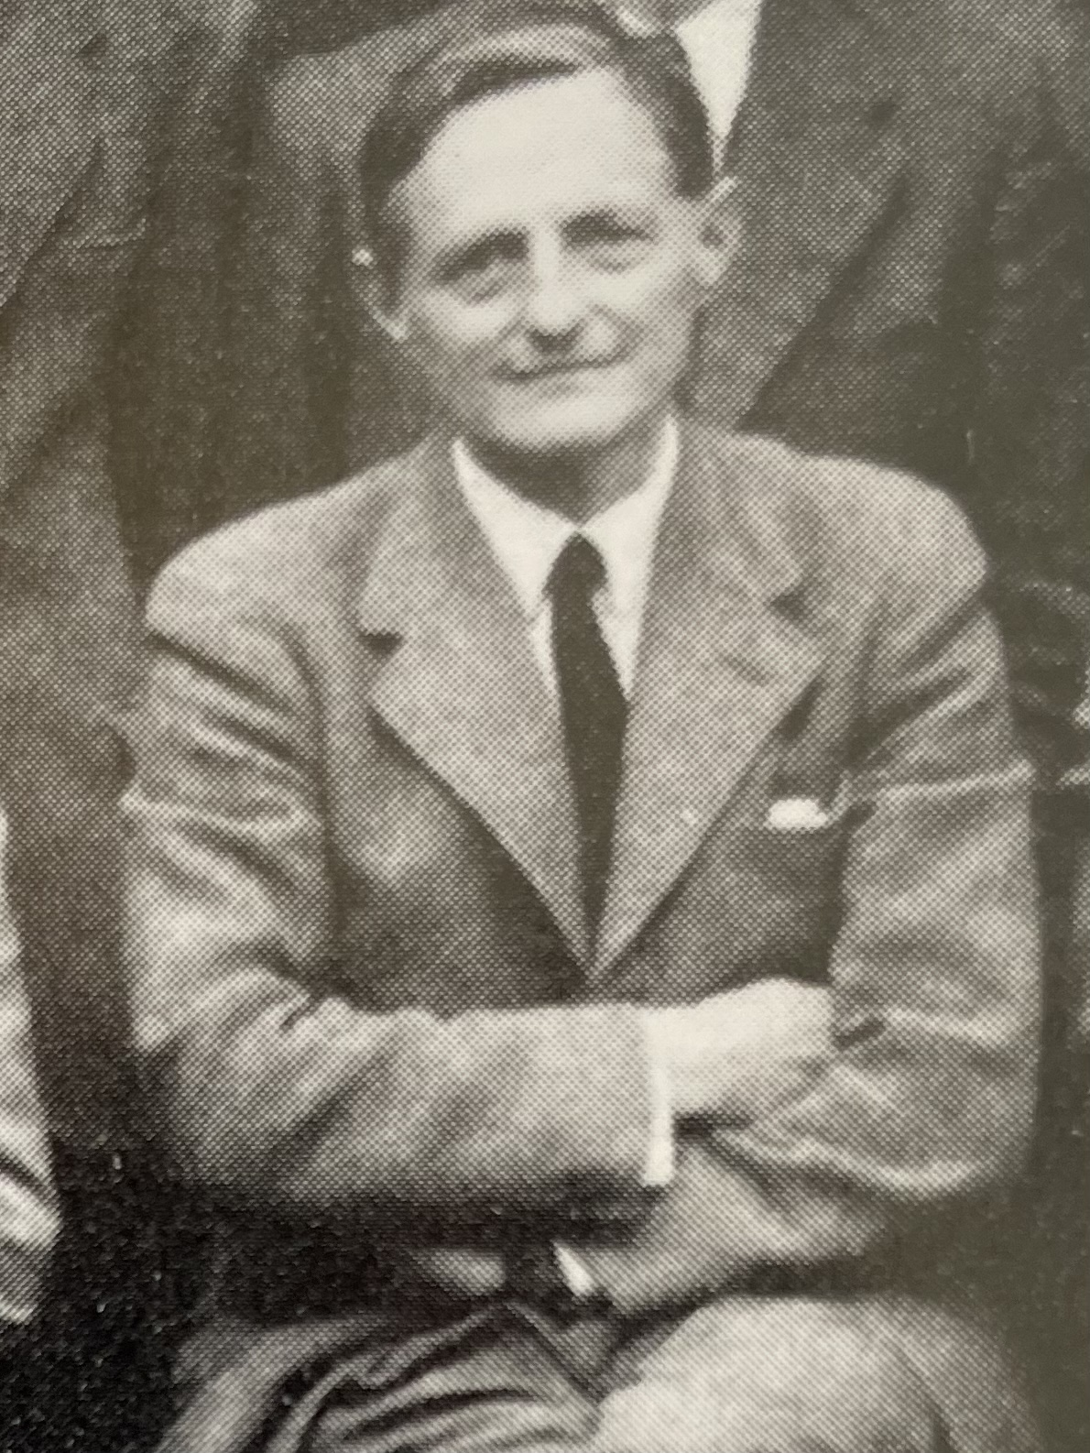
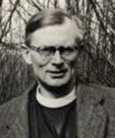
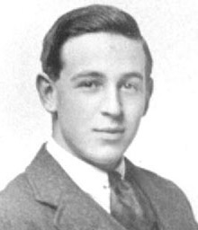
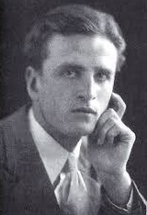

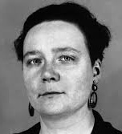
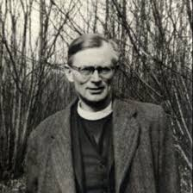
DEEPER DIVE:
C.S. Lewis and His Friends
The Inklings!
St. Philip’s Church The Rev’d Brian K. McGreevy May 13, 2026

Slide 2
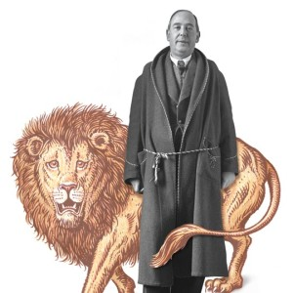
DEEPER DIVE
C.S. Lewis and His Friends:
The Inklings!
The Rev’d Brian K. McGreevy, J.D., Presenter

Slide 3
And let us consider how to stir up one another to love and good works, not neglecting to meet together, as is the habit of some, but encouraging one another, and all the more as you see the Day drawing near.
Hebrews 10:24-25

Slide 4
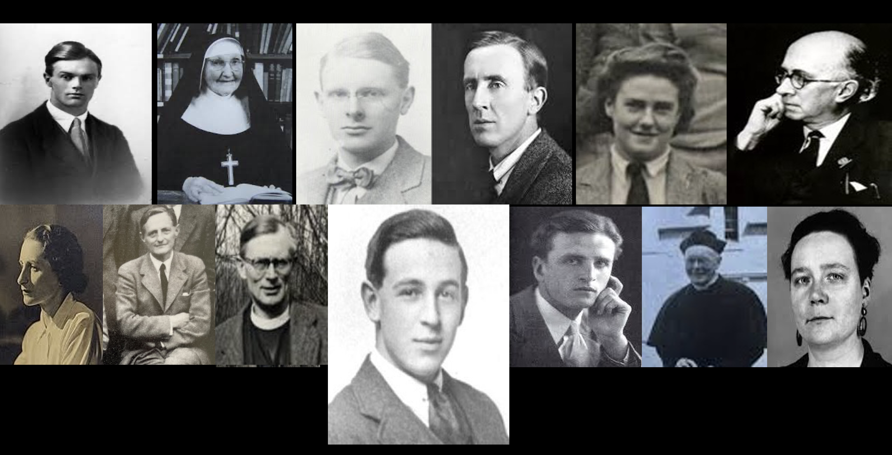
Introduction to Deeper Dive: C.S. Lewis and His Friends
A closer look at Lewis’s theology and practice of friendship, and the role of friendship and its influence in Lewis’s life in certain key areas.
Among the friends we will mention are men, women, students, priests, scholars—a wide variety!
Pictured here (left to right) are
Owen Barfield
Sister Penelope
Arthur Greeves
J.R.R. Tolkien
Stella Aldwinckle
Roger Lancelyn Green
Bottom row (left to right)
Ruth Pitter
Hugo Dyson
Austin Farrer
(Lewis)
Dom Bede Griffiths
Father Walter Adams
Dorothy Sayers
Tonight! EPISODE 4: The Inklings!

Slide 5
Who were the Inklings and why do they matter?
A group that gathered around C.S. Lewis and J.R.R. Tolkien beginning in the
1930s and lasting for several decades, defined by Lewis as “…an informal club, whose qualifications are a tendency to write, and Christianity.”
Based in Oxford and meeting in Lewis’s rooms at Magdalen College on
Thursday evenings and at the Eagle and Child pub Tuesday mornings, the group included writers, painters, philologists, physicians, historians, theologians, soldiers, and actors.
The major figures in the Inklings were C.S. Lewis, J.R.R. Tolkien, Owen Barfield, Charles Williams, Hugo Dyson, Adam Fox, ”Humphrey” Havard, and Warnie Lewis, plus dozens of others who played a part in the group at various points in its history.
“This small group altered …the course of imaginative literature (fantasy, allegory, mythopoeic tales), Christian theology and philosophy, comparative mythology, and the scholarly study of the Beowulf author, of Dante, Spenser, Milton, courtly love, fairy tale, and epic. They had fashioned a new narrative of hope amid the ruins of war, industrialization, cultural disintegration, skepticism, and anomie…, and made designs on the culture that our own age is only beginning fully to appreciate. Out of the texts they studied and the tales they read, they forged new ways to convey old themes — sin and salvation, despair and hope, friendship and loss, fate and free will — in a time of war, environmental degradation, and social change.” --Philip and Carol Zaleski, The Fellowship

Slide 6
In the midst of the cultural forces of despair and atheism in the wake of World
War I, the Inklings appeared and in a most unfriendly environment crafted a new
narrative (or rediscovered an older one) of Hope, based on a deep Christian faith
and a recovery of the transcendentals of Truth, Goodness, and Beauty. They were
unafraid to boldly engage the culture and mounted a counter-cultural offensive
about how to live and think Christianly in a post-Christian world. They were
deeply invested in recovering a Biblical understanding of fellowship and the power of community. Despite scorn from many of their contemporaries in the intellectual and academic worlds, the popularity of the Inklings has outlasted those critics and indeed has never been stronger.
Lewis and Tolkien and their bond were the nucleus of the Inklings, but other early members were important as well. Following Lewis and Tolkien’s meeting in 1926, they introduced one another to their friends, and after Lewis’s conversion in 1931, a group coalesced around them and took the name “the Inklings” from an undergraduate club that had ceased to meet. Major Warren “Warnie” Lewis served as the maitre d’ for meetings in Lewis’s rooms, taking coats, serving tea and drinks. Lewis’s old friends from his college days, Owen Barfield and Nevill Coghill, were key member, as was Tolkien’s friend Hugo Dyson, and the Magdalen College Dean of Divinity, Rev’d Adam Fox (an expert on Plato and a published poet). Tolkien’s friend C.L. (Charles) Wrenn, tutor in Anglo-Saxon at Oxford, was an early member of the group, as well as Dr. Robert “Humphrey” Havard, Lewis’s physician and an expert on Aquinas and medieval philosophy. Meetings were held in Lewis’s rooms on Thursday evenings and at the Eagle and Child pub (the “Bird and Baby”) on Tuesday mornings.
The ritual of an Inklings was unvarying. When half a dozen or so had arrived, tea would be produced, and then when pipes were well alight Jack would say, “Well, has nobody got anything to read us?” Out would come a manuscript and we would settle down to sit in judgment upon it—real unbiased judgment too, since we were no mutual admiration society: praise for good work was unstinted but censure for bad work was often brutally frank.—Warnie Lewis diary

Slide 7
While many scholars have suggested that the Inklings were simply a group of
Christian friends who were writers gathered by C.S. Lewis, perhaps a better analysis would be to say that they were gathered around the friendship of Lewis and Tolkien, a bond so strong in the early years particularly that others were drawn to it like moths to a fire. Inklings scholar Diana Glyer has written compellingly about the dynamics of the group in her excellent works The Company They Keep and Bander-snatch. “In his book The Four Loves, Lewis describes the pleasure of working with one’s colleagues side by side. In fact, he builds his whole theory of friendship upon this very idea: “You will not find the warrior, the poet, the philosopher or the Christian by staring in his eyes as if he were your mistress: better fight beside him, read with him, argue with him, pray with him.” Tolkien and Lewis modeled exactly this kind of friendship, and others wanted it and were drawn in.― Diana Pavlac Glyer, Bandersnatch
“The Inklings were anything but monolithic. Even in the early years, the club embraced a variety of professions, including don, doctor, lawyer, and soldier; the popular image of the Inklings as sequestered academics is clearly inadequate. The members’ shared Christianity also included a wide spectrum of views. Differences notwithstanding, the members were glued together by shared adherence to the Nicene Creed and a shared set of enemies, including atheists, totalitarians, modernists, and anyone with a shallow imagination. Above all, they were friends--encouraging, provoking, enlightening, and correcting one another. --The Fellowship

Slide 8
Inklings meetings ran the gamut from serious to hilarious, and fortunately there are diary entries from various members that give us a flavor of the group and its range:
[W]e had at most meetings a chapter of what I call “the new Hobbit” from Tolkien; this being the books ultimately published as “The Lord of the Rings.” [O]n 30th
October there was a long argument on the ethics of cannibalism, and on 28th
November Roy Campbell read his translation of a couple of Spanish poems and John Wain won an outstanding bet by reading a chapter of “Irene Iddesleigh”[see below]* without a smile. At our next meeting David Cecil read a chapter of his forthcoming book on [18th century poet Thomas] Gray. Sometimes, but not often, it would happen that no one had anything to read to us, and on these occasions the fun would grow riotous, with Jack at the top of his form and enjoying every minute—“No sound delights me more,” he once said, “than male laughter.” At the Inklings his talk was an outpouring of wit, nonsense, whimsy, dialectical swordplay, and pungent judgements.---George Sayer
*Irish writer Amanda McKittrick Ros reigns supreme in the estimation of many authors as one of the worst writers in history. "Uniquely dreadful," proclaims the Oxford Companion to Irish Literature. "The greatest bad writer who ever lived," says author Nick Page. Ros, who died in 1939, abused (some would say, tortured) the English language in three novels and dozens of poems. She refers to eyes as "globes of glare," legs as "bony supports," pants as a "southern necessary," sweat as "globules of liquid lava" and alcohol as the "powerful monster of mangled might." The Oxford literary group "The Inklings," which included C. S. Lewis and J.R.R. Tolkien, held competitions to see who could read her work aloud longest while keeping a straight face. Mark Twain considered her first book, Irene Iddesleigh, as "one of the greatest unin­tentionally humorous novels of all time.” Smithsonian, June 2009

Slide 9
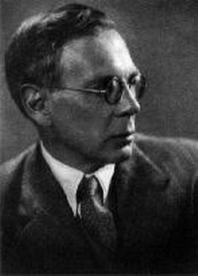
Charles Williams—the most unusual Inkling
According to Lewis, “I first heard of Charles Williams a great many years ago when a man who was sitting next to me at dinner (Dr. R. W. Chapman) asked me if I had read any of his novels. He described them as ‘spiritual shockers’. I was interested and made a mental note that this was an author to be looked into but did nothing about it. A few years later I spent an evening at Exeter
College in the rooms of Mr. N. K. Coghill. He was full of a book he had just read called The Place of the Lion, by Charles Williams. No man whom I have ever met describes another man’s work better than Mr. Coghill (his descriptions of Kafka always seemed to me better even than Kafka himself) and I went home with his copy of The Place of the Lion. Twenty-four hours later I found myself, for the first time in my life, writing to an author I had never met to congratulate him on his book. By return of post I had an answer from Williams, who had received my letter when he was on the point of writing a similar letter to me about my Allegory of Love.
“After this, as may be supposed, we soon met and our friendship rapidly grew inward to the bone. Until 1939 that friendship had to subsist on occasional meetings, though, even thus, he had already become as dear to all my Oxford friends as he was to me. There were many meetings both in my rooms at Magdalen and in Williams’s tiny office at Amen House. Neither Mr. Dyson nor my brother, Major W. H. Lewis, will forget a certain immortal lunch at Shirreff’s in 1938 (he gave me a copy of He Came Down From Heaven and we ate kidneys ‘enclosed’, like the wicked man, ‘in their own fat’) nor the almost Platonic discussion which followed for about two hours in St. Paul’s churchyard.” Lewis, Essays Presented in Honor of Charles Williams

Slide 10
Williams was born in London in 1886, the only son of a journalist and a milliner, and grew up in genteel poverty in London until poverty forced the family to move to Hertfordshire. He attended St. Alban’s School on a scholarship, where he was recognized as a prodigy, and continued in his staunch Christian faith as a devout Anglican, but with a fascination for ritual and magic. Awarded a scholarship to University College London at the age of 15, he dropped out before earning a degree because he could not pay the fees and began work in a Methodist bookshop and then was hired as a proofreading assistant by the Oxford University Press at Amen House, where his talents were recognized and blossomed and he was soon appointed an editor. He married his wife, Florence, at the age of 30 and set up house in London. Williams began lecturing on literature for the London County Council, soon developing his own style and a loyal following, prefiguring his great success as a lecturer at Oxford, while also becoming a prolific writer of poetry, fiction, and of theology. He met C.S. Lewis in 1936 after their letters almost crossed in the mail and then became part of the Inklings, which had a marked effect on his works as well as vice versa. He moved to Oxford with the OUP when they left London in 1939 because of the war.
Charles Williams might talk to you for an hour, he might take you out for tea, write letters to you, ring you up; make you read verse, learn Collects, keep your temper once a week, write essays for him, but after a month your attention was more directed to the Holy Ghost than to Charles Williams –(Description from one of Williams’s students)
For all his strangeness, the abiding impression that Williams left with both his most devoted followers and those fellow authors who admired him (T.S. Eliot, W.H. Auden, C.S. Lewis) was of a saintly man, who was equally at home in ordinary or mystical realms. –Colin Duriez, The Oxford Inklings

Slide 11
Three World-Changing Works
1. Thomas Cranmer of Canterbury –-a play presented at the Canterbury
Festival in 1936 George Bell, Dean of Canterbury Cathedral, decided to re- introduce theater to the Cathedral and to encourage specifically Christian art by establishing the Canterbury Festival in 1928, an annual festival of which the centerpiece would be a specially commissioned drama presented in the Cathedral. T.S. Eliot’s Murder in the Cathedral was the highly acclaimed selection for 1935, and it was a huge honor for Williams to be asked to write the play for the following year. Following Williams as the playwright for the 1937 festival was Dorothy Sayers’ Zeal for Thy House—august company on both sides. Williams’ play was a brilliant success—a signal accomplishment for someone who had never published a play before!
2. Descent into Hell (1937)
Descent into Hell is widely regarded as the best of Williams’s theological novels and is the first written with the influence and input of the Inklings. It is Williams’s fictional exploration of the Church Fathers’ ideas on Co-inherence, which became one of the keystones of Williams’s theology, especially the idea of bearing one another’s burdens and deep fellowship. If it is true that That Hideous Strength is a Charles Williams novel written by C. S. Lewis, it is also true that Descent Into Hell is Charles Williams’ s extended exposition of the following C. S. Lewis quote: Indeed the safest road to Hell is the gentle slope, soft underfoot, without sudden turnings, without milestones, without signposts
3. Editing and publishing of the works of Søren Kierkegaard into English, commencing with The Present Age (trans. Dru and Lowrie; Oxford University Press), for which Williams wrote the introduction
Kirkegaard was a brilliant, important 19th century Danish philosopher and Christian theologian whose works Williams was instrumental in introducing to the English-speaking world, and his introduction to the first of the works published in English helped explain the theological relevance of Kirkegaard in post-WWI Britain.

Slide 12
Fellowship: the sorting of priorities and iron sharpening iron
From a November 1939 letter from C.S. Lewis to his brother Warnie, who had been called to active duty in the war: “On Thursday we had a meeting of the Inklings
[in Lewis’s rooms at Magdalen.] I have never seen in my life Dyson so exuberant–”a roaring cataract of nonsense.” The bill of fare afterwards consisted of a section of the new
Hobbit book by Tolkien, a nativity play from Williams (unusually intelligible for him, and approved by all) and a chapter out the book on the Problem of Pain from me. It so happened that the subject matter of the three readings formed almost a logical sequence, and produced a real first rate evening’s talk of the usual wide-ranging kind–” from grave to gay, from lively to severe.”
The sequence of readings that evening all related to the nature of Evil. The section of the “new Hobbit” was one of many read to the Inklings in this period and almost certainly was the section in The Lord of the Rings about the sinister meaning of the Ring of Power. Charles Williams’ offering was a Christmas play The House by the Stable where Pride (in the form of a beautiful woman) and Hell (her brother) seek to steal the Soul (a precious jewel) from a man's breast. This devilry is interrupted only by the figures of Joseph and the pregnant Mary who are seeking shelter for the night. Williams is working the traditional Augustinian view of Evil as a perversion of Good into a contemporary form, something approved in earlier readings to the Inklings. Lewis began writing The Problem of Pain in the summer of 1939 and read it in installments to the Inklings, to whom it is dedicated. The fact that this was read November 9th means it was a section early on in his theoretical treatise on Evil and suffering and that its application was immediate in the heightened in context of War. Perhaps that evening the group of friends chewed over the fact that within poetry and within story and even within history the abstract and concrete dilemma of Evil could be at least be partly resolved in a “little Incarnation” [‘when two or three are gathered together in My name, I am there in the midst of them’] that anticipated or echoed the time when Myth became fact in the Gospels. –adapted from Colin Duriez, Bedeviled: Lewis, Tolkien, and the Shadow of Evil

Slide 13
Lewis describes a typical scene in the 1940s: Picture to yourselves an upstairs sitting room with windows looking north into the Grove of Magdalen College on a sunshiny Monday morning in vacation at about 10. The professor [Tolkien] and I, both on the Chesterfield, lit our pipes and stretched out our legs. Williams, in the armchair opposite to us, threw his cigarette into the grate, took up a pile of the extremely small, loose sheets on which he habitually wrote that came, I think, from a two-penny pad for memoranda, and began reading.
“The day after war in Europe ended, on Tuesday 8th May 1945, Charles Williams was almost alone in the temporary offices of the Oxford University Press for the last day he would work. That evening he walked the Oxford streets, where victory bonfires were burning everywhere. There was a sense of ending as revelers went wild. The following day Williams could not work, as he was gripped with severe pain. Later that day he was taken to the Radcliffe infirmary located nearby on the Woodstock Road. His wife, Florance, arrived by train from London after hearing of the emergency and stayed in Oxford. After the weekend, Williams was operated on for a condition that had troubled him years before, but he never regained consciousness. All that Lewis heard was that Williams was to have minor surgery. The evening of the day of Williams’ operation Lewis gave a talk on Resurrection at the Socratic Club. Hope in the resurrection of the body after death was a central tenet of his Christian belief. The day after, on Tuesday morning May 15th Lewis made his way to the Radcliffe, carrying a book he wanted to lend Williams, intending to join the other Inklings as usual at the Bird and Baby a few minutes walk away. He was stunned to find that his great friend had passed away. The shock persisted as he sleepwalked down to St. Giles and the Eagle and Child pub, where the Inklings had gathered, unprepared as he have been for the news. Warren Lewis wrote in his diary: “And so vanishes one of the best and nicest men that has ever been my good fortune to meet. May God receive him into his Everlasting happiness. The Inklings can never be the same again.”–from The Oxford Inklings by Colin Duriez

Slide 14

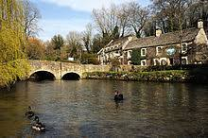
With the loss of Charles Williams, the long-planned Victory Inklings in mid December 1945 was a much reduced affair. A few of the Inklings arrived at their location in the Cotswold Hills. The Lewis brothers, Tolkien, and Humphrey Havard were in the first party. It was just after the end of
Michaelmas Term and they settled in a homely pub called The Bull on the
River Coln just west of the Thames. The celebration lasted four days, days hard-won from their work and family responsibilities and commitments. The first day before the others arrived Warnie patiently walked with Tolkien, who would constantly stop to look at wildflowers or whatever else caught his attention...
Warnie wrote in his diary “...we were very cozy in our own lounge in the evening, where I read Lewis Carroll's Life by Collinwood, and Tollers my Dr. Brown's Letters. Jack arrived without Barfield, who was ill,... after which we have one of the best winter walks I ever took. On Thursday in the afternoon we walked through Horcourt and Whelford, a mere hamlet with a simple little church where we all felt that God dwells. There to my surprise and pleasure Tollers said a prayer. Down on the river was a perfect mill house where we amused ourselves by dreaming of it as a home for the Inklings. We drank beer at the unusually name to Pig & Whistle at Coln St. Aldwyn, a dream village.”--from The Oxford Inklings by Colin Duriez

Slide 15
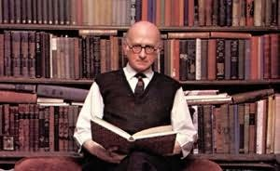
Roger Lancelyn Green (1918-1967)—an occasional but important Inkling
Roger Lancelyn Green was a student of Lewis 20 years his junior; Lewis used to borrow his watch for lectures. They soon discovered their common fascination with faerie and began reading each other’s drafts. Green started attending Inklings meetings from time to time. Green became famous as an author, and he had perhaps the greatest impact of any of the Inklings on the Narnia stories. His friend- ship with Lewis was characterized by mutual encouragement about writing as well as mutual spiritual devotion. Lewis dedicated The Discarded Image, his last book, to Green. Green and his wife took Lewis and Joy to Greece shortly before the end of Joy’s life, one of Lewis’s happiest memories.
“On March 10, 1949, a few months after the last Inklings evening meeting, Roger Lancelyn Green dined with Lewis at Magdalen College. They talked in Lewis’s rooms until midnight, during the course of which Lewis read two chapters from the manuscript of The Lion, the Witch and the Wardrobe. He had made an effort at writing a fairy story in about 1939, but that attempt had stalled, probably owing to his many wartime duties. What he originally had written, however, the Inklings had not received well, so Lewis burned the manuscript. He told Green that he had already read this new attempt to Tolkien. When he heard that
Lewis had shown the story to Green, Tolkien turned on Green and declared: “It really won’t do, you know! I mean to say: ‘Nymphs and their Ways, The Love-Life of a Faun’. Doesn’t he know what he’s talking about?” Lewis knew exactly what he was talking about, and Green was delighted. When Green published a short book about Lewis for the Bodley Head Monograph series of biographies of its own authors, he observed that Lewis had set aside his fairy story “owing to criticism from one of his older friends by then rather out of touch with children and their books, and wedded to different modes of thought where fairy-tale and fantasy were concerned.” Modestly, Green added that “by March 1949 he was working on it again, and reading the early chapters to another friend, who proved more encouraging—and perhaps saw more clearly that here was the beginning of a really new and exciting development in children’s literature.” Lewis deeply appreciated Green’s support, and George Sayer reported

Slide 16
that Lewis doubted he would have finished the book without Green’s encourage- ment. Other than from Green, he received little encouragement from his old friends in writing his Narnia stories. Griffiths did not read them until after Lewis died. Lewis appears not to have told Dorothy L. Sayers, Ruth Pitter, or Sister
Penelope about his children’s story at first, but he did suggest to Sister Penelope the pen name of G. H. Pevensey for a science-fiction novel she was attempting.
Sister Penelope did not use the name, but Lewis changed the name to Pevensie and used it as the family name of the children in The Lion, the Witch and the Wardrobe.
“Lewis was writing a fairy story for children who lived in Britain just after World War II. They lived with trains, airplanes, radios, and tourists. They read the tales of King Arthur and Hercules. Their culture had inherited the stories from around the world. Children are not professors of Anglo-Saxon. As much as Tolkien talked about the boundary between our world and the world of faerie, he did not write stories that involved crossing that boundary, but Lewis did. Tolkien worked hard at imitating a style of elevated language and duplicating a form of storytelling that predated the Norman invasion of 1066. As monumental an achievement as The Lord of the Rings may be, it is not a fairy story. By contrast, The Lion, the Witch and the Wardrobe is a fairy story for children in 1950 who inherited the global collection of stories of the fading British Empire. For them, Santa Claus, or Father Christmas, was the magical figure who remained in the modern world and helped form a bridge to the world of imagination.
“In June 1949, Lewis told Green he was interested in the idea of being drawn by magic into Narnia across time and space. By the end of December, culminating a most difficult six-month period for Lewis, he sent to Green for his review the completed manuscript of a story in which the children are drawn by magic into Narnia across time and space—Prince Caspian. Though his stories often began with a picture, they sometimes began with an idea like being drawn into Narnia across time and space. With The Chronicles of Narnia [and Green’s encouragement], Lewis experienced a renewal of his imaginative power.—excerpted from “The Birth of Narnia” by Harry Lee Poe

Slide 17
EPILOG: Reflections on Friendship from The Four Loves
“I have no duty to be anyone's Friend and no man in the world has a duty to be mine. No claims, no shadow of necessity. Friendship is unnecessary, like philosophy, like art, like the universe itself (for God did not need to create).
It has no survival value; rather it is one of those things which give value to survival.”
“In each of my friends there is something that only some other friend can fully bring out. By myself I am not large enough to call the whole man into activity; I want other lights than my own to show all his facets. Now that Charles is dead, I shall never again see Ronald’s reaction to a specifically Caroline joke. Far from having more of Ronald, having him ‘to myself’ now that Charles is away, I have less of Ronald. Hence true Friendship is the least jealous of loves. Two friends delight to be joined by a third, and three by a fourth, if only the newcomer is qualified to become a real friend. They can then say, as the blessed souls say in Dante, ‘Here comes one who will augment our loves.’ …”
“To love at all is to be vulnerable. Love anything and your heart will be wrung and possibly broken. If you want to make sure of keeping it intact you must give it to no one, not even an animal. Wrap it carefully round with hobbies and little luxuries; avoid all entanglements. Lock it up safe in the casket or coffin of your selfishness. But in that casket, safe, dark, motionless, airless, it will change. It will not be broken; it will become unbreakable, impenetrable, irredeemable. To love is to be vulnerable.”

Slide 18
TO PONDER:
The Impact of the Christian Friendship of Lewis and the Inklings
--The debt Lewis owed to each of them in his journey deeper into the Christian faith in different phases in his life
--The impact of the ministry of these men on Lewis, his faith, and his writing
--What if Lewis had not allowed himself to enter into a deep and vulnerable friendship with a student like Green because of his intellectual pride?
--Consider the Inklings’ commitment to drawing out one another’s gifts and using their gifts with serious purpose to advance the Kingdom: how might you emulate this?
--Consider the role of friendship in your life and what kind of friend you are: what can you learn from the example of Lewis and these friendships with men of different ages in the different phases of his life?
--Where might God be calling you to initiate an intergenerational friendship grounded in faith?
--What role do Truth, Goodness, and Beauty play in your life and your understanding of following Christ and drawing others to Him?
--Consider the seriousness and sense of stewardship with which the Inklings approached their time as friends, with talk about things that matter. How does the content of our conversation with friends measure up?
What priority do investing in Gospel-focused friendship and deep fellowship have in our lives?

Slide 19
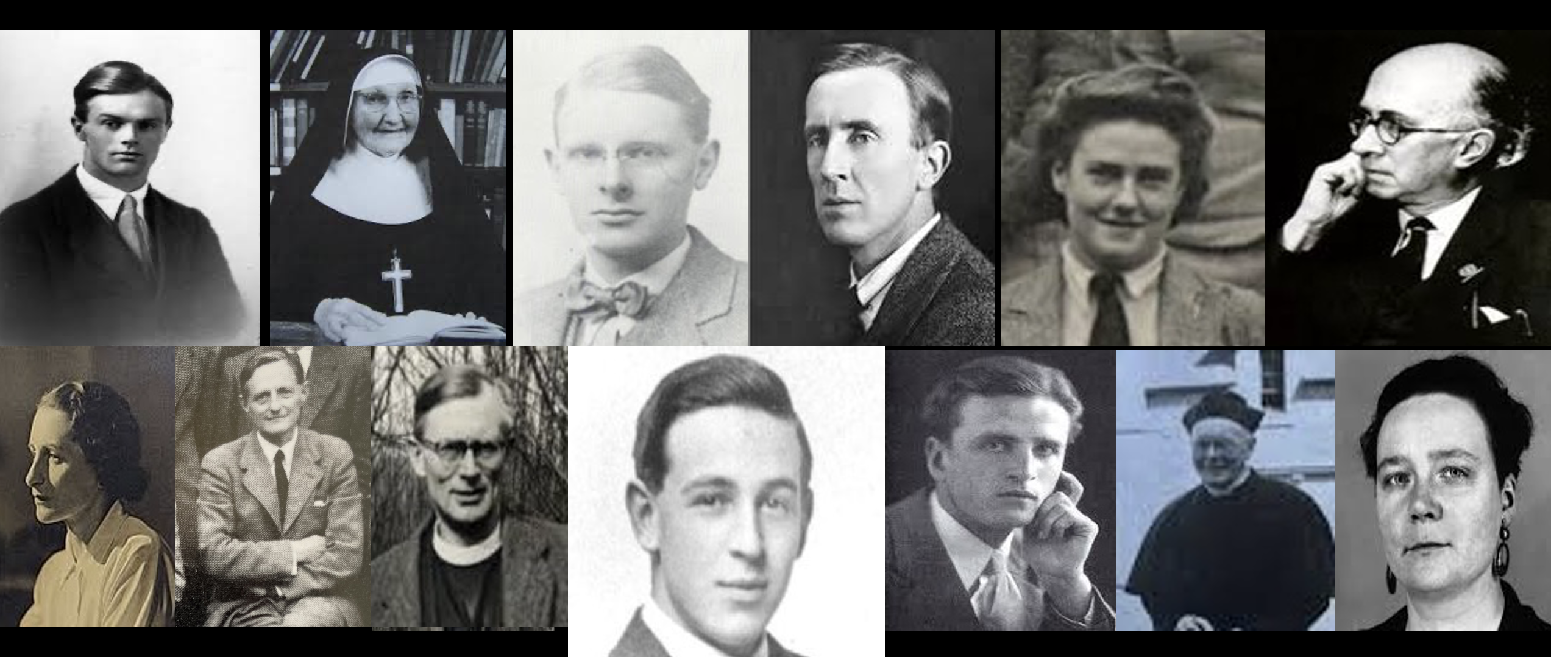
“For a Christian, there are, strictly speaking, no chances. A secret Master of the Ceremonies has been at work. Christ, who said to the disciples "Ye have not chosen me, but I have chosen you," can truly say to every group of Christian friends "You have not chosen one another but I have chosen you for one another." The Friendship is not a reward for our discrimination and good taste in finding one another out. It is the instrument by which God reveals to each the beauties of all the others. They are no greater than the beauties of a thousand other men; by Friendship God opens our eyes to them. They are, like all beauties, derived from Him through the Friendship itself, so that it is His instrument for creating as well as for revealing. At this feast it is He who has spread the board and it is He who has chosen the guests. It is He, we may dare to hope, who sometimes does, and always should, preside. Let us not reckon without our Host.”
—C.S. Lewis, The Four Loves
,

Slide 20
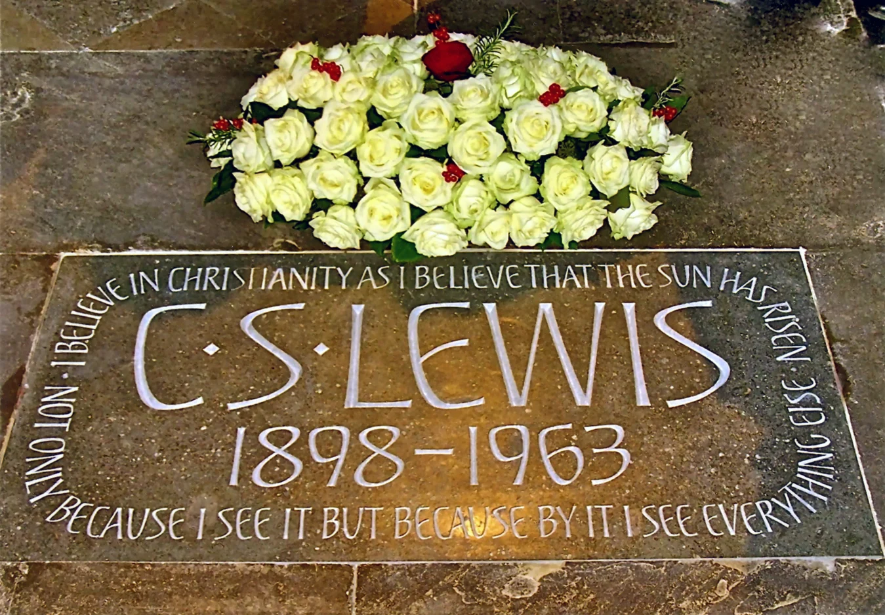
“I believe in Christianity as I believe that the Sun has risen, not only because I see it but because by it,
I see everything else.”
--from Lewis’s essay Is theology poetry?

