Slide 1
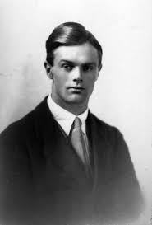
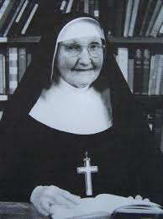
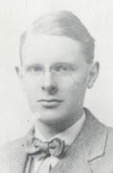
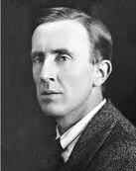
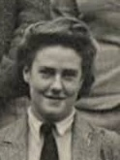
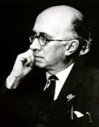
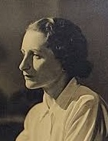
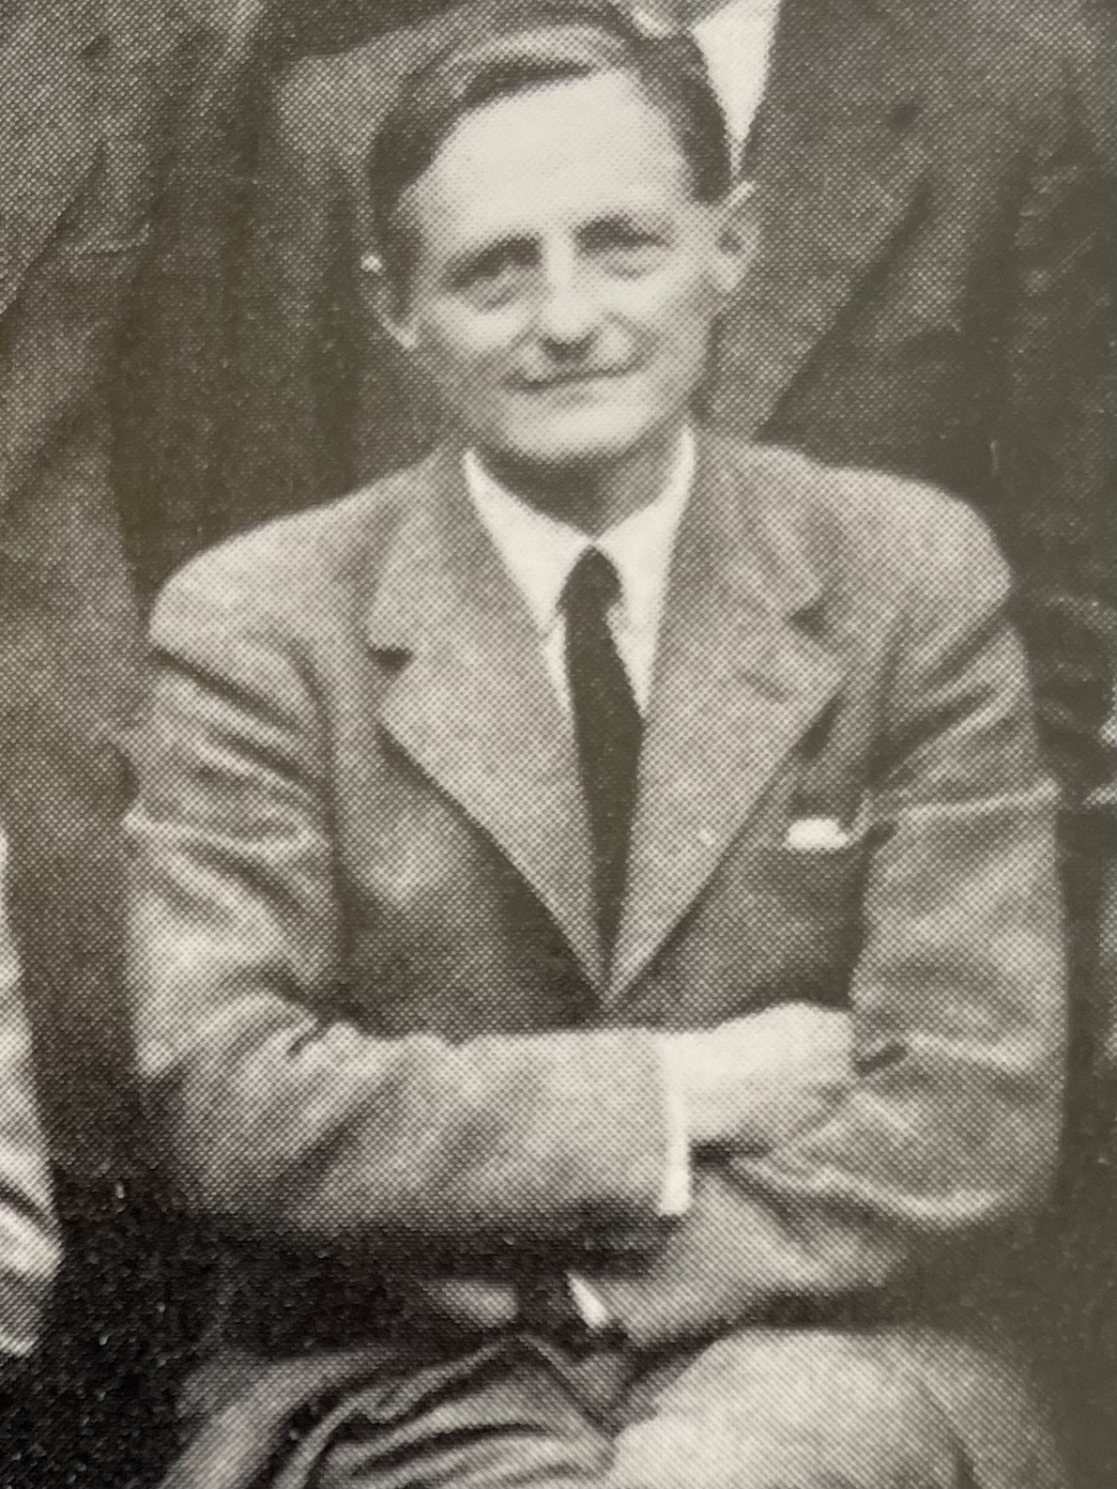
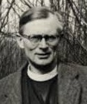
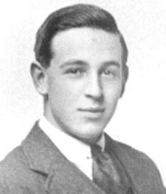
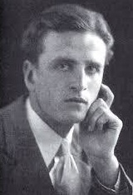

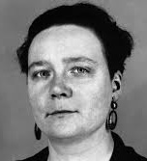
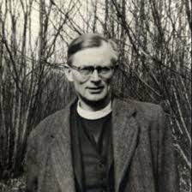
DEEPER DIVE:
C.S. Lewis and His Friends
Clergy Friends:
Dom Bede Griffiths, Father Walter Adams, and Father Austin Farrer
St. Philip’s Church The Rev’d Brian K. McGreevy May 6, 2026

Slide 2
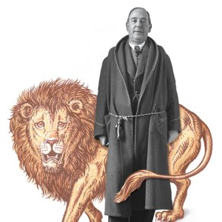
DEEPER DIVE
C.S. Lewis and His Friends:
Clergy Friends:
Dom Bede Griffiths, Father Walter Adams, and Father Austin Farrer
The Rev’d Brian K. McGreevy, J.D., Presenter

Slide 3
And let us consider how to stir up one another to love and good works, not neglecting to meet together, as is the habit of some, but encouraging one another, and all the more as you see the Day drawing near.
Hebrews 10:24-25

Slide 4
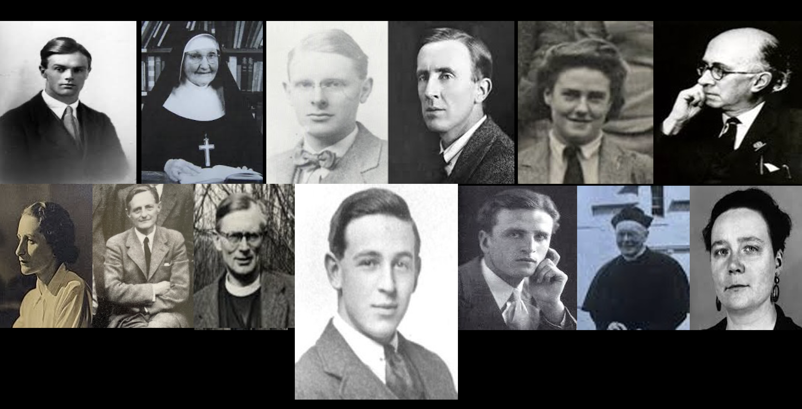
Introduction to Deeper Dive: C.S. Lewis and His Friends
A closer look at Lewis’s theology and practice of friendship, and the role of friendship and its influence in Lewis’s life in certain key areas.
Among the friends we will mention are men, women, students, priests, scholars—a wide variety!
Pictured here (left to right) are
Owen Barfield
Sister Penelope
Arthur Greeves
J.R.R. Tolkien
Stella Aldwinckle
Roger Lancelyn Green
Bottom row (left to right)
Ruth Pitter
Hugo Dyson
Austin Farrer
(Lewis)
Dom Bede Griffiths
Father Walter Adams
Dorothy Sayers
Tonight! EPISODE 3: CLERGY FRIENDS: Dom Bede Griffiths, Father Walter Adams, and Father Austin Farrer

Slide 5
Dom Bede Griffiths (1906-1993)
Alan Richard Griffiths grew up in a devout Anglican family, studied at
Christ’s Hospital School, and won a scholarship to Magdalen College,
Oxford, joining the university the same term that C.S. Lewis joined the faculty of Magdalen. Lewis was his tutor in English.
“Lewis was at that time no more of a Christian than I was, but he had been through the same phase of Romanticism as I was then passing through, and had reached a more rational philosophy of life. When I explained to him my reasons for reading English literature, he protested vigorously against my view of life but he was naturally unable to convince me, as I was not open to reason on the subject. I had ceased to practice any form of Christianity and I regarded Christianity as a religion of the past, which had ceased to have any significance for the present day.”
After Griffiths took his degree in 1929, Lewis persuaded him to stay in Oxford and read philosophy, where at Lewis's suggestion he read Dante's Divine Comedy and Saint Augustine's Confessions, which deeply affected him. In 1930 Griffiths began reading the New Testament and in 1931 became a believer. He considered taking holy orders at first thinking of the Church of England but then became attracted to Catholicism. In 1933 after trying his vocation as a monk in a monastery in the Cotswolds he was clothed as a novice. He had been deeply moved by the Venerable Bede’s Ecclesiastical History of the English People and therefore took the name Bede, being known thereafter as Dom Bede Griffiths.

Slide 6
C.S. Lewis wrote that Griffiths was his “chief companion on the road to
Christian faith.” Lewis scholar Joel Heck states, “two atheists, a teacher and
his student, saw evidence for the existence of God in many places and found
themselves kindred spirits in a growing understanding of that truth. The
spiritual journeys of C.S. Lewis, the Oxford don, and Alan Richard Griffiths,
the student, were strikingly similar. Griffiths described their early relationship
as acquaintanceship ripened into friendship, adding that “between 1929 and 1932 I was probably nearer to Lewis than to anyone else.” Journeying together creates a certain kind of intimacy that is available nowhere else. By the time Griffiths first met Lewis in 1927, Lewis had moved beyond atheism to a belief in a Universal Spirit, but not belief in God. Lewis shared with Griffiths many of his conversations with Owen Barfield and they had influenced Griffiths to become an Idealist. Between 1929 and 1932 both Griffiths and Lewis were being drawn to the Christian faith. They shared their discoveries together and Lewis would later dedicate his now famous spiritual autobiography, Surprised by Joy, to Griffiths. In that book Lewis describes a conversation the weekend of February 8th 1930 with Owen Bartfield and Griffiths about philosophy as a way rather than a subject for Plato and Boethius. This conversation was influential in the last steps of Lewis's journey toward theism.”
In the weeks leading up to his conversion, Lewis recounted the sense of being followed like a fox chased by the Hound of Heaven, saying “the fox had been dislodged from the wood and was now running in the open, the draggled and weary hounds barely a field behind, and nearly everyone was now in the pack: Plato, Dante, MacDonald, Herbert, Barfield, Tolkien, Dyson, Joy itself. Everyone and everything had joined the other side. Even my own pupil Griffiths, though himself not yet a Believer, did his share.”

Slide 7
According to Griffiths, “while I was reading philosophy I kept up a constant
correspondence with Lewis, and it was through him that my mind was gradually
brought back to Christianity. During the following years we pursued the study
of Christianity together, and first one of us and then the other would make the
discovery of some Masterpiece of Christian thought which we had not known
before. I remember in particularly how the discovery of William Law’s Serious
Call and Butler’s Analogy of Religion excited us both. An unseen hand seem to be leading us both to the same goal.”
It was a remarkable thing for a brilliant Oxford don to develop such a close friendship with a student and to have the humility to let the learning from one other go in both directions. Lewis and Griffiths stayed close friends for the rest of their lives, carrying on a voluminous correspondence marked by depth and intellect and vulnerability, and continued to meet together until Griffiths moved to India for mission work. Griffiths was one of the four clergy to whom Lewis sent drafts of Mere Christianity for review and comment. Their letters are full of many spiritual topics, including ideas about how to reach atheists with the Gospel. A source of tension early in their friendship after their conversions was Griffith's conviction that Lewis should become a Catholic. Lewis told him bluntly that that would never happen and that he wished that Griffiths would stop trying to persuade him. After that the Friendship continued to blossom, and a deep affection and a sense of partnership in the Gospel persisted until Lewis’s death in 1963.

Slide 8
Father Walter Adams, SSJE (1869-1952)
According to Lewis scholar Lyle Dorsett, “…it is doubtful that anyone had a more profound impact on C.S. Lewis's Spiritual Development in the spiritually formative years from 1940 to 1952 than Father Walter Adams. 71 years old when he and Lewis first met, Adams was born in England in 1869.
His father served as an Anglican priest and encouraged his son to attend
Keble College, Oxford. After his Keble years, Adams did further study at
Wells Theological College. Then in 1897, after ordination to the Anglican priesthood, he served as a curate in parish churches. In 1916, already in his 40s and unmarried, Father Adams heard a call to leave parish ministry and become a Mission Priest of the Society of St. John the Evangelist. The SSJE rule states that “we men who God calls into this Society have been drawn into Union with Christ by the power of His Cross and Resurrection. We have been reborn in him by water and the Spirit and called to make life-long vows of poverty, celibacy, and obedience in an enduring fellowship.”
“The members of the SSJE were commonly called the Cowley Fathers because the Mother House was originally located off the Cowley Road on Marston Street at the edge of Oxford. The SSJE was founded in 1866 as the first Anglican religious community for men. The order’s founder, Richard Meux Benson, was one of the most powerful and influential spiritual forces in late 19th century Anglicanism. Benson's teachings and theological presuppositions were embraced by Walter Adams and therefore became part of the spiritual fare Lewis would have consumed as he learned from Adams and read his and Benson's publications. Lewis owned and read with care and marked up a copy of Benson's work on the Resurrection and Ascension of Jesus Christ entitled The Life Beyond the Grave. Even a casual reading of Benson's writings and the two little books written by Adams reveals how much Lewis took from them and passed on to others in his own books and letters of pastoral care. Benson had a passion for holiness, longing to know and love God more intimately, and exhibited complete confidence in the Bible.

Slide 9
“He also drew much from the writings of well-known Anglicans like Richard
Hooker and Lancelot Andrews. The vision of the SSJE was to train up missionary priests who shared the vision for unity of the spiritual, intellectual, and practical Christian life, firmly rooted in a worshiping community that actively engaged in evangelism and spiritual direction. For nearly 12 years from 1940 to 1952 C.S. Lewis walked the short trek from his rooms at Magdalen College Oxford to the immediately adjacent village of Cowley where the Cowley Fathers lived and ministered. The Marston Street Monastery at this time had 18 to 20 monks residing there in community living. The facility included living quarters for the priests, a few Spartan guest rooms, a chapel for worship, curtained confessional booths, and some austere counseling rooms furnished with a table and two chairs, where a regular visitor like C.S. Lewis would meet with his spiritual director. The Mission House offered regularly scheduled worship services including the celebration of the Eucharist and Morning and Evening Prayer. The priests became spiritual directors to a wide range of seekers and faithful Anglicans, including Bonhoeffer. Unless one of them was out of town, Lewis met with Walter Adams nearly every week.
“From this humble and relatively unknown monk, the increasingly famous Oxford don who hungered to grow in holiness learned to follow several essential paths to an increasingly Christ-like life. Adams stressed Lewis's need for daily prayer, weekly Communion, and the reading of the Daily Office from the Anglican Book of Common Prayer. Lewis, like the Cowley Fathers used the 1662 Prayer Book. Adams also advised Lewis to go to confession weekly, and to make an annual retreat for a few days. Adams passed on to Lewis the SSJE's love for Holy Scripture, evangelism, passion for holiness, appreciating of the writing of the early church fathers, and a desire for really meeting the Lord Jesus Christ in Eucharist and in prayer. Adams also taught his able pupil to love the liturgy. Lewis became convinced that a fixed form of service was an

Slide 10
advantage because the worshiper knows what is coming. We are actually set free, not put in shackles with a fixed or rigid form. To Lewis, the liturgy was alive and he even told one friend that continuously repeating the Sursum
Corda (“lift up your hearts”) had helped him overcome depression. The
Book of Common Prayer as well as liturgy thus gradually became an integral part of the fabric of C.S. Lewis's worship and devotional life. Adams taught him to read and love the Psalms, and Lewis developed the habit of praying through all 150 each month.”
“When Father Adams died March 3, 1952, at the age of 82, his death staggered Lewis. He wrote to an Italian priest and friend these words: “Pray for me, especially at present, when I feel much an orphan because my aged Confessor and most loving father in Christ has just died.” Lewis said of Adams, “if I ever met a holy man he is one. I owe him a great deal. Everything he ever said to me was so simple that you might have thought it childish but it was always what was needed. To me he meant a great deal. Indeed in all the years in which he was both my spiritual director and close friend I have met no one from whom I have derived so much help and counsel and whose companionship I have valued so highly.”
This section on Father Adams is adapted from Lyle Dorsett’s most excellent and underappreciated book Seeking the Secret Place: The Spiritual Formation of C.S. Lewis.

Slide 11
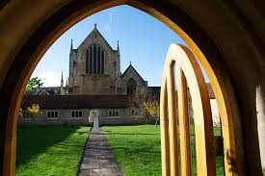
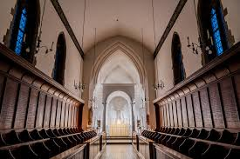

Slide 12
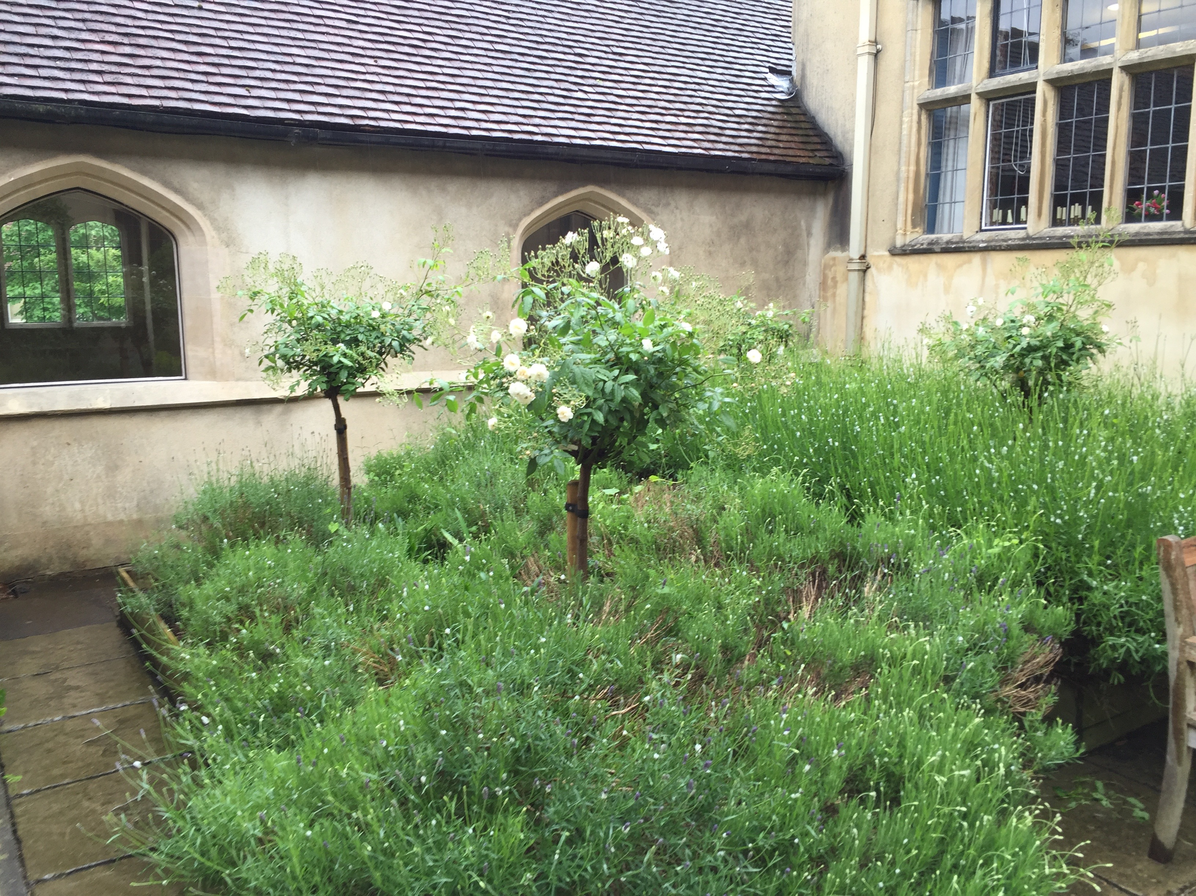
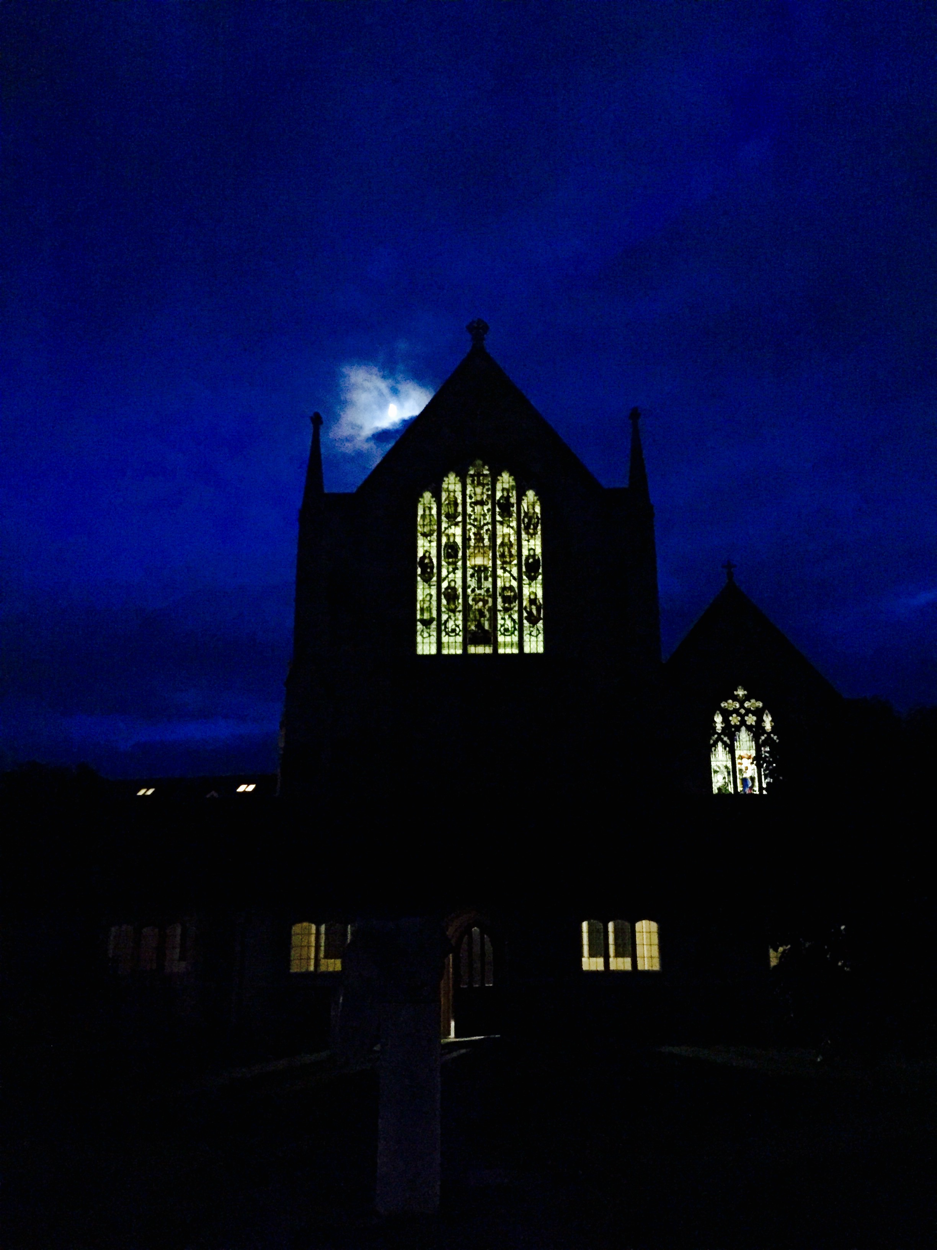

Slide 13
Father Austin Farrer (1904-1968) adapted from No Ordinary People by Joel Heck
Richard Harris, Bishop of Oxford, called Austin Farrer “the greatest mind produced by the Church of England in the 20th century.” The Gresham
Professor of Divinity, Gordon Phillips described Farrer as “a scholar, a wit, a saint, a philosopher, and a man of prayer. He was a hawk among sparrows.” Farrer's father was a Baptist minister and lecturer in Church
History. Farrer graduated from St Paul's School at the Cathedral in London and then won the top scholarship to Balliol College, Oxford. While at Oxford he was confirmed in the Anglican Church in 1924. Like Lewis, Farrer was one of the very rare pupils who earned a Triple First in Moderations and Greats and then (unlike Lewis) in Theology. Ordained to the Anglican priesthood after Oxford, he continued to study theology and philosophy. He served as a Chaplain and tutor at St. Edmund Hall, working closely and highly effectively with student ministry to undergraduates. In New Testament circles Farrer was known for his work on the Gospel of Mark in particular. Farrer was a prolific scholar and preacher, authoring many books, some of them compilations of sermons but also books on philosophy. The last position that Farrer held and perhaps the most important was as Warden (President) of Keble College from 1960 to 1968.
Austin Farrer first came to Oxford in 1931 and met C.S. Lewis sometime shortly after that. He came to speak at the Socratic Club in 1942. He went on to speak at the Socratic Club 19 times, more than any other speaker except Lewis. When Lewis sent drafts of what would become Mere Christianity out to four clergymen to get their perspective, Farrer was the one representing Anglicanism. Farrer and Lewis became close friends, chiefly because they were both Christians committed to the truths of Scripture, but also because they were prolific writers, Oxford academics, and people concerned for the spiritual well-being of souls. Farrer admired

Slide 14
the way Lewis cared for the souls and spiritual well-being of his readers and stated of Lewis that “pastoral concern continues to rule his pen.”
Lewis dedicated his book Reflections on the Psalms to Farrer.
“In later years, their friendship deepened through the efforts of Farrer’s wife, the novelist Katherine Farrer, to befriend Joy Davidman. The Farrers were one of the few in Lewis’s circle of friends to embrace Joy Davidman and their marriage. In 1956, Farrer witnessed Lewis and Joy’s marriage at the Oxford Registry Office; he later administered Extreme Unction to Joy while she lay dying and he presided at her funeral. Likewise, he tended to Lewis during his final illness, read the lesson at his funeral, and preached at his memorial service.
“Farrer’s wife Katharine, also known as “K” in the letters, was always a warm and inviting presence. She was one of the first friends of Lewis’s to meet Joy Davidman. Katharine was a writer herself, translating Gabriel Marcel’s Etre to Avoir as Being and Having, writing a novel titled At Odds with Morning, in addition to three detective novels she discusses with Lewis in her correspondence: The Missing Link, Cretan Counterfeit, and Gownman’s Gallows. It was Katharine who felt the sudden urge to call Joy Davidman on 18 October 1956. At that very moment, Joy tripped over the telephone wire. When she fell, the bone in her leg (which was later discovered to be eaten up with cancer) snapped. Joy could hear Katharine on the phone but could not respond. Katharine and Austin took Joy to the hospital, where her cancer was discovered by doctors.
Austin Farrer often lectured abroad and Katharine accompanied him. In 1966, they travelled to Baton Rouge, Louisiana through the swamp. The host did not know that Katharine wrote detective novels and was taken aback when she exclaimed, “What a lovely place to hide a body!”adapted from Crystalhurd.com

Slide 15
When Farrer spoke at Lewis’s memorial service at Magdalen College, he said Lewis had “more actuality of Soul than the common breed of men.
He took in more, he felt more, he remembered more, he invented more.
The reflections on his early life record an intense awareness, a vigorous reaction, and taking of the world into his heart, which must amaze. Lewis had a capacity for experience beyond our scope. If it is a crime to think about all you strongly feel and feel the realities about which you think, then the crime was certainly his. It was this feeling intellect, this intellectual imagination that make the strength of his religious writings. He paid you the compliment of attending to your words. He did not pretend to read your heart. He was endlessly generous. When he had entered into any relationship, his patience and his loyalty were inexhaustible. but it is not the work of Lewis’s pen, it is the work of God's fingers that we are to praise.”

Slide 16
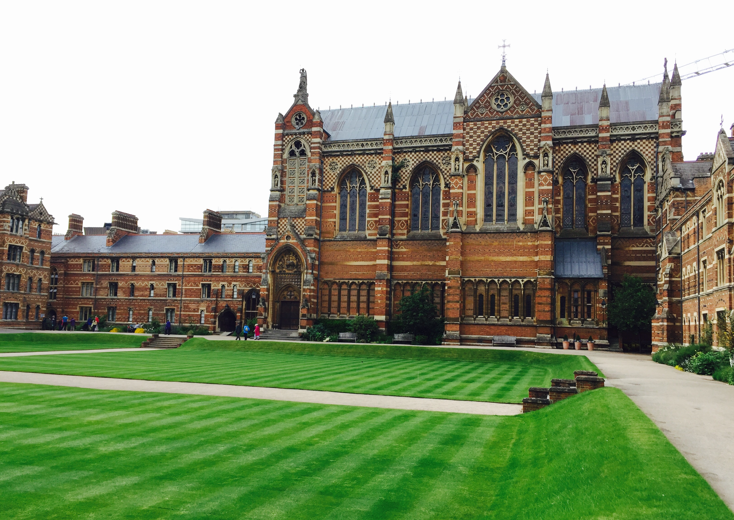

Slide 17
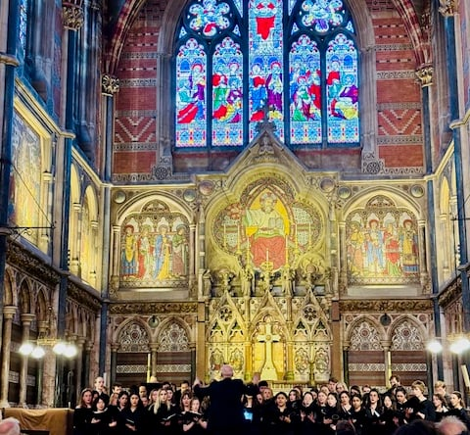

Slide 18
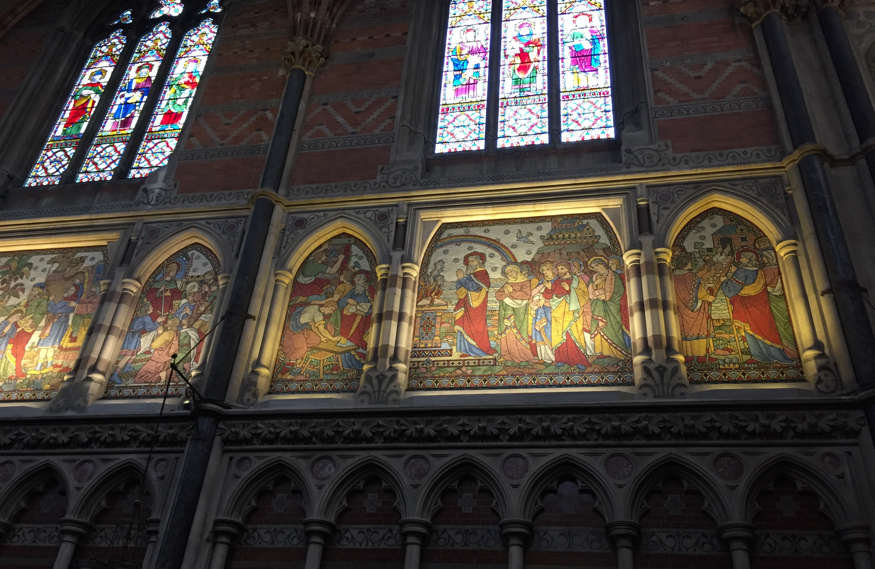
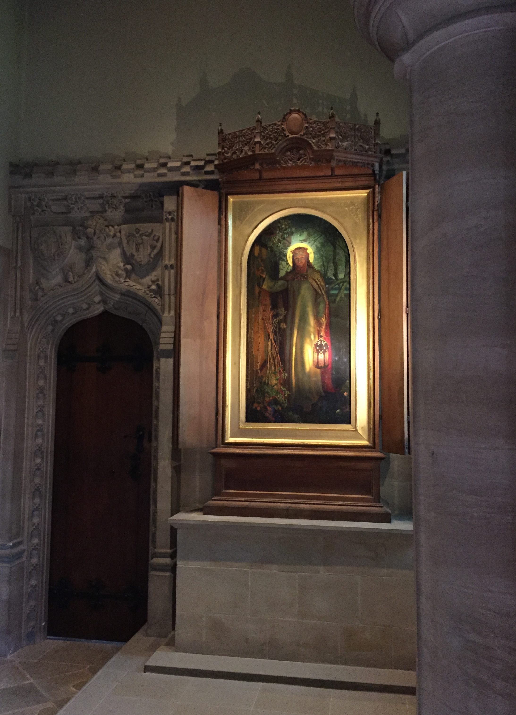

Slide 19
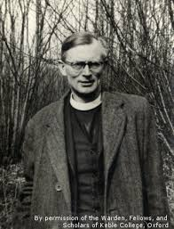
TO PONDER:
The Impact of the Christian Friendship of Lewis with Dom Bede Griffiths, Father Walter Adams, and Father Austin Farrer
--The debt Lewis owed to each of them in his journey deeper into the Christian faith in different phases in his life
--The impact of the ministry of these men on Lewis, his faith, and his writing
--What if Lewis had not allowed himself to enter into a deep and vulnerable friendship with a student because of his intellectual pride?
--What if Lewis had thought he was beyond the need of counsel and of prayer from a clergyman who was not Lewis’s scholarly equal?
--Consider the role of friendship in your life and what kind of friend you are: what can you learn from the example of Lewis and these friendships with men of different ages in the different phases of his life?
--Where might God be calling you to initiate an intergenerational friendship grounded in faith?
--What role do Truth, Goodness, and Beauty play in your life and your understanding of following Christ and drawing others to Him?

Slide 20
“For a Christian, there are, strictly speaking, no chances. A secret Master of the Ceremonies has been at work. Christ, who said to the disciples "Ye have not chosen me, but I have chosen you," can truly say to every group of Christian friends "You have not chosen one another but I have chosen you for one another." The Friendship is not a reward for our discrimination and good taste in finding one another out. It is the instrument by which God reveals to each the beauties of all the others. They are no greater than the beauties of a thousand other men; by Friendship God opens our eyes to them. They are, like all beauties, derived from Him through the Friendship itself, so that it is His instrument for creating as well as for revealing. At this feast it is He who has spread the board and it is He who has chosen the guests. It is He, we may dare to hope, who sometimes does, and always should, preside. Let us not reckon without our Host.”
—C.S. Lewis, The Four Loves
,

Slide 21
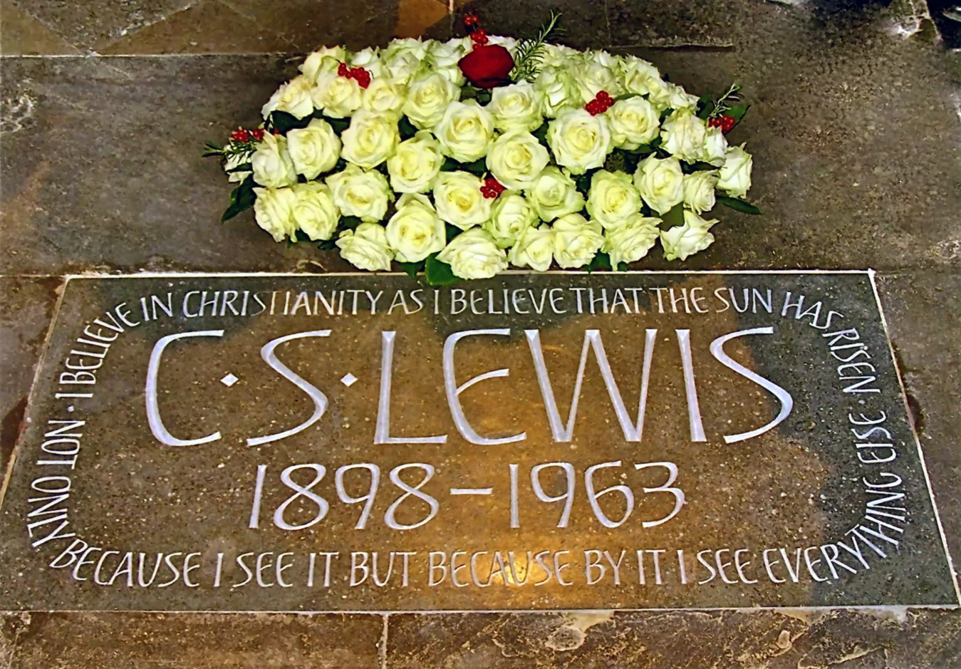
“I believe in Christianity as I believe that the Sun has risen, not only because I see it but because by it,
I see everything else.”
--from Lewis’s essay Is theology poetry?

