Slide 1
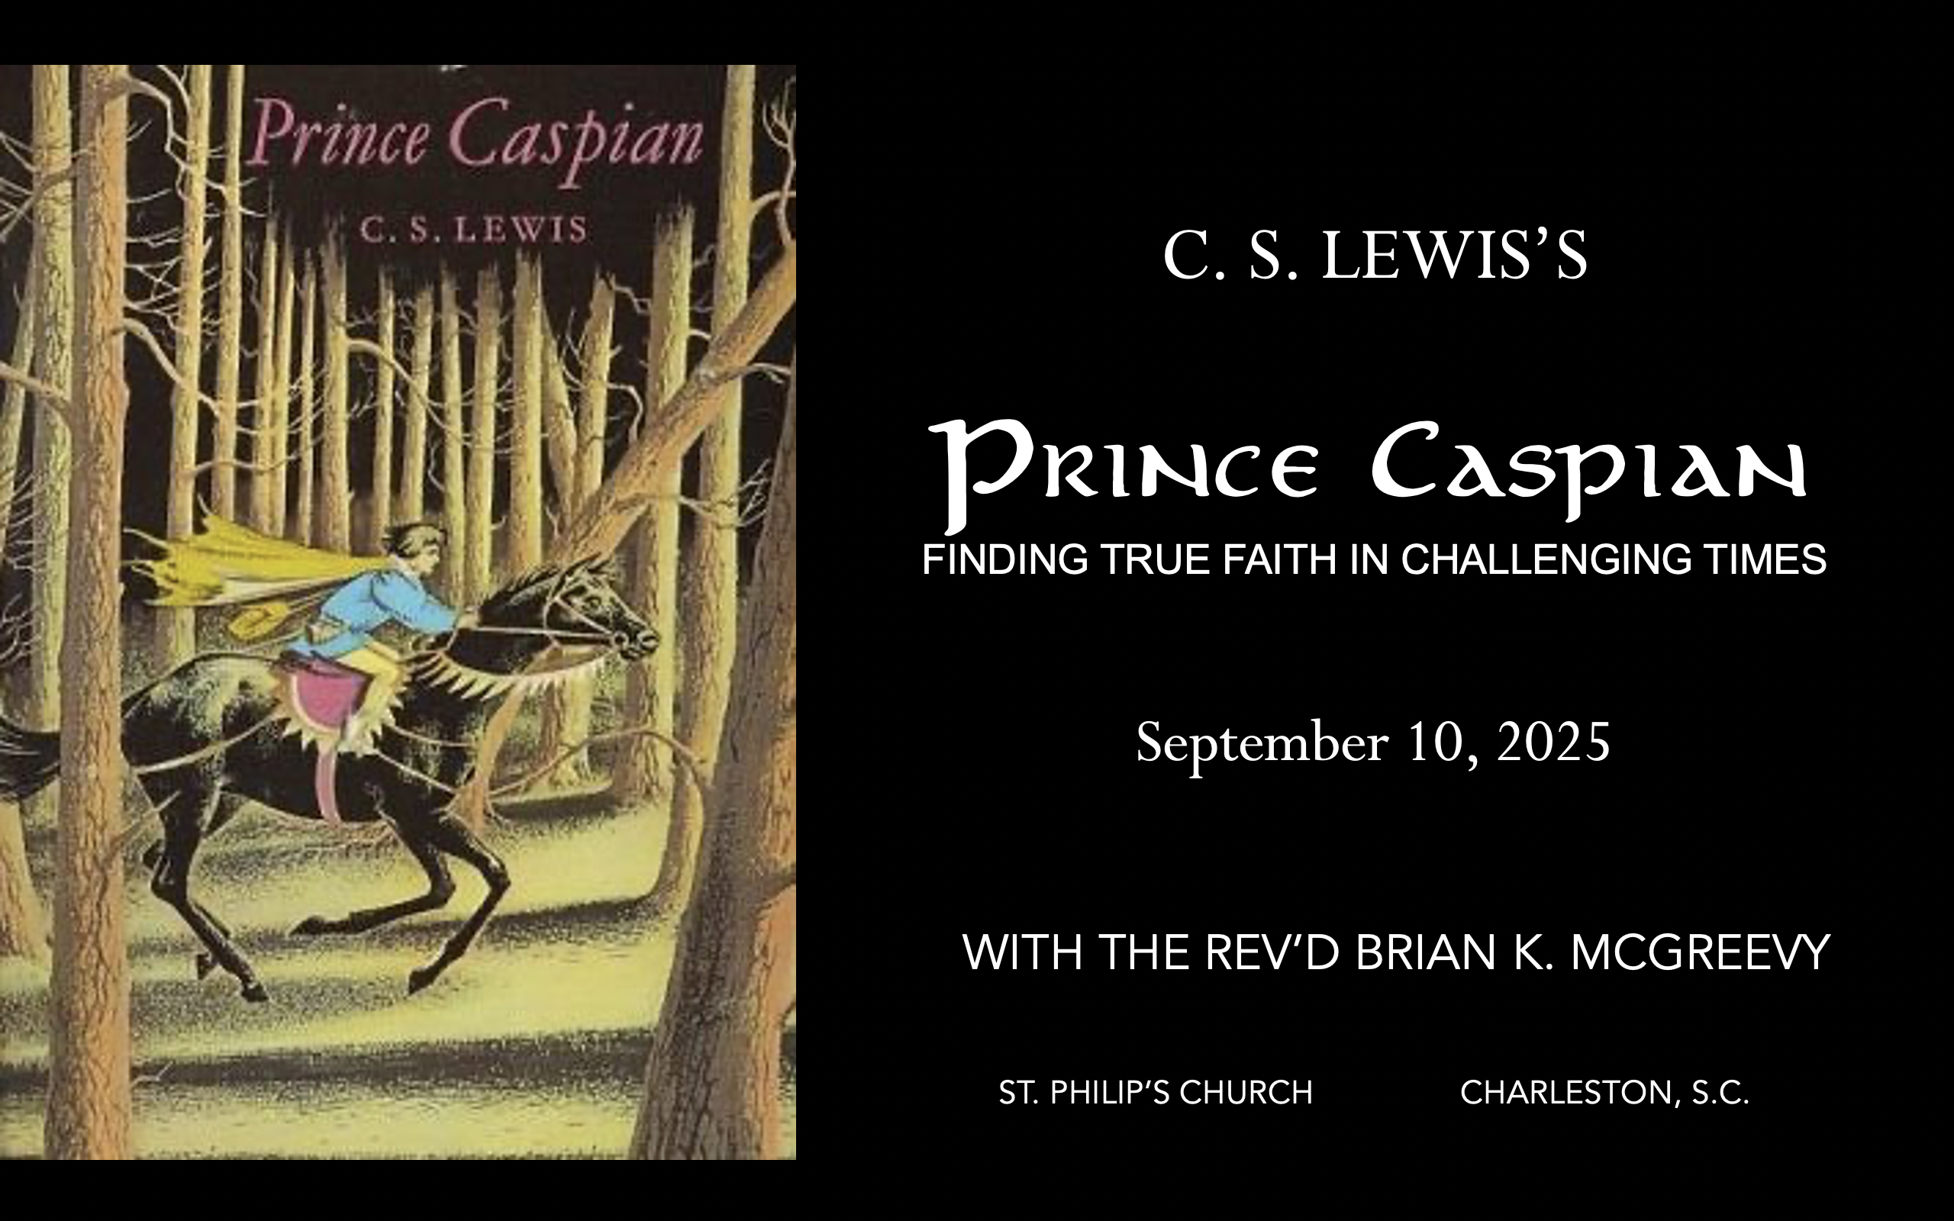
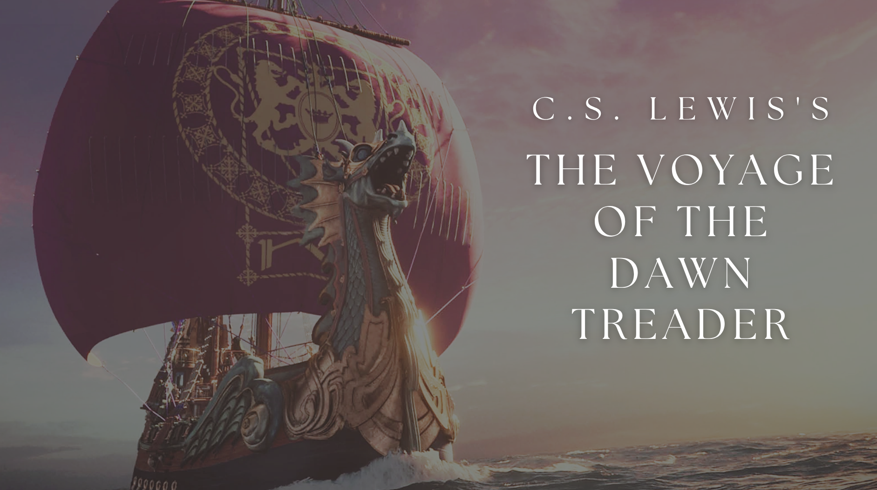
September 16, 2026
St. Philip’s Church
Charleston, South Carolina
September 16, 2026
St. Philip’s Church
Charleston, SC
The Rev’d Brian K. McGreevy, J.D., Facilitator

Slide 2

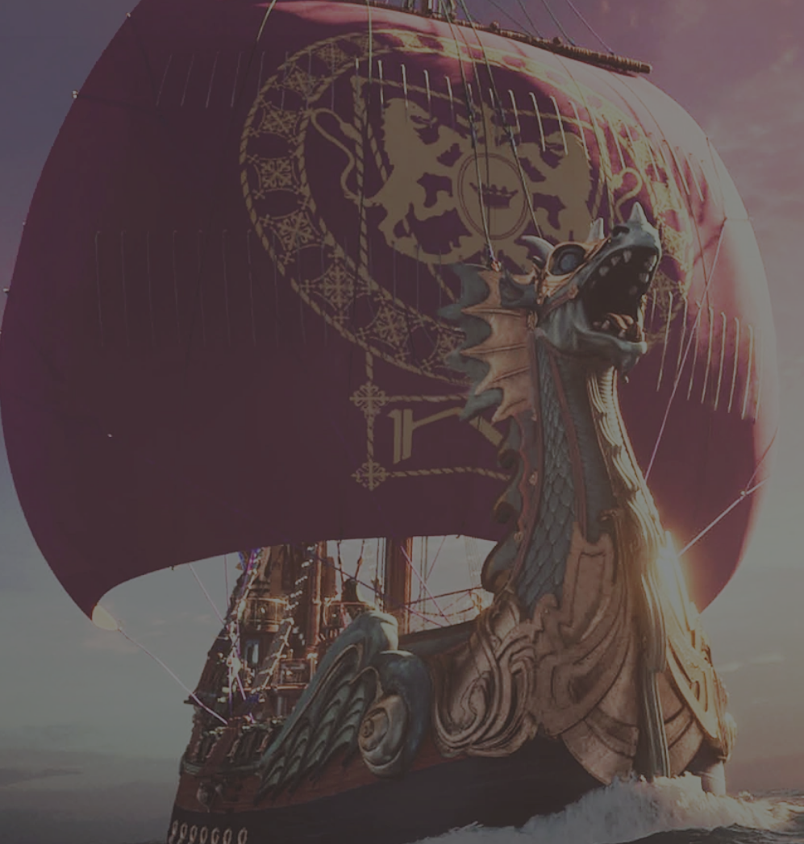
How to approach this class:
How to approach this class:
--On the beach
--Snorkeling
--Scuba diving
--Email list/QR code
How to read this book:
--Try reading aloud and slowly, looking for layers of meaning
--Look for themes/underline and highlight passages that resonate with you
What we’ll be doing:
--Setting the background and context
--Following the story chapter by chapter
--Drawing out principles for living with Joy and Purpose
--Looking at relevant Scripture

Slide 3
I appeal to you therefore, brothers, by the mercies of God,
to present your bodies as a living sacrifice, holy and acceptable to God,
which is your spiritual worship.
Do not be conformed to this world,
but be transformed by the renewal of your mind,
that by testing you may discern what is the will of God,
what is good and acceptable and perfect.
Romans 12:1-2

Slide 4
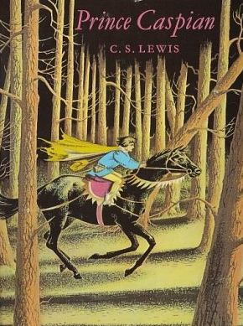
Why Lewis?
The most unlikely Christian
--painful and dysfunctional childhood
--despair and bitterness after World War I
--brilliant, proud, and aggressive atheism
--worldly success
Sehnsucht
The impact of a bold friend and the formation of the Inklings
“The most thoroughly converted man”
--scholar, teacher, author, friend, mentor
--worldview
--authenticity
--humility
--gift for analogy and for story
--heart after God
--Joy

Slide 5
The Chronicles of Narnia: Such a Gift!
More popular than ever—new film being released in 6 months has a nearly $300 million budget!
Record interest in Lewis, Tolkien and the Inklings
Films have grossed more than $1.5 BILLION
Over 100 million copies sold in 47 languages
The Lion, the Witch, and the Wardrobe voted the best English children’s story of all time (Waterstone’s)
The Last Battle was awarded the Carnegie Award, the highest award for children’s literature
Written in a very brief period of time:
The Lion, the Witch and the Wardrobe (1950)
Prince Caspian (1951)
The Voyage of the Dawn Treader (1952)
The Silver Chair (1953)
The Horse and His Boy (1954)
The Magician's Nephew (1955)
The Last Battle (1956)
The Narnia Code—the seven planets of the Medieval cosmology

Slide 6
The Origins of Narnia
Meanwhile in his spare time…
The Personal Heresy: A Controversy (1939)
The Problem of Pain (1940)
The Case for Christianity (1942)
A Preface to Paradise Lost (1942)
Broadcast Talks (1942)
The Abolition of Man (1943)
Christian Behaviour (1943)
Beyond Personality (1944)
Perelandra (1943)
That Hideous Strength (1945)
The Screwtape Letters (1942)
The Great Divorce (1945)
Miracles: A Preliminary Study (1947)
Arthurian Torso (1948)
Transposition, and Other Addresses (1949)
English Literature in the Sixteenth Century Excluding Drama (1954)

Slide 7
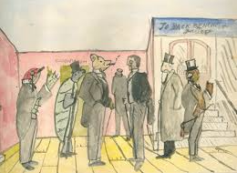
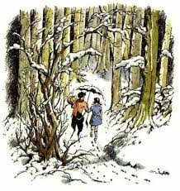
The Origins of Narnia
1907—Lewis (age 9) writes to his brother Warnie that he is writing and illustrating “A History of Mouse-land,” which is eventually combined with Warnie’s love of India to form the imaginary realm of Boxen, whose main characters are dressed and talking animals. Lewis developed a history of Boxen and a political structure for it in his early teens.
1914—The image of a Faun carrying an umbrella and parcels in a snowy wood came to Lewis’s imagination when he was 16, and he made a sketch of it which continued to reappear in his memory over the next decades.
1939—On September 2, the day before Britain declares war on Germany, four evacuee children arrived at Lewis’s home, the Kilns, the first of various groups of children Lewis will house continually through the war up through
1945--Around this time, Lewis begins a story, later set aside, about four evacuee children from London sent to stay with an old professor. Surprised to find how few imaginative stories his young guests seemed to know, he decided to write one for them and scribbled down the opening sentences of a story about four children—then named Ann, Martin, Rose and Peter—who were sent away from London because of the air raids, and went to stay with a very old professor who lived by himself in the country.

Slide 8
The Origins of Narnia
1947—“All my seven Narnian books began with seeing pictures in my head. The Lion, the Witch, and the Wardrobe began with a picture of a Faun carrying an umbrella and parcels in a snowy wood. This picture had been in my mind since I was about sixteen. Then one day, when I was about forty, I said to myself: ‘Let's try to make a story about it.’ At first I had very little idea how the story would go. But then suddenly Aslan came bounding into it. I think I had been having a good many dreams of lions about that time. Once He was there He pulled the whole story together.”—Radio Times interview, 1960
1954--“I did not say to myself ‘Let us represent Jesus as He really is in our world by a Lion in Narnia’: I said ‘Let us suppose that there were a land like Narnia and that the Son of God, as He became a Man in our world, became a Lion there, and then imagine what would happen.”
--letter to a fifth grade class in Maryland
Lewis was passionate in his views about children’s stories:
“A children's story that can only be enjoyed by children is not a good children's story in the slightest.”
“No book is really worth reading at the age of ten which is not equally – and often far more – worth reading at the age of fifty and beyond.”
"Someday you will be old enough to start reading fairy tales again.”—from Lewis’s dedication to his goddaughter Lucy Barfield in The Lion, the Witch, and the Wardrobe

Slide 9
Why Narnia is still so important to read today:
“The Chronicle of Narnia still find an audience because they are real. I don’t mean that in the sense that I believe there is actually some place called Narnia or talking beasts or celestial bodies that retire into human form. I think rather that Lewis managed to create stories that immerse us in a narrative world where what matters most to us –– and what speaks to our hearts –– is actually the core of the drama. Again, he doesn’t “tell” us these things; he shows us these things; he gives us the feel of them; he appeals to our imaginations with them. We are invited to reimagine the drama and joy of Christianity from within our very own world, which is often a world drained of wonder. Lewis created the world of Narnia so that those who entered there could learn to see our own world anew,… as a “spiritual pilgrimage,” which means that by entering into the fiction as fully as possible, we are being drawn into a narrative where the development of character matters, where who you are and who you become matter, and where sacrifice and courage and the virtues also matter. You are supposed to be changed by the journey through these chronicles.”--Dr. Leonard DiLorenzo, Notre Dame
“To understand the deep appeal of Narnia, we need first to appreciate the place of stories in helping us to make sense of reality, and our own place within it. The Chronicles of Narnia resonate strongly with the basic human intuition that our own story is part of something greater and grander - something which, once we have grasped it, allows us to see our situation in a new and more meaningful way. A veil is lifted; a door is opened; a curtain is drawn aside; we are enabled to enter a new realm. Our own story is now seen to be part of a much bigger story, which both helps us understand how we fit into a greater scheme of things, and discover the difference we can make.”—Rev. Dr. Alister McGrath, Oxford University

Slide 10
Why Narnia is still so important to read today (continued)
“C.S. Lewis wrote about stealing past “the watchful dragons of the mind” to describe the ability of literature to reach the hearts and minds of a reader with ideas they might not otherwise consider. He proposed that such stories could work upon the imagination to bring the heart to Christ. Indeed, his own experience was something of that sort. He credits the work of George MacDonald with “baptizing his imagination” long before he committed his life to Christ, or even acknowledged that there is a God. [Tolkien scholar] Dr. Holly Ordway had much the same experience through the literature of Tolkien. In her book, Not God’s Type, she calls this the “light from the invisible lamp.” These “baptisms of the imagination” happen, in part, due to the invitation into what English majors everywhere know as “the literary universe.” This is the realm in which the story exists.”—An Unexpected Journal July 2, 2018, “The Power of Story” Karise Gililland
In our 21st century world where we are overwhelmed with an onslaught of media and noise coming at us around the clock, our minds often shut down and don’t want to engage with more “facts” or arguments or narratives even about important matters, but the longing of our hearts for meaning and purpose and beauty is still there. Stories are the best way to get around our weariness and re-engage our hearts with what is True, Good, and Beautiful.

Slide 11
Why study The Voyage of the Dawn Treader today?
What do a picture on the wall that comes to life and splashes real water out of the frame, a valiant warrior mouse, a petulant boy turned into a dragon, and stars in the heavens that come to earth to retire all have in common? They are all part of the glorious imagery of C.S. Lewis's beloved classic The Voyage of the Dawn Treader, the third book in the Chronicles of Narnia---this book is first of all a great and compelling story, full of vivid imagery, which makes a spell-binding read. But it is so much more than that! Like the other Narnia stories, this book is full of important theological and spiritual Truths that Lewis has woven into the story.
Among the profound spiritual truths that we will unpack in this class are the following which seem especially timely:
--the futility of the wisdom of the world
--the corrosive nature of temptation
--our need for transformation by Jesus rather than just a self-improvement program
--the reality of darkness, fear, and danger but the stronger reality of the abiding presence of God
--the importance of courageously leaning into our longings for what is Good, True, Beautiful, and Eternal

Slide 12
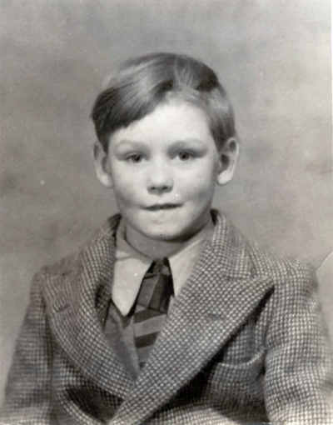
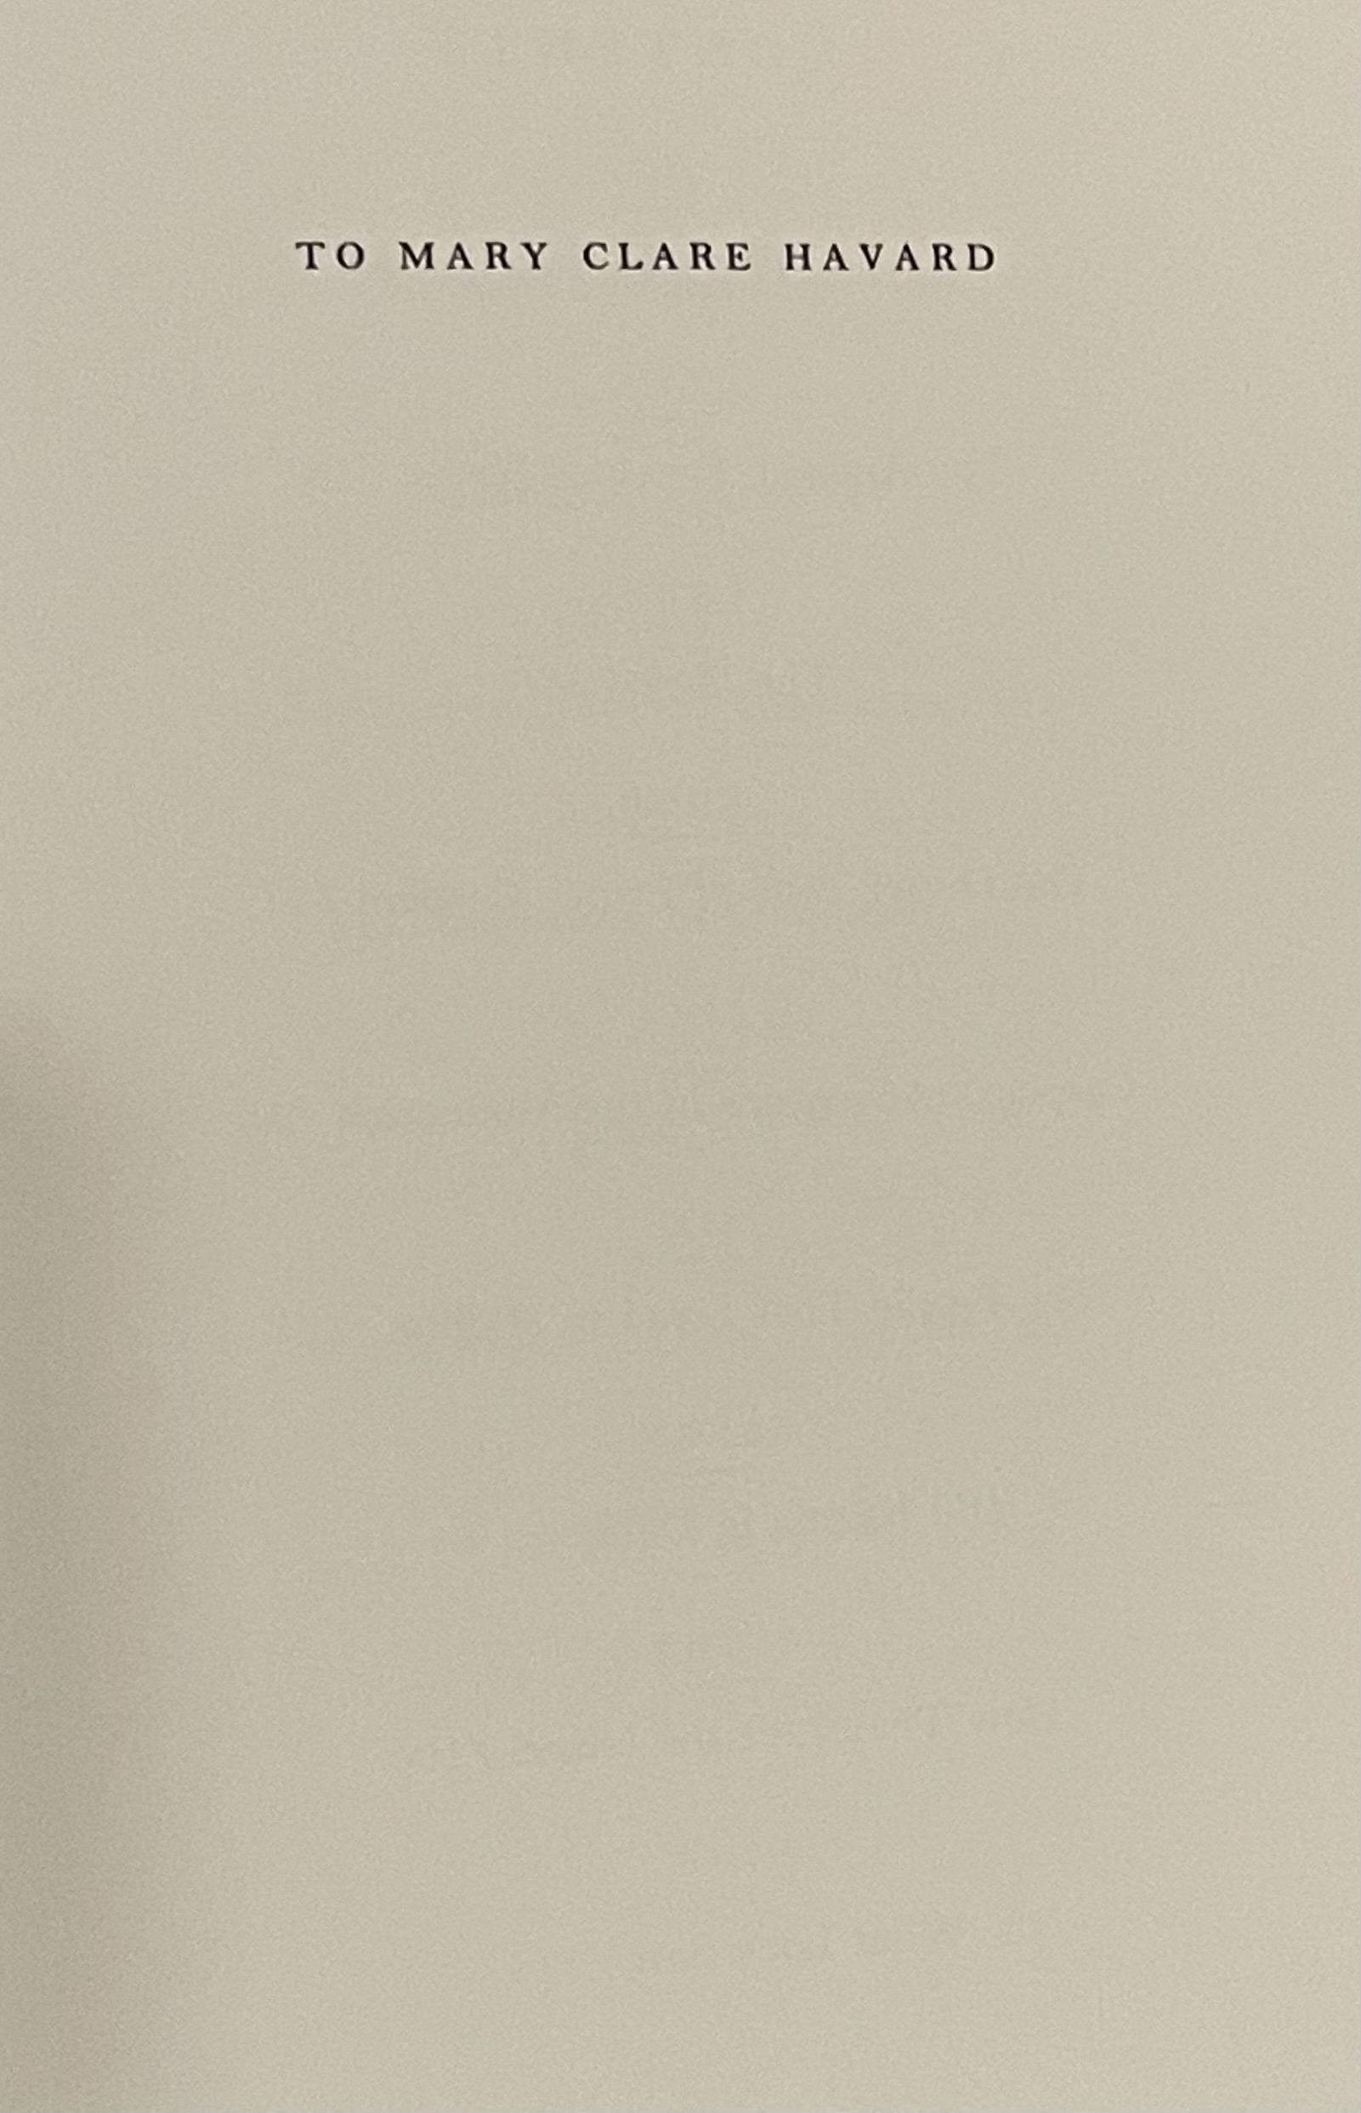
The third book in the Narnia series was written early in 1950 and completed even before The Lion, the Witch, and the Wardrobe was actually published. It was published in 1952 by Geoffrey Bles.
Lewis dedicated the book to Geoffrey Corbett, who was 12 at the time of the book’s publication and was the third adopted child of fellow Inkling Owen Barfield, to whose daughter Lucy Lewis had dedicated The Lion, the Witch, and the Wardrobe. Lewis was close to Geoffrey and paid his school fees. Because of his appreciation for his adopted parents, Geoffrey later changed his name to Jeffrey Barfield. When his sister Lucy became seriously ill later in life, Jeffrey would often visit her and read out loud the Narnia stories which they both loved.

Slide 13
Order, Setting, and Overall Theme
The third in the series, written in early 1950
Published in 1952
Illustrated by Pauline Baynes
Set in England in 1942, around two years after they first went to Narnia
In Narnia time it is around1,300 years after The Lion, the Witch and the Wardrobe
but only a few years after the events in Prince Caspian
Publication order—THE CORRECT order in which to read the Chronicles!
The Lion, the Witch and the Wardrobe (1950)
Prince Caspian (1951)
The Voyage of the Dawn Treader (1952)
The Silver Chair (1953)
The Horse and His Boy (1954)
The Magician's Nephew (1955)
The Last Battle (1956)

Slide 14
Inspiration for The Voyage of the Dawn Treader
According to Walter Hooper, Lewis’s secretary, as well as the research of David Downing at the Wade Center, Lewis drew inspiration for The Voyage of the Dawn Treader, which he called “a very green and pearly story,” from Homer’s Odyssey and the medieval legend of St. Brendan, a tale first written out in the 900s as Navigatio Sancti Brendani Abbatis.)St. Brendan was an Irish saint who set sail from Ireland in the 6th century in search of the Land of Promise. After seven years, his crew finds the Land of Promise, but an angel tells them that it cannot be inhabited until it is given to the Blessed at the end of time. This parallels the journey of Reepicheep and the three British children with Caspian to the Utter East, the land of Aslan.
From Patheos 12/15/2018 article by Carl McColman:
“The Voyage of St. Brendan is about as close you can get to a medieval bestseller. Over 100 manuscript copies of the text have been preserved, showing that it was widely copied, and we may assume widely read, in medieval times. The story of Brendan belongs to a genre of Celtic literature called the Immrama, or the "wondrous sea voyages." Many such tales extend all the way back into pagan mythology, where god-like figures with exotic names such as Bran the Blessed or Mael Duin set sail from the west coast of Ireland, heading out over the boundless sea in search of an earthly paradise. The Voyage of St. Brendan the Navigator is a thoroughly Christian tale; its protagonist is not a pagan god, but the abbot of a Christian monastery. One day a friend of Brendan's visits his cloister and announces that he has sailed west, all the way to the land of promise - in other words, to Paradise itself. Brendan, not surprisingly, is entranced by this news, and after considering the matter in his own prayers, resolves to sail himself, with several of his monks as companions, in their own quest for this earthly paradise.”

Slide 15
“And thus begins a charming, if fantastic, tale of visiting a variety of islands over the course of seven years at sea, many of which are inhabited by monks (of course), while others feature a choir of birds who chant the psalms, an uninhabited island where nevertheless a mystical hospitality occurs, providing food for the voyagers, and various other unusual settings.
“Along the way, Brendan and his company have narrow escapes from whales and sea serpents, find the very mouth of hell itself…Finally, Brendan and his company reach the very island of Paradise itself, filled with glittering jewels, abundant fruit, and an angel who turns them back, noting that they must return to Ireland to live out the rest of their mortal lives, before finally returning to the Promised Island for all eternity.”

Slide 16
Some Quotations to Whet Your Appetite
“There was a boy called Eustace Clarence Scrubb, and he almost deserved it.”
“In our world," said Eustace, "a star is a huge ball of flaming gas."
“Even in your world, my son, that is not what a star is, but only what it is made of.”
“Most of us know what we should expect to find in a dragon's lair, but, as I said before, Eustace had read only the wrong books. They had a lot to say about exports and imports and governments and drains, but they were weak on dragons.”
“It would be nice, and fairly nearly true, to say that “from that time forth Eustace was a different boy.” To be strictly accurate, he began to be a different boy. He had relapses. There were still many days when he could be very tiresome. But most of those I shall not notice. The cure had begun.”
“But no one except Lucy knew that as [the albatross] circled the mast it had whispered to her, "Courage, dear heart," and the voice, she felt sure, was Aslan's, and with the voice a delicious smell breathed in her face.”
“Gone! And you and I quite crestfallen. It’s always like that, you can’t keep him; it’s not as if he were a tame lion.”
“It isn't Narnia, you know," sobbed Lucy. "It's you. We shan't meet you there. And how can we live, never meeting you?"
"But you shall meet me, dear one," said Aslan.
"Are -are you there too, Sir?" said Edmund.
"I am," said Aslan. "But there I have another name. You must learn to know me by that name. This was the very reason why you were brought to Narnia, that by knowing me here for a little, you may know me better there.”

Slide 17
BEULAH LAND
I'm kind of homesick for a country
To which I've never been before
No sad goodbyes will there be spoken
For time won't matter anymore
Beulah Land I'm longing for you
And some day on thee I'll stand
There my home shall be eternal
Beulah Land, sweet Beulah Land
I'm looking now, just across the river
To where my faith shall end in sight
There's just a few more days to labor
Then I will take my heavenly flight
Beulah Land I'm longing for you
And some day on thee I'll stand
There my home shall be eternal
Beulah Land, sweet Beulah Land
TEXT—Squire Parsons after Isaiah 62:4

