Slide 1
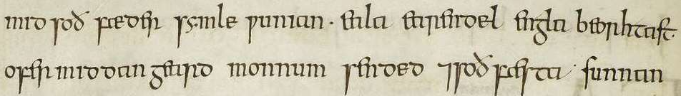
How to approach this
Eärendil the Morning Star:
The Christian Inspiration for J.R.R. Tolkien’s
The Lord of the Rings
THE REV’D BRIAN K. MCGREEVY, J.D.
ST. PHILIP’S CHURCH
MARCH 25, 2026

Slide 2
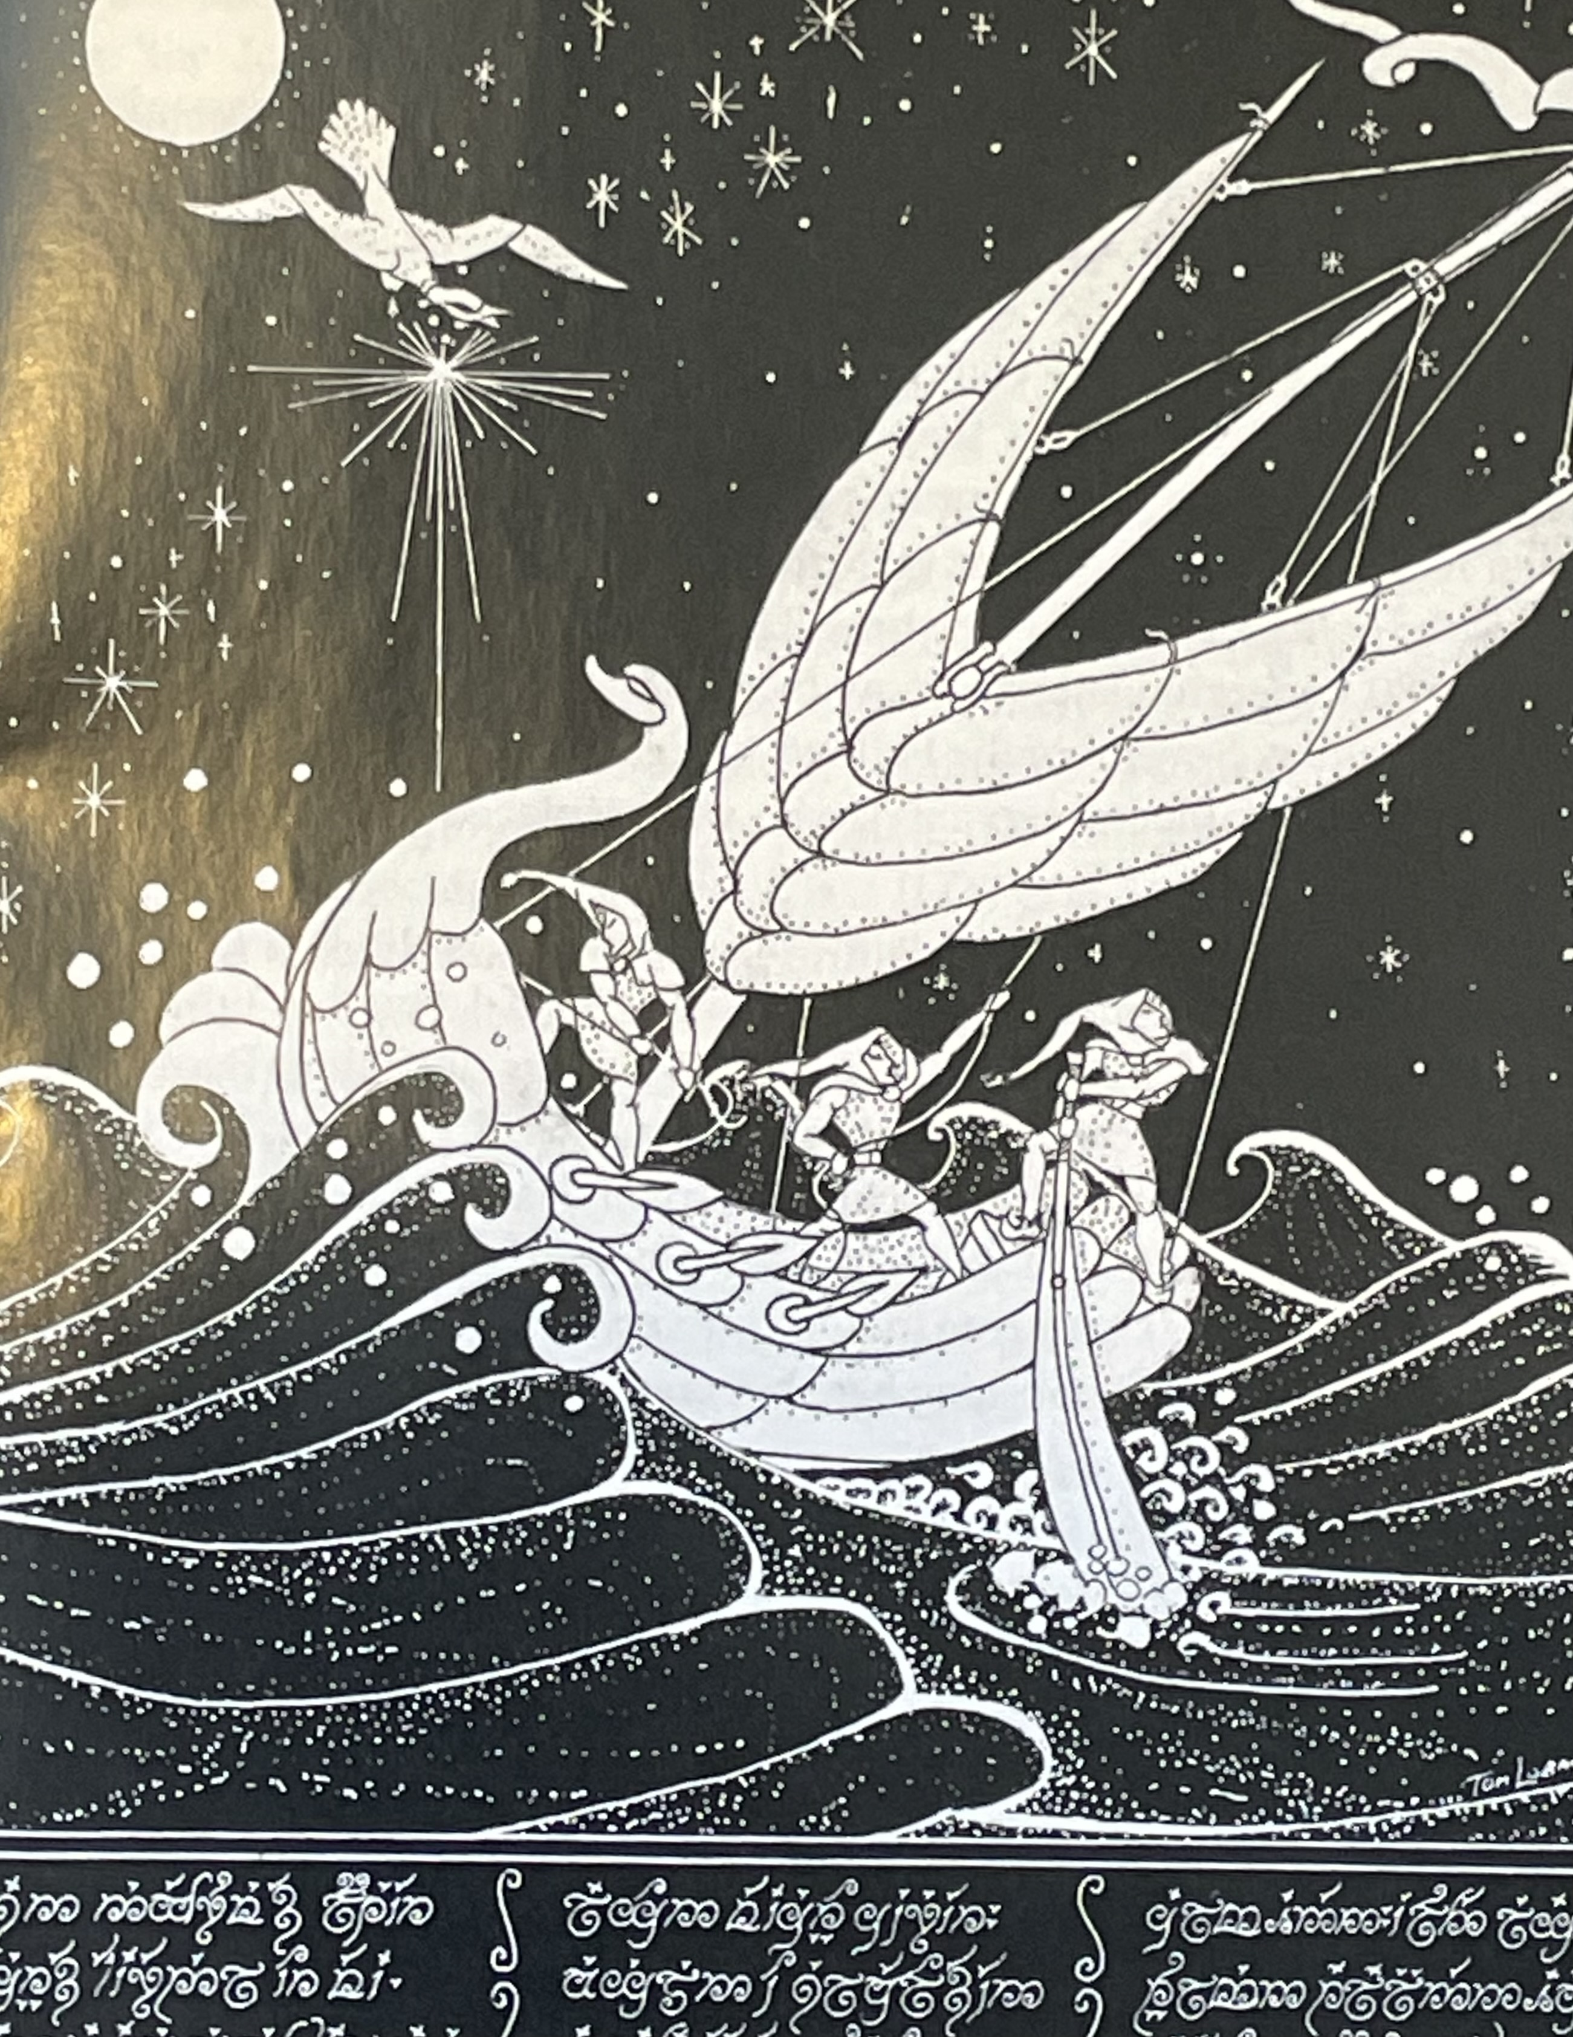
A BRIEF TOLKIEN TIMELINE
3 January 1892 Birth of John Ronald Reuel Tolkien in Bloemfontein, Orange Free State, South Africa. Moves to UK with mother at age 3; father dies the next year.
Autumn 1900 Tolkien attends the prestigious King Edward’s School in Birmingham.
Spring 1904 Tolkien's mother Mabel is diagnosed with diabetes and dies and November. Ronald (age 12) and his brother Hillary become wards of Father Morgan, a Catholic priest at the Birmingham Oratory.
Summer Term 1911 Tolkien becomes School Librarian at King Edward's and the Tea Club and Barrovian Society (TCBS) is formed with “the immortal four:” G.B. Smith, Rob Gilson, Christopher Wiseman, and Tolkien.
October 1911 Tolkien begin studies at Exeter College, Oxford.
July 1915 Tolkien graduates with a First in English Language and Literature and is commissioned as a 2nd Lieutenant in the Lancashire Fusiliers.
25 September 1915 Final meeting of all four main members of the TCBS before all part for WWI, where most will die.
22 March 1916 Ronald and Edith Bratt are married in Warwick. He ships off to France in June and participates in the Battle of the Somme.

Slide 3
November 1918 After Tolkien contracts trench fever and is discharged from the army, he returns to Oxford and obtains employment with the Oxford English Dictionary.
1920-1924 Tolkien takes post at Leeds University, where he starts the Viking Club for students. He commutes from Oxford, beginning work on his translation of Beowulf. Tolkien throws himself into an enormously productive period during which he helps create a dictionary of Middle English, produces a scholarly work on Sir Gawain and the Green Knight, begins work on several mythic projects, and begins to experiment with the development of Quenya.
Autumn 1925 Tolkien takes up an appointment as Rawlinson and Bosworth Professor of Anglo-Saxon at Oxford.
1926 Tolkien forms the Kolbitar Club at Oxford to study Icelandic literature.
11 May 1926 First known meeting between CS Lewis and Tolkien at an English faculty meeting at Merton College, Oxford, and a deep friendship develops. Lewis wrote to a friend, “I was up till 2.30 a.m. on Monday talking to the Anglo-Saxon professor Tolkien who came back with me to College from a society and sat discoursing of the gods & giants & Asgard for three hours, then departing in the wind & rain—who cd. turn him out, for the fire was bright and the talk good?”
December 1929 CS Lewis reads and critiques Tolkien’s “The Lay of Luthien.”
Summer 1930 Tolkien writes the first sentence of The Hobbit: ”In a hole in the ground there lived a Hobbit.”
19-20 September 1931 Tolkien and Hugo Dyson spend the evening talking with C.S. Lewis on Addison’s Walk, which results in Lewis’s conversion to the Christian faith.

Slide 4
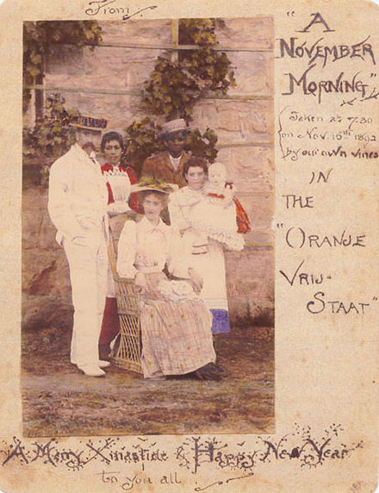
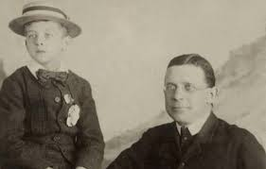
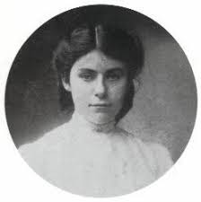
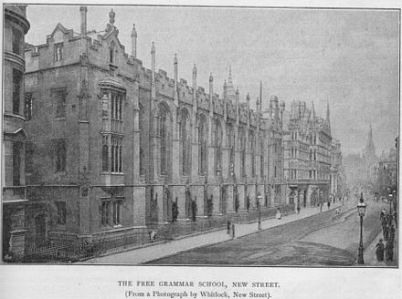
,

Slide 5
Presenter’s Note: I am deeply indebted to Tolkien scholars John Garth,
Catherine McIlwaine, and Holly Ordway for their work used in this presentation.
Background: Tolkien comes up to Exeter College, Oxford, from King Edward’s School
--Tolkien’s deep Catholic faith and life revolved around John Henry Newman’s Birmingham Oratory and its worship schedule and its priests, Fr. Morgan being his guardian—in Letters 306 he recounts that as a schoolboy he was supposed to serve Mass as an altar boy before school and usually did. Tolkien had memorized the Latin Mass and even the seasonal responses.
--King Edward’s School was part of the Anglo-Catholic wing of the Church of England, and one of its alumni was Edward Burne-Jones, who along with William Morris helped found the Pre-Raphaelite Brotherhood, being deeply influenced by the ideas of John Ruskin. Their influence was strong at King Edward’s, and Tolkien records that he and the other members of the TCBS were inspired by their example to “engage a crusade against a culture that had no heart.”
--Burne-Jones and Morris were both students at Exeter College, Oxford, which continued to have a strong Anglo-Catholic tone in Tolkien’s era, with architecture by G.G. Scott modeled after Ste. Chapelle in Paris, and the highest number of Catholics of any Oxford College. Their tapestry of the Adoration of the Magi was commissioned for Exeter College Chapel and their other most famous collaboration was in the Arthurian frescos at the Oxford Union Library around the corner from Exeter, where Tolkien often studied.
--Exeter in 1911 when Tolkien came up had a strong intellectual and creative and artistic and Catholic ethos, lived out on an ancient and beautiful cloistered campus in the heart of Oxford.

Slide 6
What was the Pre-Raphaelite Brotherhood?
The Pre-Raphaelite Brotherhood founded in 1848 was a group of artists opposed to the Royal Academy’s promotion of the Renaissance master Raphael as the example to be emulated. They were also in revolt against the triviality of the immensely popular genre painting of the time.
Inspired by the theories of influential polymath and Oxford Professor John Ruskin, who urged artists to ‘go to nature’, they believed in an art of serious subjects treated with maximum realism. Their principal themes were initially religious, but they also used subjects from literature and poetry, particularly those dealing with love and death. They also explored modern social problems.
Its principal early members were William Holman Hunt, John Everett Millais, and Dante Gabriel Rossetti. After initial heavy opposition the Pre-Raphaelites became highly influential, with a second phase of the movement from about 1860 which included Edward Burne-Jones and William Morris, who were divinity students at Oxford. The Pre-Raphaelite Brotherhood was heavily influenced by Christian themes,, although not strictly a religious organization. They aimed to return to the earnest, sincere spiritual themes found in art before Raphael, often incorporating religious symbolism, intense realism, and biblical subjects with a focus on medieval, high-church spirituality.
--adapted from the Tate Gallery website

Slide 7
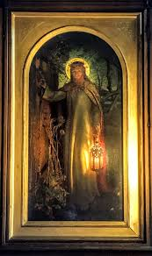
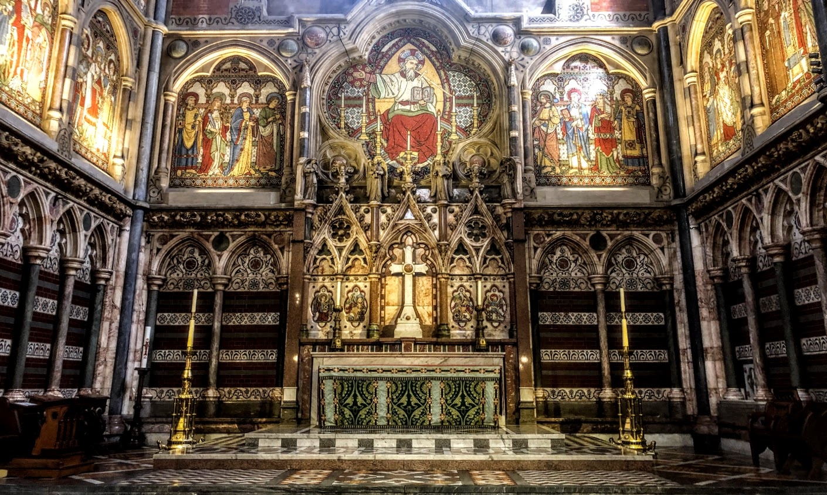
LIGHT was a defining characteristic of the art of the Pre-Raphaelite Brotherhood (PRB)
Reacting against the dark backgrounds that characterized painting at the time, the PRB embraced a radical turn in technique that focused on natural and bright light in the scenes they depicted, flowing from their theological understanding of Light and Darkness—God as the author of Light, the Light of Creation, and especially the Light of Christ. This dedication to the use and depiction of light characterizes their work, and it is no coincidence that one of the most iconic Pre-Raphaelite works is William Holman Hunt’s “The Light of the World” depicting Christ at the door, with an inscription from Revelation 3:22, which is displayed in the Keble College Chapel at Oxford, the chapel itself reflecting Pre-Raphaelite sensibilities with its luminous mosaics of sacred scenes and rich decor.

Slide 8
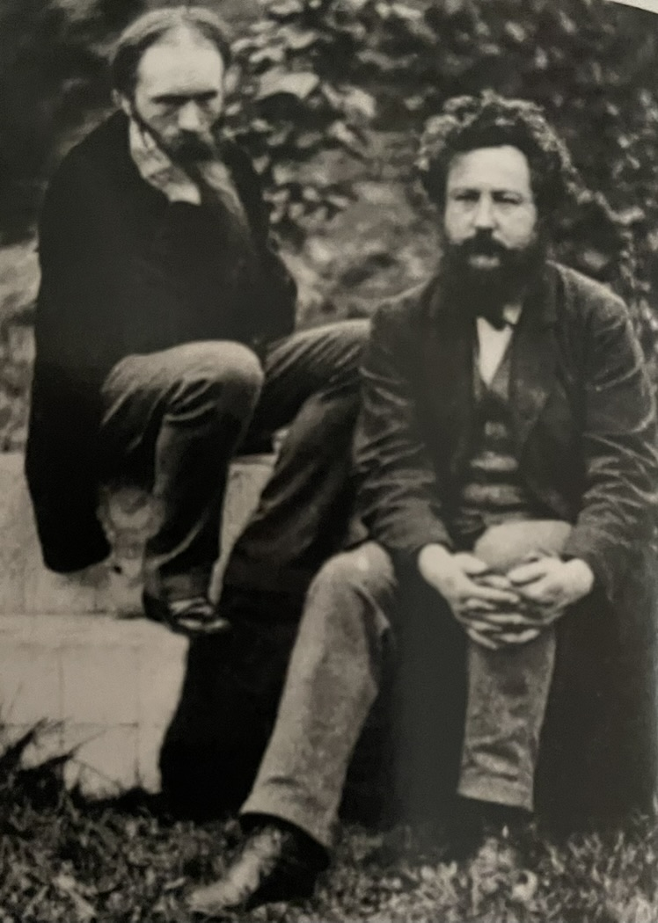
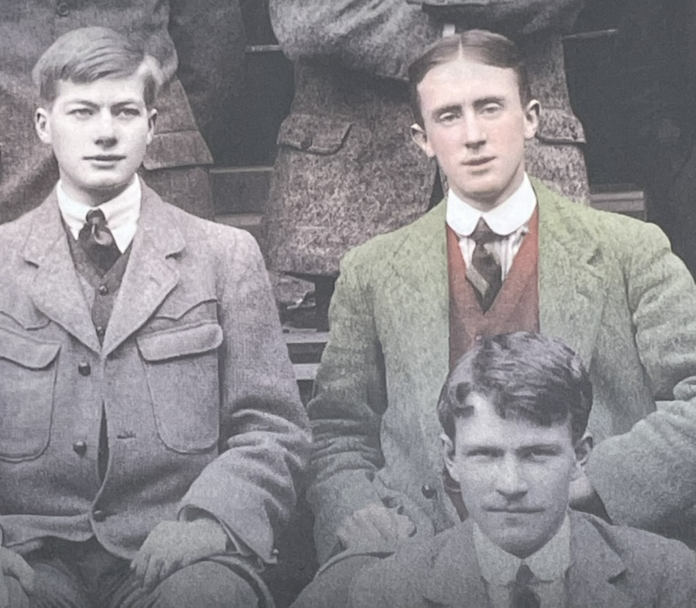
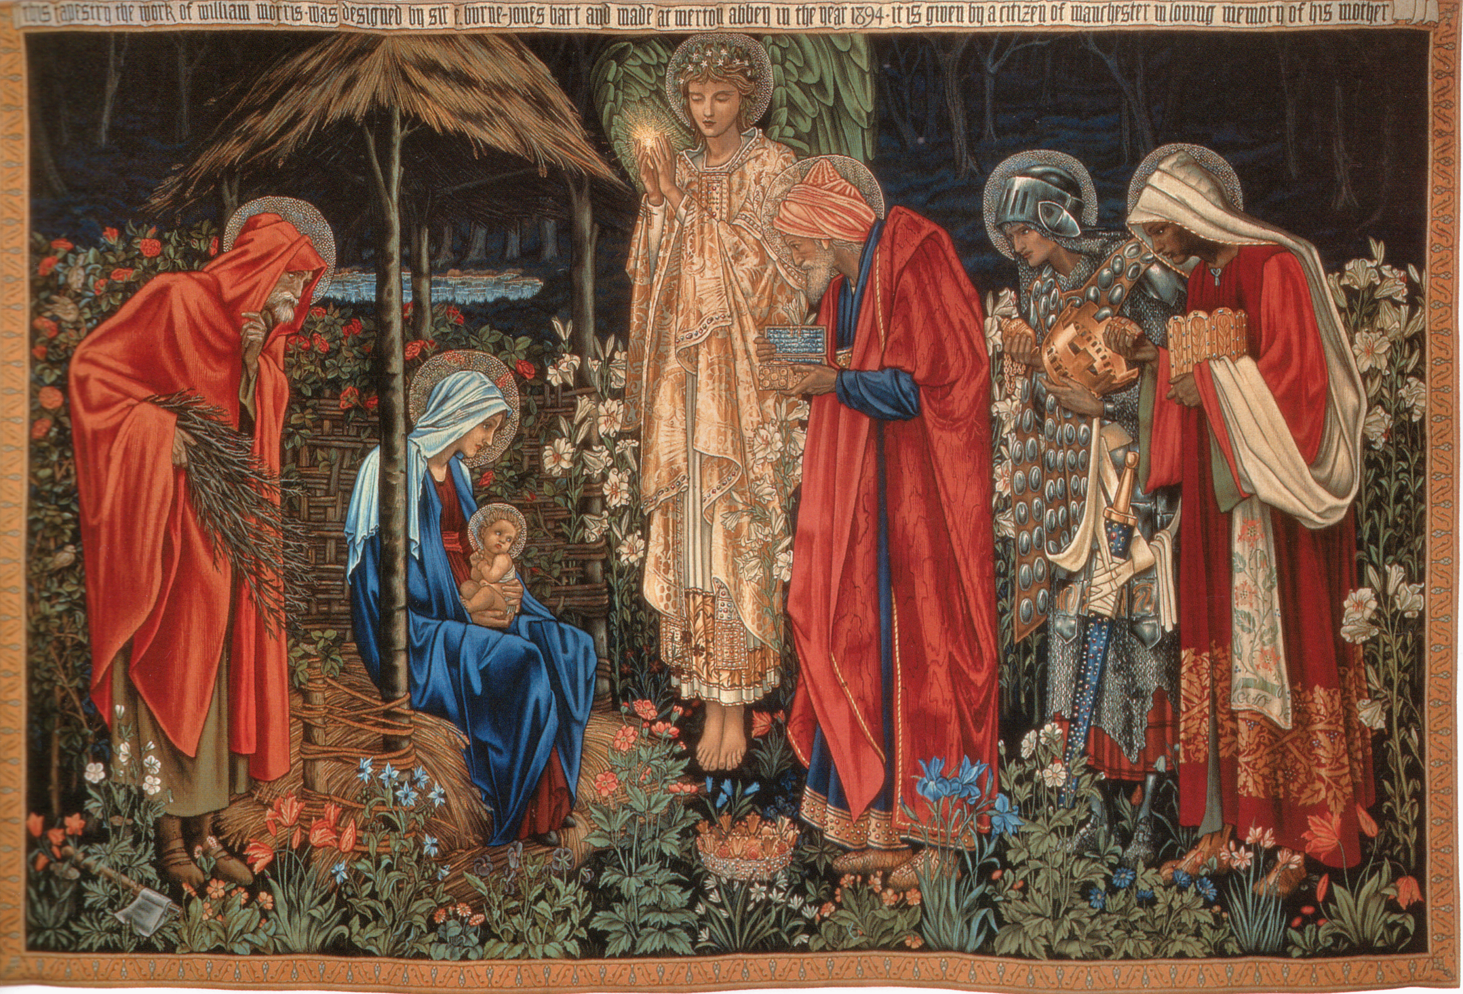
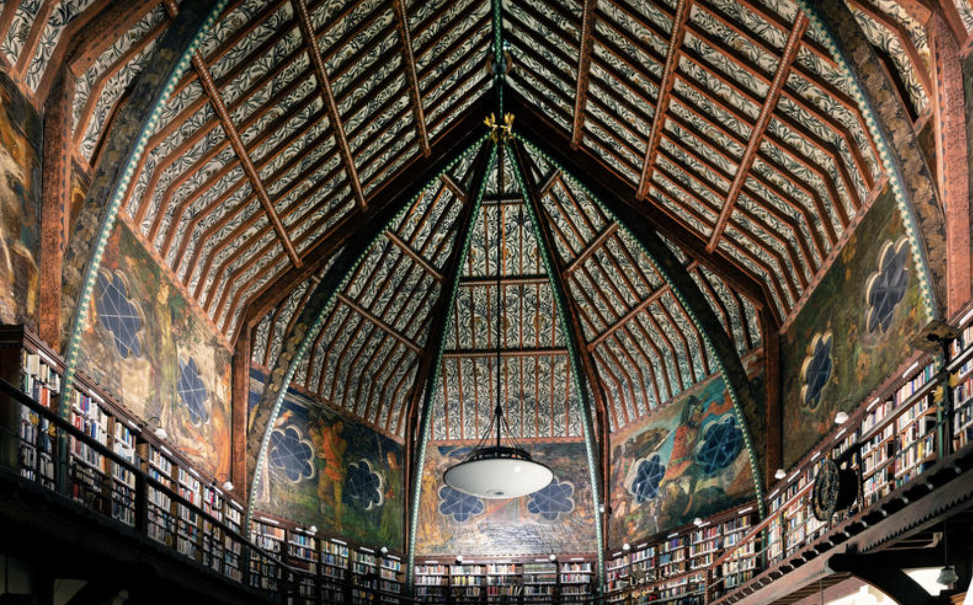
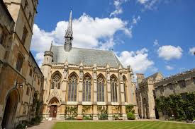
Edwards Burne JonesE

Slide 9
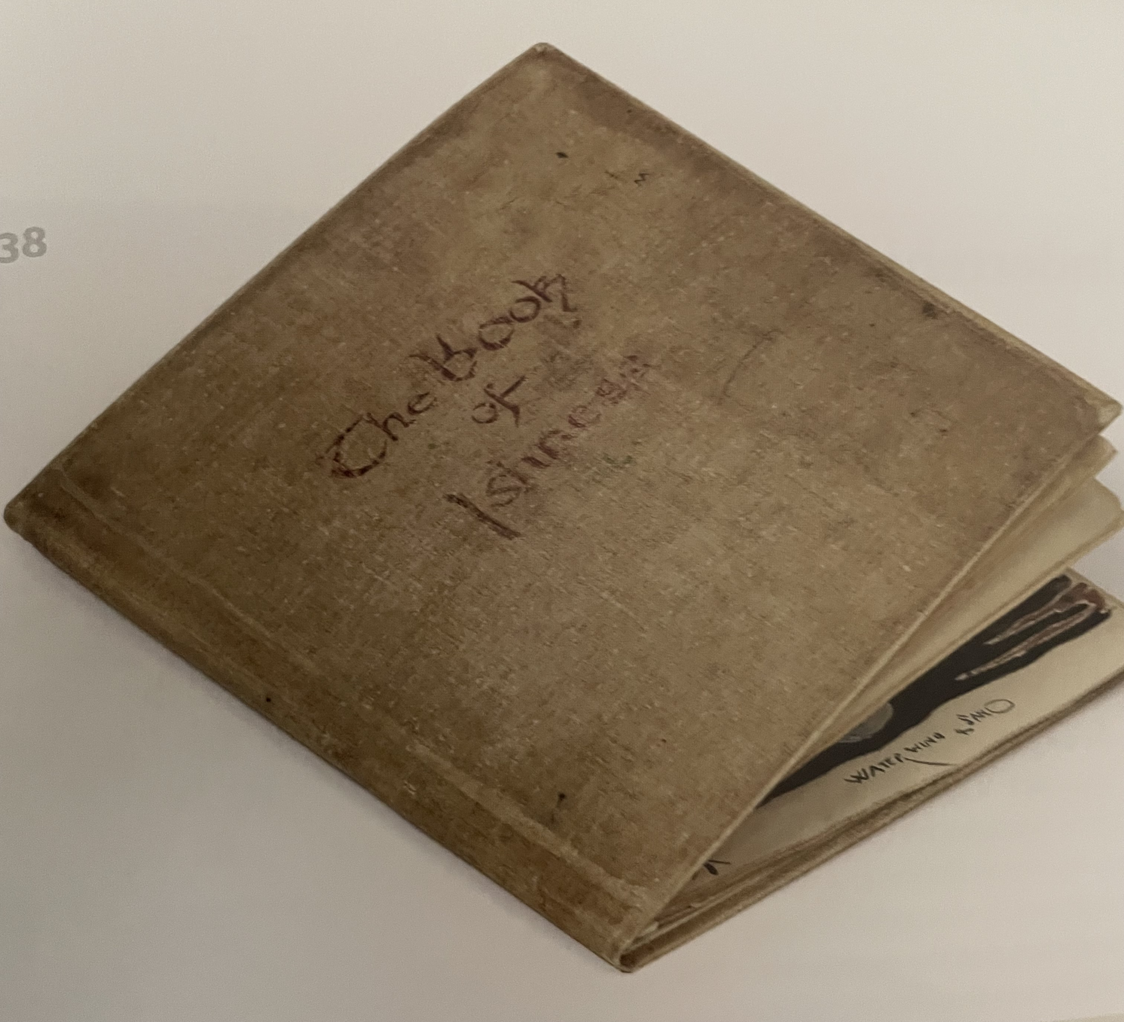
The Book of Ishness
--The Book of Ishness was a hardback sketchbook used by
Tolkien for his artwork and some artistic writing from 1914
to 1928. An envelope kept with the book and labelled
“Earliest Ishnesses” includes other art and drawings from
1911-1914.
--Correspondence between Tolkien and his sister Mary
mentions a conversation linking the ishnesses with John
Ruskin, the art critic and reformer who was the champion
and mentor of the Pre-Raphaelites. Ruskin considered the
imagination the highest faculty of an artist or poet.
--In the book Tolkien attempted to express through art,
often abstract in nature, moods and emotions and what was
going on in his imagination, giving the sketches such titles
as Undertenishness, Grownupishness, Wickedness, and
Eeriness.
--The style in the Book of Ishness is generally far more
abstract than the more representative style of art/drawing
in which Tolkien was already very accomplished.

Slide 10
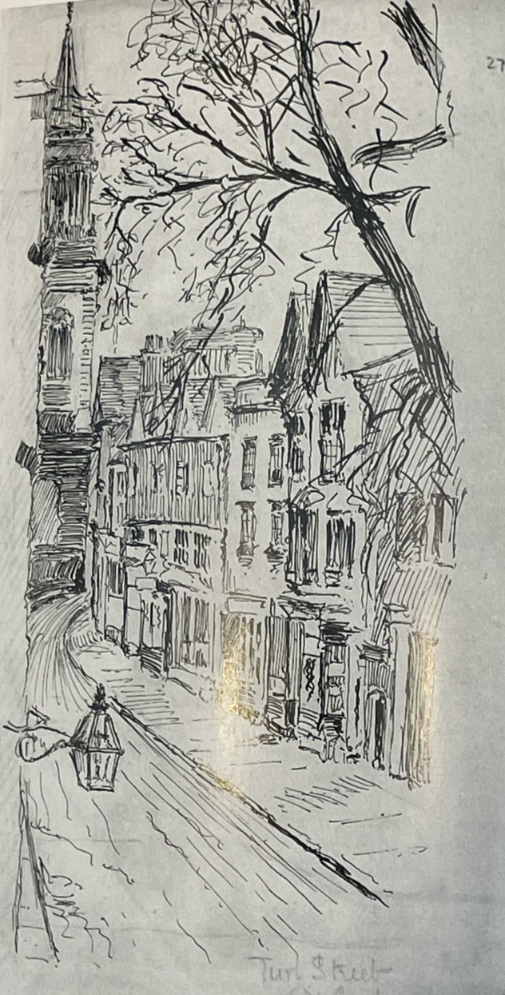
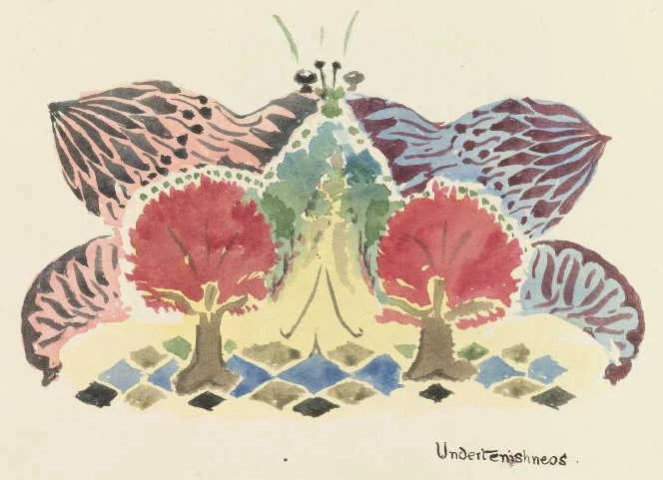
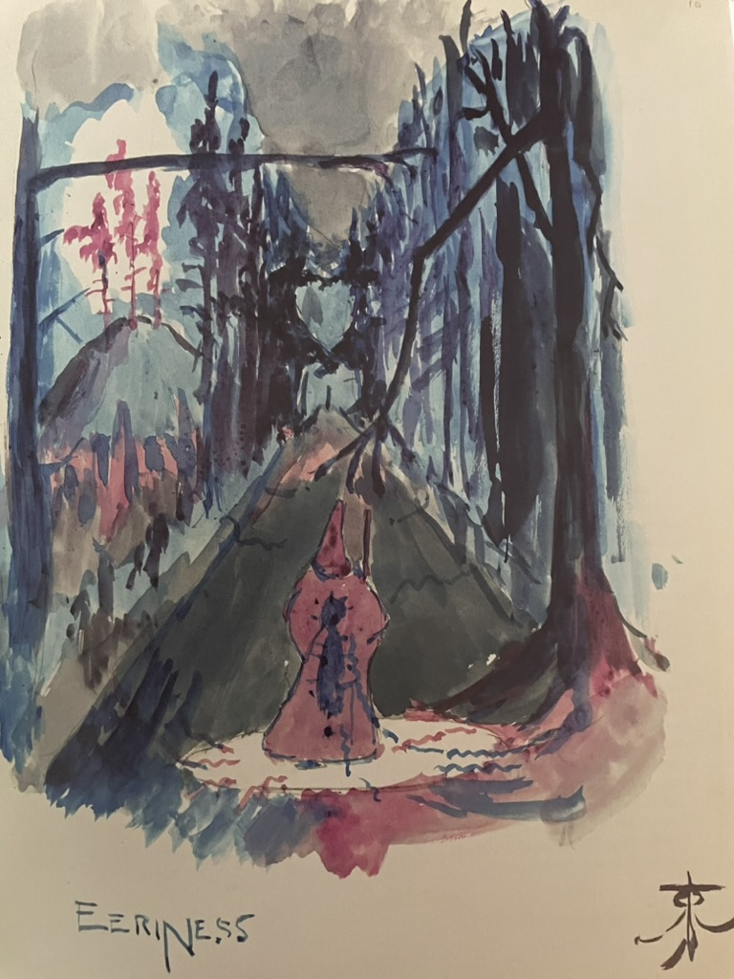
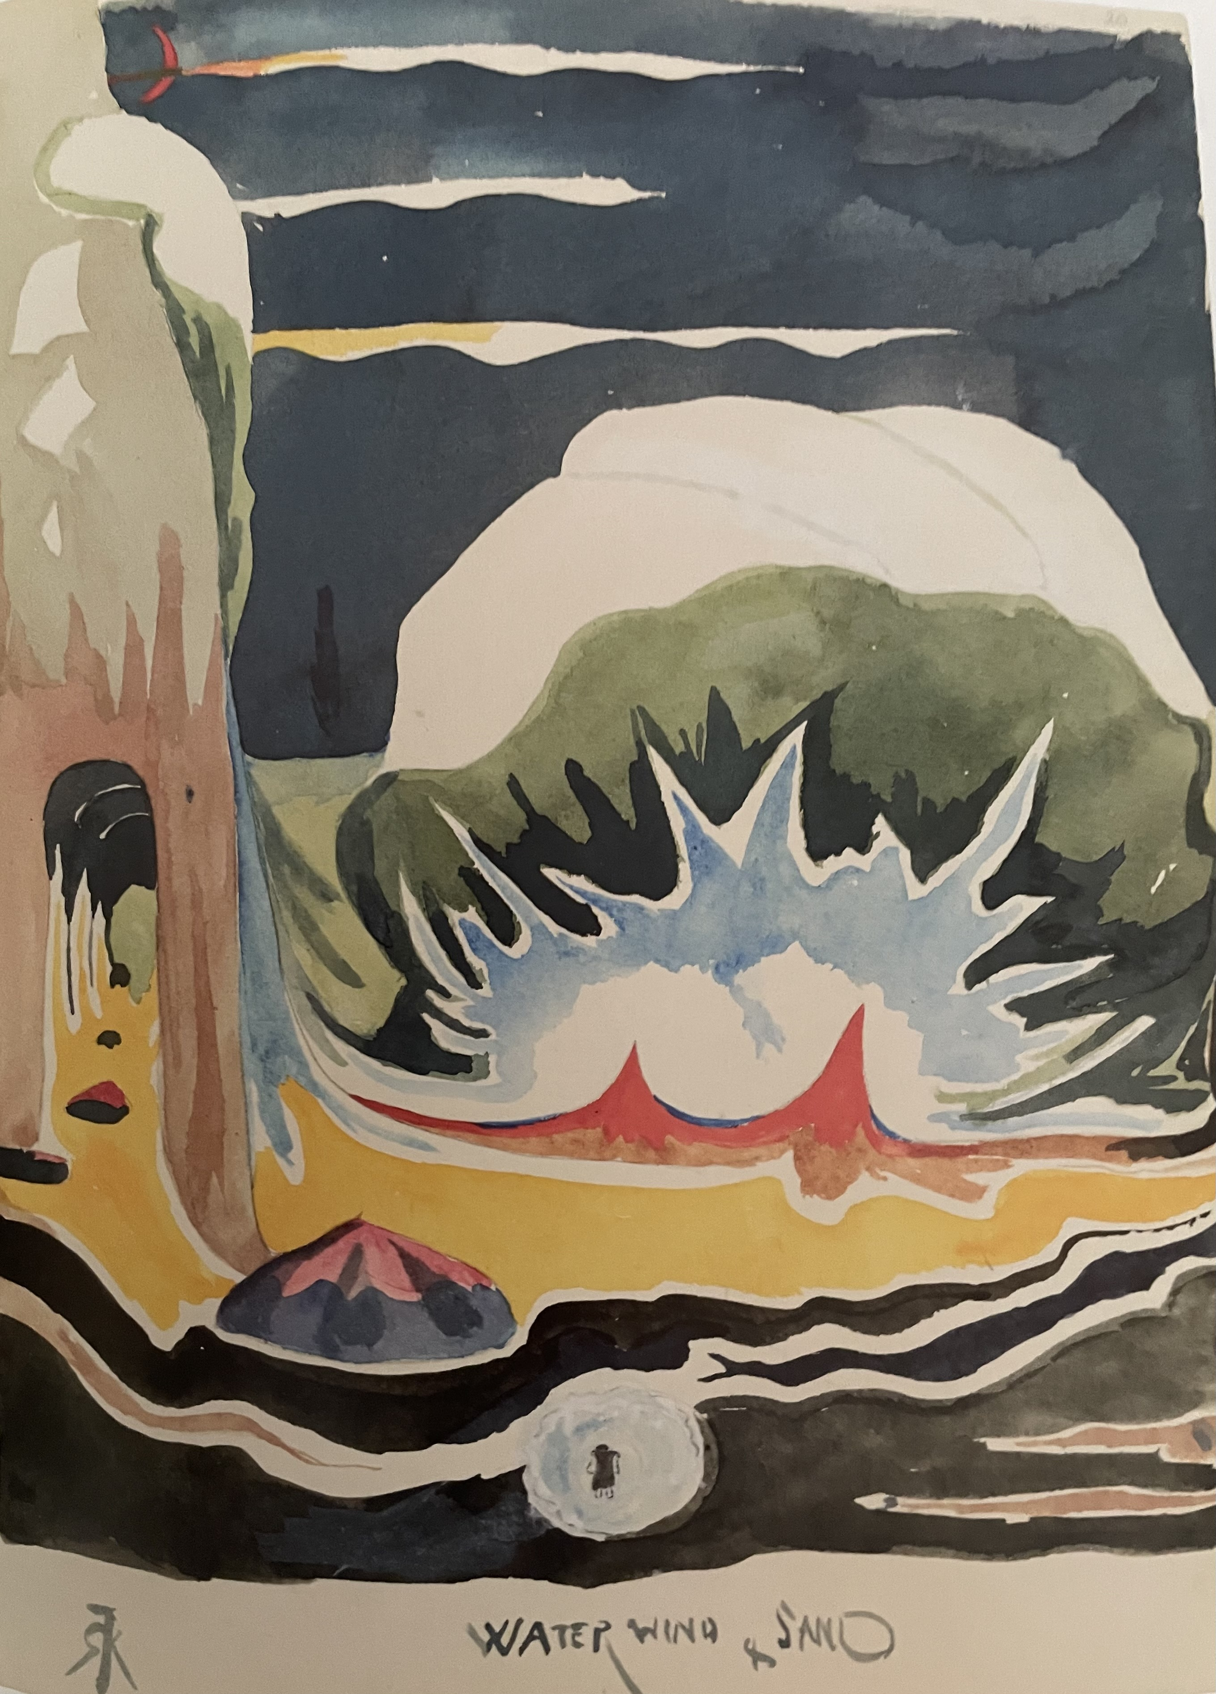
Sketch of Turl St. Undertenishness Eeriness Water, Wind, Sand
(1911) (1912) (1914) (1915)

Slide 11
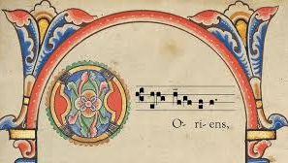
The O Antiphons
These prefatory chants are sung at Vespers/Evensong on the last seven days of Advent. They date back at least to the eighth century and are probably earlier than that. For many centuries they have been one of the key musical features of the days leading up to Christmas, and they would have been known to Tolkien since childhood in their Latin form. They are most widely known today through the hymn “O Come, O Come, Emmanuel,” for which the verses are taken from the O antiphons.
In the original Latin, each antiphon begins with O and refers to a different Scriptural attribute of Jesus Christ each day. They are usually ordered as follows:
17 December: O Sapientia (O Wisdom)
18 December: O Adonai (O Lord)
19 December: O Radix Jesse (O Root of Jesse)
20 December: O Clavis David (O Key of David)
21 December: O Oriens (O Morning Star)
22 December: O Rex Gentium (O King of the Nations)
23 December: O Emmanuel (O God with Us)
O Oriens, splendor lucis aeternae, et sol justitiae: veni, et illumina sedentes in tenebris, et umbra mortis.
"O Morning Star, splendour of light eternal and sun of righteousness: Come and enlighten those who dwell in darkness and the shadow of death".

Slide 12
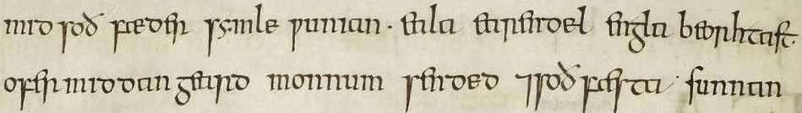
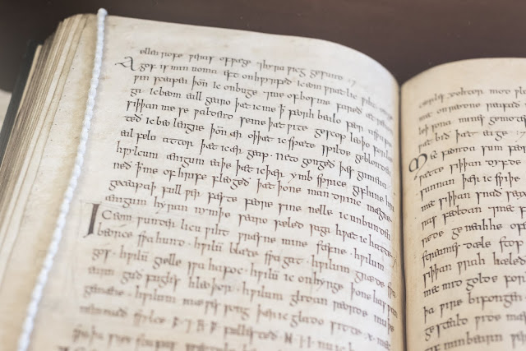
Cynewulf, Crist 1, and the Exeter Book
Cynewulf was a gifted 8th or 9th century poet who wrote in Old English and to whom Crist 1, the poetic theological meditation on the O Antiphons, is usually ascribed, along with the subsequent Crist 2 and Crist 3. It is found in manuscript form in the famous Exeter Book, a codex that was compiled in the 10th century and housed at Exeter Cathedral in the UK. It the largest and oldest known manuscript of Old English literature. One section of Crist 1 is a rich meditation on the O Oriens (O Morning Star) antiphon, as follows:
Eala earendel, engla beorhtast,
ofer middangeard monnum sended,
ond soðfæsta sunnan leoma,
torht ofer tunglas, þu tida gehwane
of sylfum þe symle inlihtes!
Swa þu, god of gode gearo acenned,
sunu soþan fæder, swegles in wuldre AY-AH-LA AIR-ON-DILL ANGLA-BAIR-SHTAST
butan anginne æfre wære, OH-FUR MID-DAN YAIRD MOHNUM SANDED
swa þec nu for þearfum þin agen geweorc
bideð þurh byldo, þæt þu þa beorhtan us
sunnan onsende, ond þe sylf cyme
þæt ðu inleohte þa þe longe ær,
þrosme beþeahte ond in þeostrum her,
sæton sinneahtes; synnum bifealdne
deorc deaþes sceadu dreogan sceoldan.

Slide 13
Translation and Scriptural background of the meditation, which is focused on Jesus Christ as the Morning Star
O Earendel, brightest of angels,
sent to mankind over middle-earth,
righteous sun's radiance, splendid above all stars!
Of thine own self thou ever enlightenest every age.
As thou, God born of God long ago, Son of the true Father,
eternally existed without beginning in the glory of heaven,
so thine own creation cry with confidence to thee now for their needs,
that thou send that bright sun to us, and come thyself
to lighten those who long have lived, surrounded by shadows and darkness, here
in everlasting night; who, shrouded by sins, have had to endure death's dark shadow.
“I, Jesus, have sent my angel to give you this testimony for the churches. I am the Root and the Offspring of David, and the bright Morning Star.” Rev 22:16 We actually heard that voice speaking from Heaven while we were with him on the sacred mountain. The word of prophecy was fulfilled in our hearing! You should give that word your closest attention, for it shines like a lamp amidst all the dirt and darkness of the world, until the day dawns, and the Morning Star rises in your hearts. 2 Peter 1:18-19 To the one who is victorious, who carries out my work to the end, I will give authority over the nations, just as I myself have received authority from my Father, and I will give him the Morning Star. Rev. 2:28

Slide 14
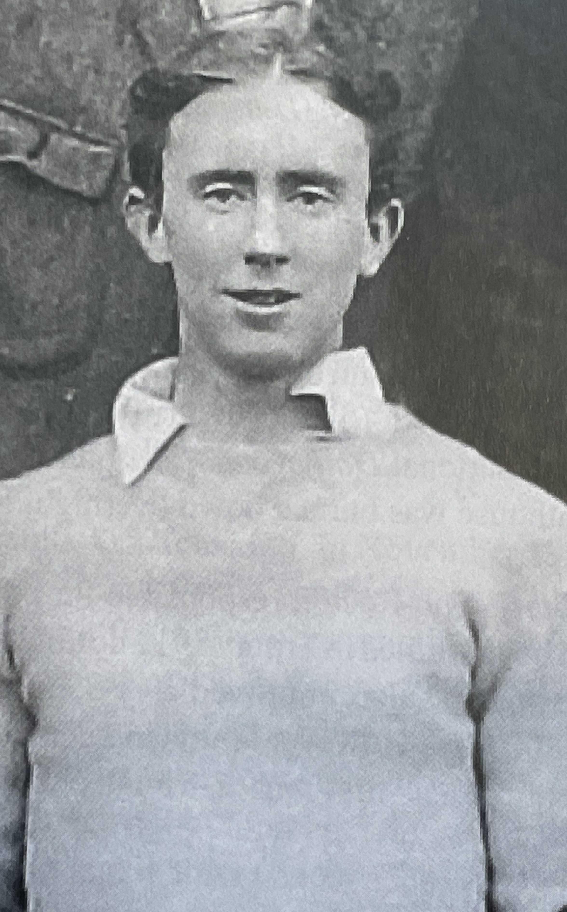
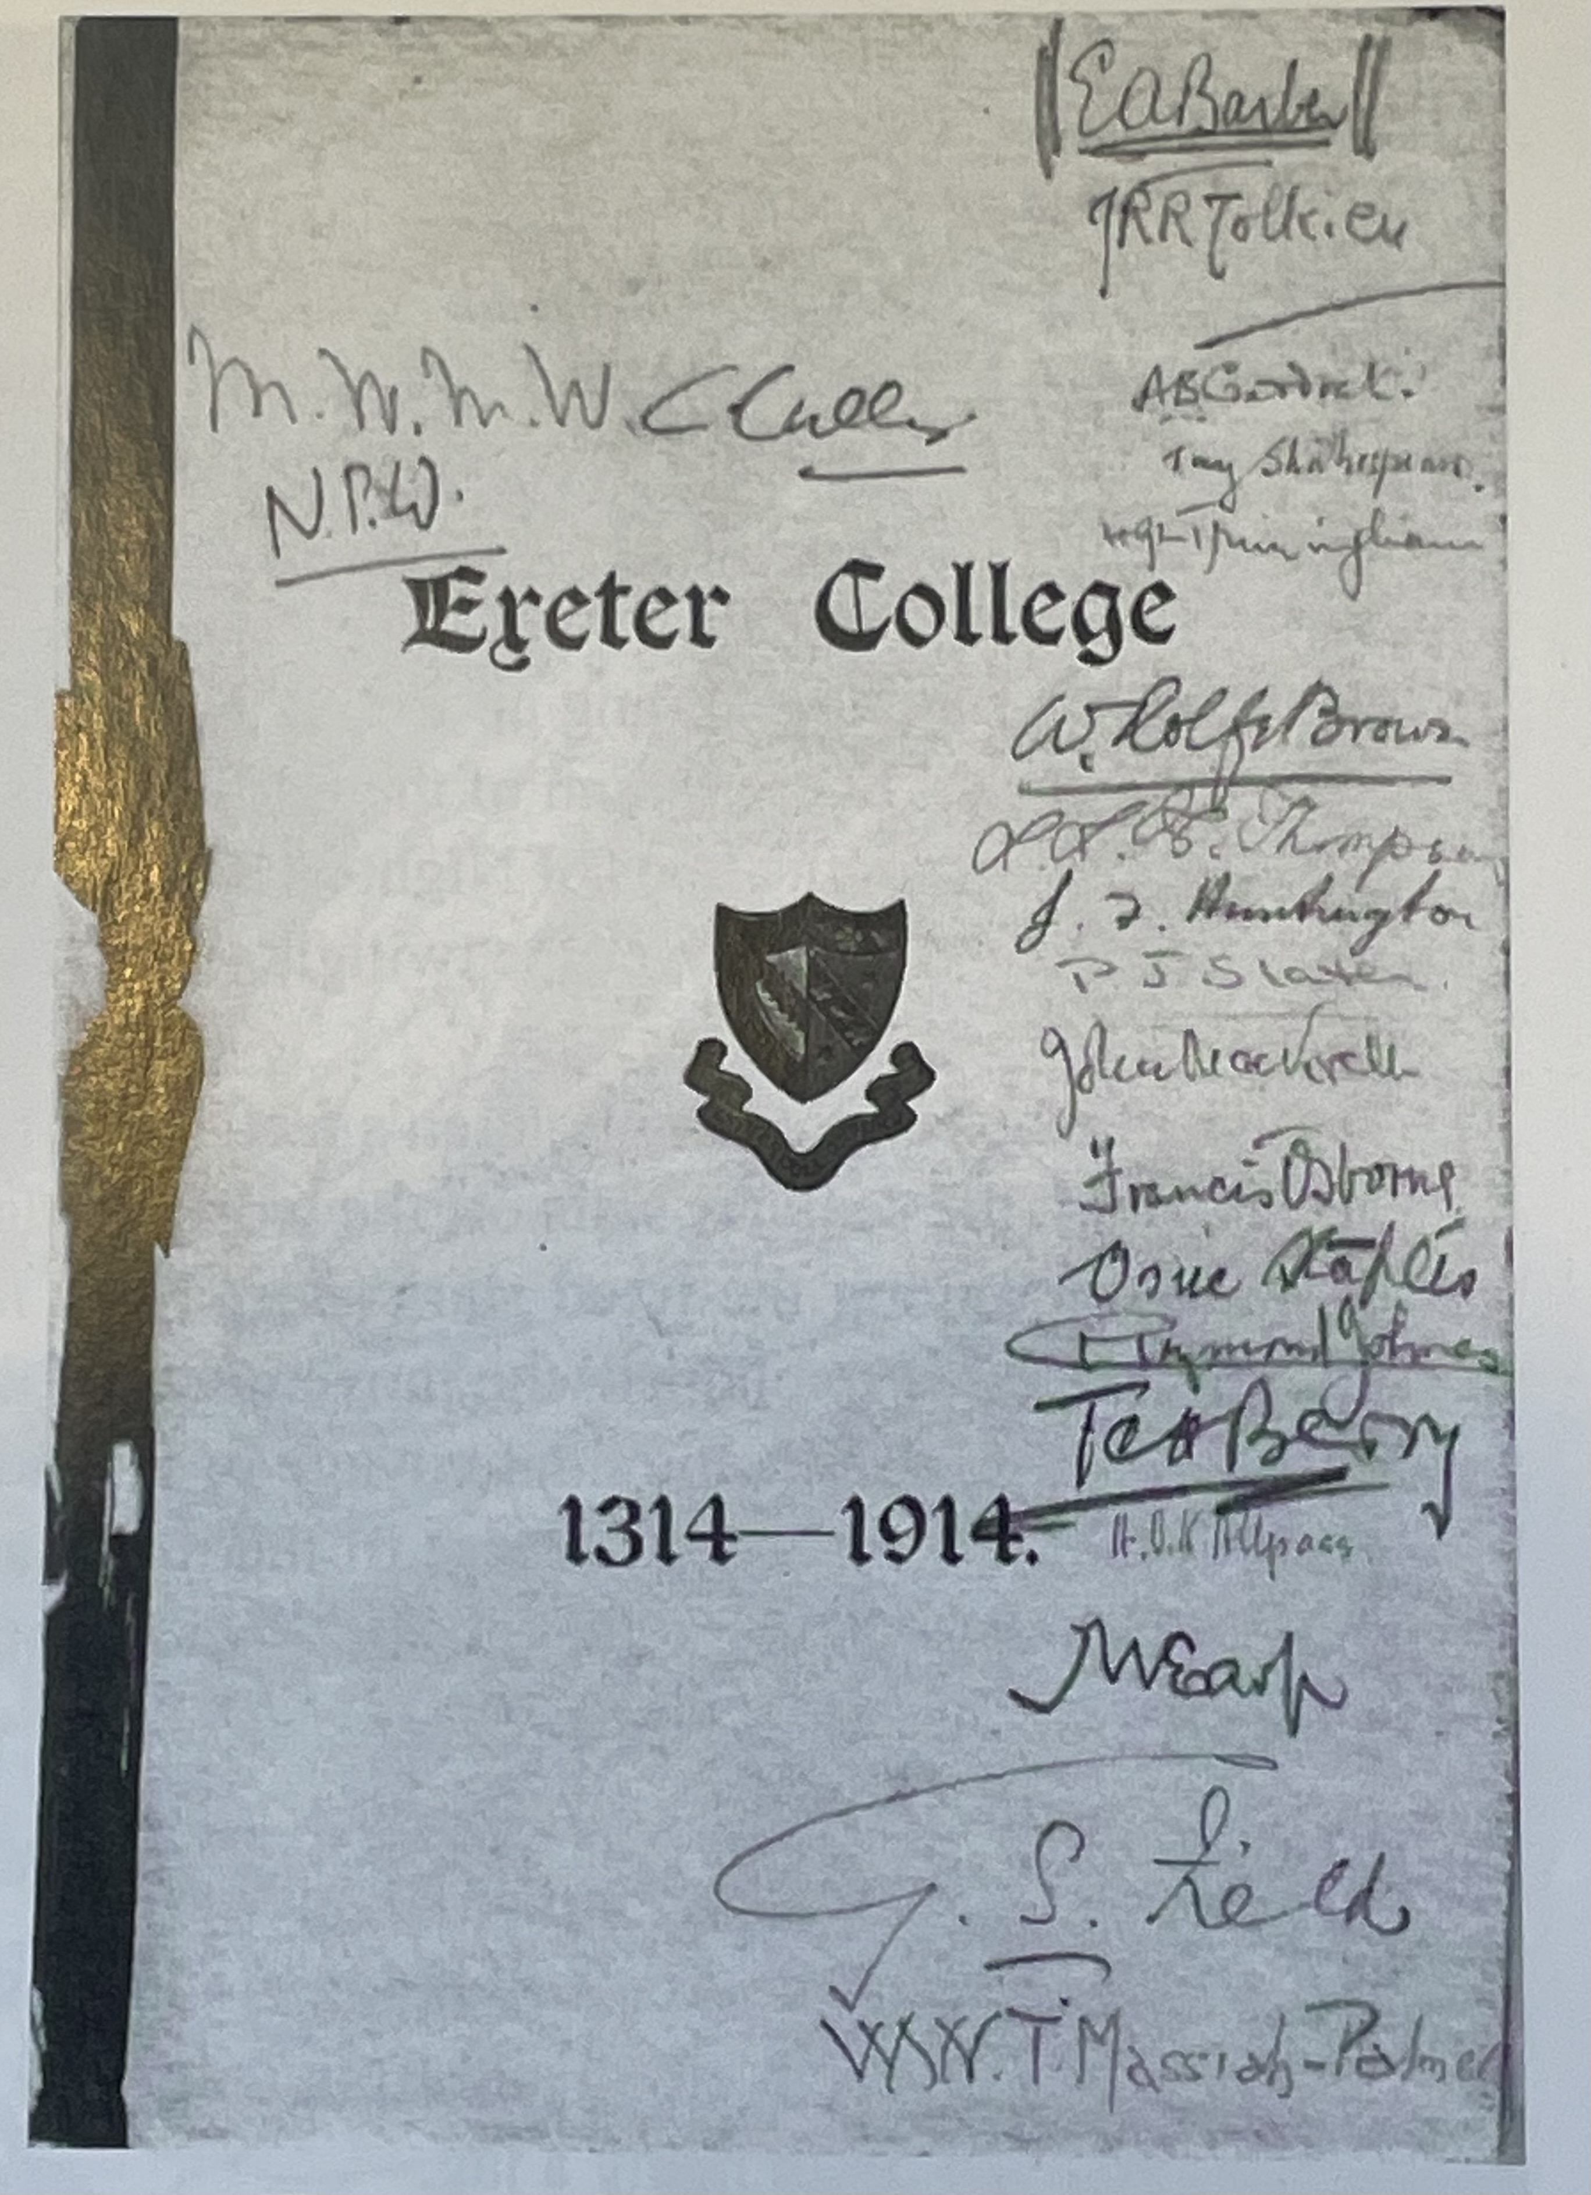
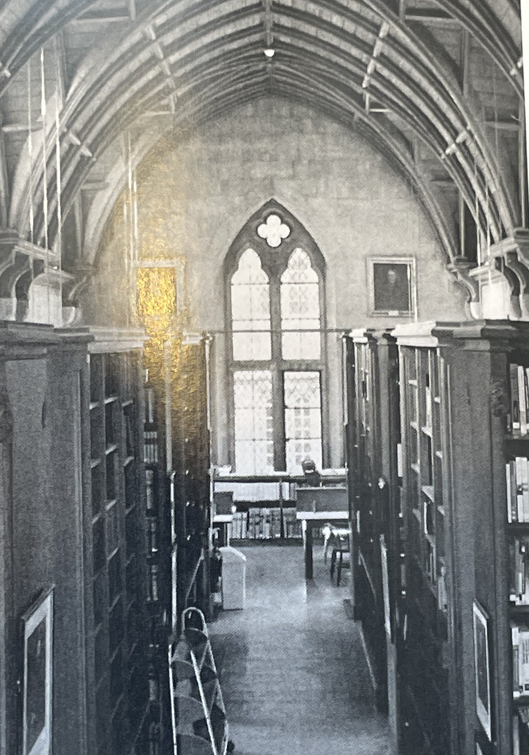
The Pivotal Moment: Summer 1914 at Exeter College
--In June 1914 Exeter celebrated its 600th anniversary.
--That same summer Tolkien checked out a number of
volumes from the college library, including a volume of
Anglo-Saxon poetry that included Cynewulf’s Crist 1. He
was entranced by it, especially the lines about Earendil, and
then checked out another book on German philology that
associated Earendil with a heroic mariner.
--Reflecting on this moment in “The Notion Club Papers”
Tolkien wrote that upon reading these lines he had
"...felt a curious thrill as if something had stirred in me.....There
was something very remote and strange and beautiful behind
those words, if I could grasp it, far beyond the ancient English.”
Hail Earendel Morning Star, brightest of angels,.
Over Middle-Earth sent unto men..
--Not only the source for Earendil in the Legendarium but
also for the term Middle Earth, both in a poem celebrating
Jesus Christ and anticipating His Incarnation in song.

Slide 15
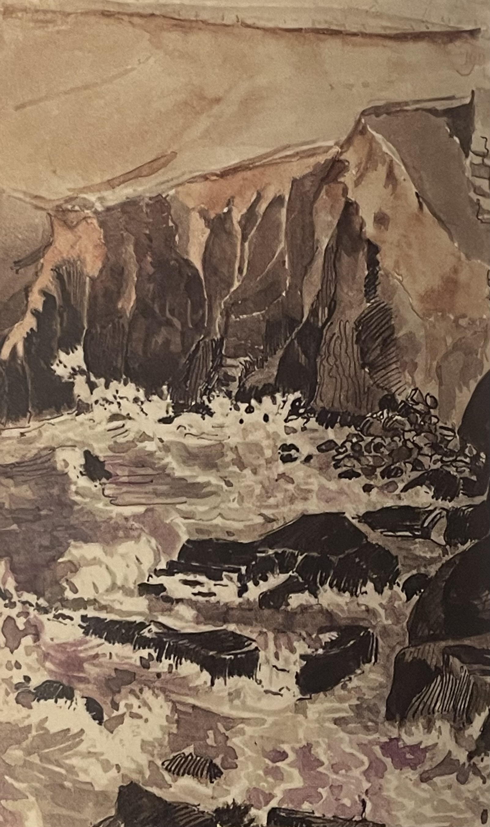
Early Tolkien biographer Humphrey Carpenter shows how these lines about Earendil continued to be in the front of Tolkien’s mind:
“In 1914 J.R.R. Tolkien...spent a holiday in Cornwall, staying on the Lizard peninsula with Father Vincent Reade of the Birmingham Oratory [...]At the end of the long vacation he travelled to Nottinghamshire to stay for a few days on the farm that his Aunt Jane was running with the Brookes-Smiths and his brother Hilary. While at the farm he wrote a poem. It was headed with the line from Cynewulf’s Crist that had so fascinated him: Éala Éarendel engla beorhtast! Its title was 'The Voyage of Éarendel the Evening Star’, and it began as follows:
Éarendel sprang up from the Ocean's cup
In the gloom of the mid-world's rim;
From the door of Night as a ray of light
Leapt over the twilight brim,
And launching his bark like a silver spark
From the golden-fading sand
Down the sunlit breath of Day's fiery death
He sped from Westerland.
Tolkien painting of cove near the Lizard, Cornwall August 12, 1914
“The succeeding verses describe the star-ship's voyage across the firmament, a progress that continues until the morning light blots out all sight of it. This notion of the star-mariner whose ship leaps into the sky had grown from the reference to 'Éarendel' in the Cynewulf lines. But the poem that it produced was entirely original. It was in fact the beginning of Tolkien's own mythology.”

Slide 16
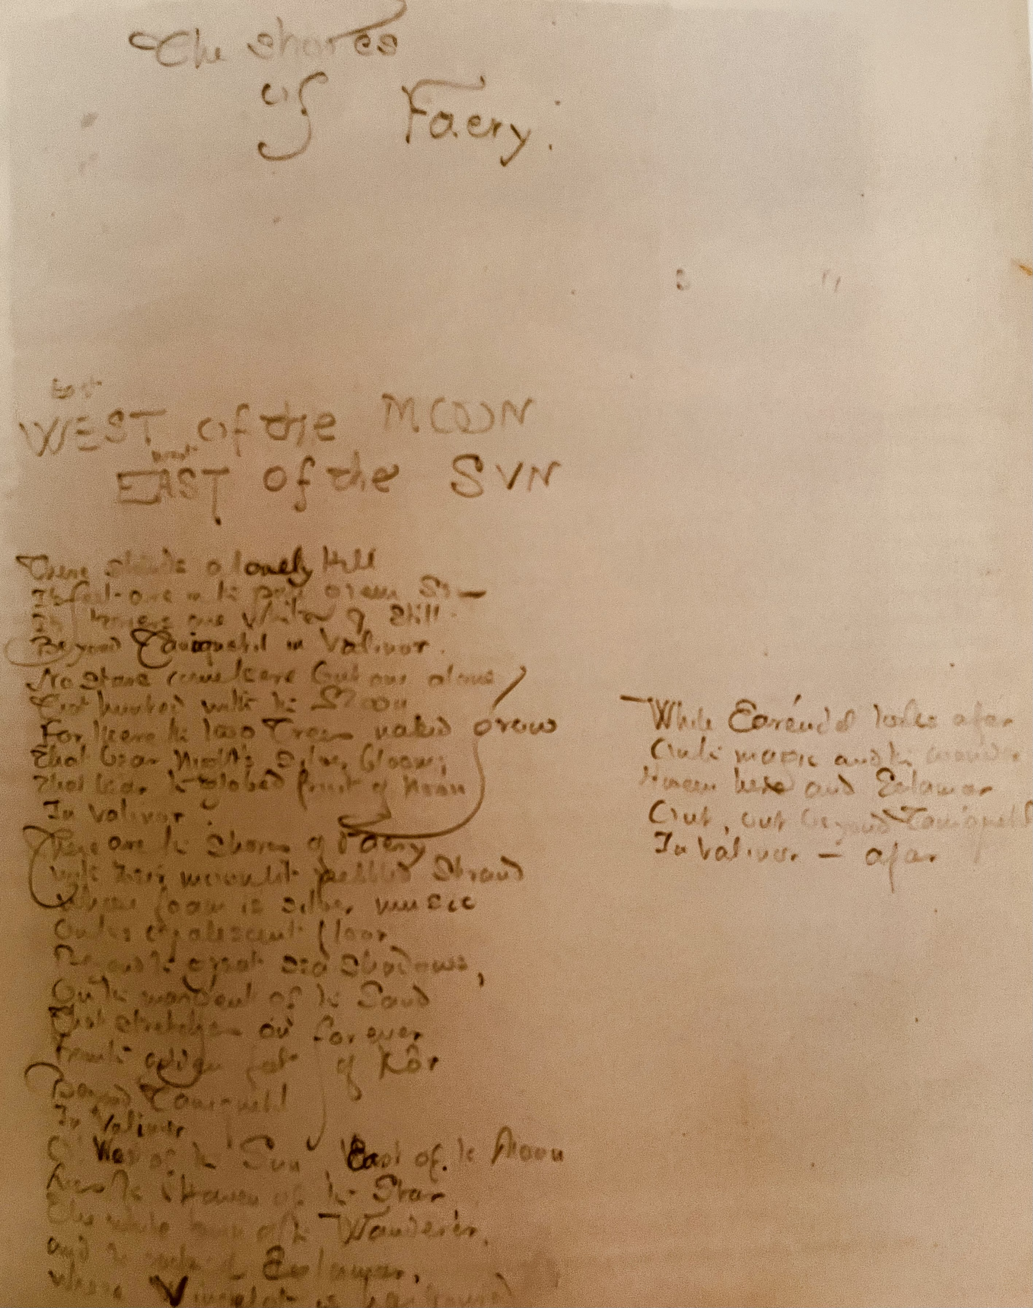
Tolkien described this poem “The Shores of Faery/East of the Moon
West of the Sun” as the first poem of his Mythology. Written around
May 1915, Earendil appears as the lonely mariner, the only sentient
being in the beautiful but empty land. The white city of the Elves on
the hill of Kôr is deserted and the only sound is the music of the
waves on the golden shore. Earendil was present in the earliest version
of the mythology, The Book of Lost Tales. He was the Half-Elven son
of Tuor and Idril who escaped from the sack of Gondolin. Years later
seeking his father he sailed to the shores of Valinor, the Blessed Realm,
only to find it deserted.
In The Lord of the Rings, the phial Galadriel gives Frodo contains light
from Earendil’s star. When he encounters Shelob the Spider, he brings
out the phial of Light and cries “Aiya Earendil Elenion Ancalima!”
which is left untranslated in the book, but which Tolkien in a letter
many years later indicated could be translated as “Hail Earendil,
brightest of stars!”
(Adapted from Catherine McIlwaine, Tolkien: Maker of Middle Earth)

Slide 17

“And you, Ring-bearer,’ she said, turning to Frodo. ‘I come to you last who are not last in my thoughts. For you I have prepared this.’ She held up a small crystal phial: it glittered as she moved it, and rays of white light sprang from her hand. ‘In this phial,’ she said, ‘is caught the light of Eärendil’s star, set amid the waters of my fountain. It will shine still brighter when night is about you. May it be a light to you in dark places, when all other lights go out.” SEGUE TO FRODO IN THE DARK PLACE OF SHELOB’S LAIR “Slowly his hand went to his bosom, and slowly he held aloft the Phial of Galadriel. For a moment it glimmered, faint as a rising star struggling in heavy earthward mists, and then as its power waxed, and hope grew in Frodo’s mind, it began to burn, and kindled to a silver flame, a minute heart of dazzling light, as though Eärendil had himself come down from the high sunset paths with the last Silmaril upon his brow. The darkness receded from it, until it seemed to shine in the centre of a globe of airy crystal, and the hand that held it sparkled with white fire. Frodo gazed in wonder at this marvellous gift that he had so long carried, not guessing its full worth and potency.”—J.R.R. Tolkien, The Two Towers
Jesus said, “I am the light of the world. Whoever follows me will not walk in darkness, but will
have the light of life.” --John 8:12
“In him was life, and the life was the light of men. The light shines in the darkness, and the darkness has not overcome it. There was a man sent from God, whose name was John. He came as a witness, to bear witness about the light, that all might believe through him. He was not the light, but came to bear witness about the light.The true light, which gives light to everyone, was coming into the world.” --John 1:4-9
Hail Earendel, Morning Star, brightest of angels,.
Over Middle-Earth sent unto men.

Slide 18
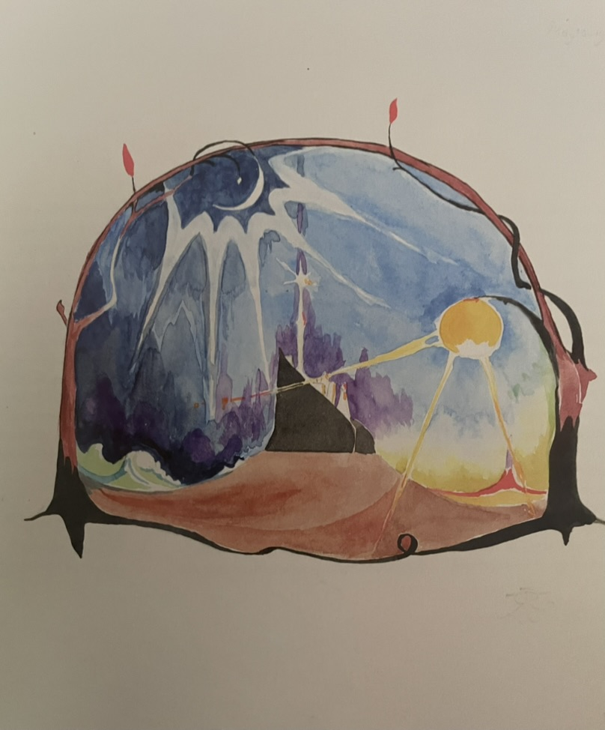
East of the Sun, West of the Moon/The Shores of Faery
Depicting Kôr, the City of the Elves in Valinor
J.R.R Tolkien, 1915

Slide 19
“But this story has entered History and the primary world; the desire and aspiration of sub-creation has been raised to the fulfillment of Creation. The Birth of Christ is the eucatastrophe of Man's history. The Resurrection is the eucatastrophe of the story of the Incarnation.
This story begins and ends in Joy. : such Joy has the very taste of primary truth. (Otherwise its name would not be Joy.) It looks forward (or backward) to the Great Eucatastrophe. The Christian Joy, the Gloria, is of the same kind; but it preeminently (infinitely, if our capacity were not finite) high and joyous.
But this story is supreme; and it is true. Art has been verified. God is the Lord, of angels, and of men—and of elves. Legend and History have met and fused. The Evangelium has not abrogated legends; it has hallowed them.”
—J.R.R. Tolkien, On Fairy Stories

