Slide 1
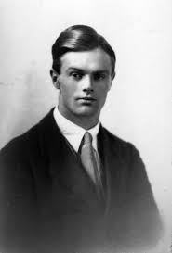
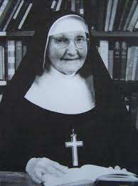
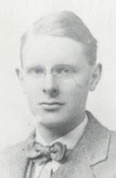
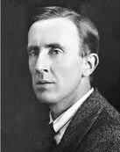
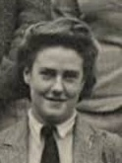
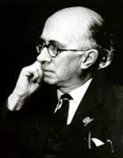
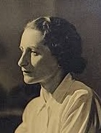
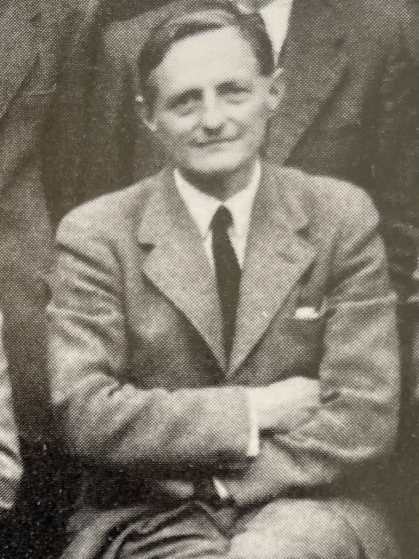
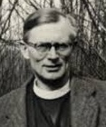
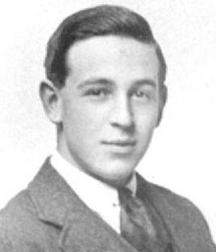
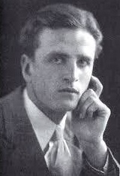

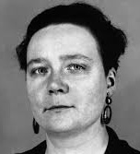
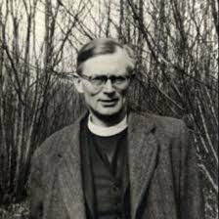
DEEPER DIVE:
C.S. Lewis and His Friends
Conversion:
Barfield, Tolkien, and Dyson
St. Philip’s Church The Rev’d Brian K. McGreevy April 15, 2026

Slide 2
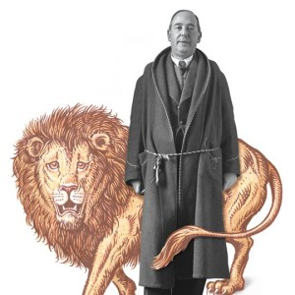
DEEPER DIVE C.S. Lewis and His Friends: Conversion—Barfield, Tolkien and Dyson The Journey from Atheism to Christianity
The Rev’d Brian K. McGreevy, J.D., Presenter

Slide 3
And let us consider how to stir up one another to love and good works, not neglecting to meet together, as is the habit of some, but encouraging one another, and all the more as you see the Day drawing near. Hebrews 10:24-25

Slide 4
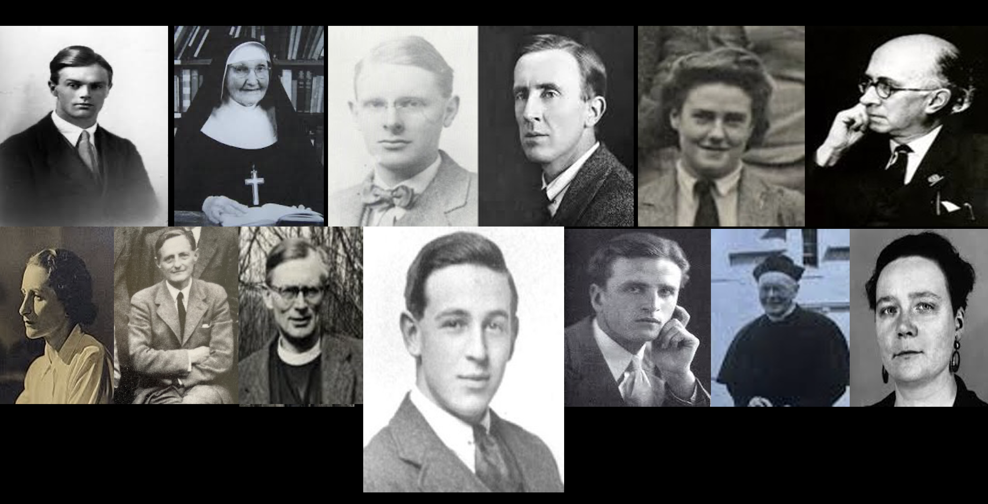
Introduction to Deeper Dive: C.S. Lewis and His Friends A closer look at Lewis’s theology and practice of friendship, and the role of friendship and its influence in Lewis’s life in certain key areas. Among the friends we will mention are men, women, students, priests, scholars—a wide variety! Pictured here (left to right) are Owen Barfield Sister Penelope Arthur Greeves J.R.R. Tolkien Stella Aldwinckle Roger Lancelyn Green Bottom row (left to right) Ruth Pitter Hugo Dyson Austin Farrer (Lewis) Dom Bede Griffiths Father Walter Adams Dorothy Sayers Tonight! EPISODE 1: CONVERSION: Barfield, Tolkien, and Dyson

Slide 5
The Significance of C.S. Lewis’s Journey of Faith Rev. Dr. Alister McGrath, Andreas Idreos Chair of Science and Religion, Oxford University Lewis’s settled and well-reasoned atheism —Science has made religious belief irrelevant —Religion is a human invention, merely wish fulfillment —suffering, death and evil (WW1) made it impossible to believe in God --Many of the same arguments people make today “Lewis’s genius lay in his ability to show how a Christian viewpoint was able to offer a more satisfactory explanation of common human experience than its rivals, especially the atheism he had once himself so enthusiastically advocated.” How Lewis’s journey is relatable today --Crisis of worldview/meaning and purpose --His authenticity and humility --Gift for analogy and for story --Importance of Objective Value (Beauty, Truth, Goodness) --Heart after God --Joy “Here we sit, all of us, eating and drinking to preserve our precious existence, and really there is nothing, nothing, absolutely no reason for existing.”—Sartre

Slide 6
Overview: An unlikely luminary Boyhood --Born in Belfast, Northern Ireland in 1898 --Painful and dysfunctional childhood --Terrible experience of schools and of England 1908 Adolescence and young adulthood --A brilliant tutor discovers a brilliant mind 1914 --Oxford 1917 --Despair and bitterness after World War I --A brilliant Triple First in Moderations (Greek and Latin Literature), Greats (Philosophy and Ancient History), and English --Brilliant, proud, and aggressive atheism --Worldly success: elected Fellow of Magdalen in 1925, publication of “Spirits in Bondage” and “Dymer” Sehnsucht The impact of a bold friend and the formation of the Inklings --Met J.R.R. Tolkien in 1926 at Merton College English faculty meeting --Addison’s Walk, True Myth, and Conversion to Christ 1931 --The Inklings begin

Slide 7
STEPS IN LEWIS’S JOURNEY 1917—Lewis comes up to Oxford to University College, but soon feels compelled to join the war effort and goes to officer training at Keble College. On his 19th birthday in November, he arrives at the front line of the Battle of the Somme. 1918—After being wounded he is sent to England to recuperate and comes back to Oxford as a student in January 1919, emotionally shattered by his experience in the war, which had a profound impact on his relationships and priorities. Lewis took in his deceased friend’s mother and sister and supported them while he was a student and after he graduated. 1919-1923--Investing in writing poetry and diligently working and investing in relationship, especially with Owen Barfield and Nevill Coghill as an undergraduate. Asking where is Truth? Determinedly seeking meaning while adopting a nihilistic, atheistic materialism, but having stabs of Sehnsucht 1923—Earns a brilliant Triple First in Moderations (Greek and Latin Literature), Greats (Philosophy and Ancient History), and English as a brilliant, proud, aggressive, and evangelical Atheist

Slide 8
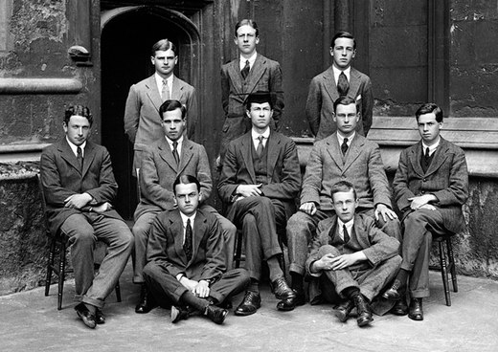
Students Matriculating at University College, Oxford, in 1917
C.S. Lewis in back row at the far right

Slide 9

BARFIELD
C.S. Lewis, Owen Barfield, and the “Great War:”
from Scientific Rationalism to the Intuitive Imagination
Lewis, when speaking about Owen Barfield, once said that there are two kinds of best friends a person can have. One was the type of friend Lewis had during his younger years in Arthur Greeves, and this was the kind of person with whom you had everything in common. The other was the kind of friend he had in Owen Barfield, and this was the type of friend with whom you disagree about everything: "He has read all the right books but has got the wrong thing out of every one... How can he be so nearly right and yet, invariably, just not right? He is at the same time fascinating and infuriating. I can only describe it as the Great War between Barfield and me. When I set out to correct his heresies, I find that he had decided to correct mine! And then we went at it, hammer and tongs, far into the night, night after night.”—Surprised by Joy
“Barfield believed that the imagination plays a very important part in how we know. He rejected the model that science is the only way to truth, to acquiring truth. He felt that the imagination was laid behind even the work of science. It gave meaning to propositions. And so he felt that Lewis was missing out in his whole approach to reality on what made knowledge possible.”—Colin Duriez in The Question of God

Slide 10
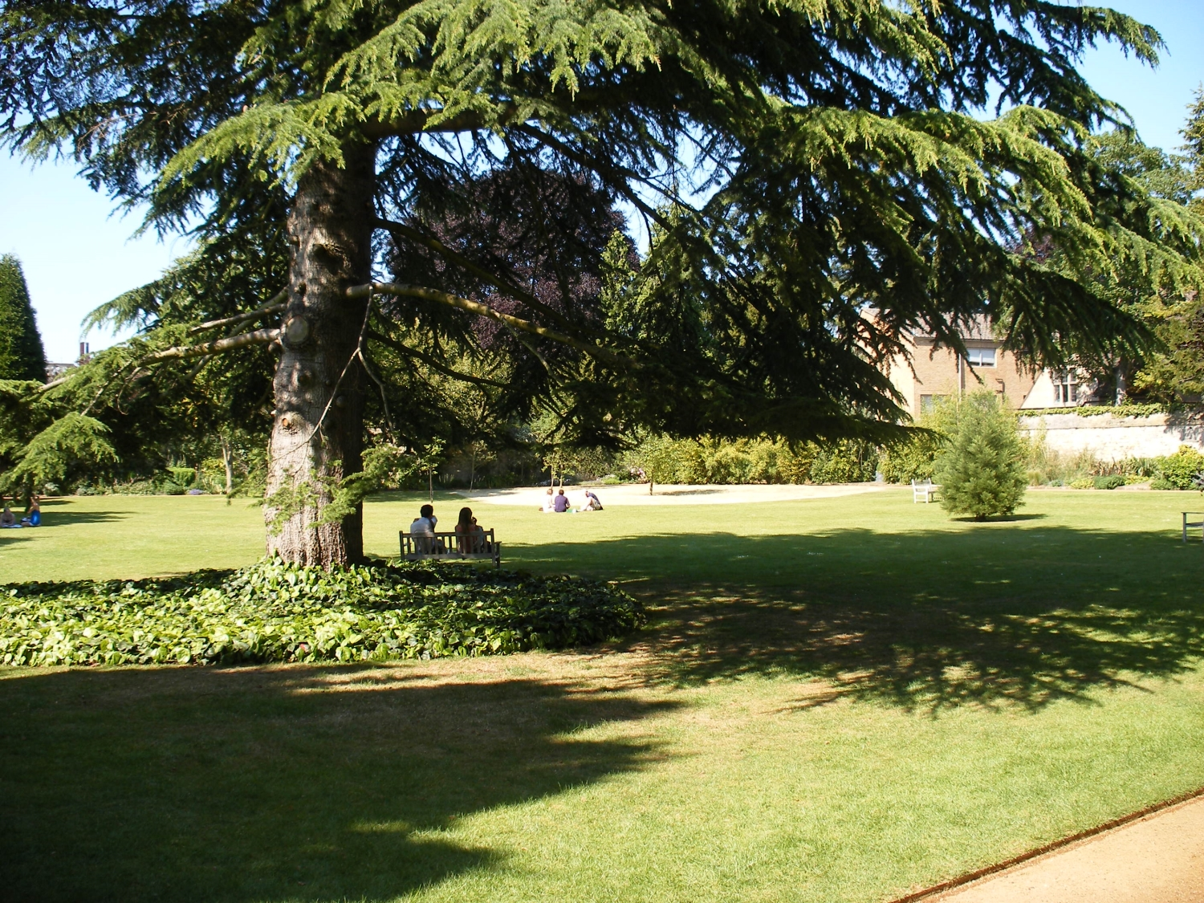
Gardens of Wadham College, Oxford, where Lewis and
Barfield would do laps for hours as they discussed their
opposing views on reason and imagination.

Slide 11
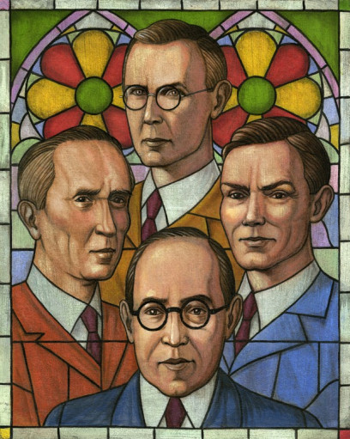
“Barfield’s counterattacks destroyed forever two elements in my own thought. In the first place he made short work of what I have called my "chronological snobbery," the uncritical acceptance of the intellectual climate common to our own age and the assumption that whatever has gone out of date is on that account discredited. “You must find why it went out of date. Was it ever refuted (and if so by whom, where, and how conclusively) or did it merely die away as fashions do? If the latter, this tells us nothing about its truth or falsehood. From seeing this, one passes to the realization that our own age is also "a period," and certainly has, like all periods, its own characteristic illusions. They are likeliest to lurk in those widespread assumptions which are so ingrained in the age that no one dares to attack or feels it necessary to defend them. A manifestation of chronological snobbery is the usage in general of the word "medieval" to mean "backwards.” --Lewis, Surprised by Joy

Slide 12
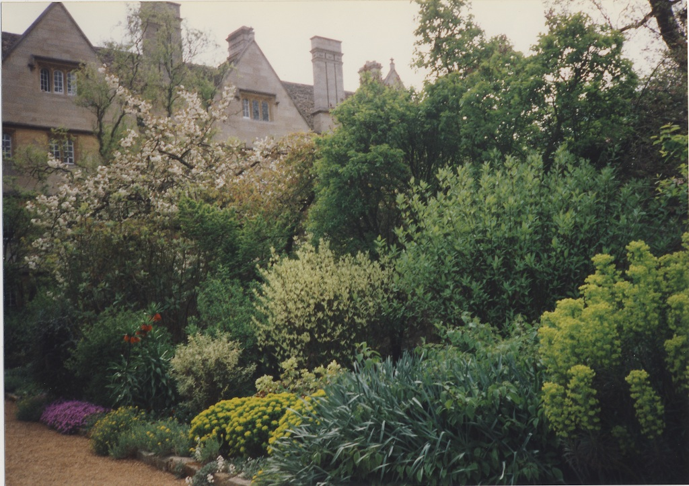
C.S. Lewis, Owen Barfield, and the “Great War:”
from Scientific Rationalism to the Intuitive Imagination
Lewis’s hopes were finally fulfilled in 1925 when Magdalen College made him a fellow. The next year, he found a publisher for his long poem Dymer. He had achieved enormous worldly success while still in his 20s-- but it was not enough.
“All the books were beginning to turn against me. Indeed, I must have been as blind as a bat not to have seen, long before, the ludicrous contradiction between my theory of life and my actual experiences as a reader. The most religious were clearly those on whom I could really feed.”--C.S. Lewis, Surprised by Joy
“The poetry he really cared about was not Ezra Pound and Gertrude Stein. All these years the greatest pleasure he ever had was from Christian poetry. Things like Spencer, Milton — all of these great poets. And yet he found out that he was reading them, as he later said, with the point left out. The same thing was happening with his friends — the people he thought he should've liked were the college atheists. But the ones he really liked were Tolkien, a practicing very devout Catholic, and Owen Barfield, who asked all the right questions.”—Walter Hooper

Slide 13
1925--Worldly success: elected Fellow of Magdalen College at age 26, publication of “Spirits in Bondage” and “Dymer.” He had achieved remarkable things that would set him on a path for a brilliant career, but he was still finding it was not enough and that something was missing. The stabs of Sehnsucht continued to affect him. 1926--Lewis met J.R.R. Tolkien for the first time at Merton College at an English faculty meeting.

Slide 14
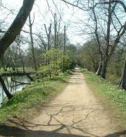
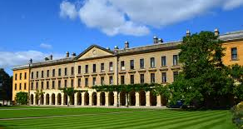
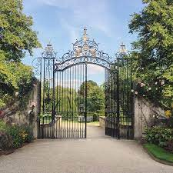
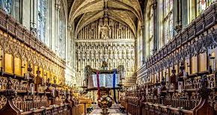
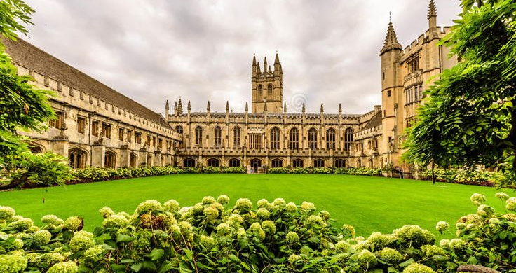
Magdalen College, Oxford

Slide 15
Where is Truth? Lewis believed atheism was right, although “grim and meaningless:” “On the one side, a many-islanded sea of poetry and myth; on the other, a glib and shallow rationalism… “Nearly all that I loved I believed to be imaginary, nearly all that I believed to be real I thought grim and meaningless.”—Lewis, Surprised by Joy “In reading Chesterton, as in reading MacDonald, I did not know what I was letting myself in for. A young man who wishes to remain a sound Atheist cannot be too careful of his reading. There are traps everywhere — "Bibles laid open, millions of surprises," as Herbert says, "fine nets and stratagems." God is, if I may say it, very unscrupulous.”—Lewis, Surprised by Joy

Slide 16
Sparks that ignite: Tolkien and Lewis become close friends Tolkien and Lewis first met in May 1926 at an English Department tea at Oxford. As they got to know each other, Tolkien invited Lewis to a meeting of the Coalbiters Club, along with their mutual friend Nevill Coghill. Tolkien was a deeply devout Christian whose Catholicism informed every aspect of his life, and Coghill was a devout Anglican Christian. Lewis and Tolkien discovered their shared passion for myth and language and literature and began to meet regularly in Lewis’s rooms every Monday morning for animated conversation, talk which Lewis described as going “beyond the walls of this world.” Both men bemoaned the lack of mythic quality in literature of the day, a lack described well by future Inkling Lord David Cecil: The descriptions of Nature are exact but they are are untouched by the light that never was on land or sea but which illuminates all great poetry. Only when the heart of the poet is touched does his poem glow into real beauty. Lewis was soon invited to Tolkien’s home, and they began sharing their writing with one another, and a deep friendship resulted. A short poem by Lewis from this era gives us a flavor of their conversation: We were talking of dragons, Tolkien and I In a Berkshire bar. The big workman Who had sat silent and sucked his pipe All the evening, from his empty mug With gleaming eye glanced towards us; ‘I seen ’em myself’, he said fiercely. Out of these meetings grew their shared project to reform the Oxford English syllabus and the development of the Cave, pulling in English faculty members and future Inklings Nevill Coghill and H.V.D. Dyson.

Slide 17
Sparks that ignite: Tolkien’s sharing The Lay of Leithian with Lewis to read As their friendship deepened, Tolkien and Lewis began to share their writings with one another. When Tolkien in a move of deep vulnerability shared a draft of The Lay of Leithian with Lewis, Lewis’s immense appreciation of it, coupled with thoughtful and helpful feedback, took their friendship to a whole new level of deep encouragement. This exchange helped form part of the bedrock of the “culture” that would later characterize Lewis’s friendships and would become a key part of the culture of the Inklings. Lewis stayed up most of the night reading the draft and sent Tolkien a note the following morning: “I can quite honestly say it is ages since I had an evening of such delight: and the personal interest of reading a friend’s work has very little to do with it. The two things that came out clearly are the sense of reality in the background and the mythical value…Detailed criticisms (including grumbles at individual lines) will follow.” And follow they did. At some point soon thereafter Lewis gave Tolkien fourteen pages of detailed commentary, ingeniously and humorously written in the form of a spoof of several literary and theological critics of the time--Schick, Schuffer, Pumpernickel, Bentley and Peabody Describing these exchanges in letters to his friend Arthur Greeves, Lewis wrote the following: Reading Tolkien’s fairy tale has been uncanny…It is so exactly like what we both would have longed to write or read in 1916: so that one feels that he is not making it up but merely describing the same world into which all of us have entry…Tolkien agrees that for what we meant by romance there must be at least the hint of another world—one must hear the horns of Elfland.” In his autobiography, Lewis described the importance of his relationship with Tolkien: "Friendship with [Tolkien] marked the breakdown of two old prejudices. At my first coming into the world I had been (implicitly) warned never to trust a Papist, and at my first coming into the English Faculty (explicitly) never to trust a philologist. Tolkien was both."

Slide 18
Sparks that ignite---Lewis’s conversion to the Christian faith and his new devotional life 1929—Influenced by his friends and his reading (and the Holy Spirit!), Lewis concludes Atheism is untenable and becomes a theist: “In the Trinity Term of 1929 I gave in, and admitted that God was God, and knelt and prayed, the most dejected and reluctant convert in all of England.” 1930—Lewis begins reading a portion of John’s Gospel in Greek each day, and commences what would become a lifelong habit of attending worship in the Magdalen College Chapel at 8 a.m. each morning, as well as attending services at Holy Trinity, his parish church in Headington Quarry, every Sunday. He also initiates a closer friendship with the Rev’d Adam Fox, Dean of Divinity at Magdalen, who was a poet and became a member of the Inklings. Daily worship, daily Scripture reading, and daily focused prayer times became hallmarks of Lewis’s schedule for the rest of his life. 1931--Lewis becomes a Christian. After his conversion to Theism, it was Tolkien's friendship that brought Lewis to encounter Christ. On 19 September 1931, Jack and "Tollers" (as Tolkien was called by his closest friends), together with their common friend Hugo Dyson (a devout Anglican), dined together at Magdalen College, adjourned to Lewis’s rooms for more talk, and then took an after-dinner stroll on Addison’s Walk in the grounds of Magdalen College, where they began discussing ancient myths and the Truth "hidden" in these legends. They talked until after three o'clock in the morning and a few days later Lewis wrote to his old friend Arthur Greeves, saying: "I have just passed on from believing in God to definitely believing in Christ, in Christianity.... My long night talk with Dyson and Tolkien had a great deal to do with it."' Tolkien recounts this conversation in his brilliant poem “Mythopoeia.”

Slide 19
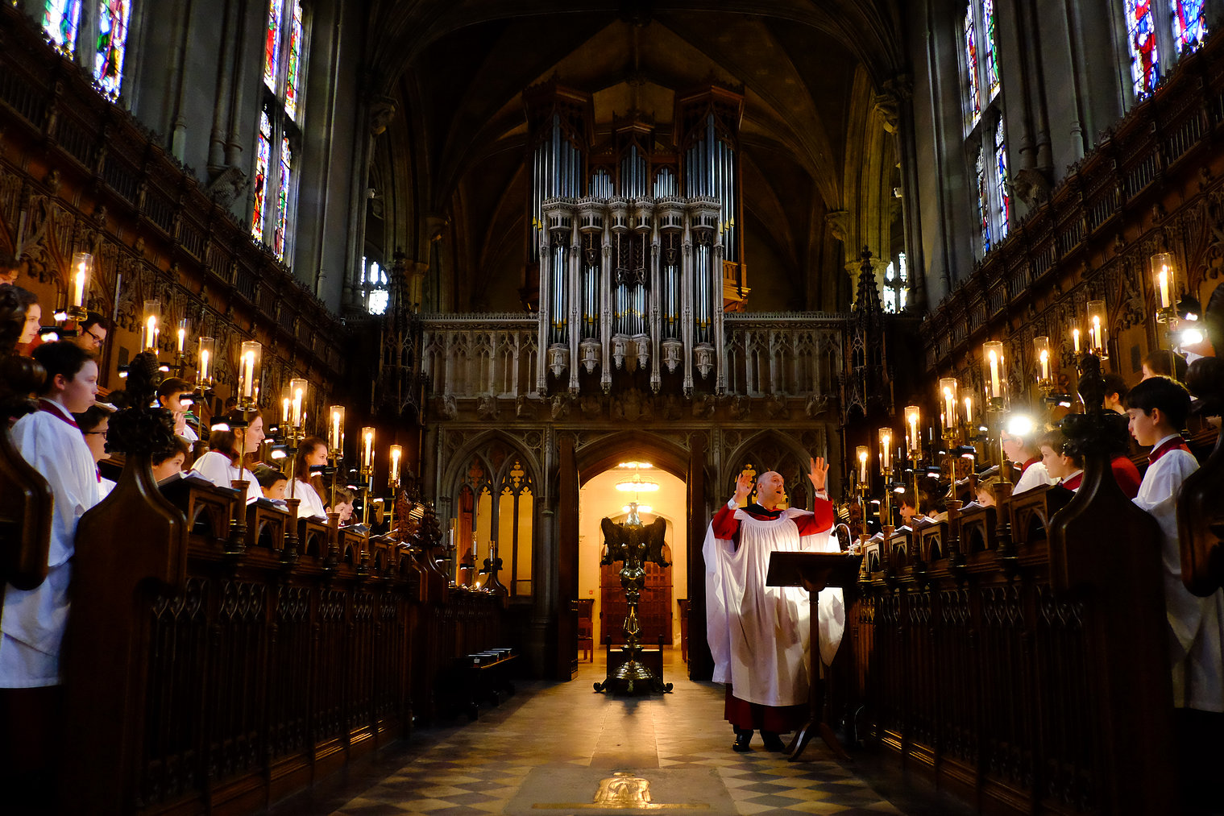

Slide 20
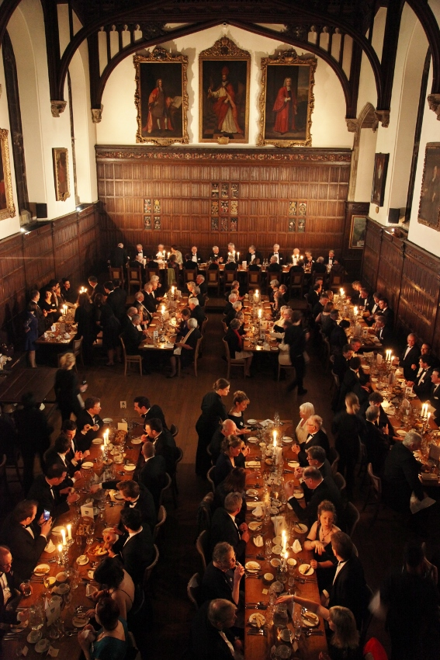
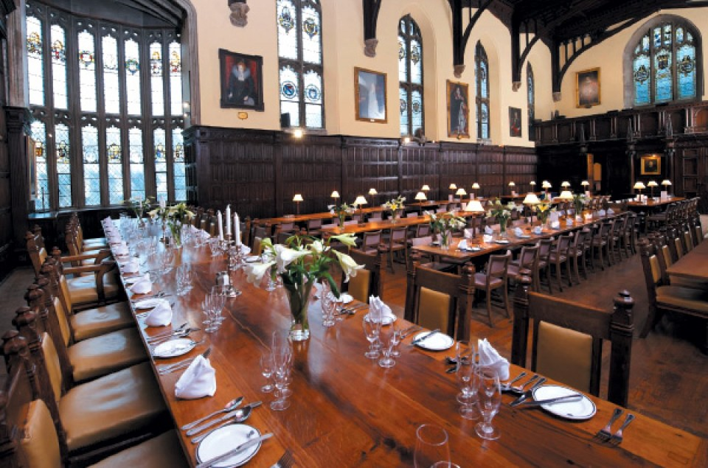

Slide 21
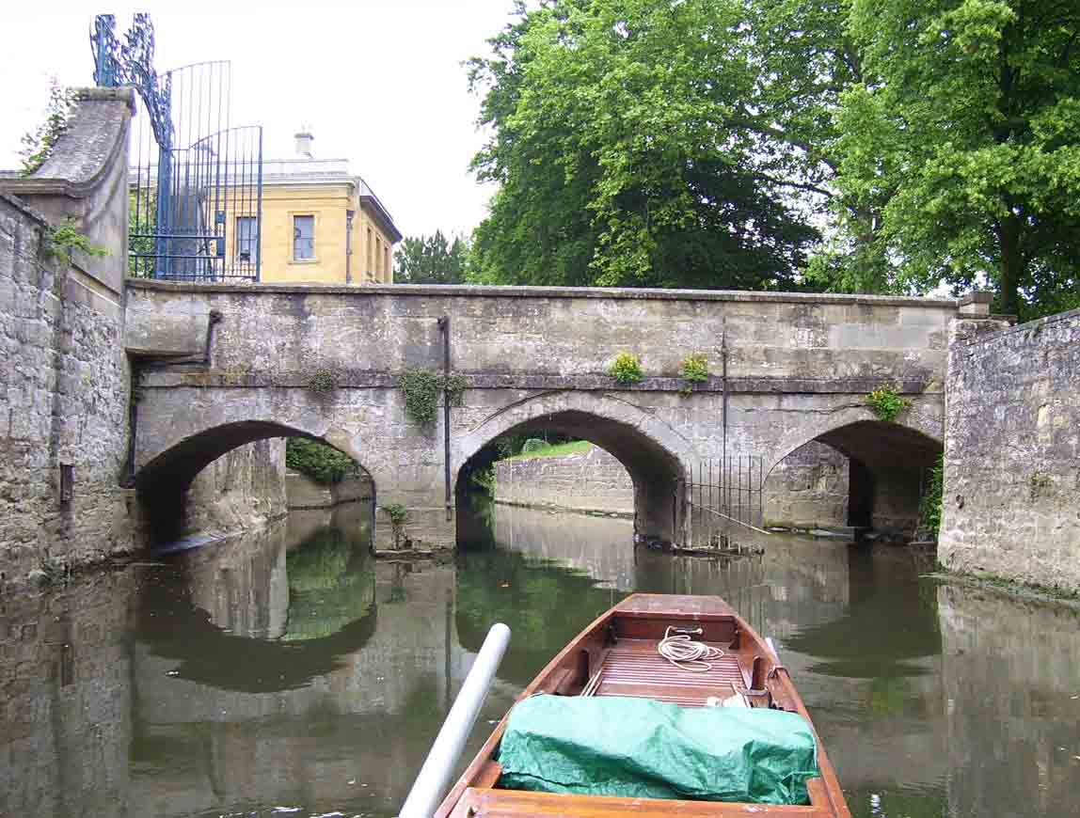
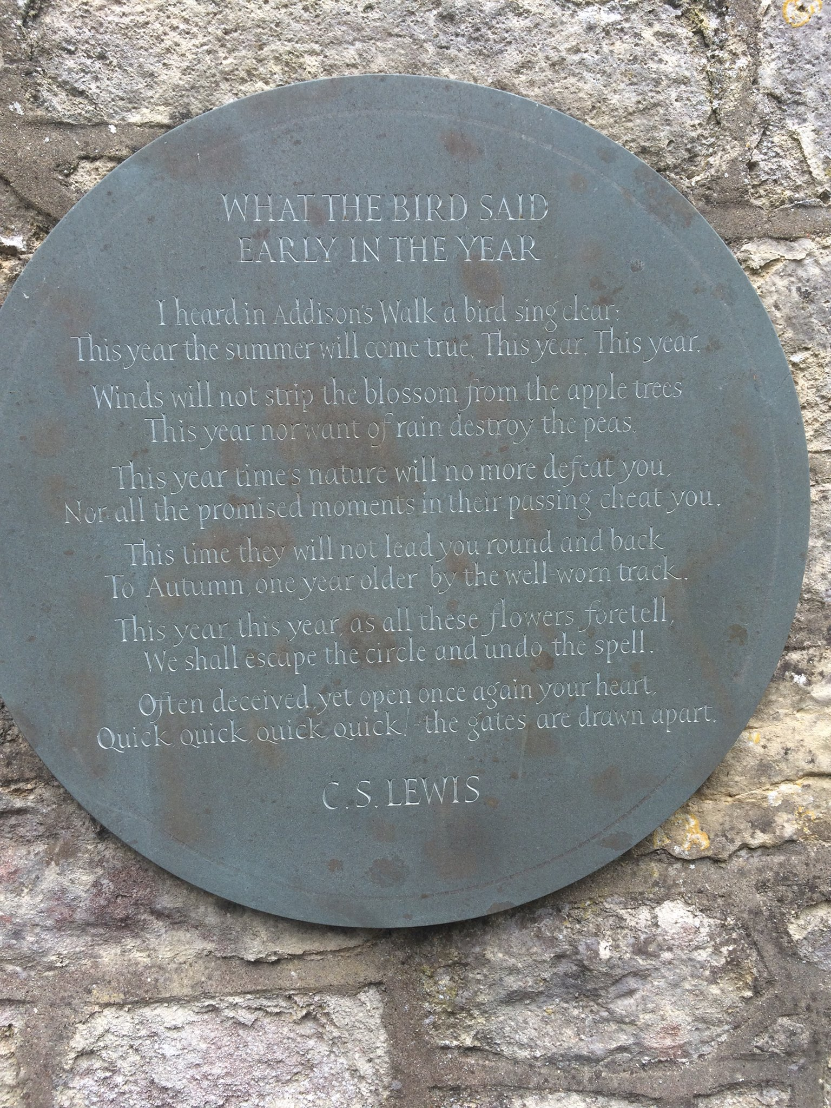
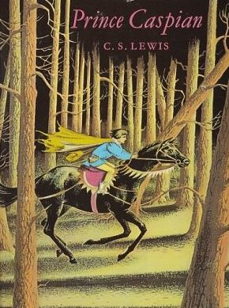
DEEPER DIVE: Addison’s Walk, Mythopoeia, and the Coming Together of Truth, Beauty, and Goodness “How deep I am just now beginning to see: for I have just passed on from believing in God to definitely believing in Christ – in Christianity… My long night talk with Dyson and Tolkien had a good deal to do with it. What Dyson and Tolkien showed me was that if I met the idea of sacrifice in a Pagan story I didn’t mind it at all: again, that if I met the idea of a god sacrificing himself to himself I liked it very much and was mysteriously moved by it: again that the idea of the dying and reviving god similarly moved me provided I met it anywhere except the Gospels. “The reason was that in Pagan stories I was prepared to feel the myth as profound and suggestive of meanings beyond my grasp even tho’ I could not say in cold prose ‘what it meant’. Now the story of Christ is simply a true myth: a myth working on us in the same way as the others, but with this tremendous difference that it really happened: and one must be content to accept it in the same way, remembering that it is God’s myth where the others are men’s myths. (Lewis letter, October 18, 1931)

Slide 22
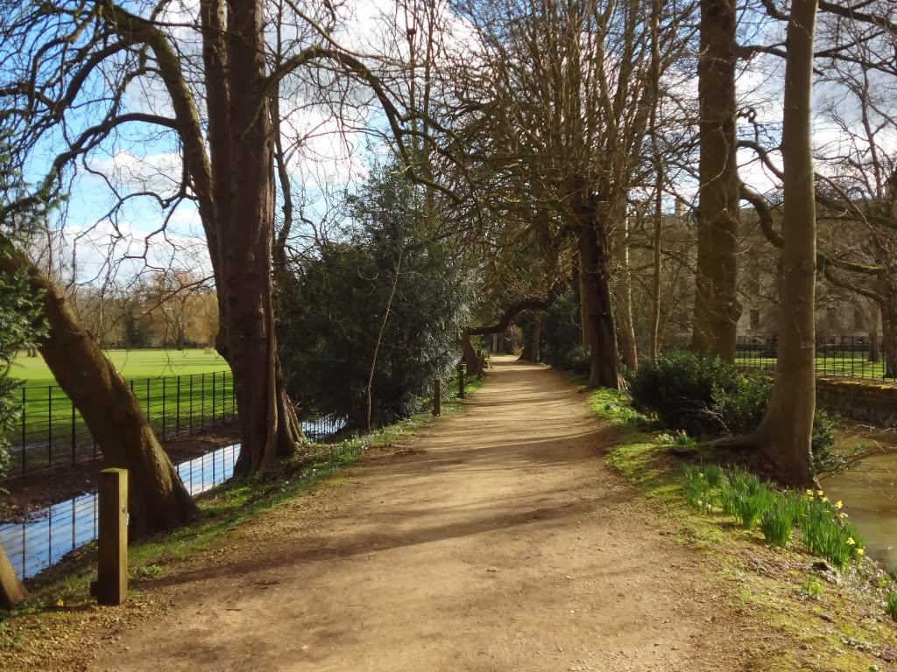
Remembering the Golden Age of freedom and happiness can help inspire a return to Truth.
“I have often despaired; but something always happens to start me hoping again. I don't know. But at least you can try to be a King like the High King Peter of old, and not like your uncle." "Then it's true about the Kings and Queens too, and about the White Witch?" said Caspian. "Certainly it is true," said Cornelius. "Their reign was the Golden Age in Narnia and the land has never forgotten them…But never in all these years have we forgotten our own people and all the other happy creatures of Narnia, and the long-lost days of freedom.”
For the creation waits with eager longing for the revealing of the sons of God. For the creation was subjected to futility, not willingly, but because of him who subjected it, in hope that the creation itself will be set free from its bondage to corruption and obtain the freedom of the glory of the children of God. Romans 8:19 Was it not you who dried up the sea, the waters of the great deep, who made a road in the depths of the sea so that the redeemed might cross over? Those the Lord has rescued will return. They will enter Zion with singing; everlasting joy will crown their heads. Gladness and joy will overtake them, and sorrow and sighing will flee away. Isaiah 51:10-11 When the Lord restored the fortunes of Zion, we were like those who dream. Then our mouth was filled with laughter, and our tongue with shouts of joy; then they said among the nations, “The Lord has done great things for them.” The Lord has done great things for us; we are glad. Ps. 126:1-3 For this is the covenant that I will make with the house of Israel after those days, declares the Lord: I will put my law within them, and I will write it on their hearts. And I will be their God, and they shall be my people. And no longer shall each one teach his neighbor and each his brother, saying, ‘Know the Lord,’ for they shall all know me, from the least of them to the greatest, declares the Lord. For I will forgive their iniquity, and I will remember their sin no more.” Jer. 31:33-34

Slide 23
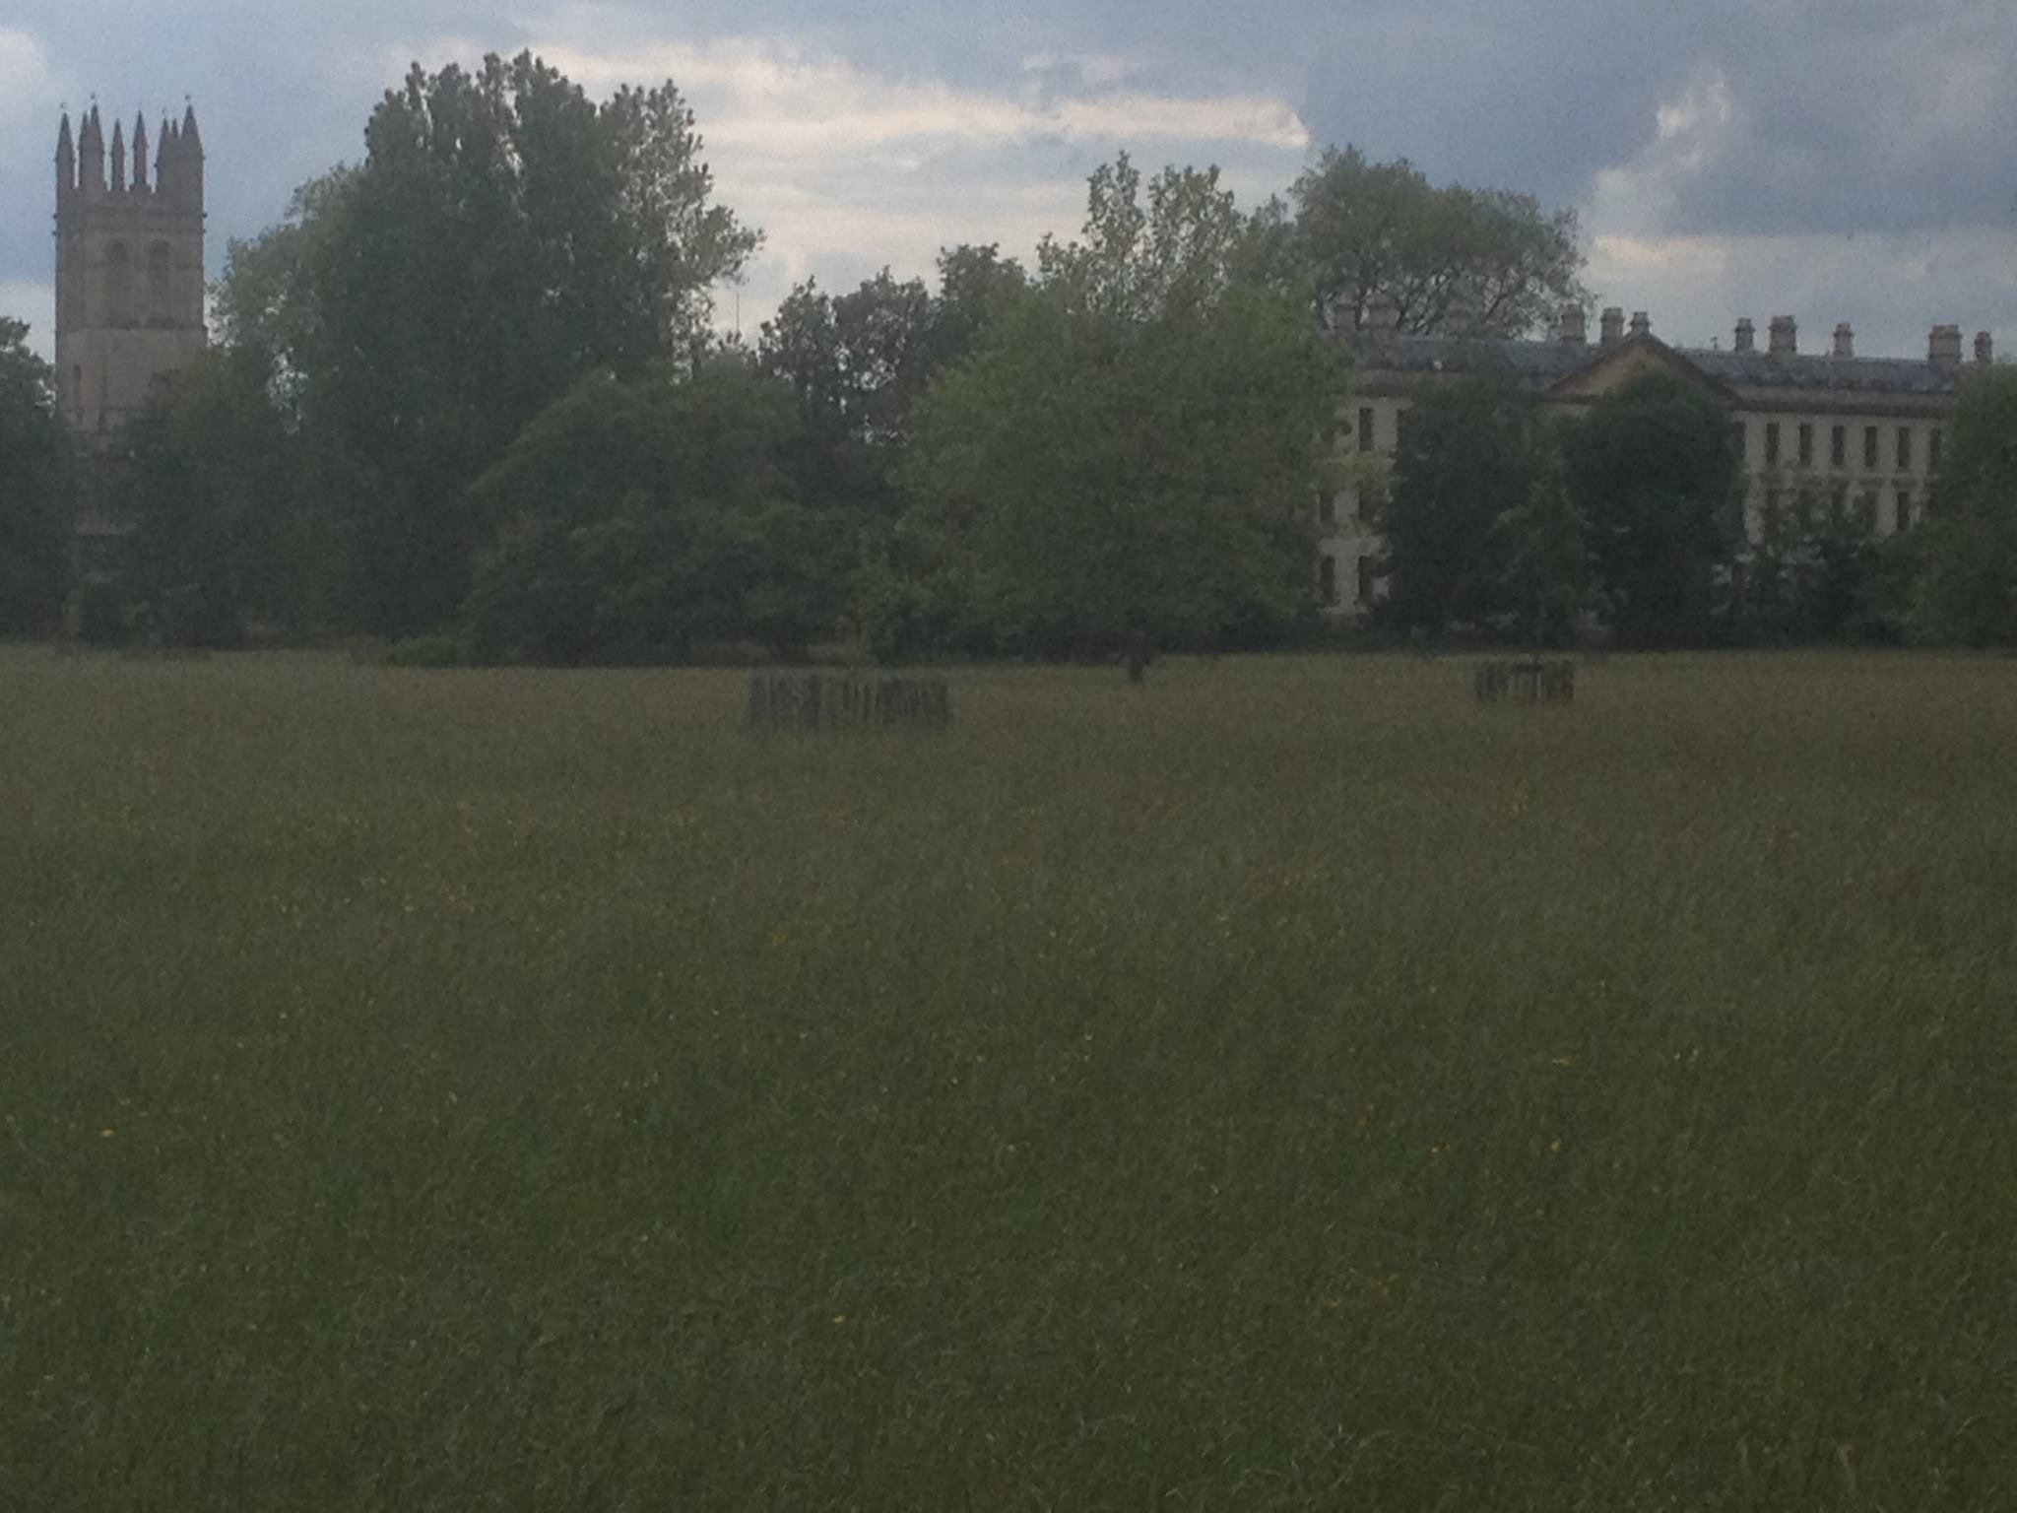

Slide 24
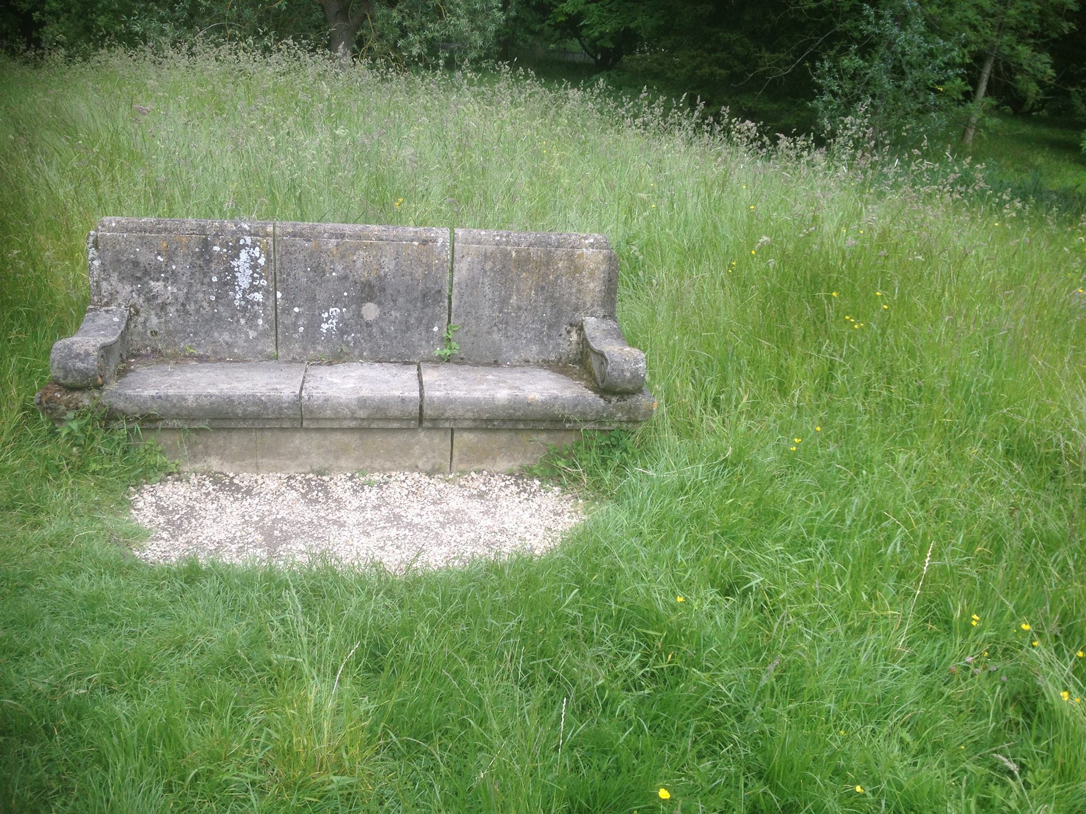

Slide 25
TOLKIEN AND DYSON: Addison’s Walk, Mythopoeia, and the Coming Together of Truth, Beauty, and Goodness “How deep [a change] I am just now beginning to see: for I have just passed on from believing in God to definitely believing in Christ – in Christianity… My long night talk with Dyson and Tolkien had a good deal to do with it. What Dyson and Tolkien showed me was that if I met the idea of sacrifice in a Pagan story I didn’t mind it at all: again, that if I met the idea of a god sacrificing himself to himself I liked it very much and was mysteriously moved by it: again that the idea of the dying and reviving god similarly moved me provided I met it anywhere except the Gospels. “The reason was that in Pagan stories I was prepared to feel the myth as profound and suggestive of meanings beyond my grasp even tho’ I could not say in cold prose ‘what it meant’. Now the story of Christ is simply a true myth: a myth working on us in the same way as the others, but with this tremendous difference that it really happened: and one must be content to accept it in the same way, remembering that it is God’s myth where the others are men’s myths. (Lewis letter, October 18, 1931) “Mythpoeia”– poem written by Tolkien for Lewis in 1931 about their conversation on Addison’s Walk that led to Lewis’s conversion. The dedication reads To one who said that myths were lies and therefore worthless, even though 'breathed through silver--Philomythus to Misomythus

Slide 26
Excerpt
He sees no stars who does not see them first of living silver made that sudden burst to flame like flowers beneath an ancient song, whose very echo after-music long has since pursued. There is no firmament, only a void, unless a jeweled tent myth-woven and elf-patterned; and no earth, unless the mother's womb whence all have birth.
The heart of Man is not compound of lies, but draws some wisdom from the only Wise, and still recalls him. Though now long estranged, Man is not wholly lost nor wholly changed. Dis-graced he may be, yet is not dethroned, and keeps the rags of lordship once he owned, his world-dominion by creative act: not his to worship the great Artefact,
Man, Sub-creator, the refracted light through whom is splintered from a single White to many hues, and endlessly combined in living shapes that move from mind to mind. Though all the crannies of the world we filled with Elves and Goblins, though we dared to build
Gods and their houses out of dark and light, and sowed the seed of dragons, 'twas our right (used or misused). The right has not decayed. We make still by the law in which we're made.
Yes! ‘wish-fulfilment dreams' we spin to cheat our timid hearts and ugly Fact defeat! Whence came the wish, and whence the power to dream, or some things fair and others ugly deem? All wishes are not idle, nor in vain fulfilment we devise -- for pain is pain, not for itself to be desired, but ill; or else to strive or to subdue the will alike were graceless; and of Evil this alone is deadly certain: Evil is.
Blessed are the timid hearts that evil hate that quail in its shadow, and yet shut the gate; that seek no parley, and in guarded room, though small and bare, upon a clumsy loom weave tissues gilded by the far-off day hoped and believed in under Shadow's sway.
Blessed are the men of Noah's race that build their little arks, though frail and poorly filled, and steer through winds contrary towards a wraith, a rumour of a harbour guessed by faith.

Slide 27
He sees no stars who does not see them first \
Blessed are the legend-makers with their rhyme of things not found within recorded time. It is not they that have forgot the Night, or bid us flee to organized delight, in lotus-isles of economic bliss forswearing souls to gain a Circe-kiss (and counterfeit at that, machine-produced, bogus seduction of the twice-seduced).
Such isles they saw afar, and ones more fair, and those that hear them yet may yet beware. They have seen Death and ultimate defeat, and yet they would not in despair retreat, but oft to victory have tuned the lyre and kindled hearts with legendary fire, illuminating Now and dark Hath-been with light of suns as yet by no man seen.
I would that I might with the minstrels sing and stir the unseen with a throbbing string. I would be with the mariners of the deep that cut their slender planks on mountains steep and voyage upon a vague and wandering quest, for some have passed beyond the fabled West.
I would with the beleaguered fools be told, that keep an inner fastness where their gold, impure and scanty, yet they loyally bring to mint in image blurred of distant king, or in fantastic banners weave the sheen heraldic emblems of a lord unseen.

Slide 28
Saved FROM something FOR something: Lewis after his conversion and the process of forging of the Inklings As Christians, Tolkien’s and Lewis’s reaction to the horrors of the Battle of the Somme and WWI was to hold onto the possibility of Truth, Goodness, and Beauty amidst them — goodness and greatness. “As authors they sought to recover the romantic and mythic traditions based on the struggle between good and evil, but… their mythic imagination only partly accounts for their influence. . . . It is their moral imagination that exerts a unique power: the proposition that every person is caught up in an epic contest between Light and Darkness. In the worlds of Tolkien and Lewis, the choices of the weak matter as much as those of the mighty. Here we are not left as orphans, for a force of Goodness stands ready to help. And that force of Goodness, ultimately, is God.”—Loconte Post-conversion priorities in the 1920s—conversion changes EVERYTHING: Investing deeply in growing in Christian faith Seeking earnestly after Truth and Beauty Pursuing life and using gifts with serious deliberation Investing in relationship and searching for Fellowship Lewis’s secretary Walter Hooper called Lewis “the most thoroughly converted man I have ever met.”

Slide 29
The Matrix of Friendship: Choices and habits that tilled the soil for the flowering of the Inklings Walking In these walks, the talk was deliberately NOT small talk, but talk of reading, philosophical ideas, and the life of the soul, as well as an appreciation of the beauty they were beholding. Reading The Inklings’ sense of stewardship in the area of intellect created a faith-based obligation to seek after Truth, and to challenge with their best intellectual acumen ideas and writing which they believed to be error. Their voracious reading provided ample fodder to sharpen one another, to hone their understanding of Christian thought, and to consider what it means not only to “…take every thought captive” but also to love God with your mind. Talking It is especially remarkable that the conversation was not about oneself, one’s peers in or outside the group, politics, gossip, but primarily about books, ideas, Christian faith, religion, Truth/Beauty/Goodness, humor, and writing. Much of the conversation seems to have revolved around sharing enthusiasms, asking questions, sharing works in progress, and seeking knowledge/wisdom. Shared passion/shared cause Seeking out those individuals who shared their passions (not mere preferences or tastes, but rather doorways to one of the Transcendentals [Truth, Beauty, and Goodness]), their attitude was of two friends side by side beholding with wonder a treasure that stood before them. WEEKLY Individual, one on one, and group time The Inklings achieved a striking balance in the use of their discretionary time that provided a fertile field for the flowering of the group, all the more remarkable because this time was deliberately carved out in the midst of extremely busy and pressured schedules with multiple competing priorities.

Slide 30
The Inklings Begin: A Group of Christians Who Would Change the World Lewis and Tolkien and their bond of friendship were the nucleus of the Inklings, but other early members were important as well. After Lewis’s conversion in 1931, a group coalesced around them and took the name “the Inklings” from an undergraduate club that had ceased to meet. Lewis described the group as follows in a letter: “We have a sort of informal club called the Inklings: the qualifications (as they have informally evolved) are a tendency to write and Christianity." Major Warren “Warnie” Lewis served as the maitre d’ for meetings in Lewis’s rooms, taking coats, serving tea and drinks. Lewis’s old friends from his college days, Owen Barfield and Nevill Coghill, were key members, as was Tolkien’s friend Hugo Dyson, and the Magdalen College Dean of Divinity, Rev’d Adam Fox (an expert on Plato and a published poet). Tolkien’s friend C.L. (Charles) Wrenn, tutor in Anglo-Saxon at Oxford, was an early member of the group, as well as Dr. Robert “Humphrey” Havard, Lewis’s physician and an expert on Aquinas and medieval philosophy. Meetings were held in Lewis’s rooms on Thursday evenings and at the Eagle and Child pub (the “Bird and Baby”) on Tuesday mornings. Building upon a deep Christian faith and a recovery of the transcendentals of Truth, Goodness, and Beauty, the Inklings were unafraid to boldly engage the culture and mounted a counter-cultural offensive about how to live and think Christianly in a post-Christian world. They were deeply invested in recovering a Biblical understanding of fellowship and the power of community.
,

Slide 31
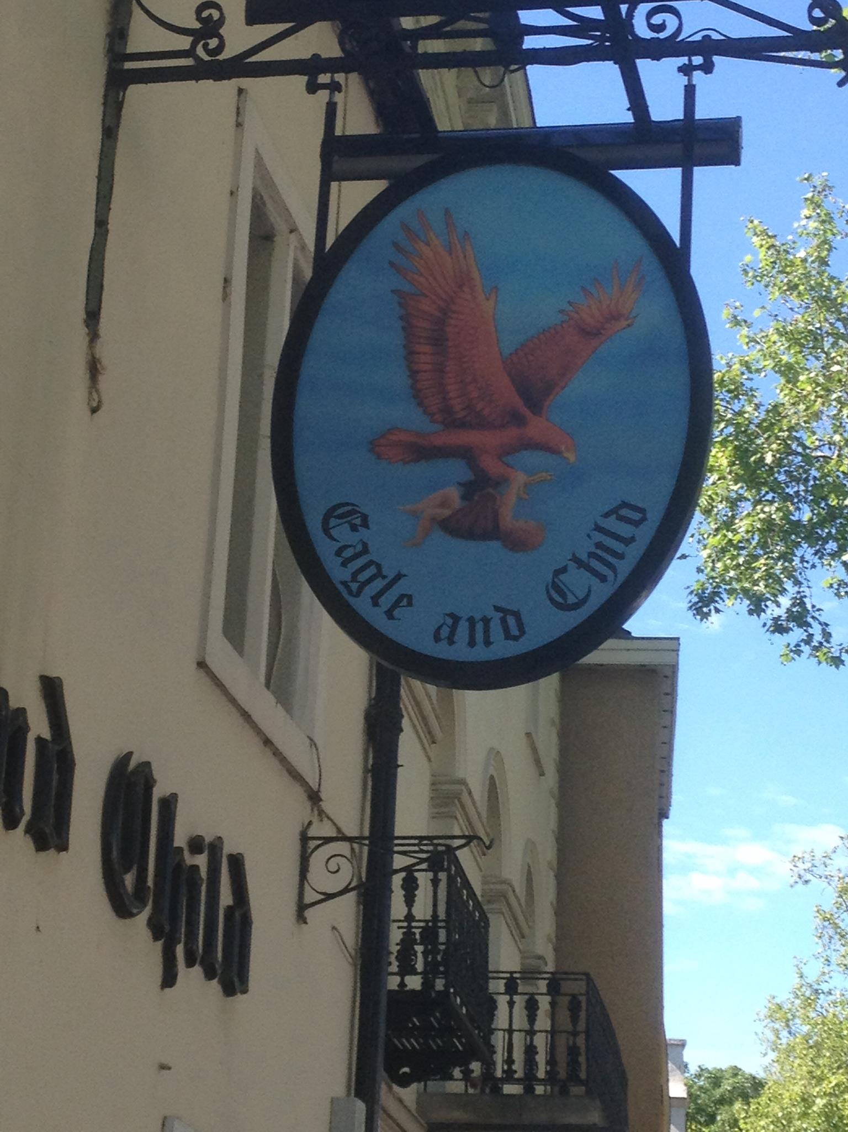
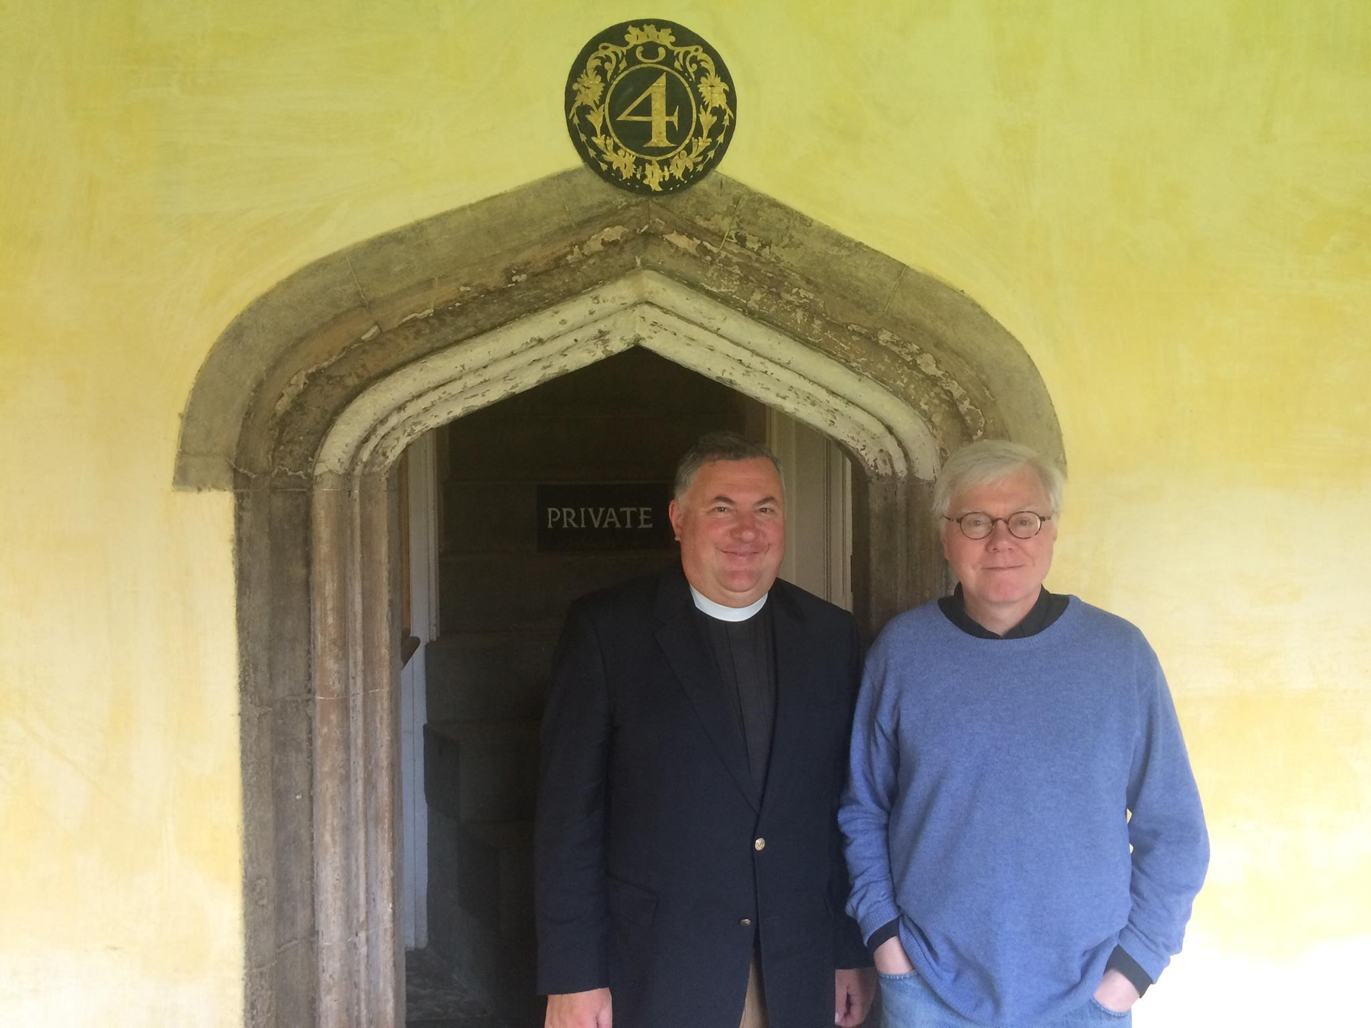
,
The Rev’d Dr. Michael Piret
Emeritus Dean of Divinity
Magdalen College, Oxford

Slide 32
TO PONDER: The Impact of the Inklings and the Christian Friendship of Lewis and Tolkien --Both Lewis and Tolkien said that without the other they would not have written The Chronicles of Narnia or The Lord of the Rings --Beowulf and Paradise Lost and the English syllabus --All of Lewis’s works of fiction and apologetics --What if Barfield, Tolkien, and Dyson had been too afraid/intimidated to share their faith with Lewis? --In what ways might you be called to be salt and light in this culture as you seek to follow Jesus and live out your faith? --Consider the role of friendship in your life and what kind of friend you are: what can you learn from the example of Lewis and Tolkien and the Inklings? --What might you be able to apply from the matrix of friendship that characterized the Inklings that would help you be more Christ-like in this area? --Where might God be calling you to be a sub-creator and to make an impact through using your gifts? --What role do Truth, Goodness, and Beauty play in your life and your understanding of following Christ and drawing others to Him?

Slide 33
“For a Christian, there are, strictly speaking, no chances. A secret Master of the Ceremonies has been at work. Christ, who said to the disciples "Ye have not chosen me, but I have chosen you," can truly say to every group of Christian friends "You have not chosen one another but I have chosen you for one another." The Friendship is not a reward for our discrimination and good taste in finding one another out. It is the instrument by which God reveals to each the beauties of all the others. They are no greater than the beauties of a thousand other men; by Friendship God opens our eyes to them. They are, like all beauties, derived from Him through the Friendship itself, so that it is His instrument for creating as well as for revealing. At this feast it is He who has spread the board and it is He who has chosen the guests. It is He, we may dare to hope, who sometimes does, and always should, preside. Let us not reckon without our Host.” —C.S. Lewis, The Four Loves
,

Slide 34
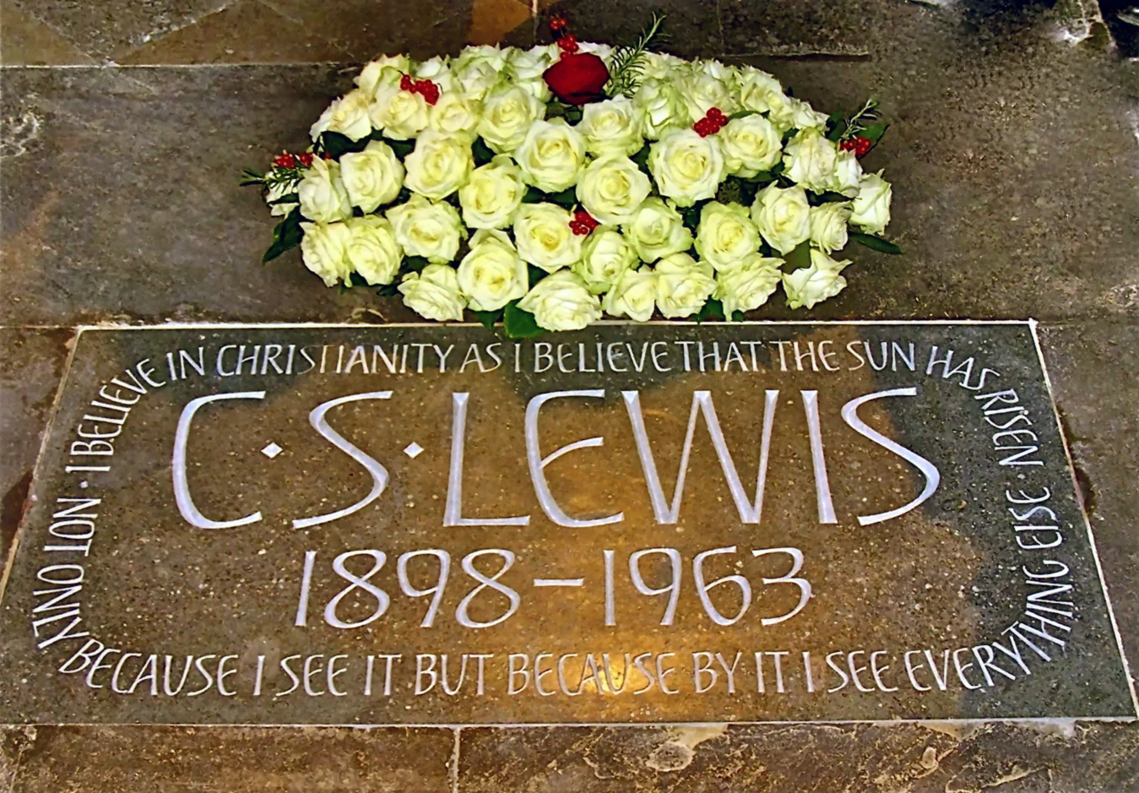
“I believe in Christianity as I believe that the Sun has risen, not only because I see it but because by it, I see everything else.” --from Lewis’s essay Is theology poetry?

