Slide 1
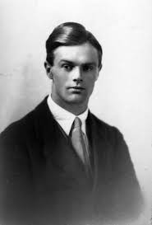
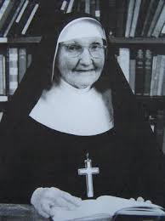
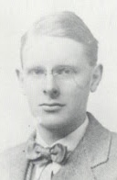
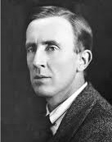
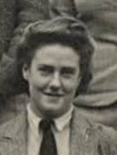
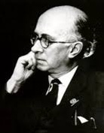
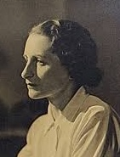
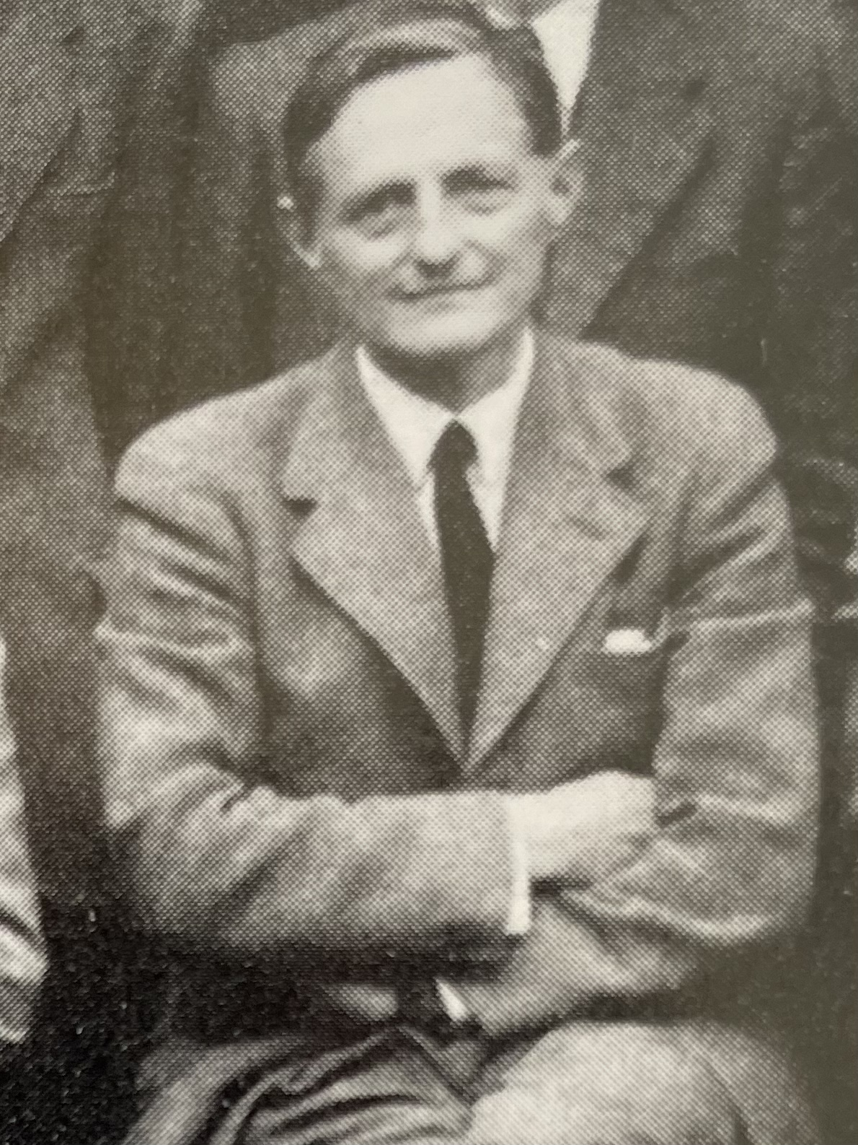
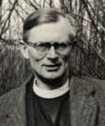
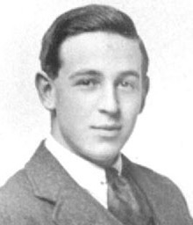
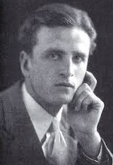

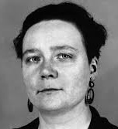
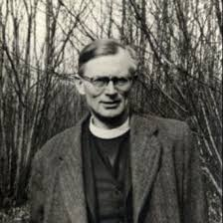
DEEPER DIVE:
C.S. Lewis and His Friends
Four Remarkable Women:
Sister Penelope, Stella Aldwinckle, Ruth Pitter, and Dorothy Sayers
St. Philip’s Church The Rev’d Brian K. McGreevy April 22, 2026

Slide 2
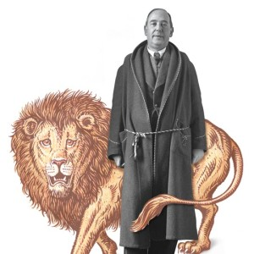
DEEPER DIVE
C.S. Lewis and His Friends:
Four Remarkable Women
Sister Penelope, Stella Aldwinckle, Ruth Pitter, and Dorothy Sayers
The Rev’d Brian K. McGreevy, J.D., Presenter

Slide 3
And let us consider how to stir up one another to love and good works, not neglecting to meet together, as is the habit of some, but encouraging one another, and all the more as you see the Day drawing near.
Hebrews 10:24-25

Slide 4
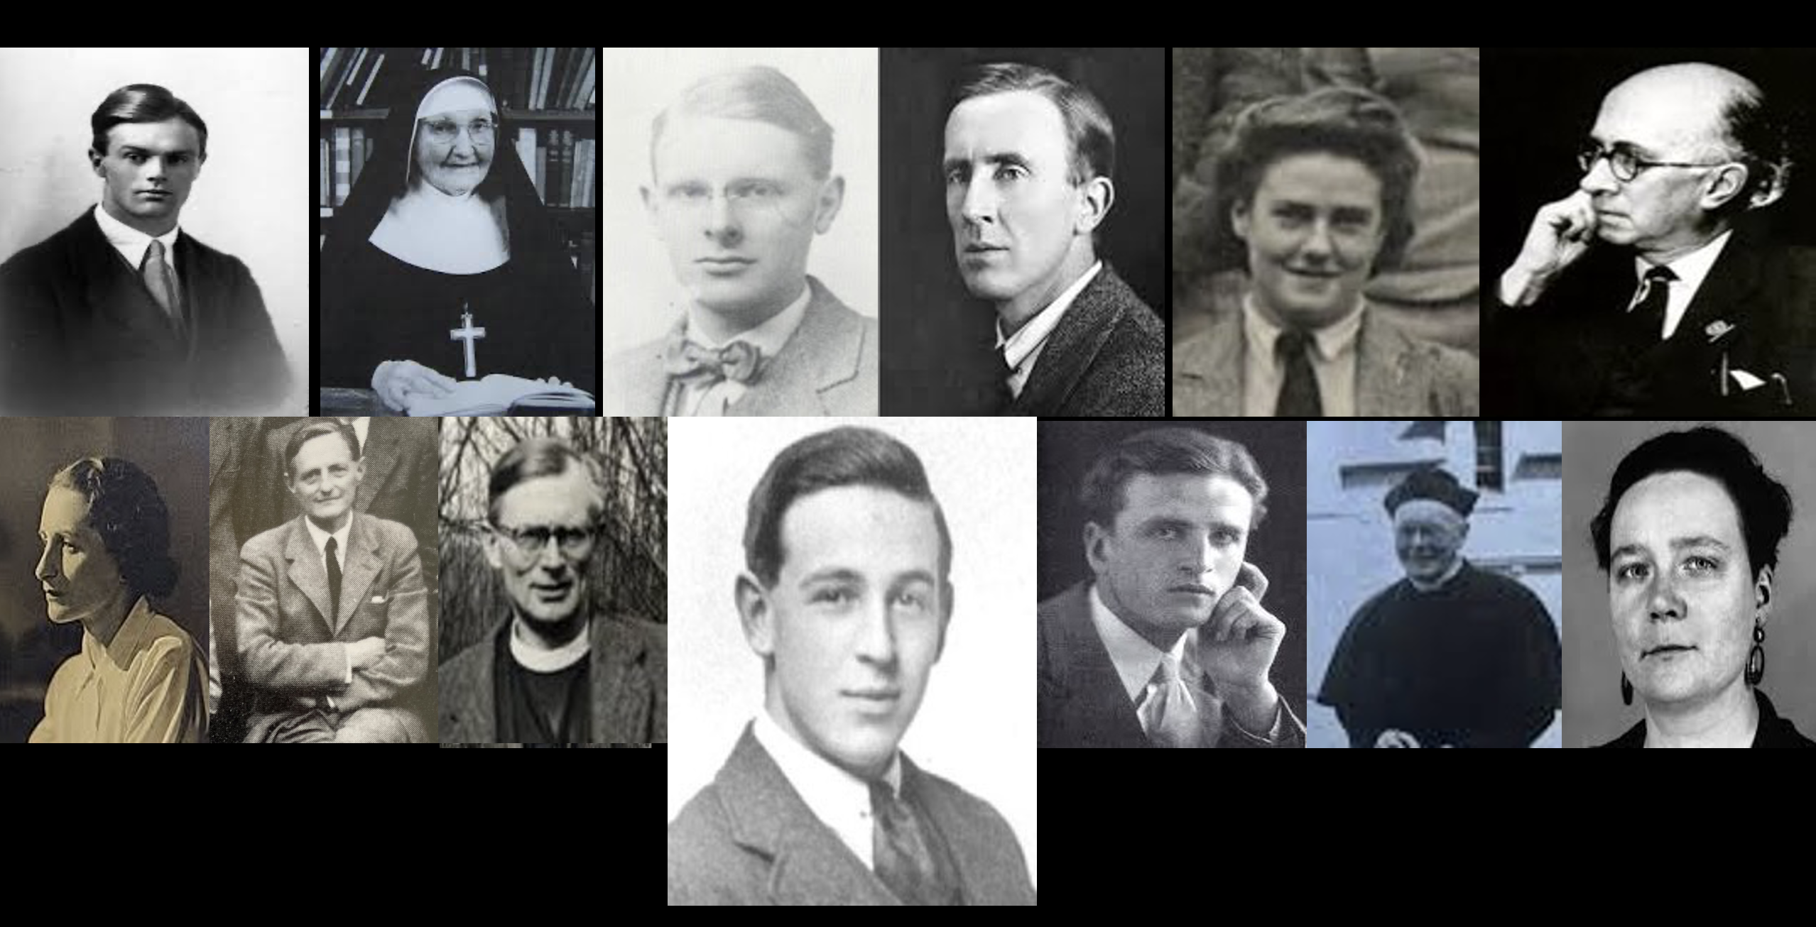
Introduction to Deeper Dive: C.S. Lewis and His Friends
A closer look at Lewis’s theology and practice of friendship, and the role of friendship and its influence in Lewis’s life in certain key areas.
Among the friends we will mention are men, women, students, priests, scholars—a wide variety!
Pictured here (left to right) are
Owen Barfield
Sister Penelope
Arthur Greeves
J.R.R. Tolkien
Stella Aldwinckle
Roger Lancelyn Green
Bottom row (left to right)
Ruth Pitter
Hugo Dyson
Austin Farrer
(Lewis)
Dom Bede Griffiths
Father Walter Adams
Dorothy Sayers
Tonight! EPISODE 2: FOUR REMARKABLE WOMEN: Sister Penelope, Stella Aldwinckle, Ruth Pitter, and Dorothy Sayers

Slide 5
Sister Penelope Lawson, CSMV (1890-1977)
Sister Penelope was an Anglican nun who was part of the Community of St. Mary the Virgin near Oxford at Wantage. A brilliant woman, she had studied German and Theology at Oxford at Keble College and was the daughter of an Anglican priest. Her first contact with C.S. Lewis was when she wrote to him in 1939 after reading his book Out of the Silent Planet (1938): “Your book has given and still gives me a joy and delight quite impossible to put into words…At ordinary times we [nuns] do not read novels at all, as you may imagine, but the right novel at the right moment can have a real spiritual value. So I got yours, and never has any made me so happy.” She also included a copy of her recent book, God Persists. Lewis wrote her back with thanks and noted that only two reviewers out of 60 had picked up any theological element in the book, and then stated (in a quotation that would become famous) “I believe this ignorance might be a help to the evangelization of England; any amount of theology can now be smuggled into people’s minds under cover of romance [fiction] without their knowing it.” From this beginning developed a deep friendship and correspondence that lasted 24 years until Lewis’s death in 1963.

Slide 6
Their rich correspondence was scholarly and academic, but also warm and devotional, exchanging ideas and book recommendations, including copies of the books and articles each of them wrote. Lewis encouraged her work on a new translation of Athanasius’s important treatise De
Incarnatione, which she dedicated to him and for which he wrote the famous preface separately titled “On the Reading of Old Books.” Their wide-ranging correspondence makes fascinating reading. They met on a number of occasions when Lewis would go to visit at Wantage and where he also gave talks to the nuns. A measure of the closeness that grew quickly between them was that in 1941 “…Lewis entrusted to Sister Penelope the original manuscript of The Screwtape Letters, because he had some apprehension that the only other manuscript copy might come to harm in the German bombings. “I enclose the MS. of Screwtape. If it is not a trouble I shd. like you to keep it safe until the book is printed (in case the one the publisher has got blitzed) – after that it can be made into spills or used to stuff dolls or anything…” Sister Penelope still had the Screwtape manuscript in the 1950s, and inquired what Lewis wanted her to do with it. Lewis cared little for it, and indicated that he would simply dispose of it straightaway if she returned it to him – most of his scribbles ended up in the w.p.b. (waste paper basket) anyway. Lewis finally told her, “If you can persuade any ‘sucker’ (as the Americans say) to buy the ms. of Screwtape, pray do, and use the money for any pious or charitable object you like.”
She eventually – though reluctantly – arranged for its sale to the Berg Collection at the New York Public Library, and so preserved the only surviving full-length original Lewis book manuscript. The funds from the sale went to refurbish St. Michael’s Chapel at the convent.”—from “Why Read Old Books” at cslewis.com

Slide 7
In 1941, Sister Penelope sent Lewis a photo of the Shroud of Turin, which he had framed and which hung in his bedroom for the rest of his life. Lewis wrote her, “Thank you so much for the head of Our Lord from the Shroud. It has grown upon me wonderfully. I don’t commit myself to the genuineness. One can never be quite certain. But the great value is to make one realise that He was a man, and once even a dead man. There is so much difference between a doctrine and a realization.”
Lewis dedicated his 1943 book Perelandra, the second of the Ransom trilogy, to Sister Penelope and her community, specifically “To Some Ladies at Wantage.” He and Sister Penelope were highly amused when the Portuguese translation of the dedication came out saying “To Some Wanton Ladies.” Another example of her delightful sense of humor was a story from her childhood she recounted of hearing a missionary speaking on the evils of alcohol, who passionately proclaimed, “Bring up your son to hate the bottle, and when he is a grown man he will never depart from it!”
Lewis regarded Sister Penelope as his intellectual and spiritual elder sister in the faith. Fluent in Greek and Latin, she could discuss with him fine points of manuscripts but also deep personal things. Lewis leaned on her through his correspondence when his wife, Joy, was dying of cancer, and she was the first to recognize that A Grief Observed, which Lewis had written under a pseudonym, was in fact authored by him. Their correspondence over the decades is warm and spiritual and scholarly all at the same time, and a fascinating window into both of their lives showing the deep and mutually influential friendship that had grown between them.

Slide 8
Stella Aldwinckle (1907-1989/Oxford Pastorate Women’s Chaplain 1941- 66)
Born in South Africa to a devout Anglican family, Stella Aldwinckle returned to England in her late teens. She was seeking a way to serve the
Lord in ministry and hoped to study at Oxford. She took correspondence courses in Greek to improve her chances for passing the admissions test and was thrilled to be accepted as a student at St. Anne’s College, Oxford, where she studied theology with Austin Farrer as one of her tutors. Following graduation and a stint teaching, she felt called to pastoral ministry and returned to Oxford and joined the Oxford Pastorate, a team attached to St Aldate’s Church whose ministry was to reach out to and encourage and counsel under-graduates about living into the Christian faith. “One afternoon towards the end of 1941 during a tea party at the St. Aldate’s Rectory for newly matriculated freshmen at Oxford University, Monica Shorten, a student at Somerville College (one of the five women's colleges in Oxford), complained to Aldwinckle that no one seemed ready to seriously discuss the deeper questions raised by agnostics and atheists. "The sermons and the religious clubs just take the real difficulties as solved—the existence of God, the divinity of Christ and so on." Miss Aldwinckle asked the young woman whether others who felt like her. "Yes, Plenty!" She replied. "Plenty of agnostics and atheists.” Having struggled herself with similar questions, Aldwinckle suggested that they set up a meeting in the college and that Miss Shorten bring these agnostics and atheists along to ask questions. A notice, described by Miss Ald "lurid" and full of "blobs of ink," went out on Somerville noticeboards, inviting "all atheists, agnostics, disillusioned about religion or think they are," to meet at the East Junior Commons Room to discuss the matter. Despite the ghastly notice, the meeting was well attended. "I went a few days later as a
Daniel to a den of lions," Miss Aldwinckle recalled, "expecting to be torn limb from limb."

Slide 9
But as it turned out the entire affair proved quite civil. Many thoughtful questions were raised. Everyone was interested and wanted to know if they could meet again and bring boyfriends. It was agreed that they would, and at the next meeting it was standing room only. People squeezed together and floods of good questions again poured forth. It was decided that what was needed was an open forum for discussion of the intellectual difficulties connected with religion in general and with Christianity in particular. The next order of business was to decide on a president. Obviously not just anyone would do. Miss Aldwinckle recognized that the success of the entire enterprise hung on this decision. She entertained the idea of Dorothy Sayers but decided against it because Sayers lived in London. However, Miss Aldwinckle had recently heard of a don at the University who was an outspoken Christian, but had been an atheist for many years. He taught English Language and Literature at Magdalen College. ‘This was our man,’ she thought, and immediately wrote Mr. C. S. Lewis whether he would honor them by becoming president. Lewis promptly responded. "Dear Miss Aldwinckle, This club is long overdue. Come to coffee on Tuesday evening in my rooms to discuss plans." By the beginning of the January of 1942, the University Socratic Club had been granted official approval and was up and running.” For thirteen years running, from 1942 to 1954, C. S. Lewis presided as the Club's president. Meetings were Monday evening during each of the three academic terms, and unless he was ill or had some other engagement he was unable to get out of, he was there. As a University Club, the Socratic was a phenomenon. Meetings were standing room only. During the years Lewis presided as president, the Socratic entertained some of the most influential atheists of the day, along with the weighty arguments they brought against Christianity. As the Socratic's point man, Lewis was often relied upon to represent the

Slide 10
Christian position and to argue its case against the opposition. Lewis accepted this role willingly. His one aim was to create and maintain an a tmosphere in which faith could thrive. To do this he used the Socratic arena as a means of challenging the prevailing intellectual prejudices against the Christian faith. —adapted from C.S. Lewis Institute, University Battles, 1/7/2010
Over the course of twenty-seven years 414 meetings were held, where 306 scholars and guest speakers either delivered or responded to a wide variety of topics. Lewis worked closely with Aldwinckle and the student leadership, as well as with his friends in the Inklings and the wider Christian world of Oxford, to set topics and speakers. Many of the sessions and debates literally became legends and are still talked about today. The friendship and partnership in the Gospel of Lewis and Aldwinckle gave Christianity a much higher profile in the University than had been the case before, and its influence is still felt today.

Slide 11
Ruth Pitter (1898-1992)
Born in Essex and taught to memorize English poetry from an early age, she could recite vast amounts of Wordsworth, Tennyson, Shakespeare, and other poets for the rest of her life. She was 5 when she wrote her first poem and her first poem was published at age 12. After regular publication in journals through her teens, her first volume of poetry was published when she was 22. She started a prosperous business painting furniture and decorative items that the outbreak of World War 2 closed down. She went to work in a factory to support the war effort and in 1941 her friend Lord David Cecil wrote that he had shared her poetry with his friend C.S. Lewis, and that Lewis was “deeply struck and went off to buy your poems.” In 1942 she read Lewis’s The Screwtape Letters and was enthralled by it. Feeling overwhelmed by the factory work and the despair of the war, she found a ray of hope in hearing Lewis’s broadcast talks (later published as Mere Christianity), began reading every other work of his she could find, and experienced a profound conversion to Christianity. She first met Lewis in 1946, and a close friendship between them developed. Her poetic output continued apace, winning various awards and culminating in being invited to Buckingham Palace as the first woman to receive the Queen’s Gold Medal for
Poetry, which she received from Queen Elizabeth II in 1955. Both Pitter and Lewis served as panelists on the popular BBC television Brains Trust show. Several of Lewis’s friends hoped that he and Pitter might marry.
Lewis and Pitter maintained a regular correspondence over decades and had a deep admiration for each other’s work. Lewis often constructively critiqued her work and made suggestions. More often he invited her critique of his poems and writing. Pitter is considered by many Lewis scholars to have had an effect on his writing in the 1940s and 1950s, his most productive period.

Slide 12
Pitter described her spiritual debt to C. S. Lewis:
Did I tell you I'd taken to Christianity? Yes, I went & got confirmed a year ago or more. I was driven to it by the pull of C. S. Lewis and the push of misery. Straight prayer book Anglican, nothing fancy [...] I realize what a tremendous thing it is to take on, but I can't imagine turning back. It cancels a great many of one's miseries at once, of course: but it brings great liabilities, too.
— Letter, Ruth Pitter to Nettle Palmer, dated 1 January 1948.
As to my faith, I owe it to C. S. Lewis. For much of my life I lived more or less as a Bohemian, but when the second war broke out, Lewis broadcast several times, and also published some little books (notably "The Screwtape Letters"), and I was fairly hooked. I came to know him personally, and he came here several times. Lewis's stories, so very entertaining but always about the war between good and evil, became a permanent part of my mental and spiritual equipment.
— Letter, Ruth Pitter to Andrew Nye, dated 18 May 1985.
Lewis for his part was a strong admirer of Pitter’s poetry. Having long wished to be a brilliant poet himself but not having achieved it, he was enormously impressed by Pitter’s work. He wrote to her after reading ”A Trophy of Arms”: You do it time after time—create a silence and vacancy and awe all around the poem. If the Lady in Comus had written poetry, one imagines it wd. have been rather like this….“Alleluia all my gashes cry” just takes one up into regions poetry hasn’t visited for nearly a hundred years….Why wasn’t I told you were as good as this?
One of the things they shared was the whole idea of longing or sehnsucht that so defined Lewis’s search for Joy that helped lead him to the Christian faith. Describing this longing in a program she did for the BBC, Pitter said:

Slide 13
“I was sitting in front of a cottage door one day in spring long ago, a few bushes and flowers round me, bird gathering nesting material, trees of the forest at a little distance. A poor place, nothing glamorous about it. And suddenly, everything assumed a different aspect, its true aspect. For a moment it seemed to me that truth appeared in its overwhelming splendor. The secret was out, the explanation given, something that had seemed like total freedom, total power, total bliss – good with no bad as its opposite, an absolute that had no opposite. This thing, so unlike our feeble nature, had suddenly cut across one’s life and vanished. What is this thing? Is it, could it be, after all, a hint of something more real than this life? A message from reality, perhaps a particle of reality itself? If so, no wonder we hunt it so unceasingly, and never stop desiring it and pining for it.”
Professor Don King, an expert on Lewis’s poetry and on Piiter, makes the argument that Lewis’s best poetry is in fact in his prose. Dr. King writes, “I found out that she [Pitter] had become so taken with the end of Lewis’s book Perelandra that she wrote him and asked if he minded if she turned the end of Perelandra into verse, so she would remember it. And he wrote her back and said something like, “I don’t know why you want to waste your poetry on my prose, but if that’s what you want to do, it’s fine with me.”
That was important for my book on Lewis’s poetry because the main argument I make in that book is that Lewis’s best poetry is in his prose.”
Lewis deeply appreciated his friendship with Pitter, her intellect, her poetic gifts, and her faith, and he was helped to be a stronger writer through the influence of this remarkable woman.

Slide 14
Dorothy L. Sayers (1893-1957)
Novelist, translator, theologian, and friend of Lewis, Sayers was born in
Oxford where her father, an Anglican priest and intellectual, was Headmaster of Christ Church Cathedral School. She was brilliant student and won a scholarship to Somerville College, Oxford, where she took a First in Modern
Languages and loved singing in the Bach Choir. After graduating she wrote poetry while working at Blackwell’s Bookshop with two of her volumes being published while she was in her early 20s. She then took a teaching post and began writing detective fiction with her famous detective character Lord Peter Wimsey first appearing in 1923. These novels became hugely successful and she became famous while in her 30s. In the 1930s she began writing theological works as well, including a play for the Canterbury Festival (following T.S. Eliot and Charles Williams) and a brilliant BBC radio drama The Man Born to Be King broadcast in 1941 and 1942 and shepherded by the Rev. James Welch at the BBC, who was also shepherding Lewis’s Broadcast Talks (later Mere Christianity). She and Lewis were invited to contribute books for a series on creativity and theology which inaugurated their correspondence. Sayers loved The Screwtape Letters, and a deeply intellectual and warm friendship sprang up between them at once. They would correspond and meet for the rest of Sayers life. Their correspondence is full of scin-tillating writing and is often hilariously funny. They often gave one another advice and feedback on their writing, but always with a sense of humor. Lewis often called Sayers “Sister Dinosaur” or
“Fellow Dinosaur” because of their shared anti-modern, classical worldview, and they joked about starting a Dinosaurs’ Club. Sayers had also become friends with Inkling Charles Williams, and his work on Dante inspired Sayers to read The Divine Comedy, about which she became passionate, ultimately publishing her own translation in 1949.

Slide 15
“It was Dante's great Comedy, however, which Lewis found to be "the highest point that poetry has ever reached," that plunged Lewis into full-blown infatuation with the Ptolemaic universe. In a 1930 letter to his friend Arthur
Greeves, Lewis described the Paradiso as "like the stars—endless mathematical subtility of orb, cycle, epicycle and ecliptic, unthinkable & unpicturable, & yet at the same time the freedom and liquidity of empty space and the triumphant certainty of movement." The whole poem felt important to him;
"its blend of complexity and beauty is very like Catholic theology—wheel within wheel, but wheels of glory, and the One radiated through the Many.” The passion of Lewis and Sayers for this same work formed a close bond.
“For Sayers, it was Dante's striking and forceful rendering of humanity's moral condition that made her blood rise and her pen flow over. The brilliant Sayers was an accomplished novelist, translator, and literary critic, who had been among the first class of women students at Oxford to receive their Masters' degrees. Her area of scholarly specialty was "modern languages"—to be precise, medieval French. When she first encountered Dante, she had already translated key texts in that area. Then she read Williams's Figure of Beatrice and the Comedia itself (which she started in a London bomb shelter as German rockets screamed down over the city) and was stirred deeply. Sayers loved Dante's story-telling skill, the earthiness and vividness of his spirituality, and his masterful use of the fine details of everything from astronomy to Thomist theology in constructing his poem. And so she made the translation of Dante her last great life-work. But for her, Dante's value went beyond his literary mastery. His moral worldview presented an antidote to modern malaises: She saw wartime Europe descending into passivity, blame-shifting, and an alarming susceptibility to propaganda. And there stood the Comedia, towering over world literature as "the drama of the soul's choice"—a gripping, multi-layered narrative poem whose very theme is moral responsibility. For Sayers, the Comedia was a "tract for our times.”—adapted from Chris Armstrong, Christian History, March 2010

Slide 16
Many Lewis scholars have suggested that Sayers was practically an Inkling and that but for the social customs of the time and place that would have precluded a woman from being part of such a club, she would have been invited to be part of the group. Sayers was friends with many individual Inklings and like them actively patrticipated in the Socratic Club. Scholar Diana Glyer quotes
Lewis’s step-son Douglas Gresham as saying “Dorothy Sayers and Jack (and my mother) were good friends, and one of the rare times I saw Jack deeply upset (other than his grief for my mother) was when he received the news that Dorothy had died.” She also notes that “when Lewis was asked in 1963 which Christian writers had helped him most, he named four G.K Chesterton, Edwyn Bevan, Rudolf Otto and Dorothy Sayers.” Clearly, Lewis and many of the other Inklings who knew her considered her to be their peer if not their superior in gifts and intellect. At the time of her death, Lewis wrote a glowing tribute to her, and closed it with these beautiful words:
For all she did and was, for delight and instruction, for her militant loyalty as a friend, for courage and honesty, for the richly feminine qualities which showed through a port and manner superficially masculine and even gleefully ogreish—let us thank the Author who invented her.—C.S. Lewis, “A Panegyric for Dorothy Sayers”, 1957

Slide 17
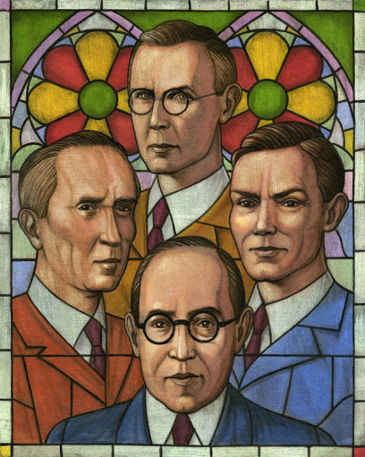
TO PONDER:
The Impact of the Christian Friendship of Lewis with Sister Penelope, Stella Aldwinckle, Ruth Pitter, and Dorothy Sayers
--The debt Lewis owed to each of them in improving his writing about faith
--The impact of the Socratic Club on generations of Oxford students and faculty
--What if these women had been intimidated by Lewis’s intellect and reputation and had failed to seek to initiate friendship with him?
--In what ways might you be called to be salt and light in this culture as you seek to follow Jesus and live out your faith?
--Consider the role of friendship in your life and what kind of friend you are: what can you learn from the example of Lewis and these women?
--Where might God be calling you to be a sub-creator and to make an impact through using your gifts?
--What role do Truth, Goodness, and Beauty play in your life and your understanding of following Christ and drawing others to Him?

Slide 18
“For a Christian, there are, strictly speaking, no chances. A secret Master of the Ceremonies has been at work. Christ, who said to the disciples "Ye have not chosen me, but I have chosen you," can truly say to every group of Christian friends "You have not chosen one another but I have chosen you for one another." The Friendship is not a reward for our discrimination and good taste in finding one another out. It is the instrument by which God reveals to each the beauties of all the others. They are no greater than the beauties of a thousand other men; by Friendship God opens our eyes to them. They are, like all beauties, derived from Him through the Friendship itself, so that it is His instrument for creating as well as for revealing. At this feast it is He who has spread the board and it is He who has chosen the guests. It is He, we may dare to hope, who sometimes does, and always should, preside. Let us not reckon without our Host.”
—C.S. Lewis, The Four Loves
,

Slide 19
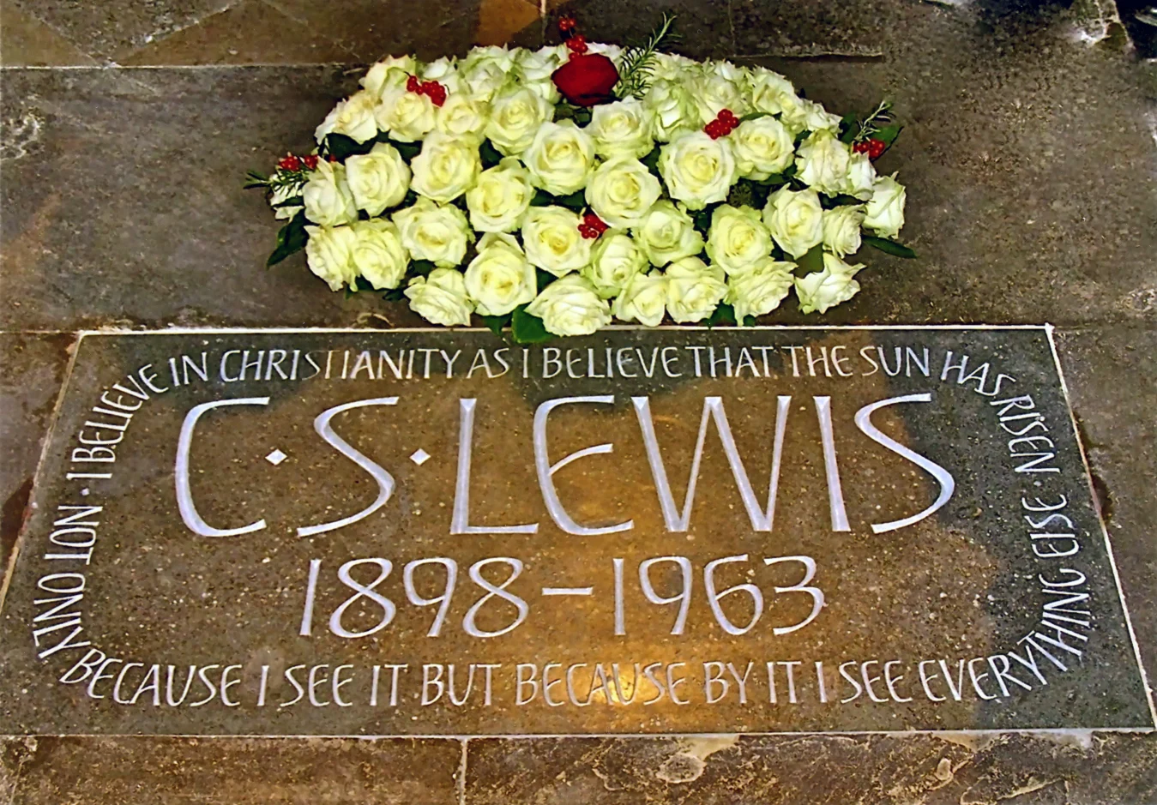
“I believe in Christianity as I believe that the Sun has risen, not only because I see it but because by it,
I see everything else.”
--from Lewis’s essay Is theology poetry?

