Slide 1




KINGDOM BUILDERS
ACADEMY
book of numbers
march 4, 2025
apostle lionel etwaru

Slide 2






“ WILDERNESS JOURNEY”
THE BOOK OF NUMBERS TELLS US THE STORY OF THE WILDERNESS JOURNEY.
THE HEBREW TITLE IS “ Bemidbar” “ In the Wilderness”
Named after the Two Censuses in ( Chaps.1, 26).
After the giving of the Law, the Lord commanded Moses to number the Army of Israel, which included all Males over 20 years.
The census was designed to reorganize Israel into a Military Camp in Preparation for the Conquest of the Promise Land.

Slide 3

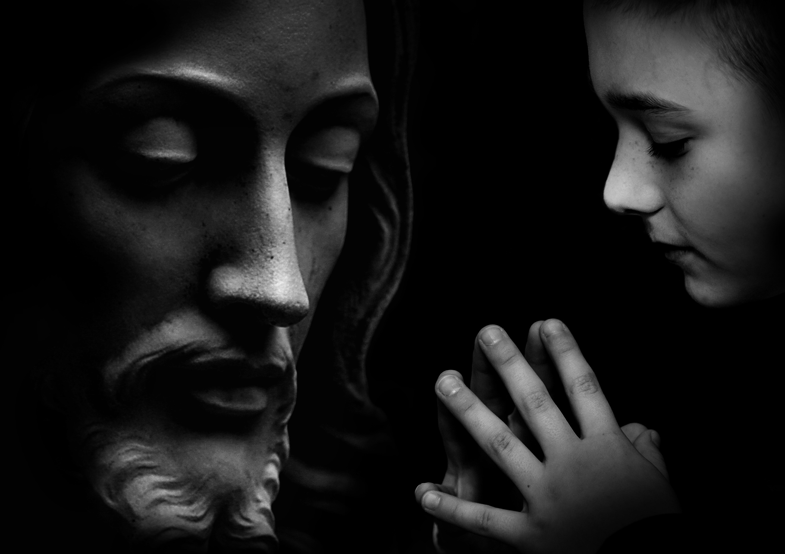

KEY FACTS
AUTHOR: MOSES
RECEIPIENTS: ISRAEL IN THE WILDERNESS.
DATE: 1444–1406 BC
KEY WORD: NUMBER ( Heb. Paqad) ( Num. 14:29).

Slide 4
AUTHOR & BACKGROUND
MOSES AS ACCEPTED AS AUTHOR. THE WORDS “ The Lord spoke to Moses”.
THIS PHRASE IS MENTIONED 80 TIMES THROUGHOUT THE BOOK.
THIS IS REAFFIRMED IN THE NT. ( Matt. 8:4; 19:8; Luke 24:44; John 1:45; 5 46-47; Rom. 10:5).
THE EVENTS RECORDED IN NUMBERS TOOK PLACE OVER A PERIOD OF 38 YEARS AND 9 MONTHS.
NUMBERS SPEAKS TO US TODAY ABOUT THE IMPORTANCE OF OBEDIENCE IN OUR SPIRITUAL JOURNEY.

Slide 5
MESSAGE
NUMBERS TELLS THE STORY OF THE INITIAL SUCCESS AND ULTIMATE FAILURE OF THE EXODUS GENERATION.
THE ISRAELITES WHO EXPERIENCED THE MIRACULOUS DELIVERANCE OF THE EXODUS FROM EYGPT SUCCUMBED TO DOUBT, FEAR, AND UNBELIEF.
THEY TURNED BACK AT KADESH BARNEA IN UNBELIEF, AND WANDERED 38 YEARS IN THE WILDERNESS.
TWO GENERATIONS REPRESENTED; ONE OF FAITHLESSNESS AND THE SECOND OF FAITH.

Slide 6
OUTLINE
  FIRST GENERATION ( 1: 1–25:18)
A. Preparation of the First Generation at Sinai. ( 1: 1-10:36).
B. Failure of the First Generation. ( 11: 1—-25:18).
  SECOND GENERATION. ( 26: 1— 36:13).
A. Reorganization of Israel on the Plains of Moab. ( 26: 1— 30:16).
B. Preparation for Conquest of the Land. ( 31: 1—36:13).

Slide 7
OBSERVATION
Moses emphasized the need for Faith and Obedience by the Second Generation by reminding them the the First Generation was Blessed ( Chaps 1-10) yet disinherited solely due to DISOBEDIENCE. ( Chaps. 11—25).
The Second Generation was challenged to remain Faithful to the Lord so the at they can inherit the PROMISED LAND. ( Chaps 26—36).
Paul referenced these Stories ( 1 Cor. 10:1–13).

Slide 8
PRACTICAL APPLICATION
NUMBERS is replete:
  With Many rich Theological Themes: God’ Holiness; Man’s Sinfulness; the necessity of Covenant Obedience, and the Consequences of Disobedience.
  The Book provides a practical insight into the Depravity of Human Nature and the Necessity of Divine Intervention in a Fallen World.
  The Wilderness Journey reminds us that we too are on a Spiritual Pilgrimage in a fallen world.
  Just as the Israelites had to learn the Lessons of Obedience, so we need to walk by Faith in God’s Word and Obedience to His Commands.

Slide 9
STUDY QUESTIONS
  In what way does the Book of Numbers function as a travel diary?
  What was the significance of age 20 as an age of accountability for Israelite men?
  What lessons about racial discrimination can be learned from the incident involving Moses’ Wife?
  Why was the Failure of the Israelites at Kadesh-barnea so decisive?
  How did the establishment of Cities of refuge ensure social justice?
  What does the Book of Numbers teach us about our walk with God?

