Slide 1


Slide 2

March 7th/8th
Week 19:
The Spirit in Acts I

Slide 3
Announcements/Reminders
Thank you for contributions to the Food Bank
Easter décor help needed:
  Saturday, April 8th, 9am, set up: 2 people
  Sunday, April 23rd, 12:30pm (after second service), clean up: 5 volunteers needed

Slide 4
Background on Acts of the Apostles
Author, purpose, outline
Luke-Acts
  Luke 1:3: “I too decided to write an orderly account for you, most excellent Theophilus”
  Acts 1:1: “In my former book, Theophilus”
common style and vocabulary
shared theological perspective

Slide 5
Background on Acts, cont.: Luke-Acts
Lk 2:32: “a light for revelation to the Gentiles”
Acts 13:47: “I have made you a light for the Gentiles, that you may bring salvation to the ends of the earth.”
Isaiah 49:6: “I will also make you a light for the Gentiles, that my salvation may reach to the ends of the earth.”

Slide 6
Background on Acts, cont.: Luke & Paul
Col. 4:14: “Our dear friend Luke, the doctor, and Demas send greetings.”
Philemon 24: “so do Mark, Aristarchus, Demas and Luke, my fellow workers”
Acts 16:10: “After Paul had seen the vision, we got ready at once to leave for Macedonia, concluding that God had called us to preach the gospel to them.”

Slide 7
Background on Acts, cont.: Purpose
increasing division and animosity
  How can Jesus be the Messiah, if he died as a common criminal?
  How can the followers of Jesus be the people of God, if most Jews rejected Jesus?
  Is Paul a traitor for welcoming “unclean” Gentiles into the people of God?

Slide 8
Background on Acts, cont.: Purpose
God’s promises to Israel in the Scriptures fulfilled in Christ and the church
the church as the authentic people of God

Slide 9
Background on Acts, cont.: Outline
The Spirit empowers the church to witness (1:1-2:47)
The apostolic witness in Jerusalem (3:1-5:42)
The witness beyond Jerusalem (6:1-12:24)
The witness to the ends of the earth (12:25-28:31)

Slide 10
Background on Acts, cont.: Outline
The Spirit empowers the church to witness (the events of Pentecost)
The apostolic witness in Jerusalem (healing and preaching; community life; persecution)
The witness beyond Jerusalem (Hellenists vs. Hebrews; Stephen; persecution and scattering; Saul’s conversion; Philip, Saul, Peter)
The witness to the ends of the earth (Paul’s missionary journeys; Jerusalem Council; Rome)

Slide 11
Acts 2:1
¹ When the day of Pentecost came, they were all together in one place.

Slide 12
Acts 2:2-4
² Suddenly a sound like the blowing of a violent wind came from heaven and filled the whole house where they were sitting. ³ They saw what seemed to be tongues of fire that separated and came to rest on each of them. ⁴ All of them were filled with the Holy Spirit and began to speak in other tongues as the Spirit enabled them.

Slide 13
Acts 2:5-12
⁵ Now there were staying in Jerusalem God-fearing Jews from every nation under heaven. ⁶ When they heard this sound, a crowd came together in bewilderment, because each one heard their own language being spoken. ⁷ Utterly amazed, they asked: “Aren’t all these who are speaking Galileans? ⁸ Then how is it that each of

Slide 14
Acts 2:5-12, cont.
us hears them in our native language? ⁹ Parthians, Medes and Elamites; residents of Mesopotamia, Judea and Cappadocia, Pontus and Asia, ¹⁰ Phrygia and Pamphylia, Egypt and the parts of Libya near Cyrene; visitors from Rome ¹¹ (both Jews and converts to Judaism); Cretans and Arabs—we hear them declaring the wonders of

Slide 15
Acts 2:5-12, cont.
God in our own tongues!” ¹² Amazed and perplexed, they asked one another, “What does this mean?”

Slide 16
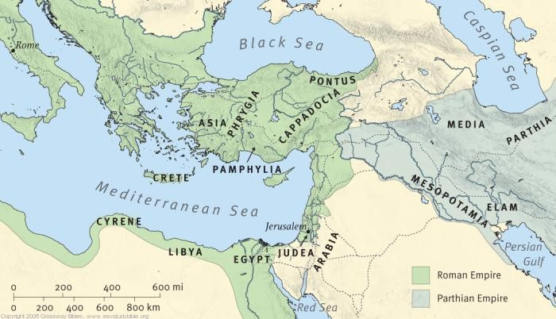

Slide 17
Acts 2:14-16
¹⁴ Then Peter stood up with the Eleven, raised his voice and addressed the crowd: “Fellow Jews and all of you who live in Jerusalem, let me explain this to you; listen carefully to what I say. ¹⁵ These people are not drunk, as you suppose. It’s only nine in the morning! ¹⁶ No, this is what was spoken by the prophet Joel…

Slide 18
Acts 2:36-37
³⁶ “Therefore let all Israel be assured of this: God has made this Jesus, whom you crucified, both Lord and Messiah.”
³⁷ When the people heard this, they were cut to the heart and said to Peter and the other apostles, “Brothers, what shall we do?”

Slide 19
Acts 2:38-39
³⁸ Peter replied, “Repent and be baptized, every one of you, in the name of Jesus Christ for the forgiveness of your sins. And you will receive the gift of the Holy Spirit. ³⁹ The promise is for you and your children and for all who are far off—for all whom the Lord our God will call.”

Slide 20
Acts 2:42-47
⁴² They devoted themselves to the apostles’ teaching and to fellowship, to the breaking of bread and to prayer. ⁴³ Everyone was filled with awe at the many wonders and signs performed by the apostles. ⁴⁴ All the believers were together and had everything in common. ⁴⁵ They sold property and possessions to give to anyone who had need.

Slide 21
Acts 2:42-47, cont.
⁴⁶ Every day they continued to meet together in the temple courts. They broke bread in their homes and ate together with glad and sincere hearts, ⁴⁷ praising God and enjoying the favor of all the people. And the Lord added to their number daily those who were being saved.

Slide 22
Looking ahead:
Next week’s passages:
  Acts 6
  Acts 8:1-25
  Acts 10

