Slide 1

Notes:
Good morning and welcome!

Slide 2

May 2nd/3rd
Week 26: The Spirit in
2 Timothy and Hebrews
Guest Teacher: Grace Lee

Slide 3
Announcements/Reminders
Closing Celebration on May 23rd
Survey link at www.grace.org/lexwomensgroups
Sign up to help with our women’s breakfast on June 24th!
  In-person sign-up sheets
  E-mail Grace at glee@grace.org

Slide 4
Announcements/Reminders, cont.
Men’s Chili Cook-Off, Tuesday, May 9th
Three upcoming events:
  Mural Painting, this Saturday, 2pm
  Spring Serve, Saturday, May 13th
  Discovery Day, Saturday, May 26th
  www.grace.org/events

Slide 5
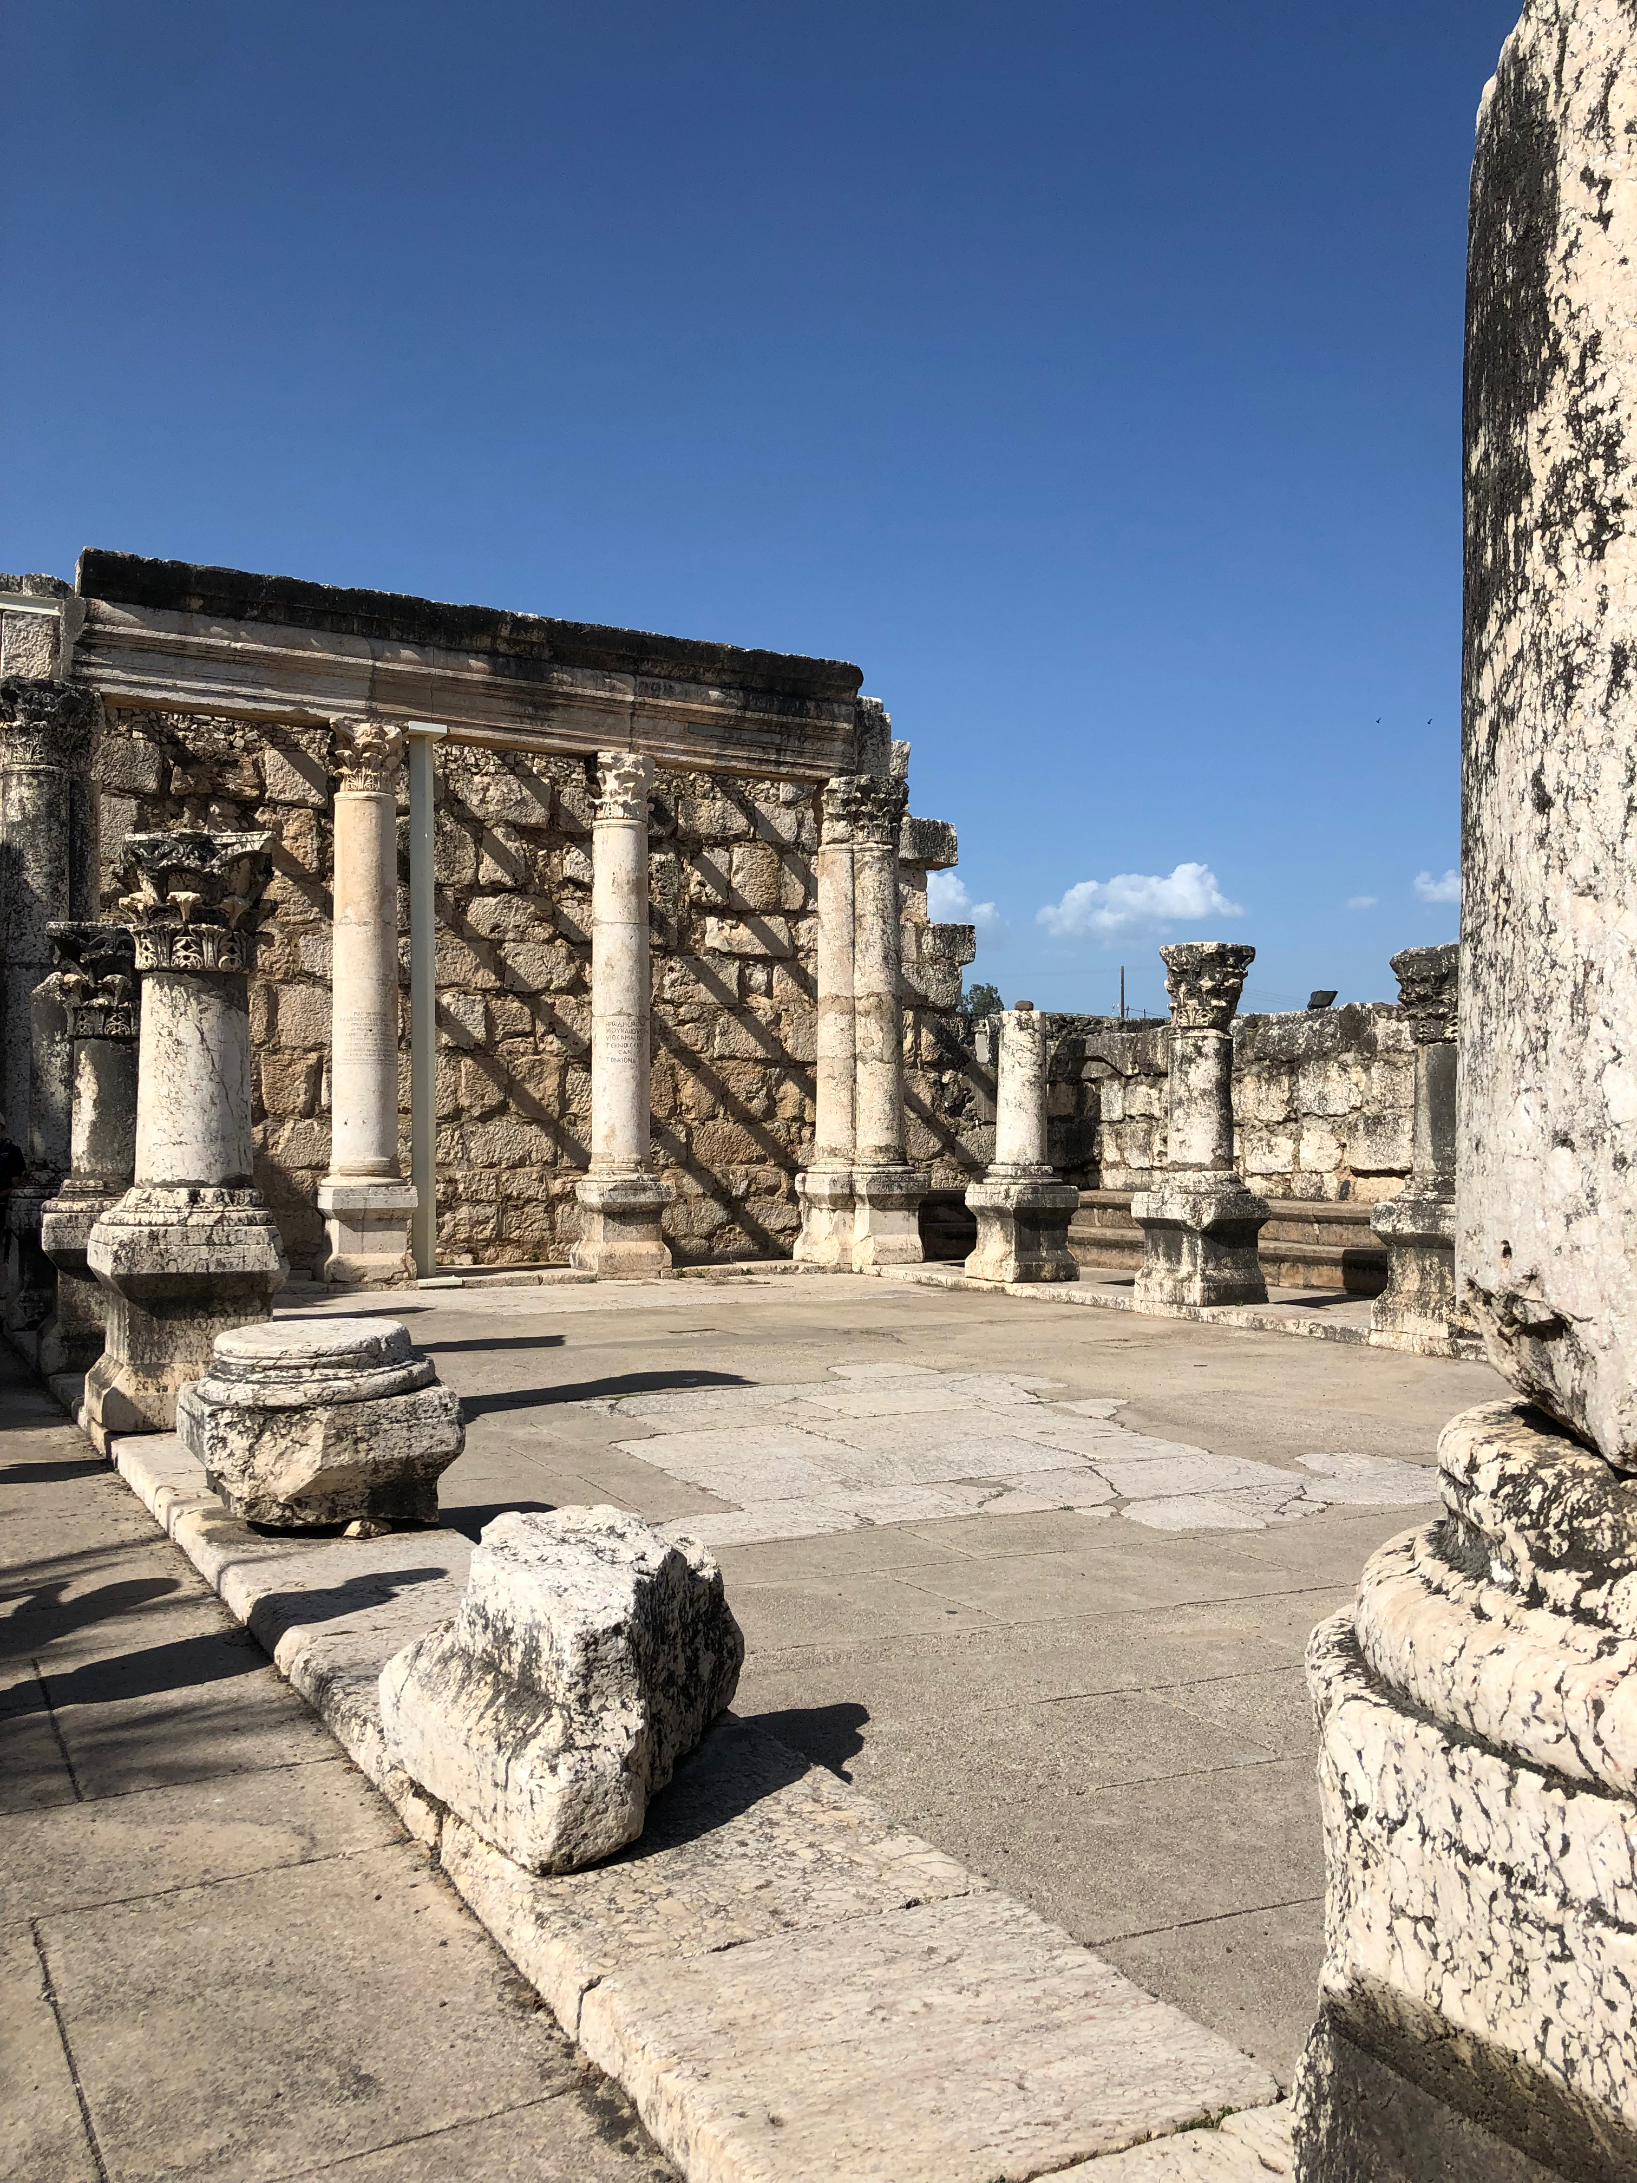

Slide 6
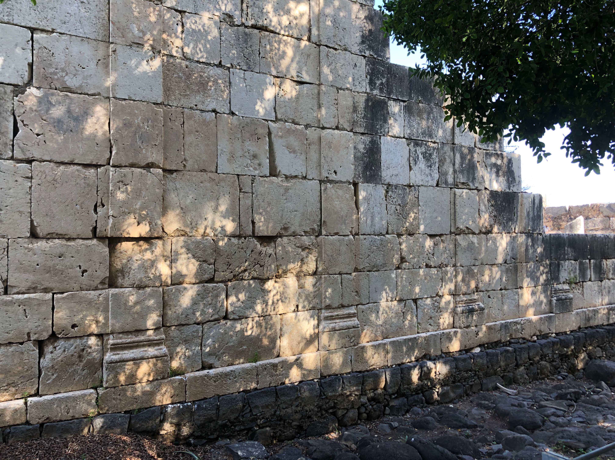

Slide 7
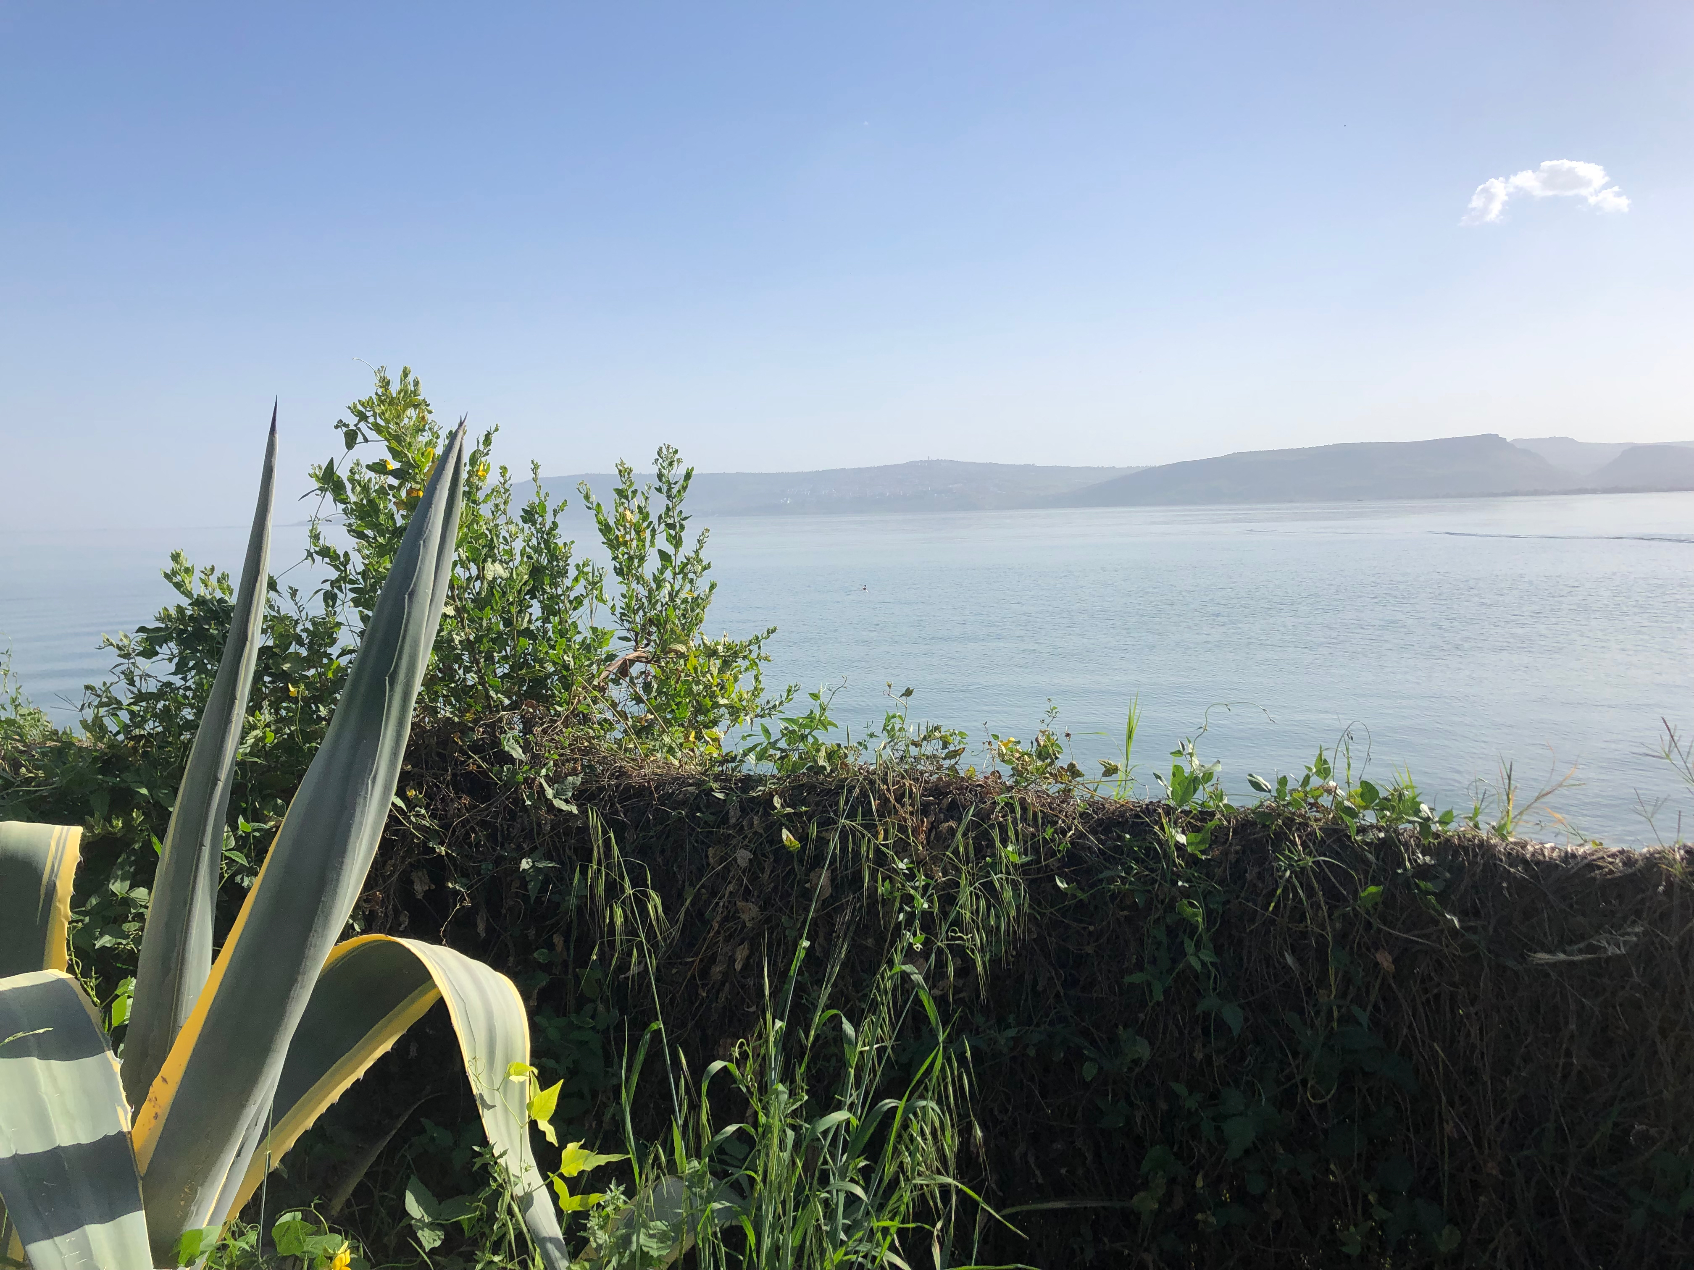

Slide 8
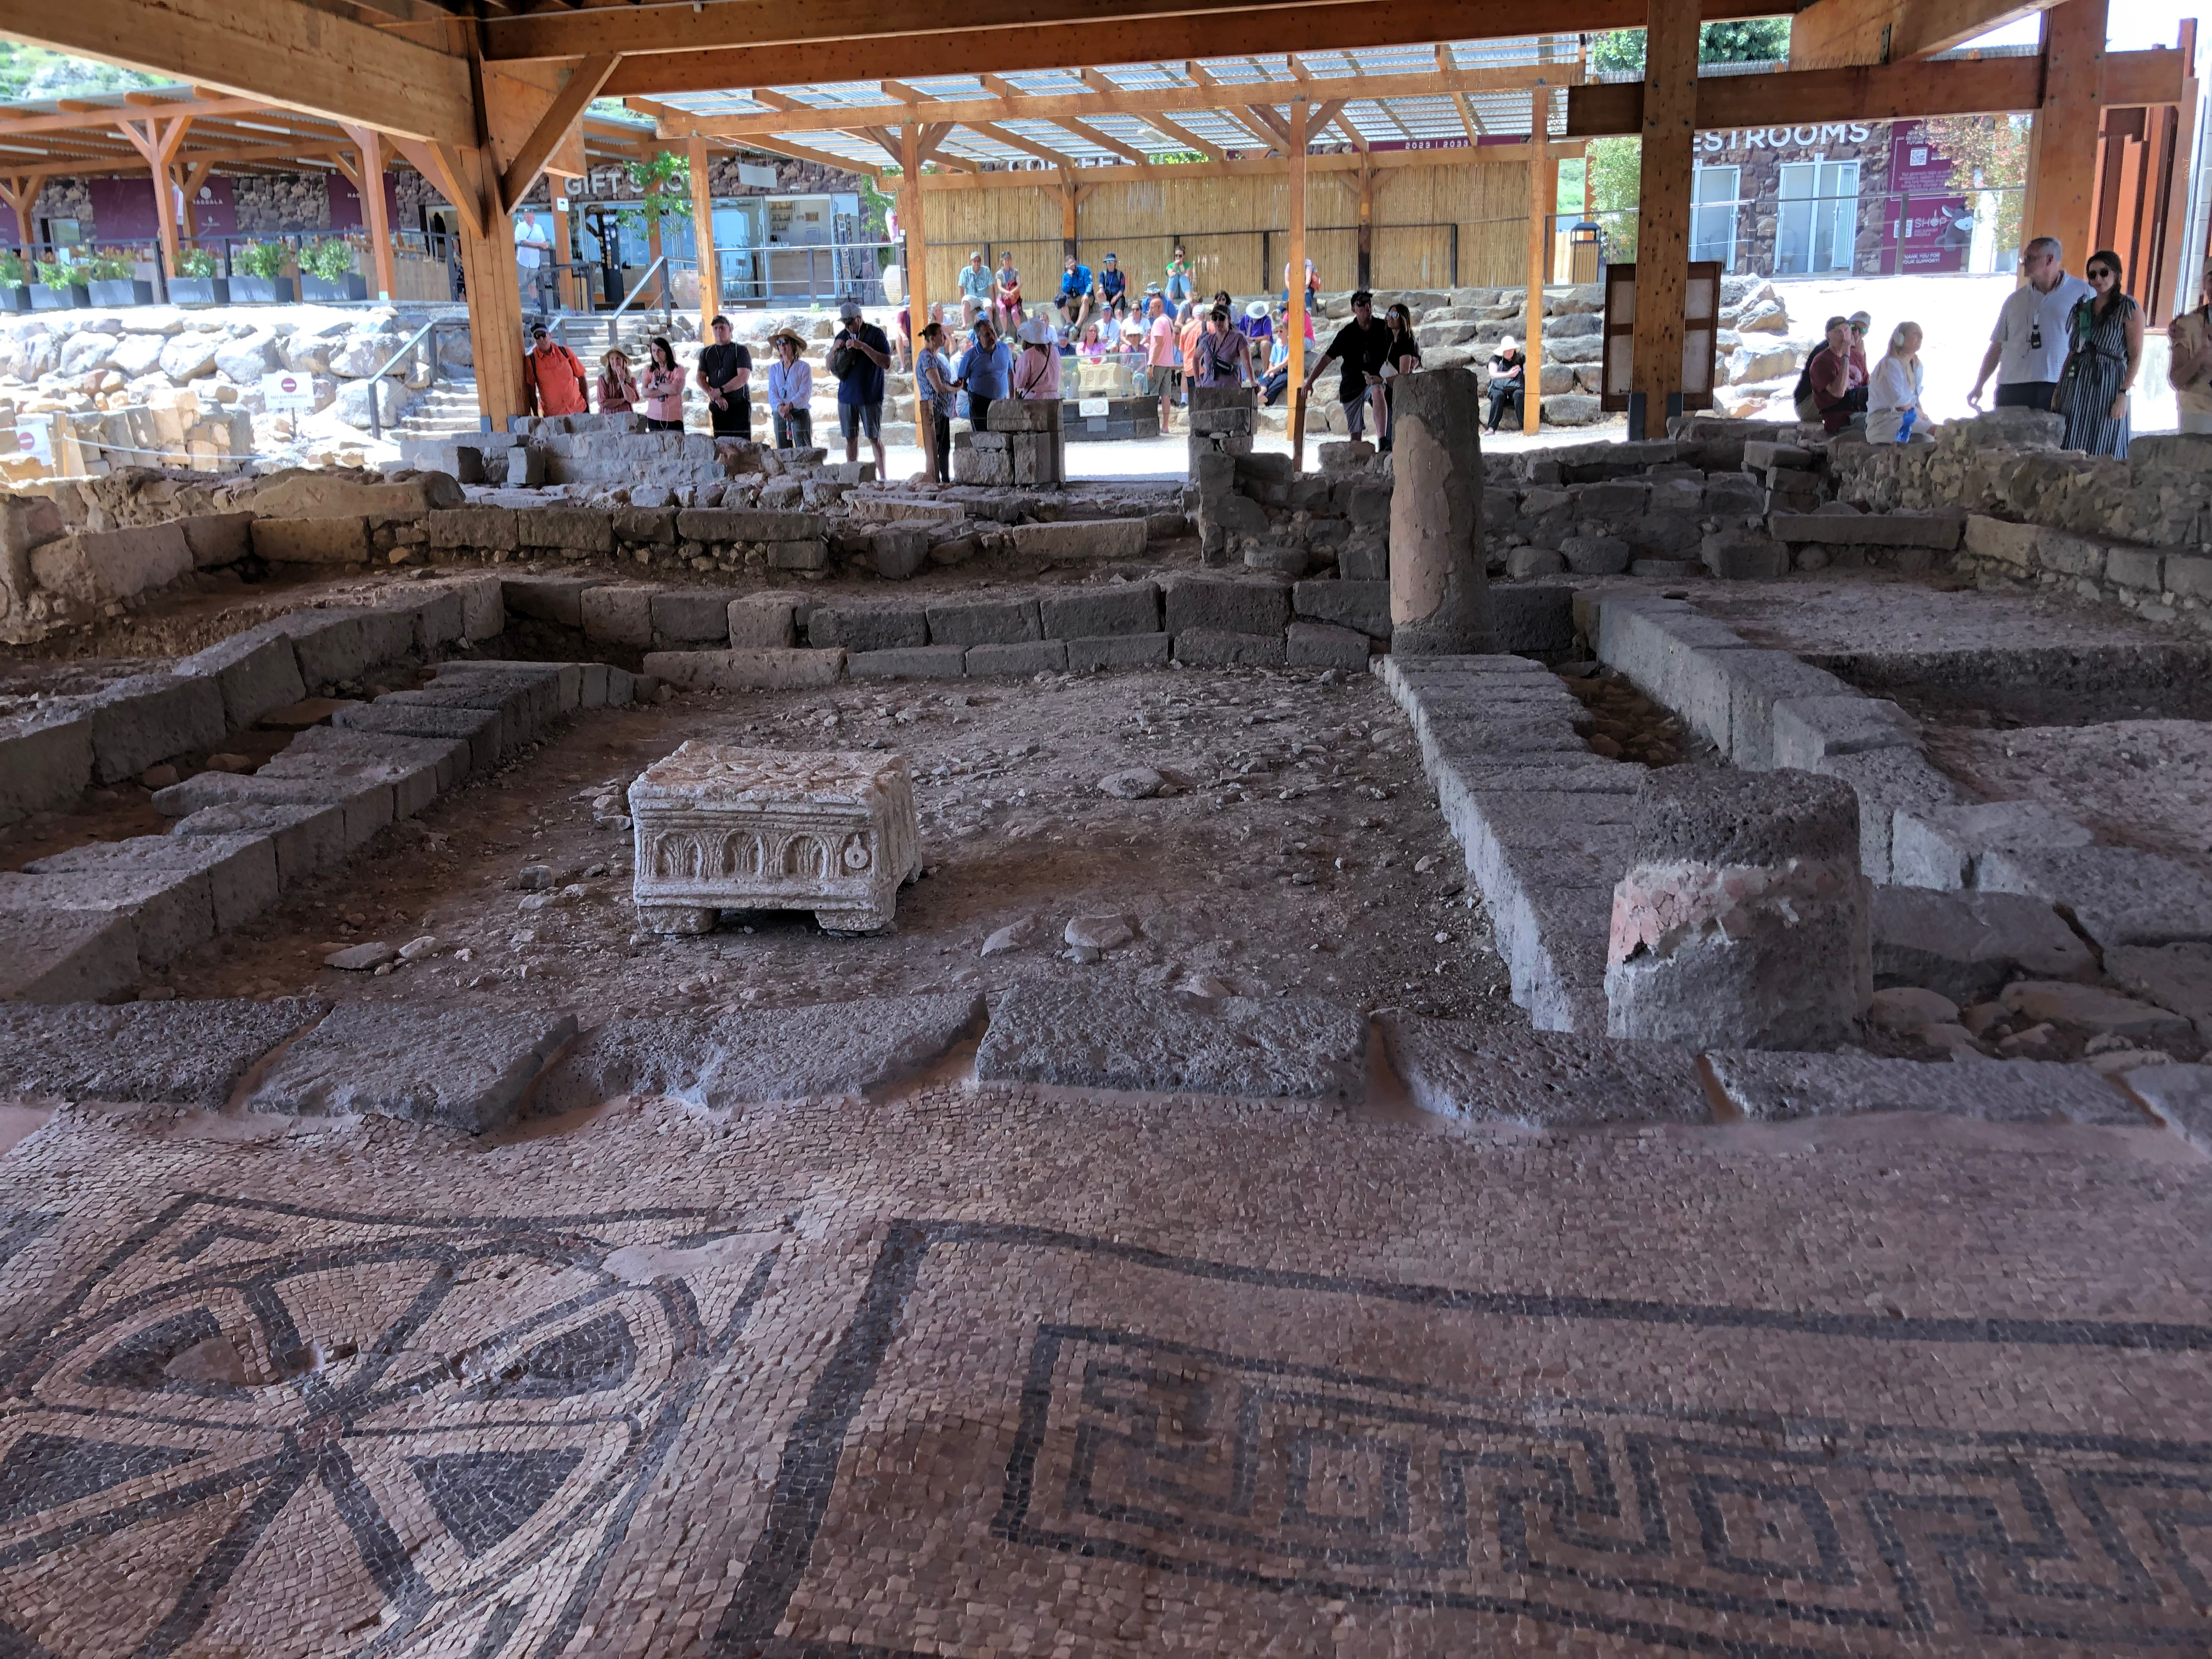

Slide 9


Slide 10
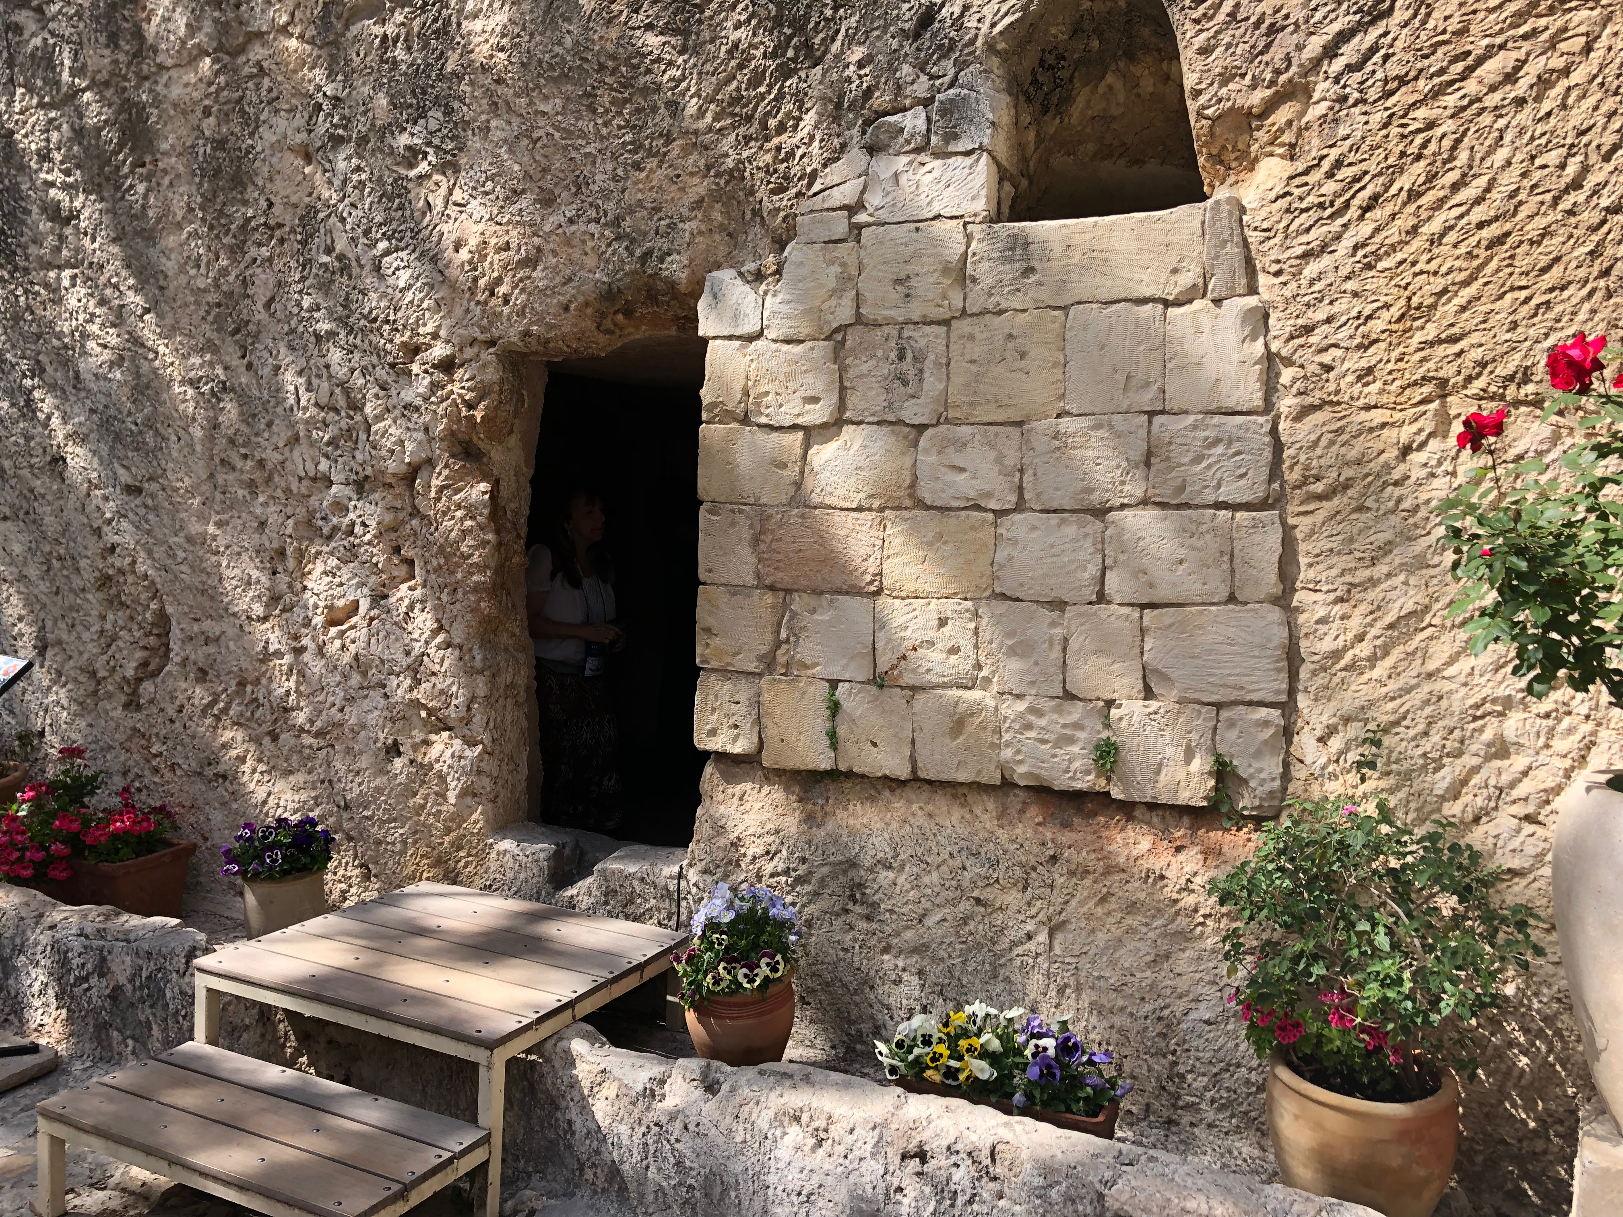

Slide 11
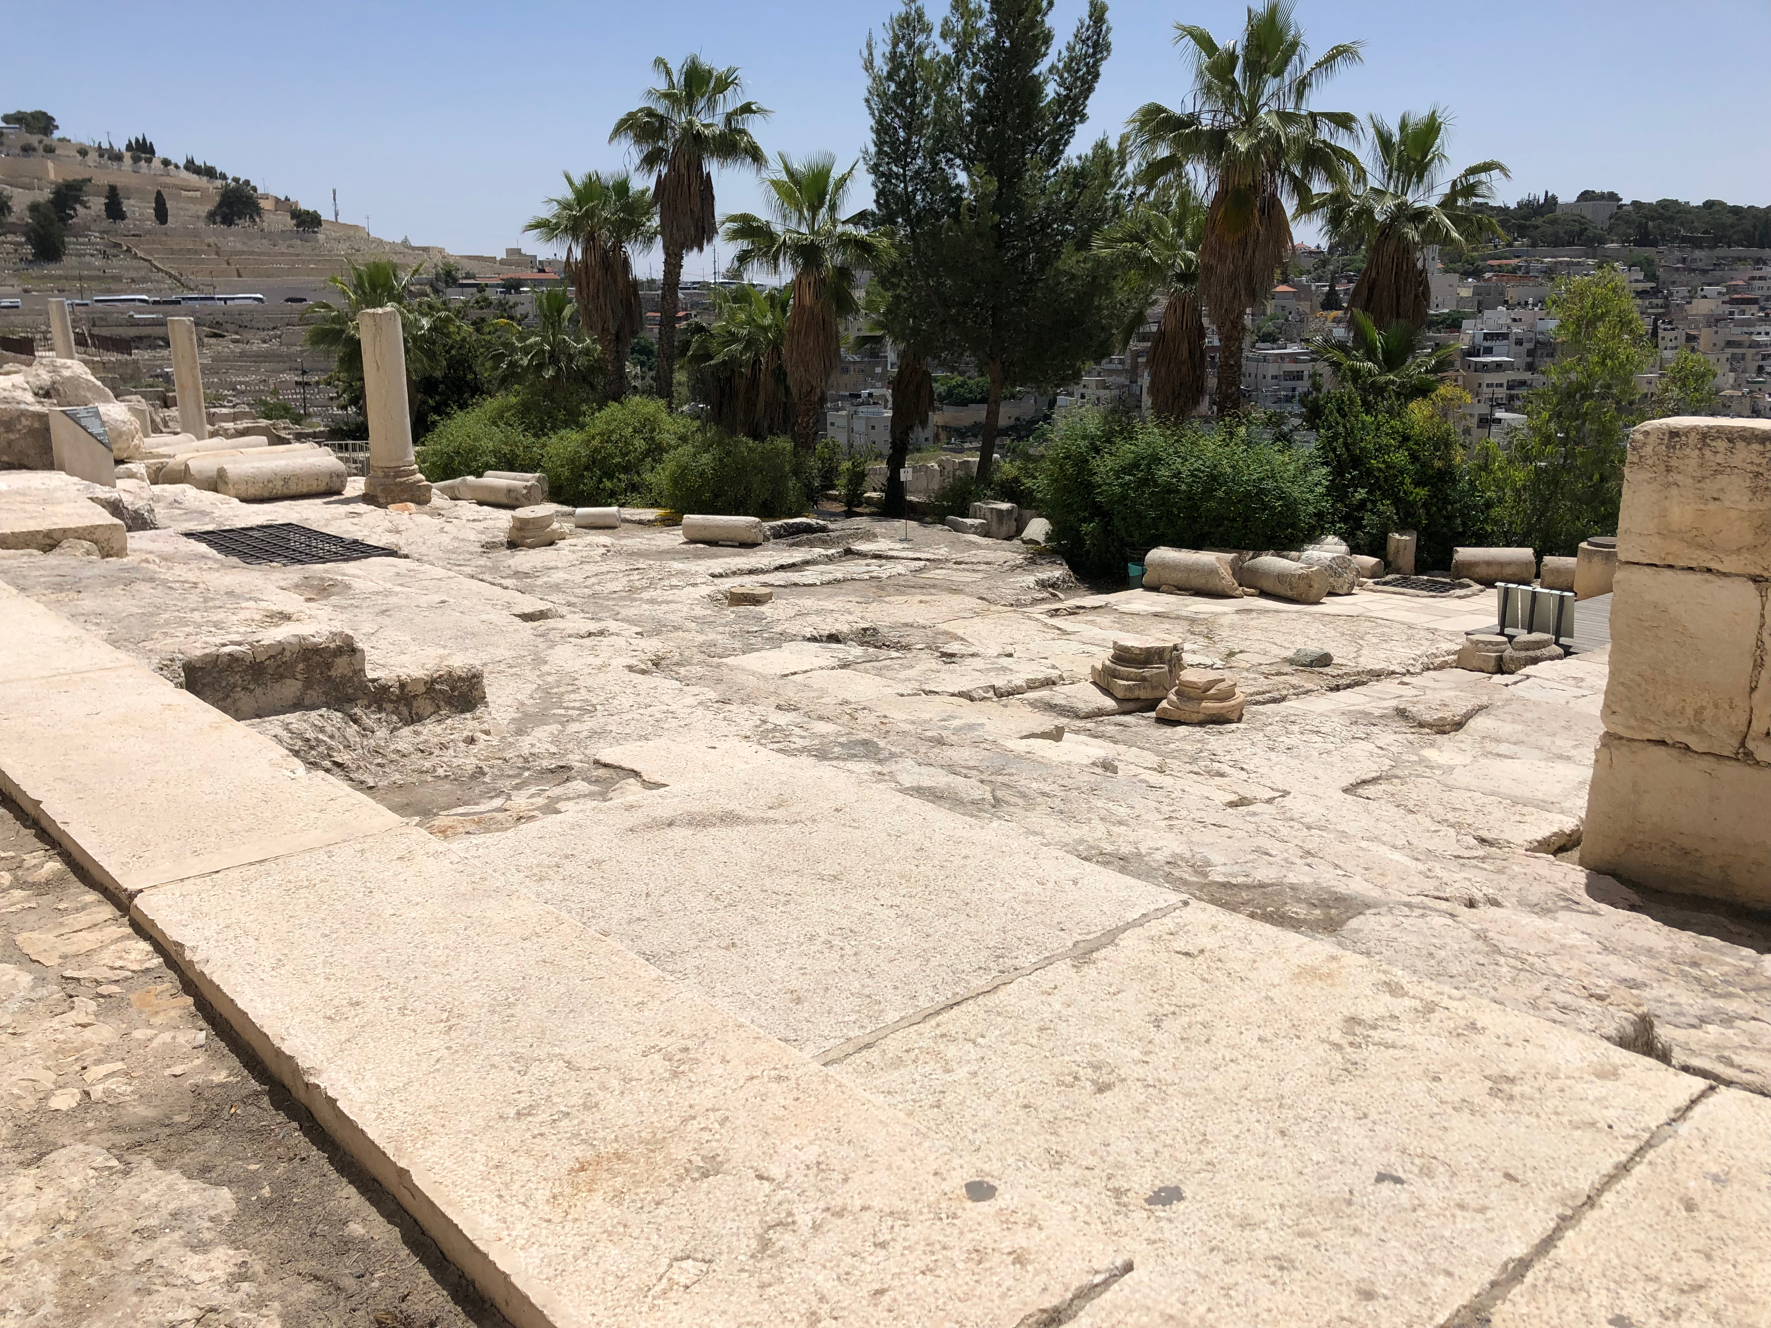

Slide 12
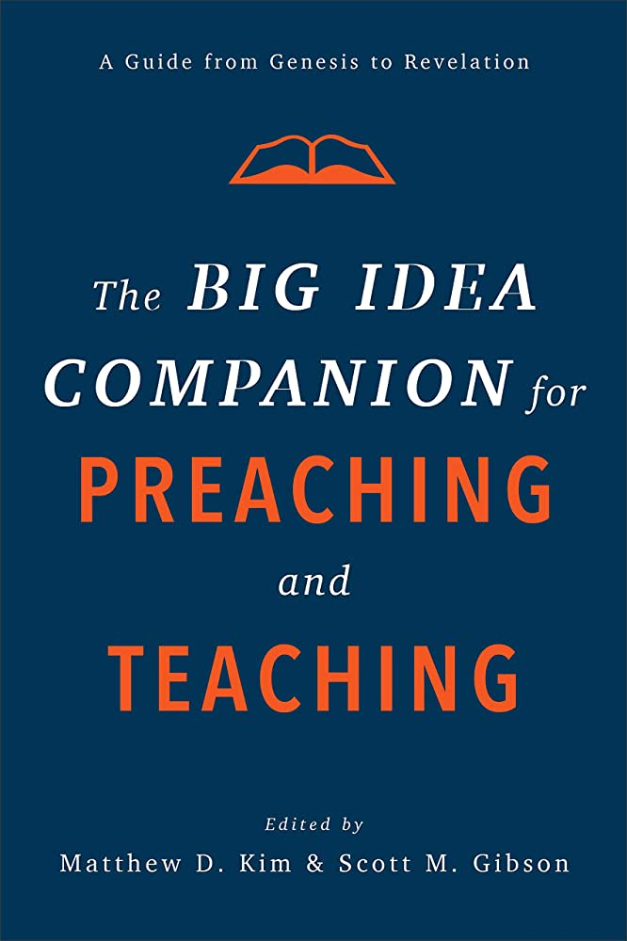
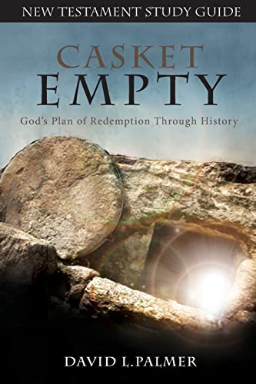
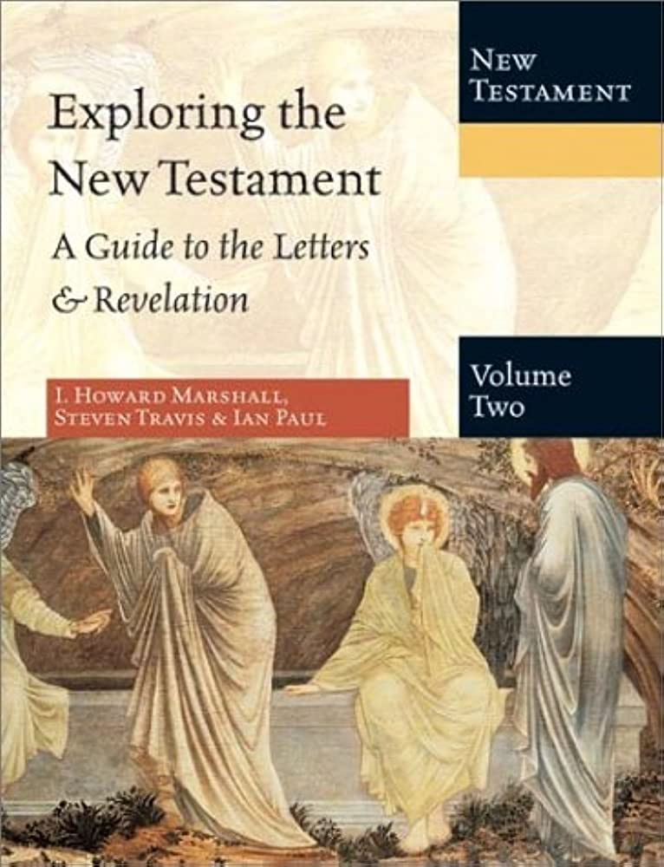
Notes:
Special credit to these three books where I gathered most of my information for today’s session.

Slide 13
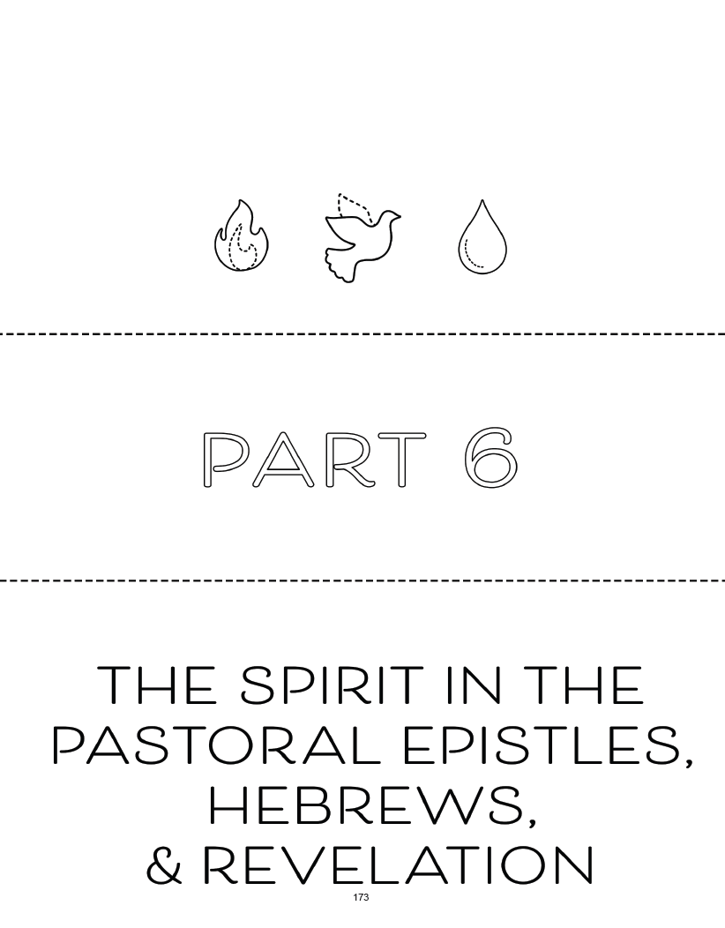
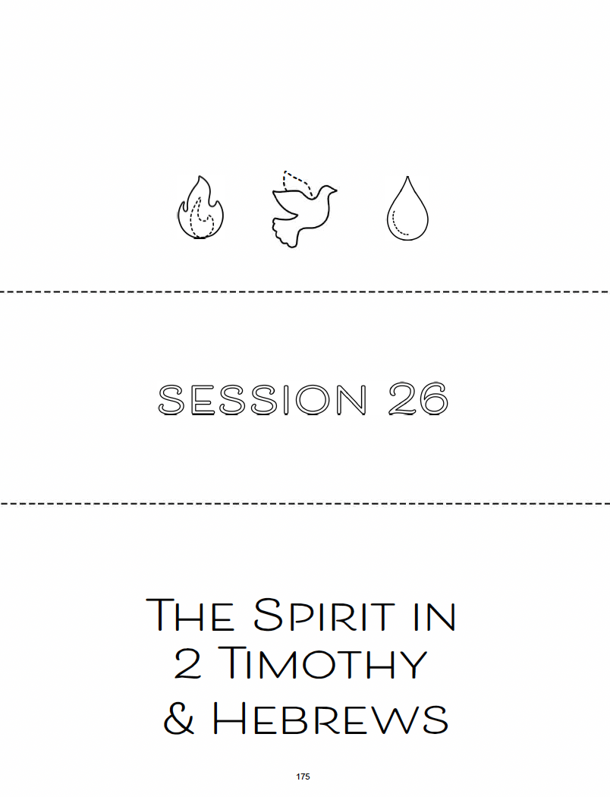
Notes:
We are now at the final part of our Bible Study. Part 6: The Spirit in the Pastoral Epistles, Hebrews, and Revelation
To start off, let’s take a brief look at what “pastoral epistles” are
<click> circle around Pastoral Epistles

Slide 14
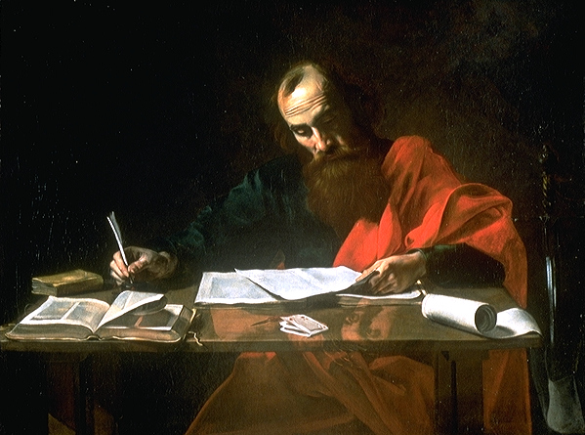
Paul and His Context
Letters (epistles) in the New Testament—of the 27 books of the NT, 21 are letters
  pastoring from a distance
  responding to particular occasions/issues
13 of the 21 NT letters are attributed to Paul
Saul; born in Tarsus in Asia Minor; Jewish family, Roman citizenship
*** Check out March 28 Recording to revisit Rachel’s lecture at www.grace.org/lexwomensgroups
Notes:
Saint Paul Writing His Epistles, by Valentin de Boulogne or Nicolas Tournier (c. 16th century, Blaffer Foundation Collection, Houston, TX)
https://en.wikipedia.org/wiki/Epistle
Back in March 28, Rachel gave an introduction on the letters of Paul, often referred to as the ”epistles.”
In summary, as the early church communities were forming and growing all over the ancient world, the Apostle Paul used letters to
“pastor from a distance.”
As Christianity was spreading and Christian communities were being established and increasing,
Christian leaders like Paul often wrote letters to provide additional teaching. Letters were usually written to address specific situations or problems.
To review this slide, you can revisit Rachel’s lecture on our womens group page.

Slide 15
Paul’s Letters
Romans, 1–2 Corinthians, and Galatians (“chief letters”)
Ephesians, Philippians, Colossians, and Philemon (“prison letters”)
1–2 Timothy and Titus (“pastoral letters”)
1–2 Thessalonians
Notes:
Continuing the Review
Paul’s writings make up about ¼ of the entire New Testament. 13 letters have been ascribed to him.
They are commonly grouped as such:
Chief Letters
Prison Letters – written while Paul was under house arrest in Rome
Pastoral Letters - <click>
The pastoral epistles include 1-2 Timothy and Titus, which are the three last letters Paul wrote towards the end of his life. They are the only letters in the NT addressed to specific individuals. Timothy and Titus held positions in church leadership.
The letters were specifically addressed to the next generation of Christian pastors, ministers, who would carry on the mission of oversight, teachings and spiritual care.
Paul was concerned how Christian leaders were appointed, how they should supervise their congregation, and furthermore how they should conduct themselves in their personal lives.
Today, we will focus on the letters written to Timothy, specifically the second letter.

Slide 16
Historical Background of 1-2 Timothy
Introducing Timothy from Lystra (Video)
https://www.youtube.com/watch?v=NmRdgrWuDNM
Reflection Questions p.176
  Who is this letter written to? Who is it from?
  Why might it have been written?
  How does this context help us understand the meaning of the text?
Notes:
7 minutes 40 seconds
https://www.youtube.com/watch?v=NmRdgrWuDNM
Let’s talk about some background. I will now show a short video to introduce some of the background.
Feel free to turn to page 176 in your booklet to the reflection questions.
As you watch the video, feel free to jot down answers, additional notes and questions.

Slide 17

Notes:
7 minutes 40 seconds
https://www.youtube.com/watch?v=NmRdgrWuDNM

Slide 18
Timothy
“and we sent Timothy, our brother and coworker in the gospel of Christ... to strengthen and encourage you in your faith” (1 Thess 3:2)
“for I have no one like him, who will be genuinely concerned for your welfare” (Phil 2:19-24)
“my true son in the faith” (1 Tim 1:2)
Notes:
Timothy
1. Timothy has proved himself to be a key partner in Paul’s missionary work.
Timothy demonstrated character and knowledge of Scriptures. Paul saw something special in Timothy and invited him in his missionary journeys.
Before Paul wrote 1 Timothy, Timothy had already helped plant churches in Philippi, Thessalonica, and Berea (Acts 16-17).
Based on what Paul says about Timothy, you can tell how much Paul trusted Timothy. He sent Timothy to the church in Thessalonica to strengthen them, and then to Philippi to encourage them.
Not only did Paul trust Timothy, he deeply loved Timothy as his own son.

Slide 19
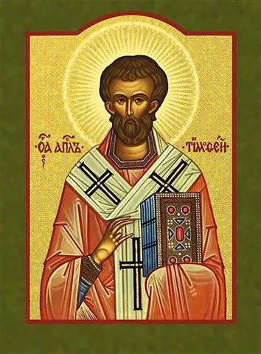
Father was Greek (Acts 16:3)
“sincere faith…grandmother Lois and mother Eunice, and, I am persuaded, now lives in you also” (2 Tim 1:5)
“from infancy you have known the Holy Scriptures” (2 Tim 3:15)
Young pastor at Ephesus
Notes:
Timothy
1. His family was an interracial marriage where his father was Greek and mom was Jewish believer.
In Acts 16, there is a quick introduction to Timothy, a disciple from Lystra.
2. Grew up in a Christian household (grandmother Lois and mother Eunice), and learned Hebrew Scriptures from a young age.
3. Why was Paul so invested in Timothy?
Timothy assumed a leadership position. He became a young minister in Ephesus.
Paul shows care for Timothy’s well-being to the point he wrote two personal letters to Timothy.
Alright, let’s take a moment to talk about Ephesus.
Ephesus (next slide)

Slide 20
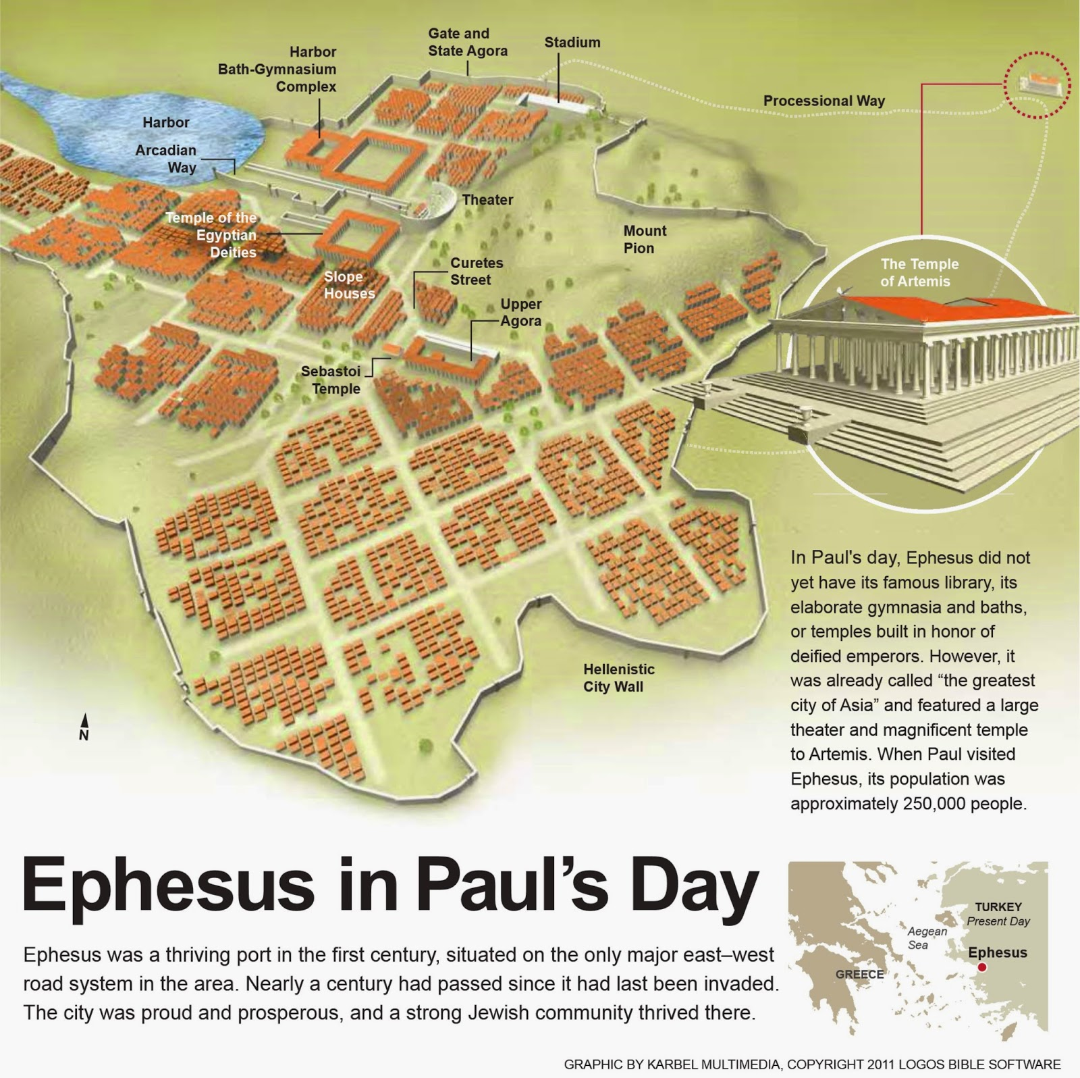
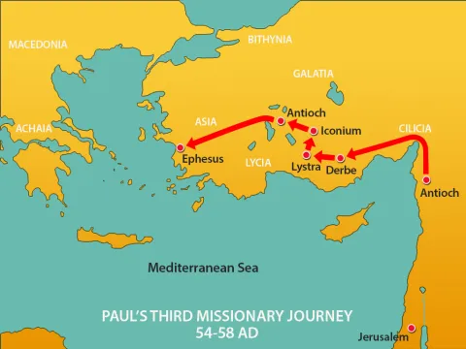
Notes:
“Ephesus was a thriving port in the first century, situated on the only major east-west road system in the area. Nearly a century had passed since it had last been invaded.
The city was proud and prosperous, and a strong Jewish community thrived there.
In Paul's day, Ephesus did not yet have its famous library, its elaborate gymnasia and baths, or temples built in honor of deified emperors.
However, it was already called "the greatest city of Asia" and featured a large theater and magnificent temple to Artemis.
When Paul visited Ephesus, its population was approximately 250,000 people.”

Slide 21
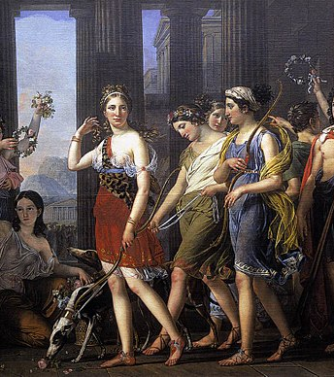
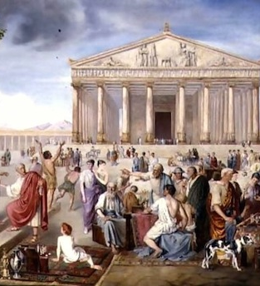
Ephesus
  Large city
  Pagan religion to goddess Artemis (Acts 19:11-27)
  Lots of false teachings and teachers!
Notes:
Timothy is this young pastor, surrounded and pressured by constant exposures to pagan religions and various teachings in the ”greatest city in Asia.”
How will Timothy care for this young community? How can Timothy protect himself and his sheep?
What was Paul’s advice?

Slide 22
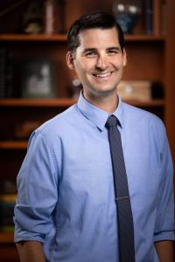
“Paul’s advice to Timothy concerning false teaching in Ephesus is to establish proper theology and right conduct within the household of God”
– Chris Rappazini
(former president of Evangelical Homiletics Society)
Notes:
Dr. Chris Rappazini, who was the former president of the Evangelical Homiletics Society, answers as so.
“Paul’s advice to Timothy concerning false teaching in Ephesus is to establish proper theology (beliefs) and right conduct within the household of God. “
Based on “The Big Idea Companion for Preaching and Teaching”
Chris Rappazini. “1 Timothy.” p.536

Slide 23
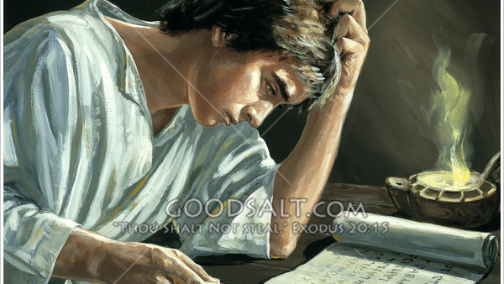
“The goal of our instruction is love from a pure heart and a good conscience and a sincere faith”
(1 Timothy 1:5)
Notes:
Photo: ”Timothy Reads Letter from Paul”
Artist/Photographer: Lifeway Collection
Based on “The Big Idea Companion for Preaching and Teaching”
Chris Rappazini. “1 Timothy.” p.536
Exegetical Idea:
Paul’s advice to Timothy concerning false teaching in Ephesus is to establish proper theology (beliefs) and right conduct within the household of God.
The Big Idea of 1 Timothy: “What we believe shapes how we live”
“In 1 Timothy, Paul offers Timothy advice on how to protect himself and others from false teachings (1:3-7, 19-20; 4:1-3, 7, 16; 6:3-6, 20). His antidote to false teachers is sound ecclesiology. Other topics do appear in this short letter, but Paul is clear what he writes to Timothy for the purpose of establishing proper conduct in the household of God (3:15)”
– Chris Rappazini
Acknowledging the difficult passages in this letter
Issues on homosexuality (1:8-11), men and women in the church (ch 2-3), and master-servant relationships (6:1-2)
Passage about God wanting everyone to be saved (2:3-4) but not everyone can be. Theological debate
Elder qualification concerning gender, divorce, alcohol, money
Paul offering Timothy the sound advice
“The goal of our instruction is love from a pure heart and a good conscience and a sincere faith” (1:5 NASB)

Slide 24
2 Timothy: Paul’s Last Words
  “the last will and testament of Paul”
  Tone of encouragement
  Focus on Timothy (next generation leader), not on himself (experienced missionary)
  Call to endure and remain faithful
Notes:
2nd Timothy is known as the “last will and testament of Paul”
Uncertain how many years passed since Paul wrote the first letter.
Unknown where Paul is writing from – either house arrest in Rome (Acts 28) or a later Roman imprisonment (2 Tim 4:13-15)
Despite what Paul is going through (facing death row), the focus is on encouraging Timothy. Not about himself.
In the first letter to Timothy, Paul focused in giving instructions in worship and church administration.
What kind of leaders should be tested and then appointed to oversee the church.
Paul’s letter also carried a tone of warning, warning Timothy the young minister against false teachings.
In the second letter to Timothy, as Paul is nearing the end of his life, there is a call to endurance.
Endurance is necessary to remain successful as a minister of the gospel.
This word not only applies to preachers, but for all believers.
Due to persecution, many have fallen and will continue to fall away from sound doctrine and holy living.
Paul is aware of this. As a seasoned missionary, church planter, teacher, he has seen it all. Yet his final words are this – REMAIN faithful.
Proclaim the gospel. Live righteously.
Not by your own strength, but by the power of the Holy Spirit who empowers you to do so.
-------------------------------------------------------
Based on “The Big Idea Companion for Preaching and Teaching”
Chris Rappazini. “2 Timothy.” p.543
The Big Idea of 2 Timothy
“The Second Letter to Timothy is Paul’s final letter. Paul is imprisoned in Rome, and he senses his life on earth is nearing its end. He wants Timothy to visit so he can pass on his ideas about ministry and missionary plans.” – Chris Rappazini
Exegetical Idea: Paul’s concluding charge to Timothy in his final letter is that although many have fallen and will fall away from right preaching and living because of persecutions that arise, believers are to remain faithful in proclaiming the gospel and living rightly” (p.543)

Slide 25
Themes in 2 Timothy
  Holy Spirit empowers believers like Timothy through love and self-discipline to testify about Christ’s resurrection
  Call to Remain steadfast in the face of opposition. Reminder that Grace of God empowers believers to endure.
  Beware of the things not of God
  Confronting false teachers and false teachings – “avoid quarrels, godless chatter, evil desires, foolish arguments”

Slide 26
Themes in 2 Timothy cont’d
  Trust in God’s Word. God’s Word (God-breathed) equips believers for the life and work they are called to do
  Be prepared to preach the truth. People will substitute sound doctrine for soft, shallow teachings.
  Paul’s satisfaction (suffering for the Lord) and anticipation for the crown of righteousness

Slide 27
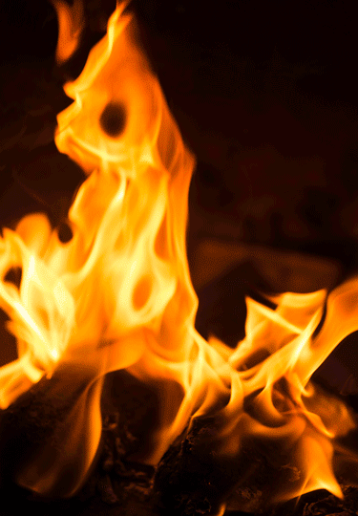
“Fan into flame the gift of God”
Salvation (John 4:10; Romans 6:23; Ephesians 2:8)
Salvation is connected to the calling to serve others
  For Paul (1:11)
  For Timothy specifically, to serve as a soldier for Christ (2:3-4) that preaches the Word (4:2)
Work of the Holy Spirit and our action coming together
Notes:
What is the “gift of God” that is being referred here?
While some commentators believe the “gift of God” refers to the gifts of the Holy Spirit, I was more convinced by the view that it is referring to the gift of salvation.
Paul refers to the “gift of God” in two other letters – once in Romans and once in Ephesians.
In Romans 6:23, it reads “for the wages of sin is death, but the gift of God is eternal life in Christ Jesus our Lord.”
In Ephesians 2:8, it reads, “for it is by grace you have been saved, through faith – and this is not from yourselves, it is the gift of God.”
So, as you read chapter 1 again, note how Paul connects his salvation to his calling as an apostle and a teacher.
He talks about the work of the Holy Spirit that empowers believers with power, love, and self-discipline.
He reminds us that God saves us and calls us to a holy life, because of grace. And this grace was given in Christ Jesus. And of this good news of being saved in Christ Jesus, Paul was appointed to be the apostle and teacher that he is. He was appointed to bless and serve the Christian community with his giftings.
It appears there is a connection between salvation and the calling to serve others. That this is all part of fanning into flame the salvation we have received. For Timothy specifically, Paul tells him to serve as a soldier for Christ that preaches the Word.
<click>
In this chapter, we see a glimpse of the mysterious work of the Holy Spirit that confirms our salvation and empowers us coming together with our actions to fan the flame.
Let me read for you this paragraph to better illustrate this.
Chapter Summary
“Paul introduces himself, then recaps Timothy's path to becoming a minister. He reminds Timothy of how his family brought him up in the faith, and then how Timothy served faithfully with Paul in the past. Paul then focuses on two primary ideas. First, that Timothy's background in the faith should give him the courage to stand fast against hard times. Second, that Timothy should use that courage to defend the truth of the gospel message. Paul will use these points and examples as the foundation for the rest of his letter.”

Slide 28
“Although [Timothy] has the Spirit of God in him to empower him for his service, he needs to fan that Spirit into flame so that he may have the courage and strength that he needs for a very testing time."
Notes:
P. 183 from Exploring the New Testament

Slide 29
“To encourage him further Paul describes how he himself was saved and called as a Christian leader and has to endure suffering which he is able to bear thanks to his trust in God. At the same time the call is not just to courage but also to faithfulness.”
Notes:
P. 183 from Exploring the New Testament

Slide 30
“Opposition to the gospel continues and there is a temptation to the Christian leader to succumb to false teaching instead of preserving faithfully the gospel which has been committed to his keeping, like a deposit placed in the hands of a banker (1:8-18)"
Notes:
P. 183 from Exploring the New Testament

Slide 31
You are NOT alone.
You have the family of faith.
You have the Holy Spirit.
In that confidence, be courageous in defending the truth of the gospel.

Slide 32
Notes:
Part 6: The Spirit in the Pastoral Epistles, Hebrews, and Revelation

Slide 33
Hebrews
Called “To the Hebrews”
Old Testament issues: high priesthood, sacrifices, order of worship
Author: Uncertain (eloquent Greek author)
Audience: Uncertain
  Traditional: Christian congregation of Jewish background
  Modern scholarship: Christians of Greek background
Context: Lots of persecution
Themes on perseverance (ch. 11), holiness and obedience (ch. 12-13)
Notes:
This epistle makes lots of references to the Old Testament, which includes priestly language, rituals and the order of worship. That is why I cannot do justice in this short amount of time to talk about Hebrews.
This letter is unique in many ways.
Hebrews was originally written in Greek, in an ”elegant style.”
Meaning this is high class material. There are 169 Greek words in this letter alone that do not occur anywhere else in the New Testament.
Furthermore, this is the one letter where the author remains uncertain.
Some suggested Paul to be the author. However, the literary style, rhetoric of Hebrews differs to the other Pauline writings.
Audience is also quite uncertain! Scholars disagree where the specific audience is located, though many suggest Rome, Jerusalem, or Alexandria (large Diaspora Jewish community).
Christians of Greek background: gentile Christians who started pagan, but eventually became converted through the teachings of the apostles
Context: Followers of Jesus, believing He is the Messiah
Facing persecution and suffering.

Slide 34
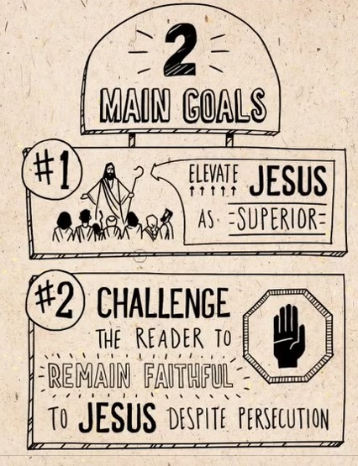
Notes:
Here is a small snapshot from the Bible Project.

Slide 35
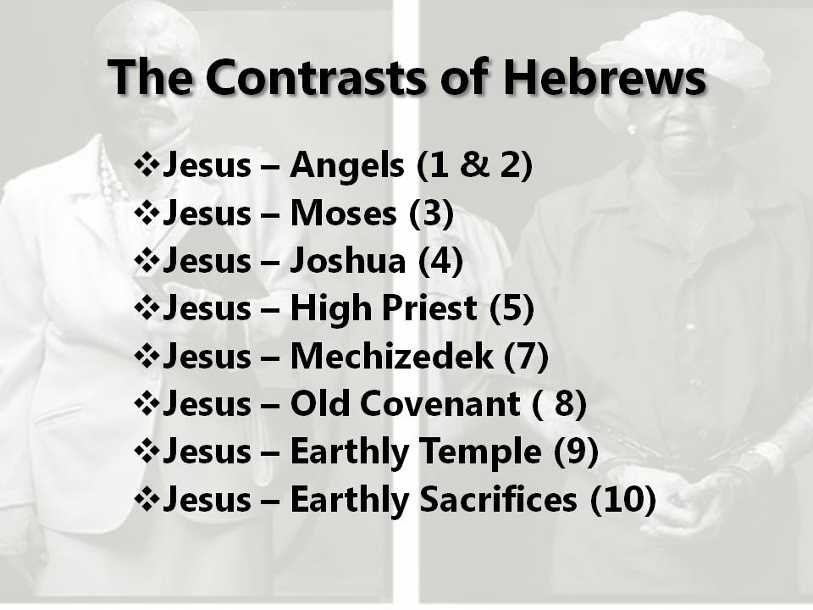
The Son is “the radiance of the glory of God and the exact imprint of his nature”
(Heb 1:3)
Notes:
Rich with Old Testament references.
- The angels
- Over all major figures of the Old Testament (Moses, Joshua)
- High priest (Melchizedek)
Larger purpose: Jesus is elevated above all the old covenantal system. Jesus changed the way how people can be reconciled with God.
We see this pointing towards Jesus, who is the Perfect Sacrifice, which is ULTIMATE revelation of God’s love & mercy.
In fact, He is GOD.

Slide 36
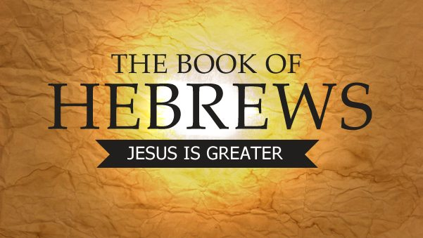


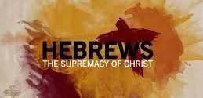

Slide 37
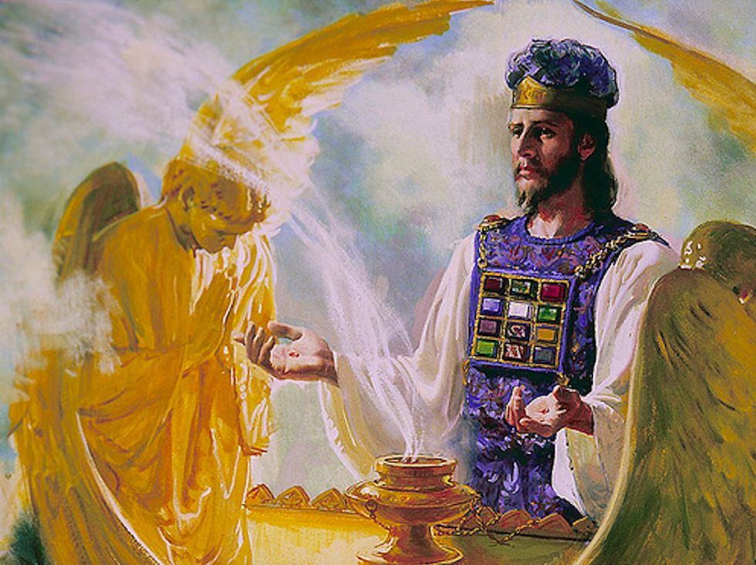
JESUS IS SUPERIOR
Note: “The author of Hebrews is not contrasting but actually emphasizing that the God whose voice we know from the Old Testament Scriptures has now spoken through his one and only Son.” (p.251 David Palmer)
Notes:
As the language exalts who Christ is, spurring the audience to pursue Christ, the author is essentially saying,
“Don’t return to the old ways of the Old Covenant. Someone greater is here!
In fact, to reject Jesus, is to reject God himself.
This is a warning!

Slide 38
Hebrews
Thesis: Jesus is “God’s climactic word to his people” (David Palmer)
Purpose: only Jesus can atone for our sins.***
Notes:
Atonement language: meaning Jesus offered himself once and for all as the ultimate sacrifice, which inaugurates the new covenant that secures our forgiveness. Therefore, with confidence through the blood of Jesus we can enter in the Holy place.
Because of what Christ has done, believers are encouraged to hold fast to hope.
Jesus is already the example for us of persevering faith.
This is important as we pause to reflect what the audience were going through.
Followers of Jesus, believing He is the Messiah
Facing persecution and suffering.
Depending on how well-versed they were in the Hebrew Scriptures, they probably faced the temptation to revert back to their old ways of worship. Following the Mosaic Law, sacrificial system that only allows for temporary cleansing.
Old ways, of the Old covenant. Don’t go back to the old covenant!
The new covenant is here! Jesus completed – it is finish. New Covenant, sins can be forgiven once and for all.
HOLD fast to Jesus
Warning against rejecting Jesus. To reject Jesus is rejecting God.

Slide 39
Side note (thanks to my missionary father)
Cults essentially question the “who” and “what” of Jesus.

Slide 40
What about the Holy Spirit?
For by one sacrifice [Jesus] has made perfect forever those who are being made holy.
The Holy Spirit also testifies to us about this.
First he says: “This is the covenant I will make with them after that time, says the Lord.
I will put my laws in their hearts, and I will write them on their minds.”
Notes:
This letter talks a lot about Jesus.
Okay, so what about the Holy Spirit?
From today’s reading, Hebrews 10:14-18
Holy Spirit testifies, reminding us of God’s Word.
Confirming to believers that this is God’s Promise to us.

Slide 41
What about the Holy Spirit?
Then he adds:
“Their sins and lawless acts
I will remember no more.”
And where these have been forgiven, sacrifice for sin is no longer necessary. (Hebrews 10:14-18)
Notes:
Now that we live in the era of the Holy Spirit, we no longer have to undergo specific rituals to receive forgiveness for our sins.

Slide 42
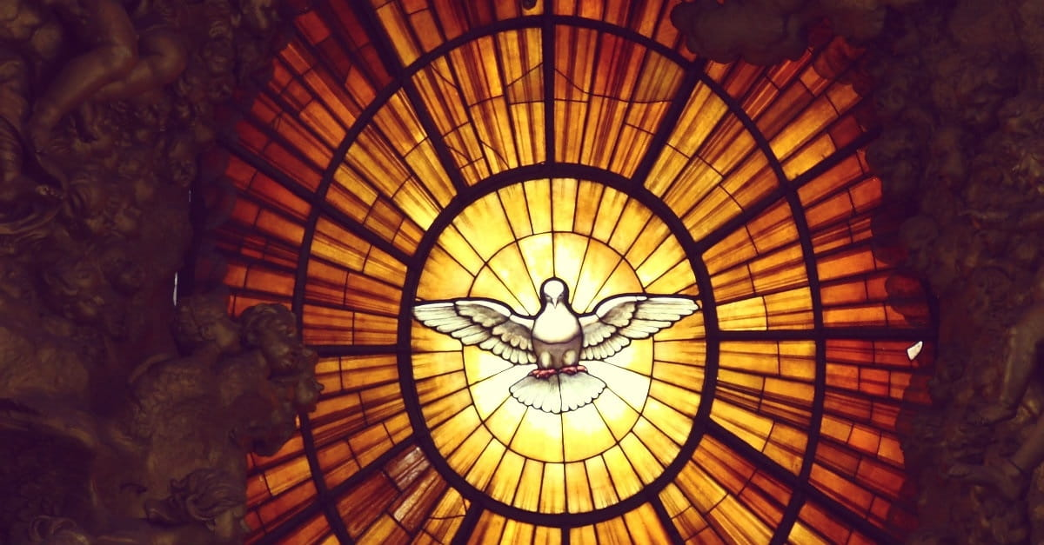
Notes:
Read more here concerning the Holy Spirit in Hebrews
https://worthychristianbooks.com/ab-simpson/chapter-21-the-holy-spirit-in-the-epistle-to-the-hebrews/

Slide 43
Notes:
Now that we live in the era of the Holy Spirit, we no longer have to undergo specific rituals to receive forgiveness for our sins.

Slide 44

See to it, brothers and sisters, that none of you has a sinful, unbelieving heart that turns away from the living God. But encourage one another daily, as long as it is called “Today,” so that none of you may be hardened by sin’s deceitfulness.”
Notes:
Grace’s concluding thoughts.
Hebrews warned about the hardening of hearts.
Hebrews 3:7-19
How is your HEART?
The Role of the Church – Christian community.
Built upon Christ
Partnership with the Holy Spirit
Persecution. Leadership. False teaching and false teachers.
Point of the pastoral epistle → what is the CHURCH? (ecclesia)
Church built upon the name of Jesus Christ.
Church built up of individuals, the marginalized, the weak and broken.
Individually and corporate, we have this mandate to ”guard the good deposit” entrusted. Good deposit – Scriptures. Giftings. Community.
We do it with the help of the Holy Spirit who lives in us (2 Timothy 1:14)
Holy Spirit’s part --- who gives us power, love, self-discipline
Our part – fan into flame “the gift of God.”
- “church ought to be known for its integrity, good works, and services to the poor and marginalized, which draw people toward the love of Christ” (p. 541 the Big Idea of Preaching and Teaching”

Slide 45
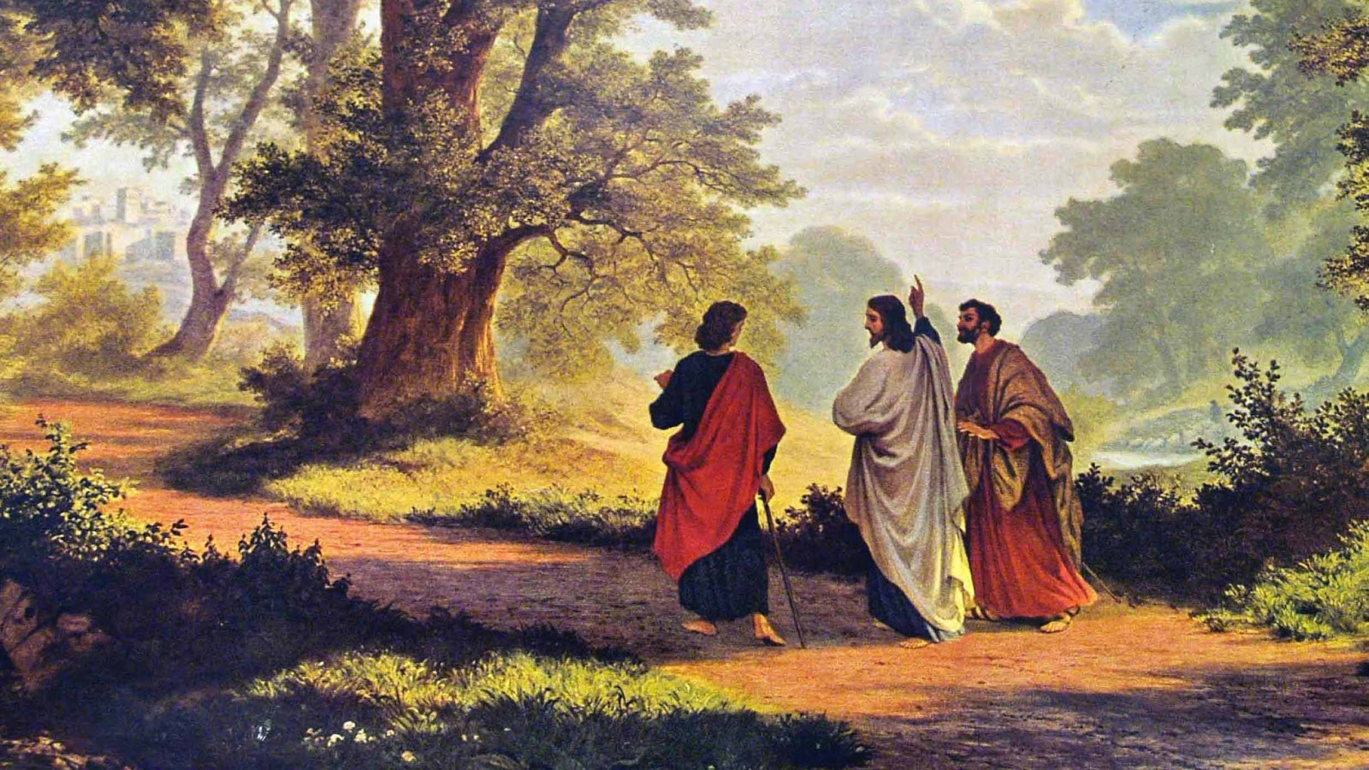
“Were not our hearts burning within us while he talked with us on the road and opened the Scriptures to us?” (Luke 24:32)
Notes:
Story of the road to Emmaus (Luke 24)

Slide 46
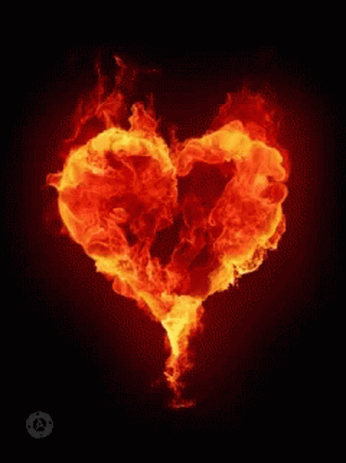

Slide 47
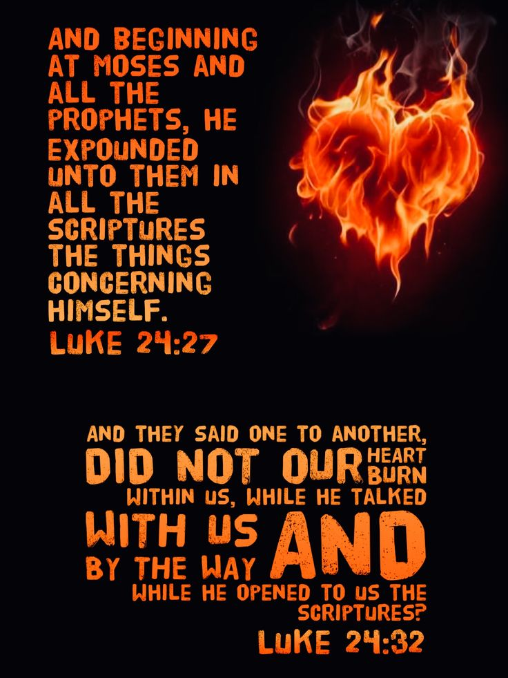

Slide 48
Bibliography
David L. Palmer. Casket Empty: God’s Plan of Redemption Through History. New Testament Study Guide. 2016.
Eds. Matthew D. Kim and Scott M. Gibson. The Big Idea Companion for Preaching and Teaching: A Guide from Genesis to Revelation. Grand Rapids, MI: Baker Academic, 2021.
I. Howard Marshall, Stephen Travis, and Ian Paul. Exploring the New Testament: A Guide to the Letters and Revelation Volume Two. Downers Grove, IL: InterVarsity Press, 2002.

Slide 49
Helpful Videos for Hebrews
Bible Project https://www.youtube.com/watch?v=1fNWTZZwgbs
The Bible Effect
https://www.youtube.com/watch?v=-cv84SzyS8Y

