Slide 1


Slide 2

Announcements & Reminders
Food Bank:
  2nd Tuesday of the month: 11/9, 12/14, 1/ 11
  Only the specific items requested, unopened, expire after 2022
Next week (11/9): Extended small-group time
Following week (11/16): Global Awareness Week
Following week (11/23): Thanksgiving Week

Slide 3
The Call of the Disciples
Goal: To watch and listen as Jesus calls his disciples, in order to
  grow in our understanding of how Jesus understood and lived out his mission
  reflect on our own unique, individual call to follow him

Slide 4
The Call of the Disciples, cont.
Then Jesus came to them and said, “All authority in heaven and on earth has been given to me. Therefore go and make disciples of all nations, baptizing them in the name of the Father and of the Son and of the Holy Spirit, and teaching them to obey everything I have commanded you. And surely I am with you always, to the very end of the age.”—Mt. 28:18-20

Slide 5
Matthew 9:9-13
As Jesus went on from there, he saw a man named Matthew sitting at the tax collector’s booth. “Follow me,” he told him, and Matthew got up and followed him.
    Matthew 9:9

Slide 6
Matthew 9:9-13
While Jesus was having dinner at Matthew’s house, many tax collectors and sinners came and ate with him and his disciples. When the Pharisees saw this, they asked his disciples, “Why does your teacher eat with tax collectors and sinners?”
Matthew 9:10-11

Slide 7
Matthew 9:9-13
On hearing this, Jesus said, “It is not the healthy who need a doctor, but the sick. But go and learn what this means: ‘I desire mercy, not sacrifice.’ For I have not come to call the righteous, but sinners.”
Matthew 9:12-13

Slide 8
Looking ahead to next week
Jesus’s public ministry: teaching and miracles, friends and followers, conflicts and controversies

Slide 9
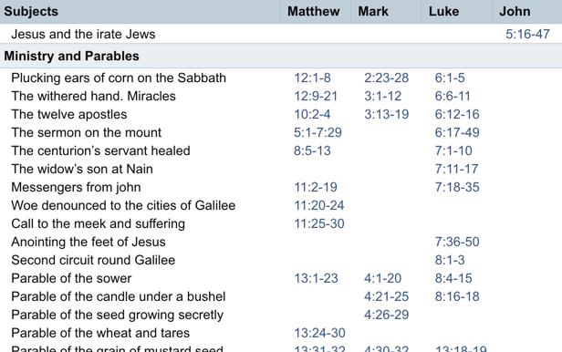

Slide 10
Looking ahead to next week
Teaching I (Mark)
  What does Jesus teach about?
  How does Jesus teach?
  Whom does Jesus teach?

Slide 11
Looking ahead to next week
Teaching I (Mark)
  Mark 4:1-34
  Mark 9:30-50
  Mark 10:13-45

Slide 12

Prayer

