Slide 1

Group Leader Winter(ish) Training
What All Group Leaders Need to Know

Slide 2
The What and Why of Group Life
Group Life Vision:
“Small groups of people practicing the way of Jesus together.”
Group Life Values:
Spiritual Formation
Strengthening Relationships
Missional Living

Slide 3
State of Group Life

Slide 4
What We Have Learned Since the Pandemic
- People are hungry for relationships
- Discipleship was not happening like we thought it
was.
- Some (many?) Christ-followers are rethinking how
they are practicing their faith.
- People are still spiritually hungry.
- People still want to make an impact on this world.

Slide 5
The What and Why of Group Life
Group Life Vision:
“Small groups of people practicing the way of Jesus together.”
Group Life Values:
Spiritual Formation
Strengthening Relationships
Missional Living

Slide 6
Why Some Groups Don’t Make It
Unrealistic Expectations
They devolve into a social group of church friends and not a group of disciples of Jesus who hunger for spiritual formation, community, and living on mission.
They become an intense Bible Study but not care for their fellow Image-bearers.
They fail to live out their faith in real-life places.
They do not forgive one another after conflict.

Slide 7
The What and Why of Group Life
Group Life Vision:
“Small groups of people practicing the way of Jesus together.”
Group Life Values:
Spiritual Formation
Strengthening Relationships
Missional Living

Slide 8
The Marks of the Thriving Groups
They show up for each other.
They communicate and connect beyond their meeting time.
They have a genuine desire to grow as disciples of Jesus together.
They serve one another and beyond
They acknowledge the pain found in community, have the hard conversations, forgive one another, and move closer on the other side of conflict.

Slide 9
By God’s Strength, let us “row in the same direction” by following the same vision.

Slide 10
The Opportunity Before Us
- “What I mean is this: One of you says, “I follow Paul”; another, “I follow Apollos”; another, “I follow Cephas”; still another, “I follow Christ.”
I Corinthians 1:12
- “Everyone did what was right in their own eyes …”
Judges 21:25
- “And knowing their thoughts Jesus said to them, “Any kingdom divided against itself is laid waste; and any city or house divided against itself will not stand”
Matthew 12:25

Slide 11


Slide 12
The Opportunity Before Us
Leading in transition
- Modeling Openness
- Willing to Trust
- Listening to Others
- Mediating when Possible
- Following up with Care
- Praying for Resolve

Slide 13
The Opportunity Before Us
To Pursue Unity
To Be Surrendered
To Seek First the Kingdom of God

Slide 14
Keys to Being a Non-Anxious Presence
Commit to Spiritual Practices such as being prayerful and being anchored in Scripture.
Realize that many concerns, critiques, and criticisms are often a mixture of truth and anxiety. And that is human.
Receive as a Learner
Be as Non-Defensive as possible
Ask yourself, “Is the Holy Spirit trying to tell me something?”

Slide 15

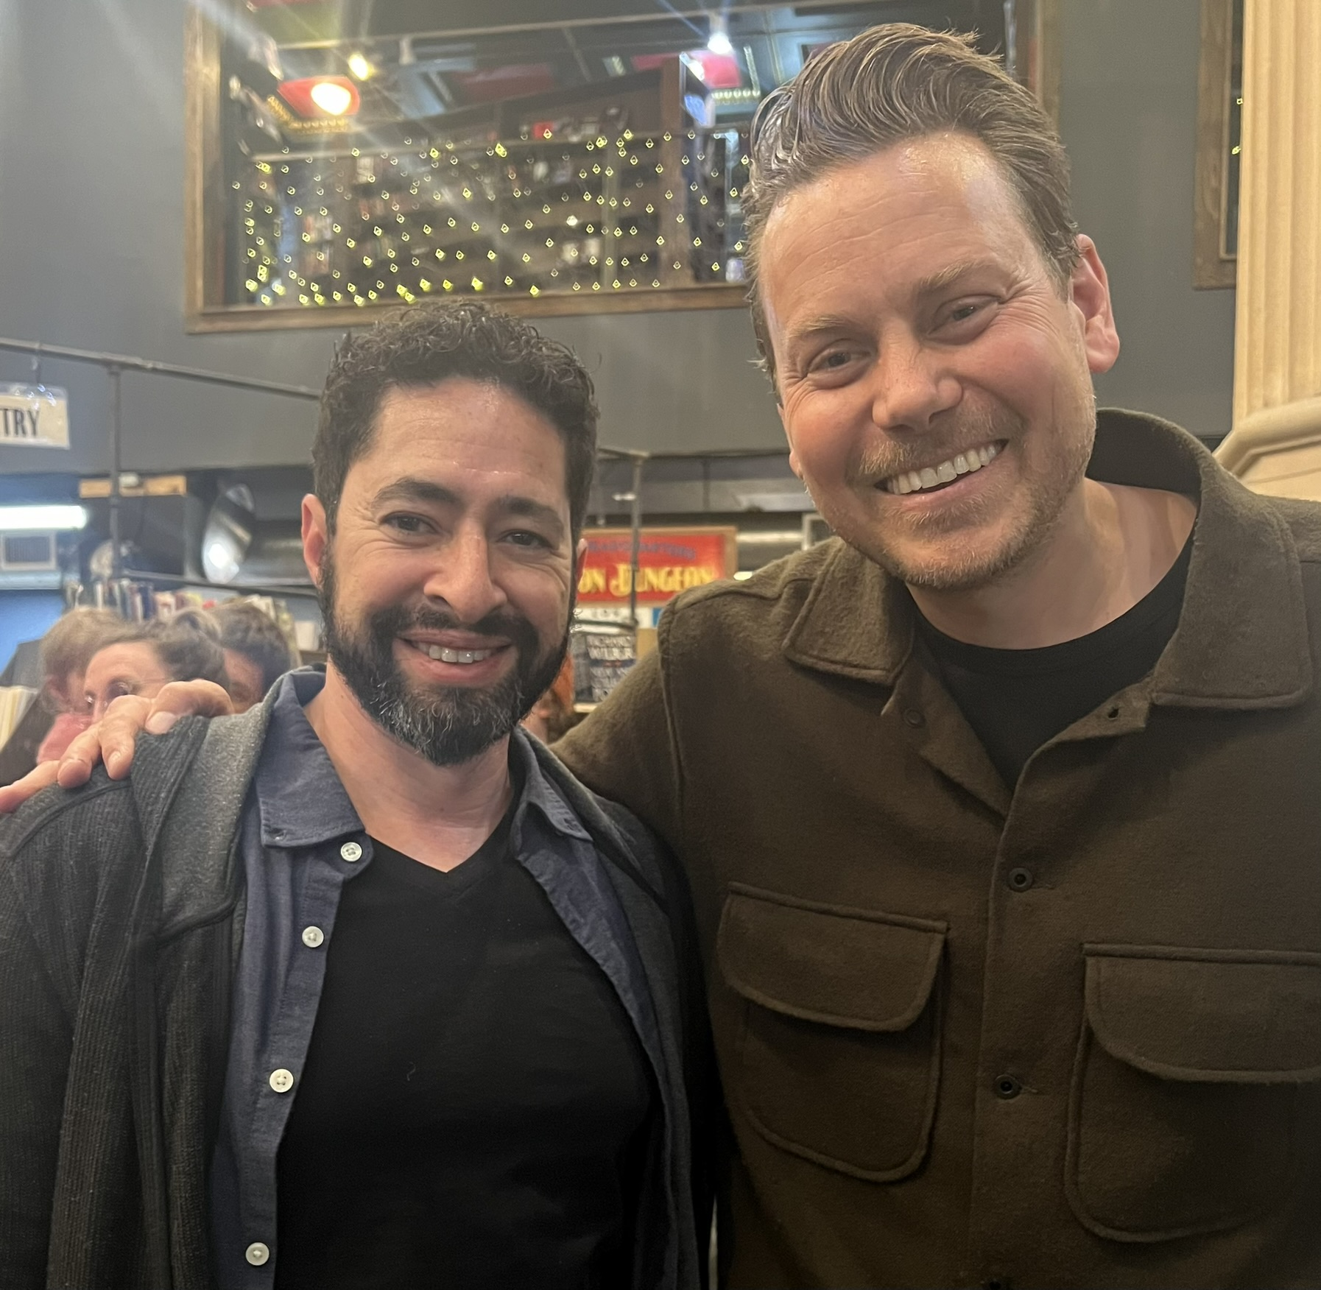

Slide 16
The What and Why of Group Life
Group Life Vision:
“Small groups of people practicing the way of Jesus together.”
Group Life Values:
Spiritual Formation
Strengthening Relationships
Missional Living

Slide 18

Resources
Grace Lee
Ministry Coordinator

Slide 19

https://grace.org/groupleaders
- Training
- Content
- Leader Development
- More
Notes:
https://www.grace.org/groupleaders/

Slide 20
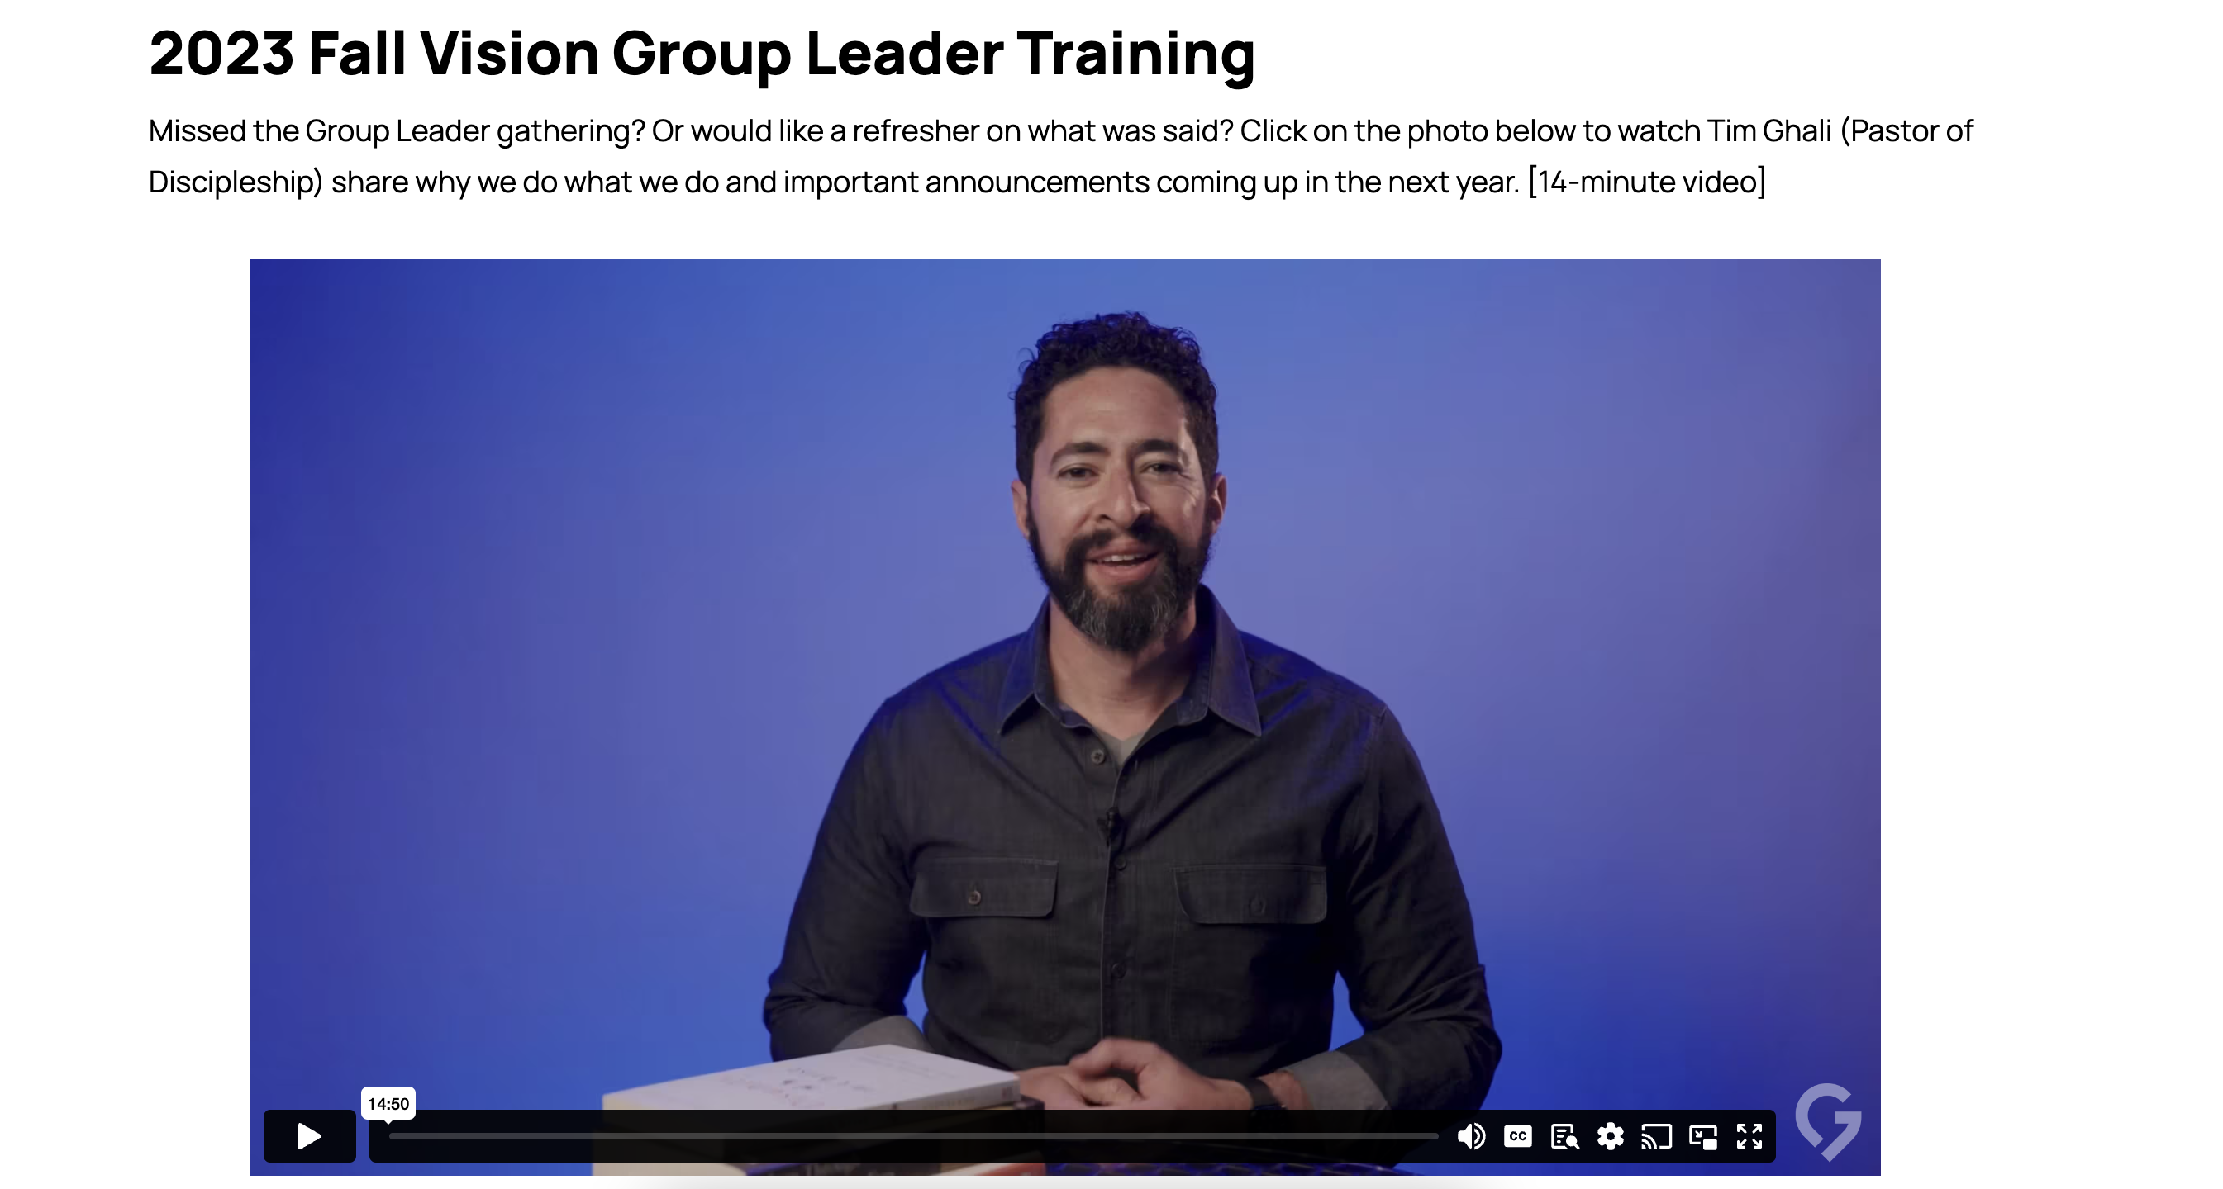

Slide 21
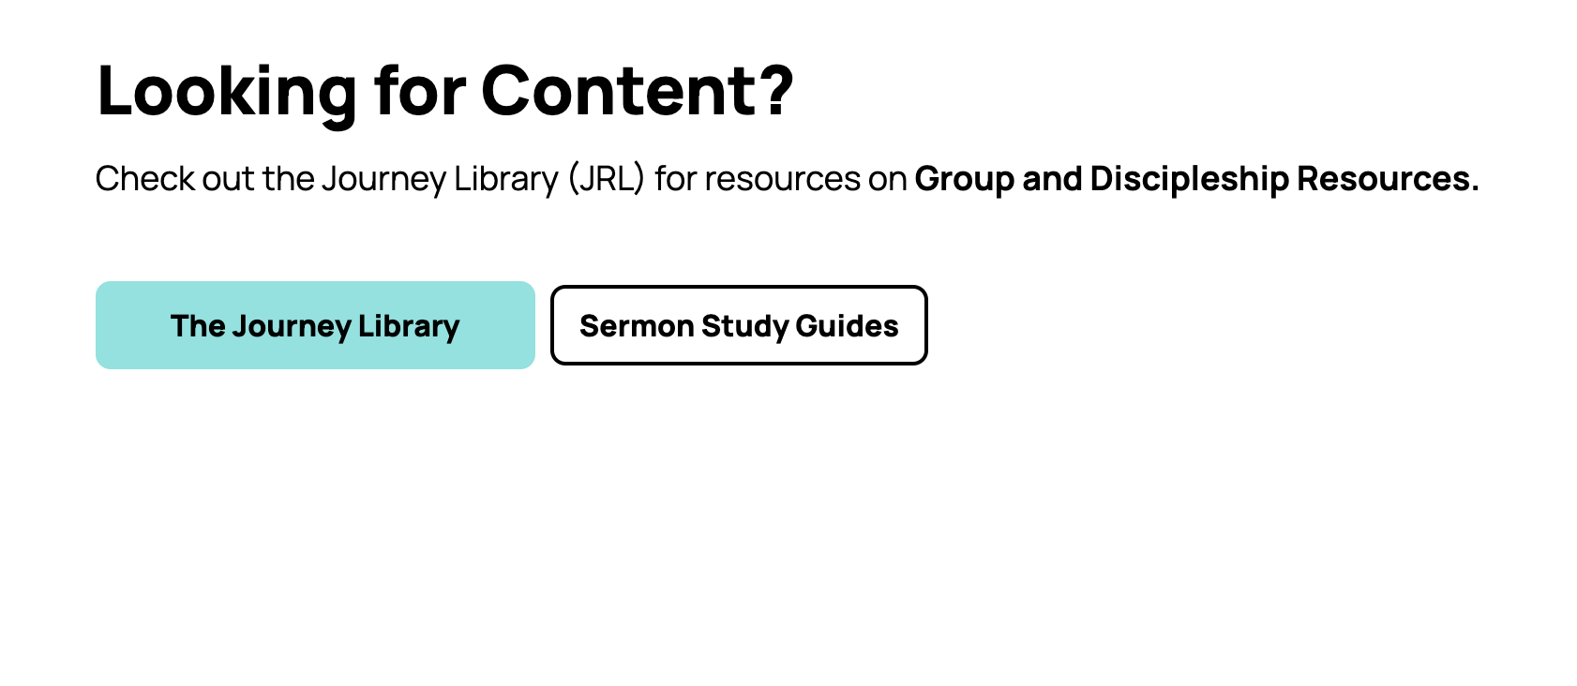

Slide 22
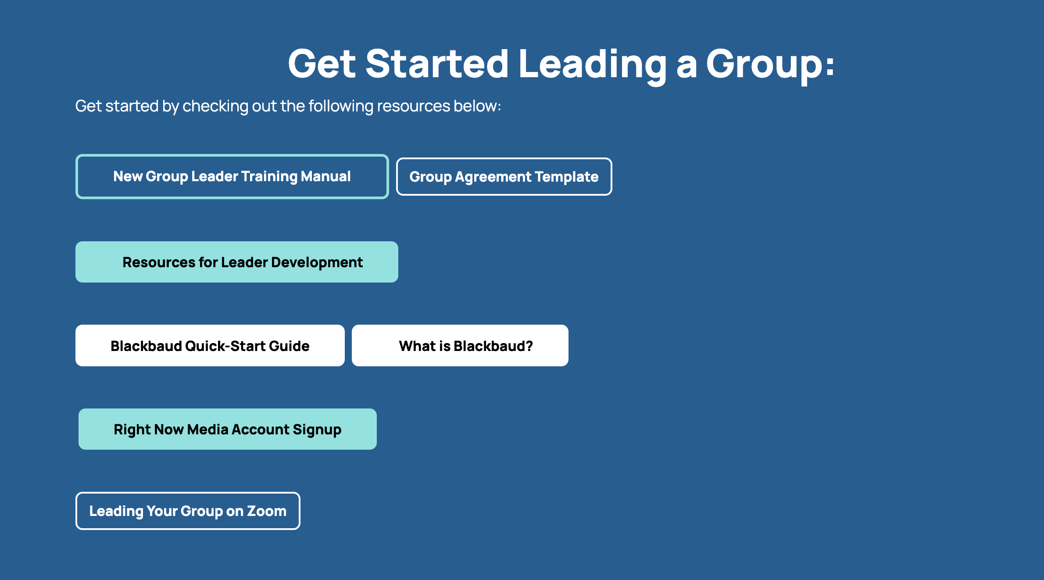

Slide 23


Slide 24
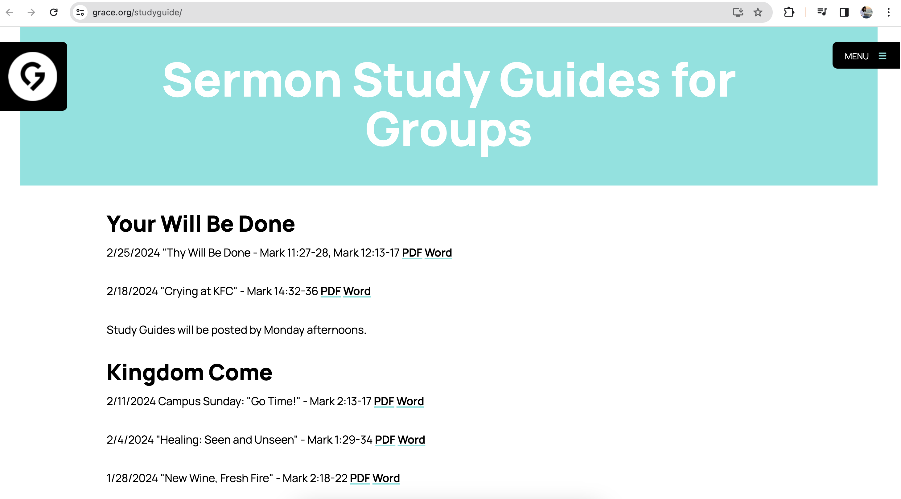
www.grace.org/studyguide

Slide 25
www.grace.org/jrl

Slide 26
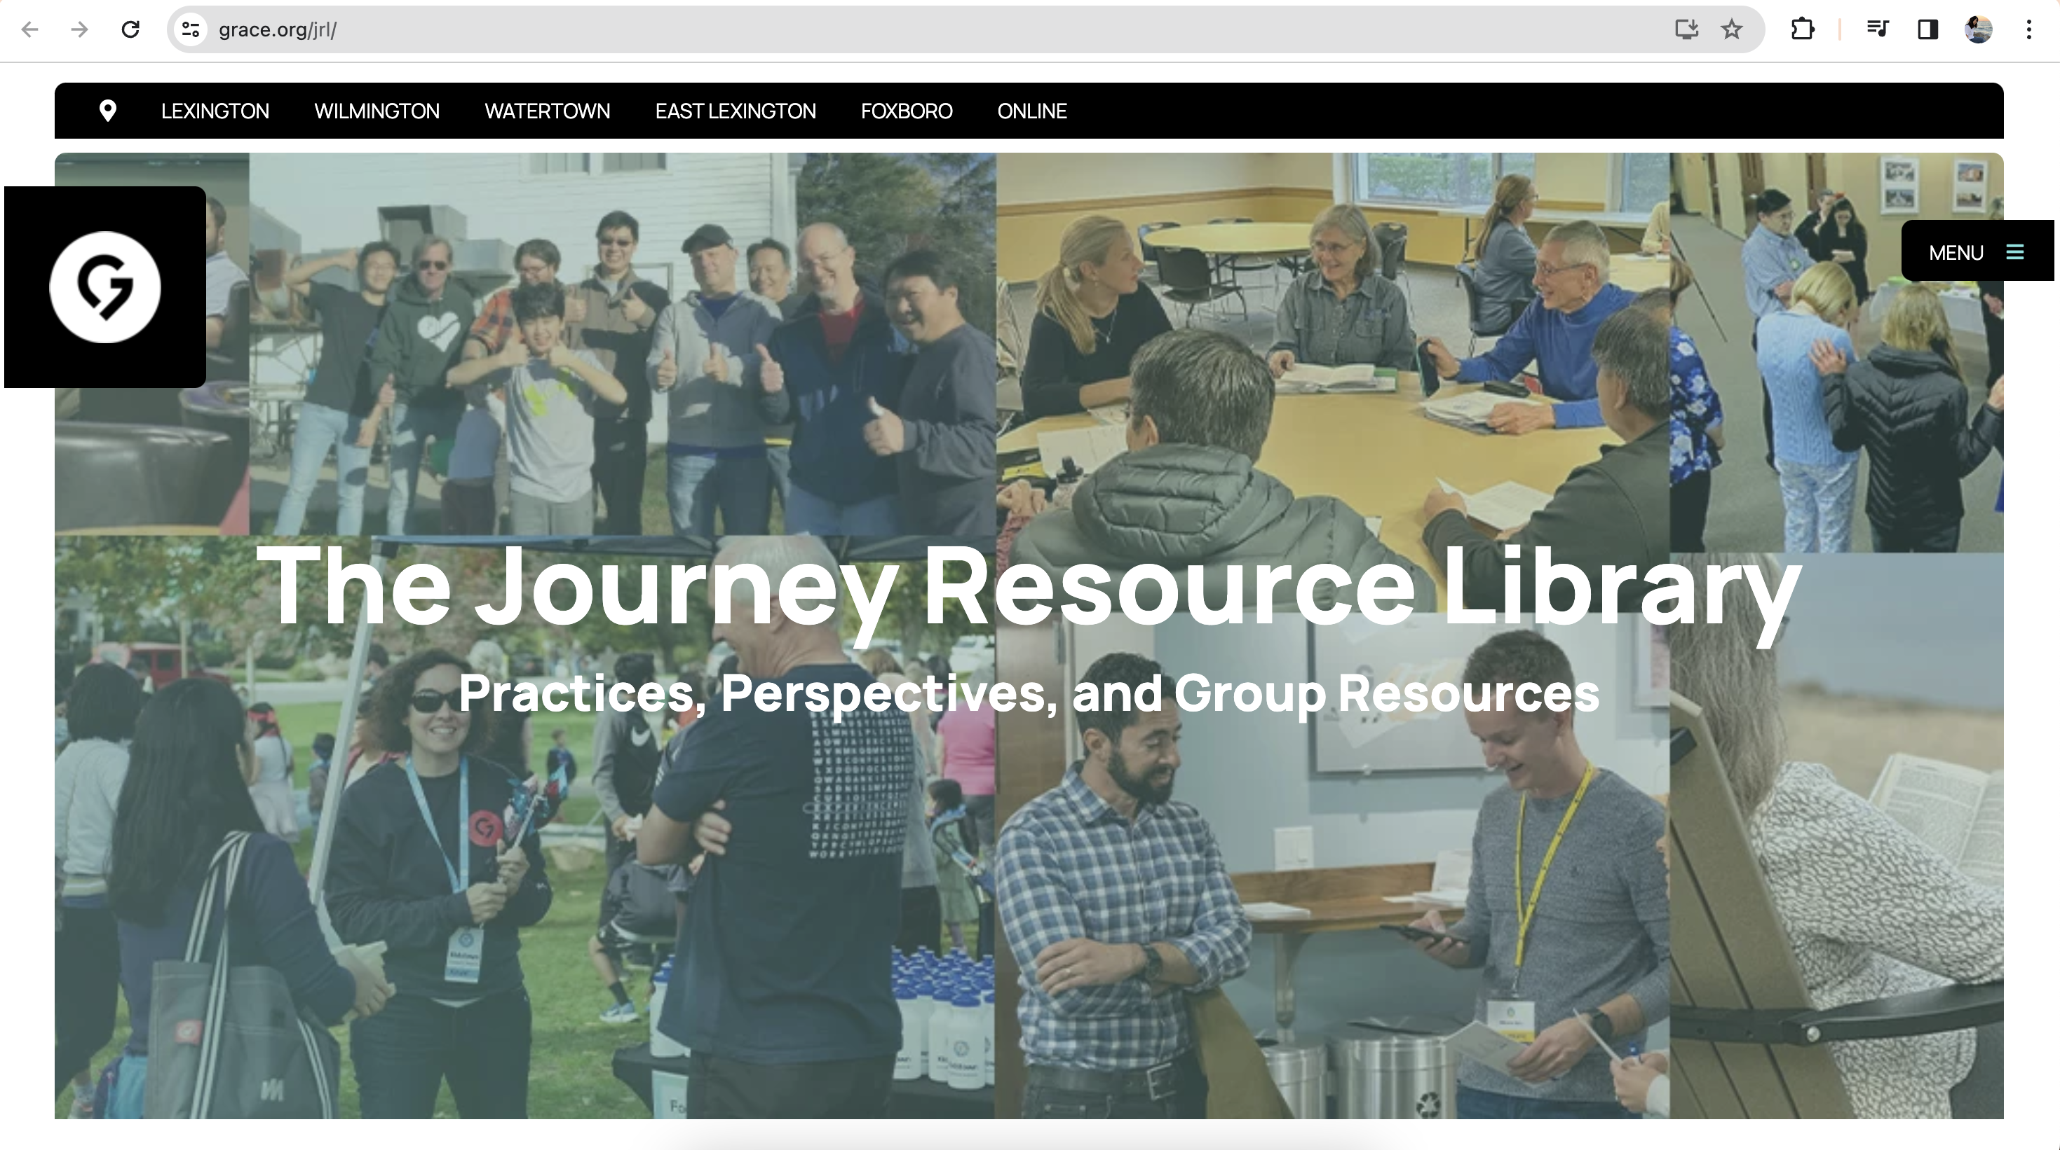

Slide 27
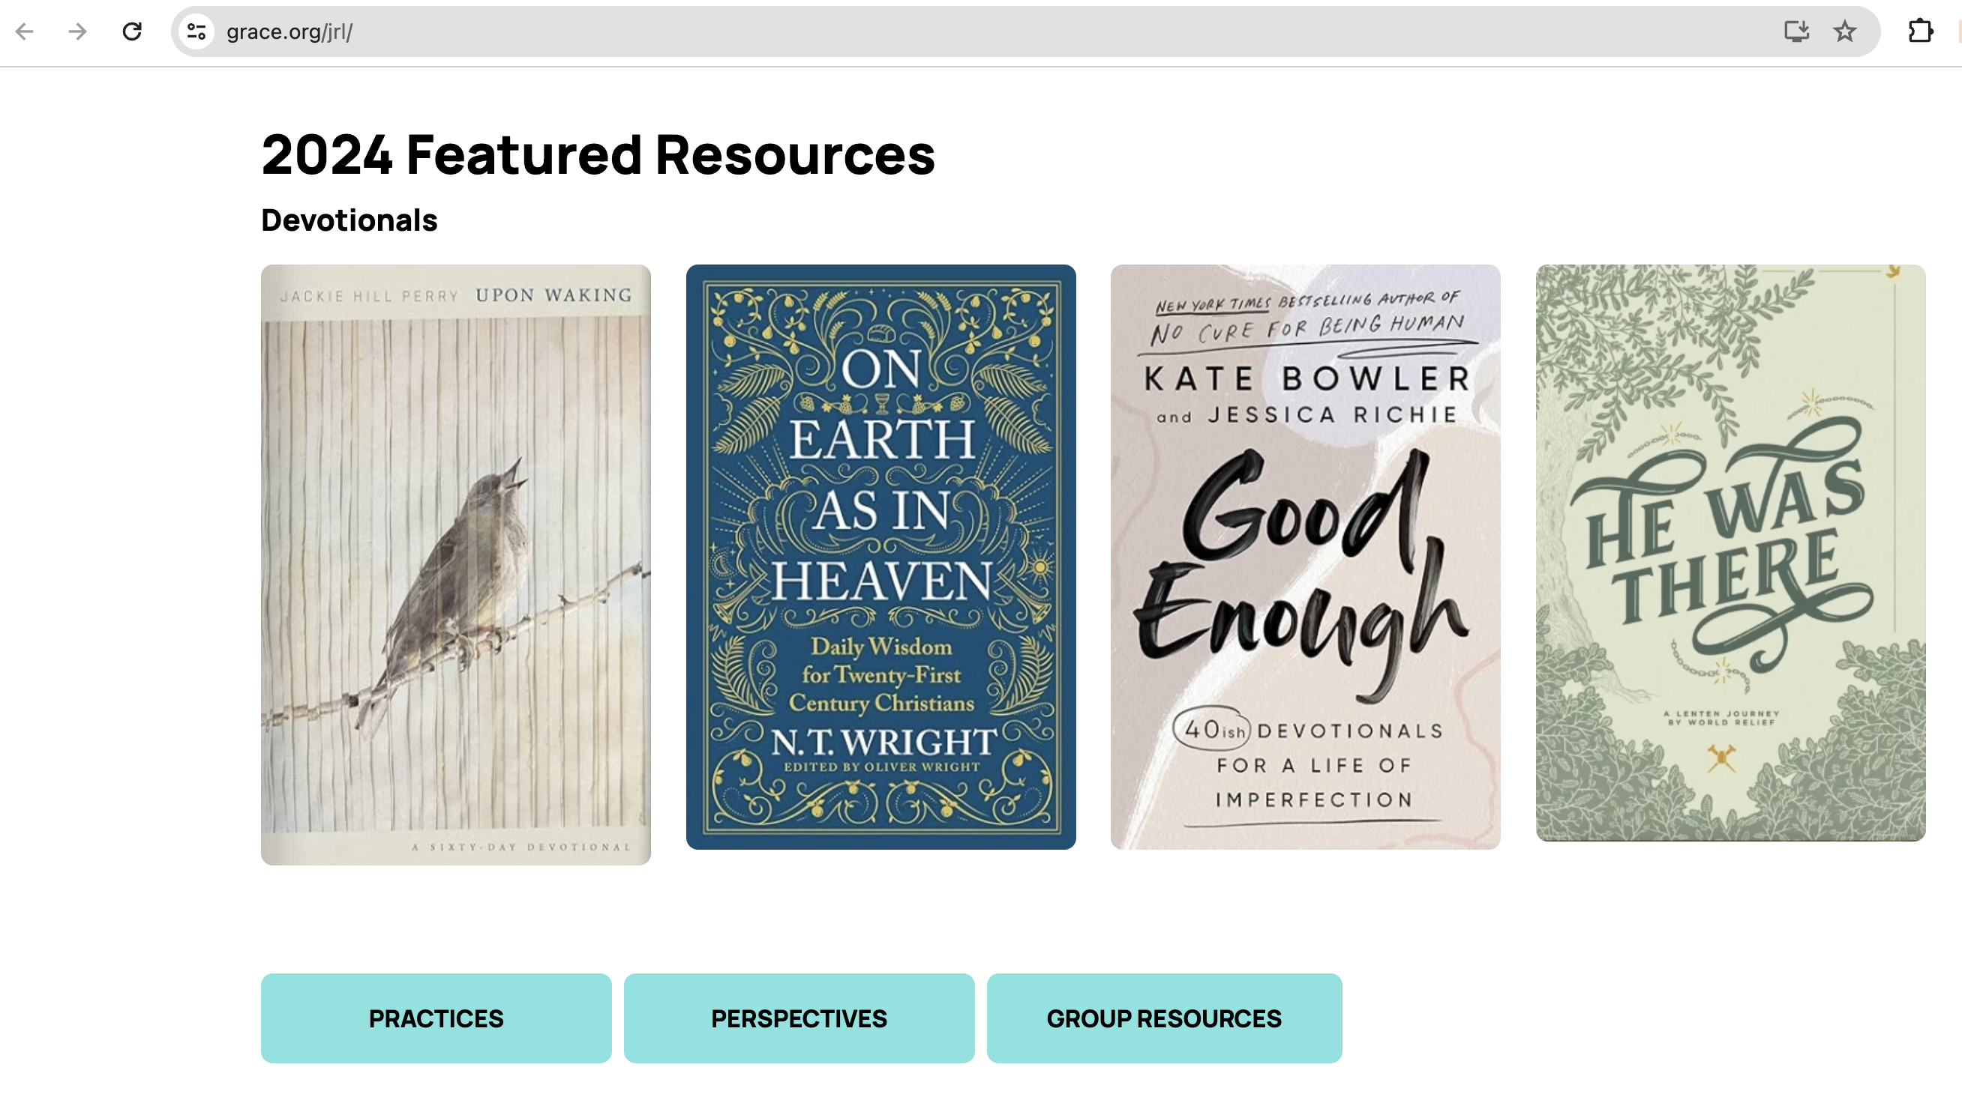
www.grace.org/jrl

Slide 28
https://grace.org/groupleaders https://grace.org/jrl https://grace.org/studyguide
Notes:
https://www.grace.org/groupleaders/

Slide 29
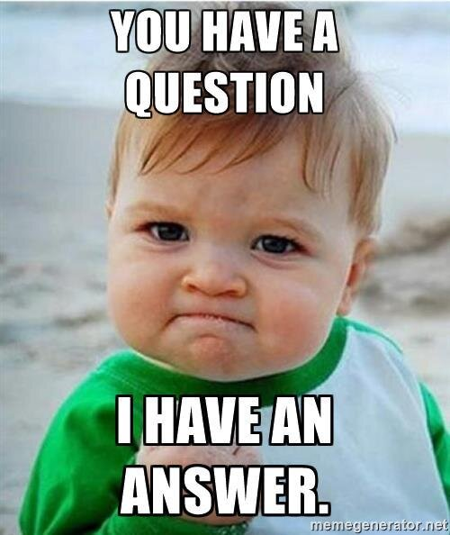
Q & A
Tim Ghali & Grace Lee
groups@grace.org

Slide 31
Connections
Dominic Bronico
Pastor of Connections and Young Adults

Slide 32
WHY DO PEOPLE GO TO CHURCH?
They are church hopping.
They are returning to church after stopping for a while.
Their friends brought them.
Something disrupted their life.

Slide 33
WHY DO PEOPLE GO TO CHURCH?
They Want to be Connected.

Slide 34
WHY DO PEOPLE STAY AT CHURCH?
They have built a relationship with Jesus.
Their friends/family also attend. (Found Community)
They find fulfillment in volunteering. (Make an impact)
They find practices that help them navigate life. (Grow with Practice

Slide 35
WHY DO PEOPLE STAY AT CHURCH?
They are Connected.

Slide 36
WHAT IS THE CONNECTIONS PROCESS
Problem: How can we personally connect, care for, and track newcomers when we have so many points of entry?
Solution: We create a funnel.

Slide 37
WHAT IS THE CONNECTIONS PROCESS
The Funnel:
  Connection Card→Follow-up→Connect with Grace

Slide 38
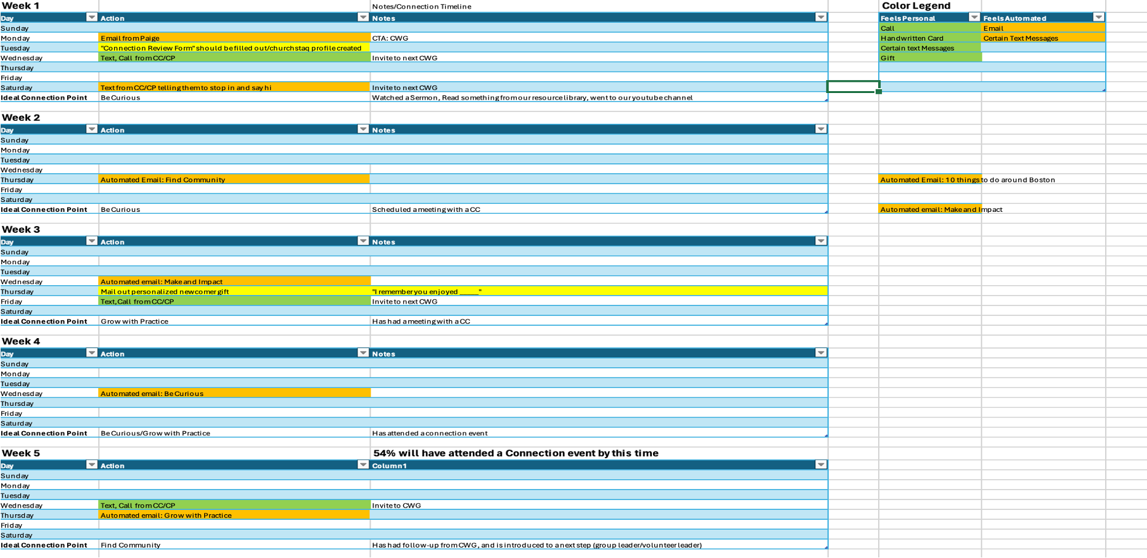
WHAT IS THE CONNECTIONS PROCESS

Slide 39
WHERE DO GROUP LEADERS COME IN?
The end point of the funnel.
  Be receptive
  Know your connection coaches
  Be responsive

Slide 41
CCB Group Leader Training
All you need to manage your groups in the palm of your hand
Sharon Whitehead, Director of Human Resources

Slide 42
What is CCB?
CCB is a one stop shop to manage all of your church involvement
Eventually, everyone will have access to their own CCB account
You can log in on your desktop, but most things are easier to do using the “LEAD App”. Today, you will learn:
How to log in
How to schedule your meetings
How to take attendance
How to communicate with your group
How to Update your group

Slide 43

Step 1: Download the App
Go to the app store on your phone
Search for “LEAD CCB”
Download the app with this icon:
Step 2: Activate your Account
Go into your email and find the email from GracechapelMA@ccbchurch.com

Slide 44
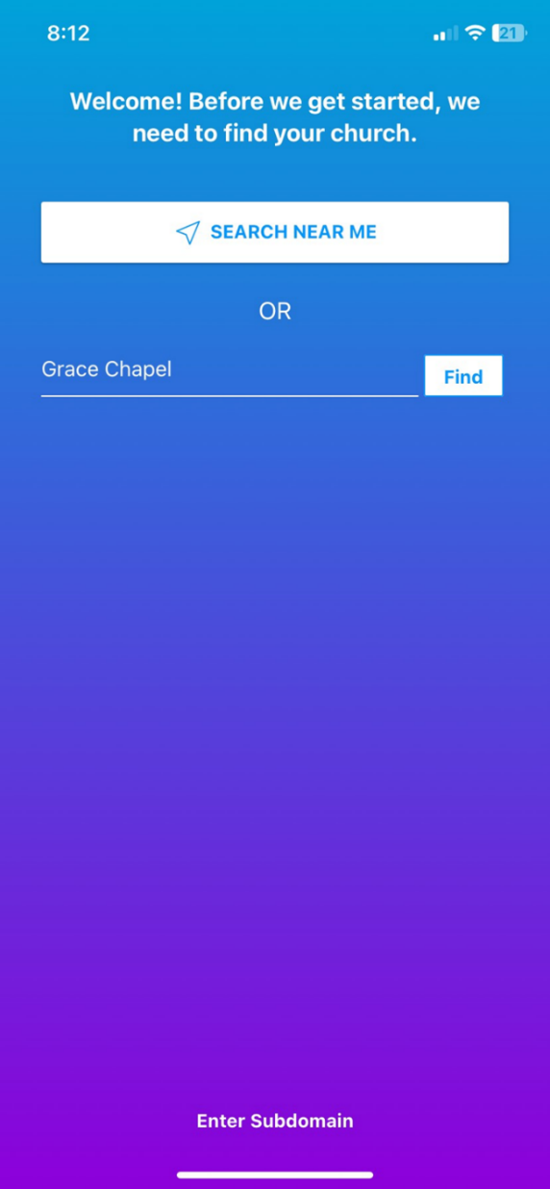
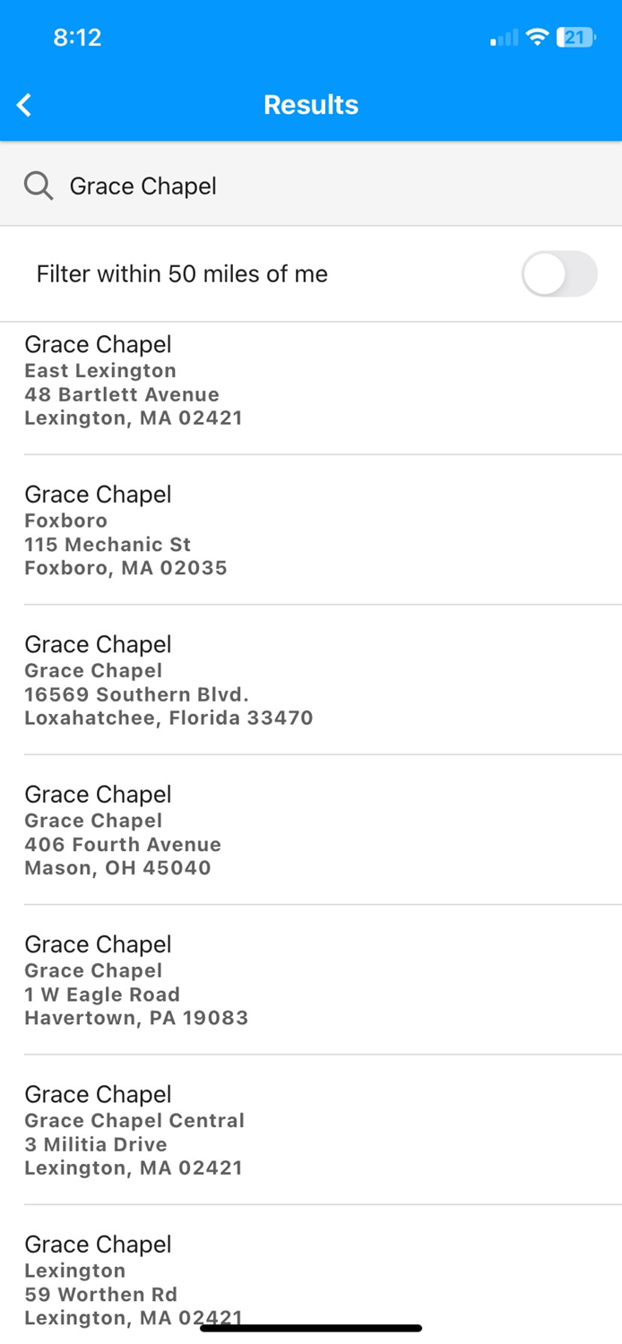

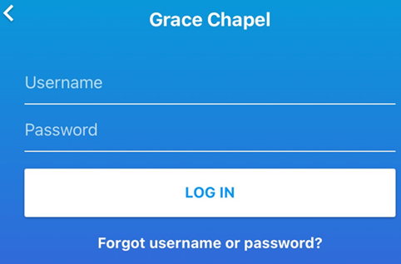
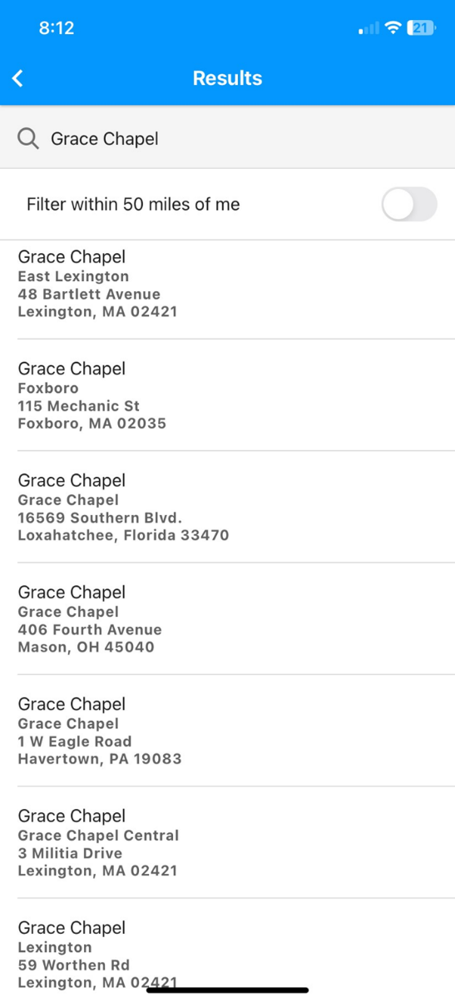
Step 3: Log into The Lead App
Search “Near me” or type in Grace Chapel or GraceChapelMA ​and select your campus
Enter your CCB login and password

Slide 45
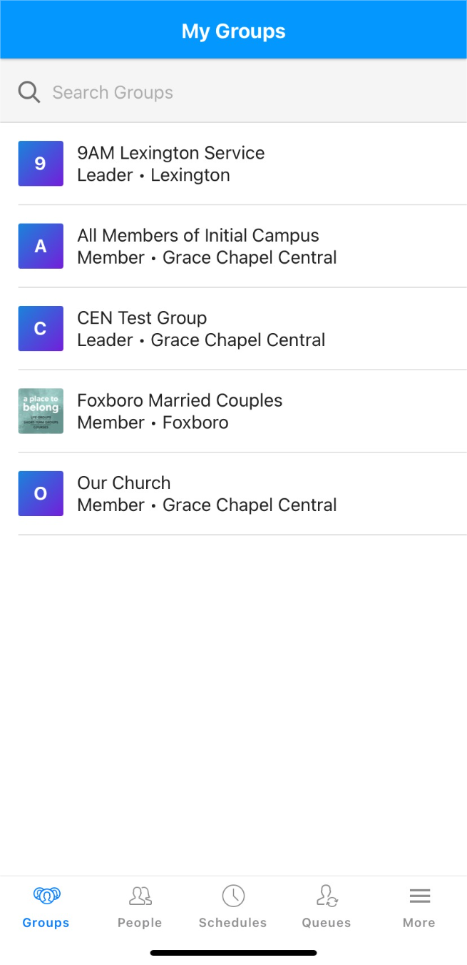
Now, Find your Group
Click on the Groups Icon
Most of the teams (such as volunteer teams) and groups you are a part of will appear in your list of groups
You can only make actions in groups you are a leader of.
All other Groups or teams will be read only

Slide 46
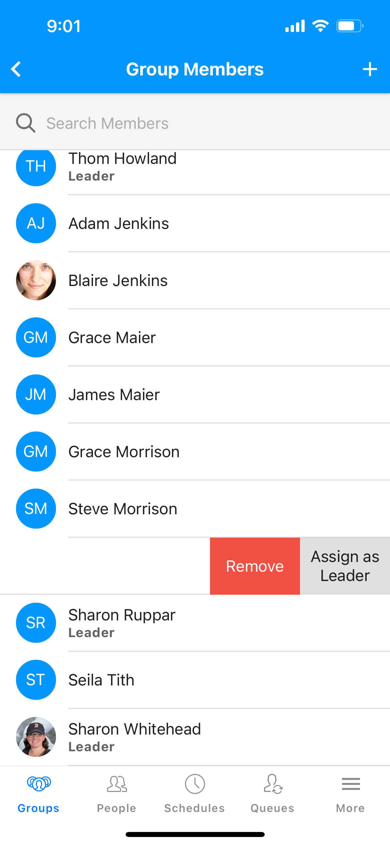
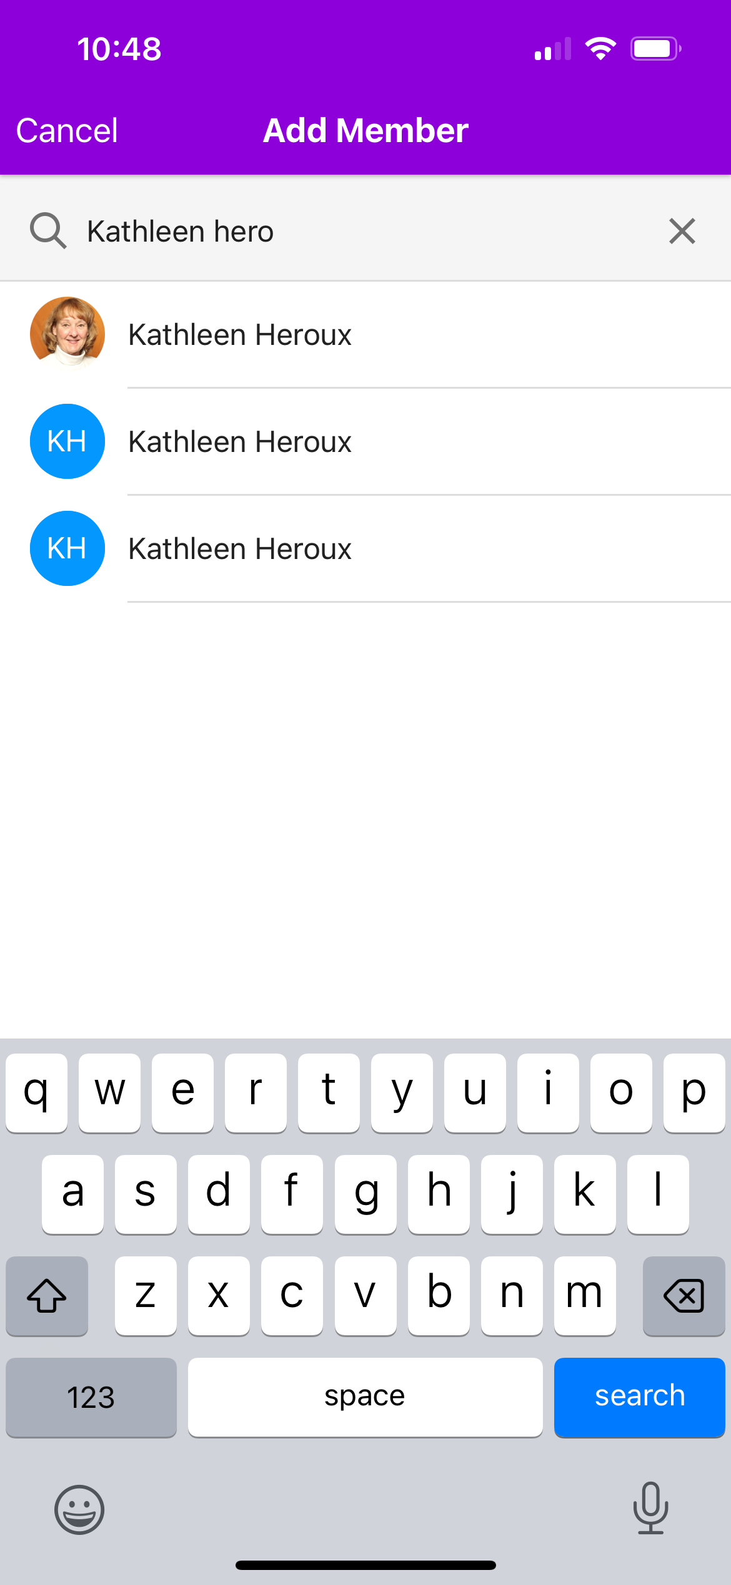
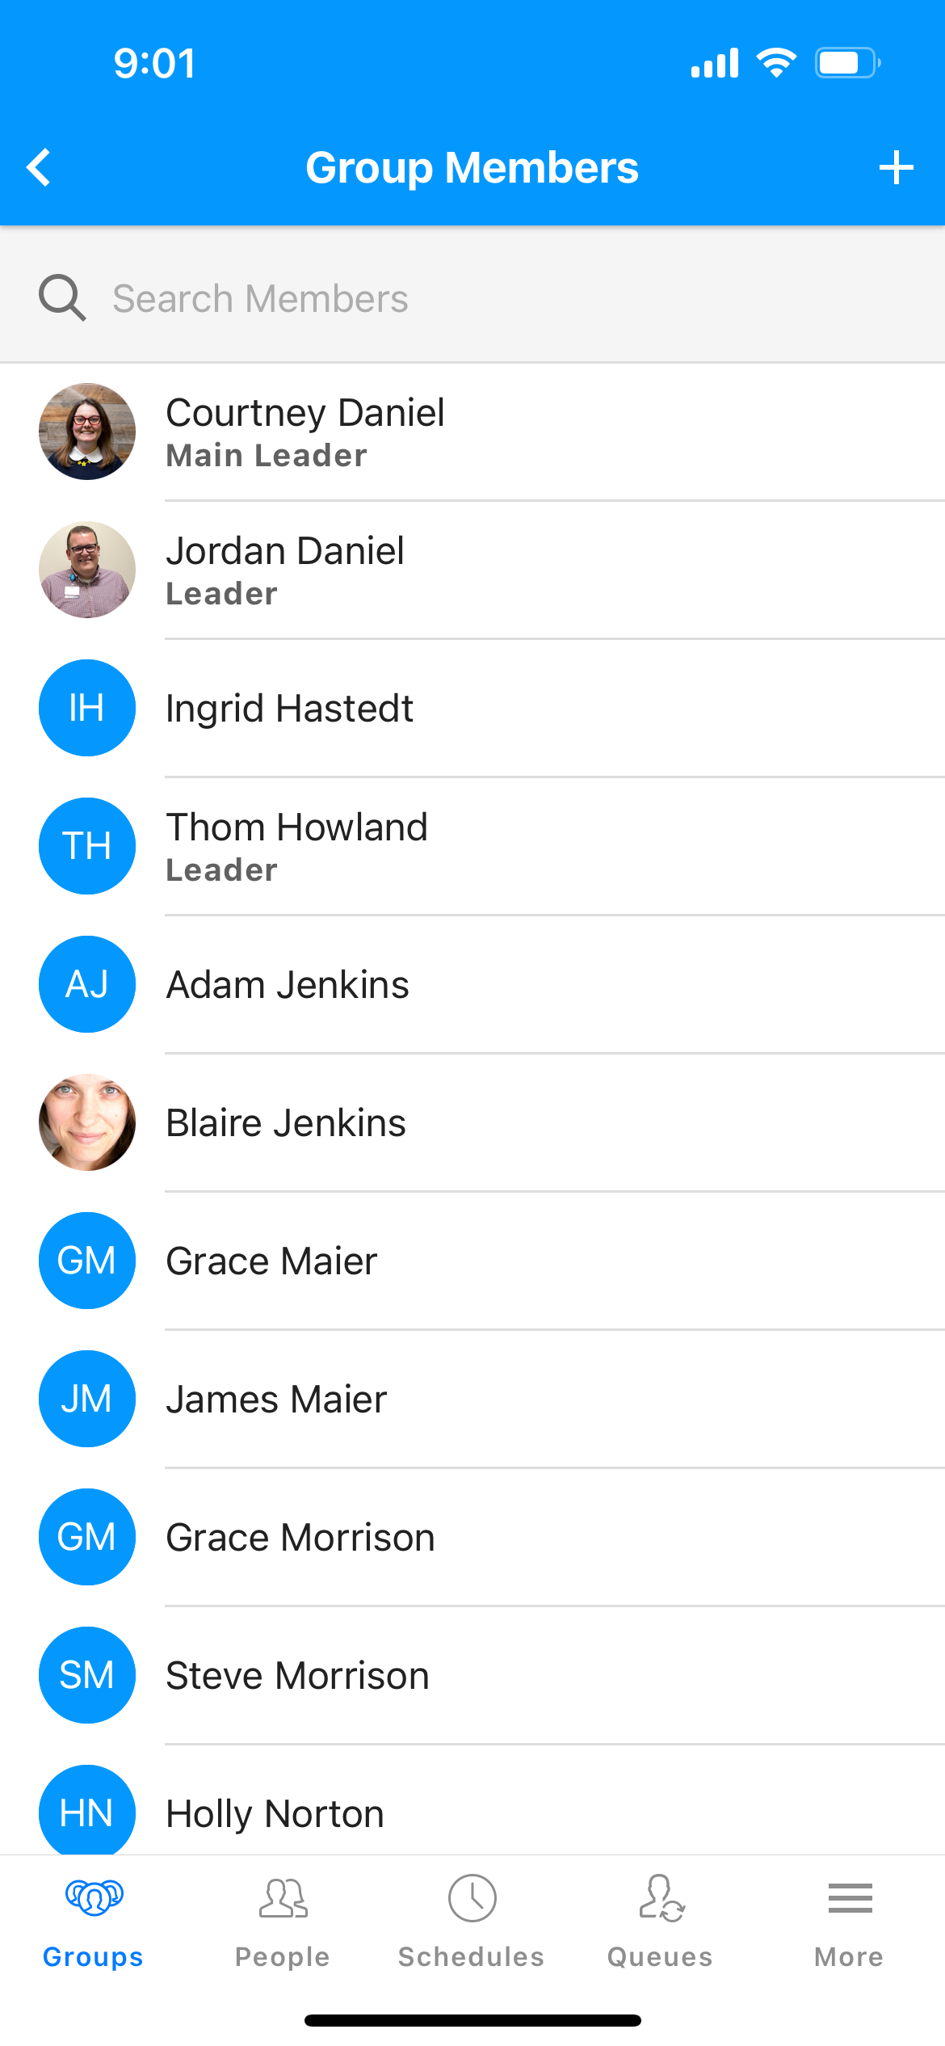
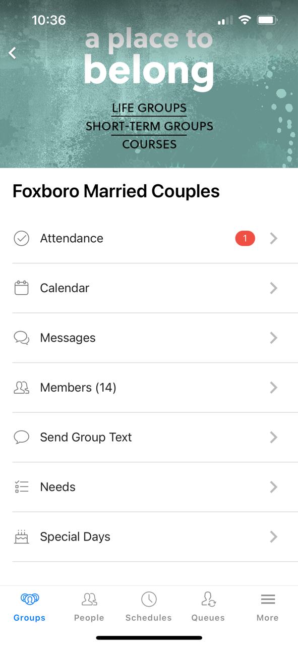
Next, check your Group Members
Click on Members
Make sure all the right people are on there
Swipe left to remove people from the group
Click the + sign to add new members
*If you see multiple people with the same name, note that and send to
Ccbquestions@grace.org

Slide 47
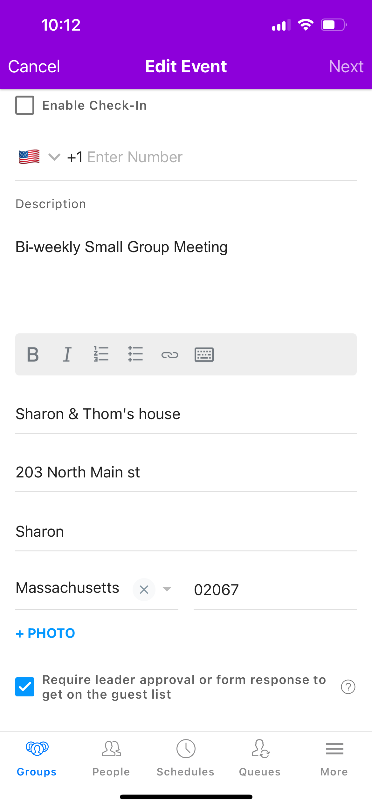
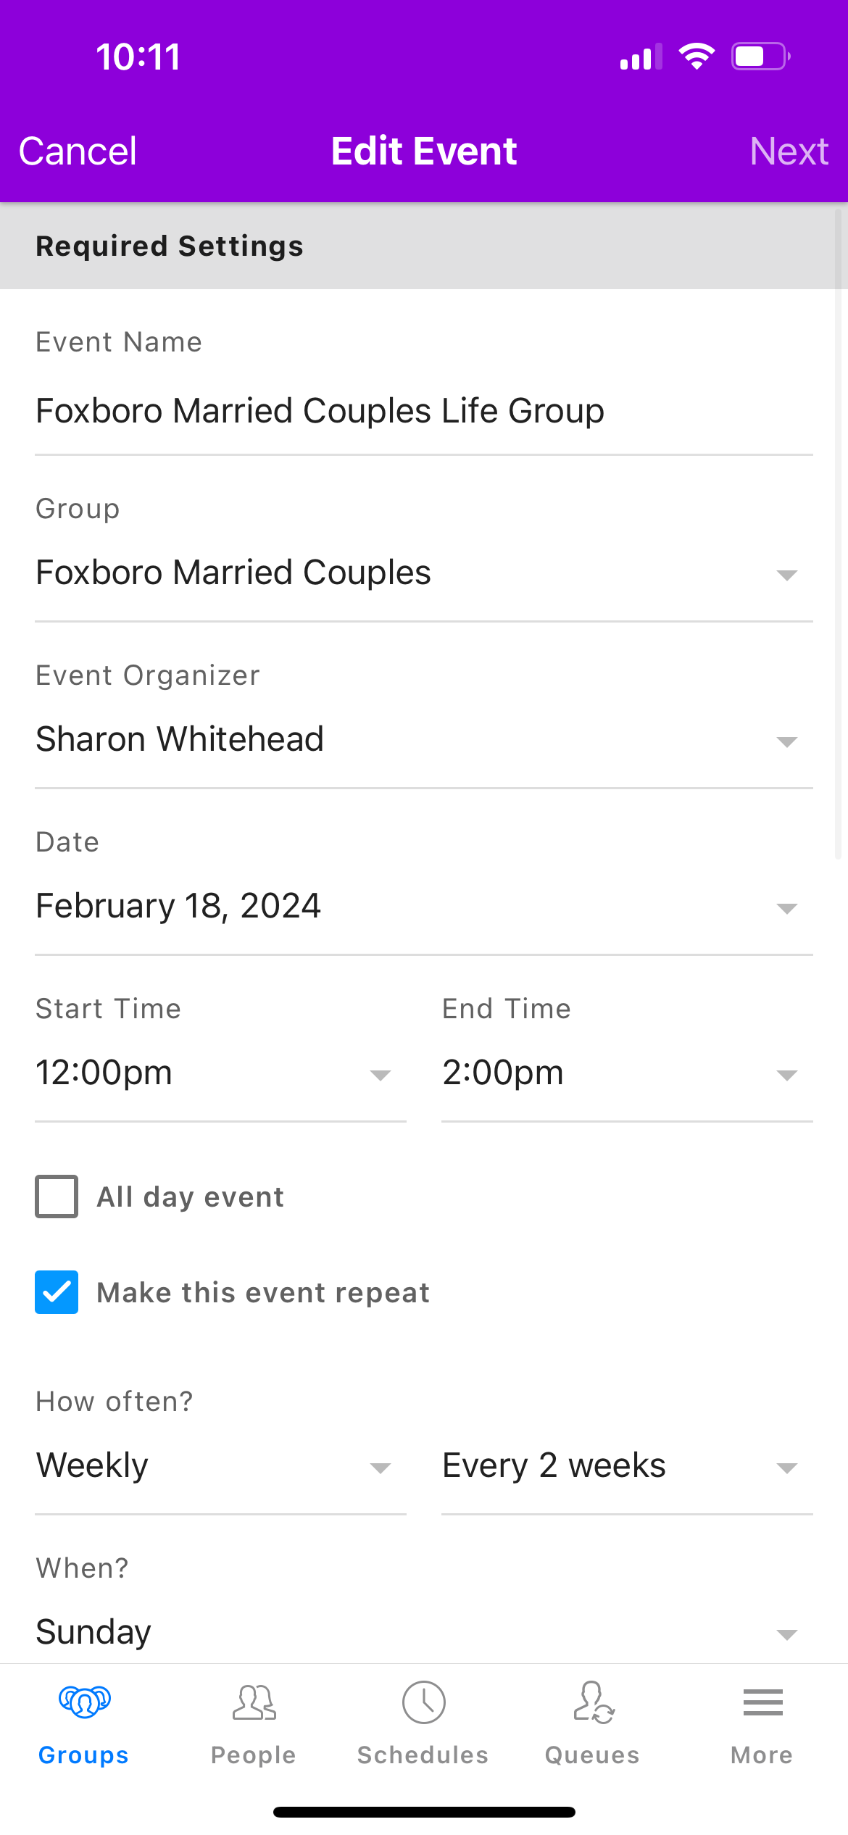
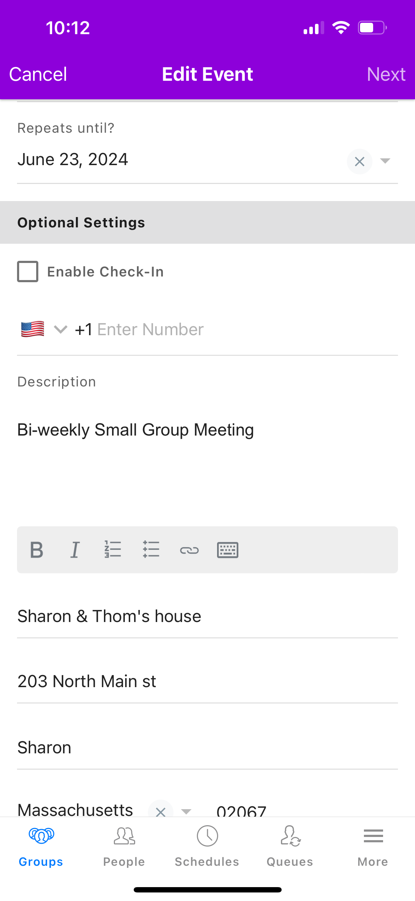
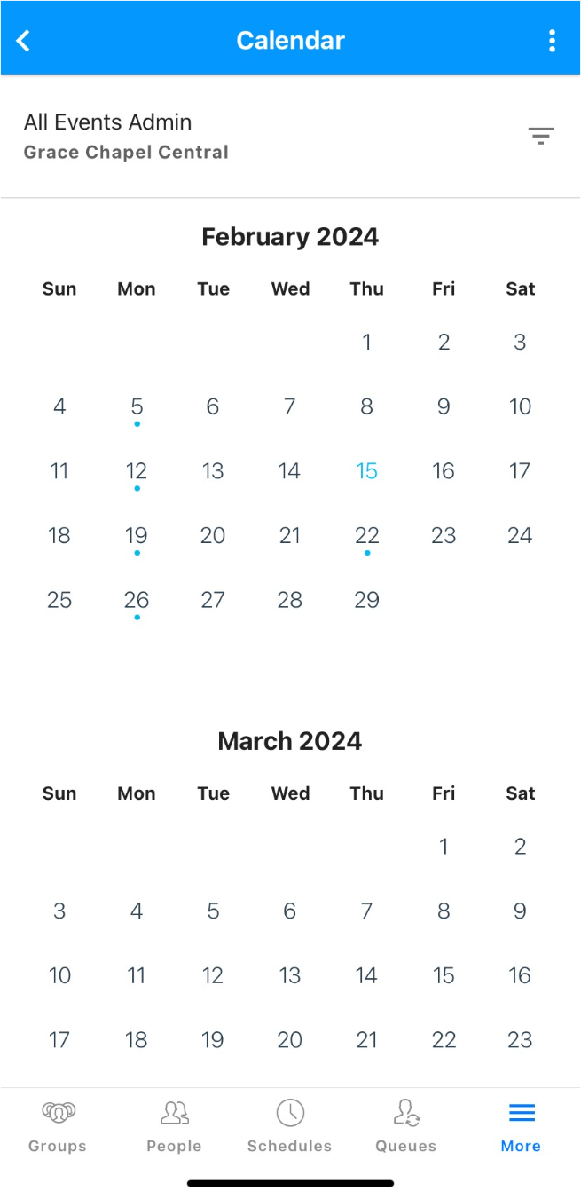
Adding your Meeting dates
Within your group, go to “Calendar”
Click on the 3 dots (Top right corner)
Click on Create Event
Pick the date of your LAST meeting (most recent meeting day/time) & enter the details
Click “Make this event repeat” and choose the right cadence
Do NOT check “enable check in”
Add location. This will be visible to your group members
Click “Require leader approval or form response to get on the guest list”
Click Save

Slide 48
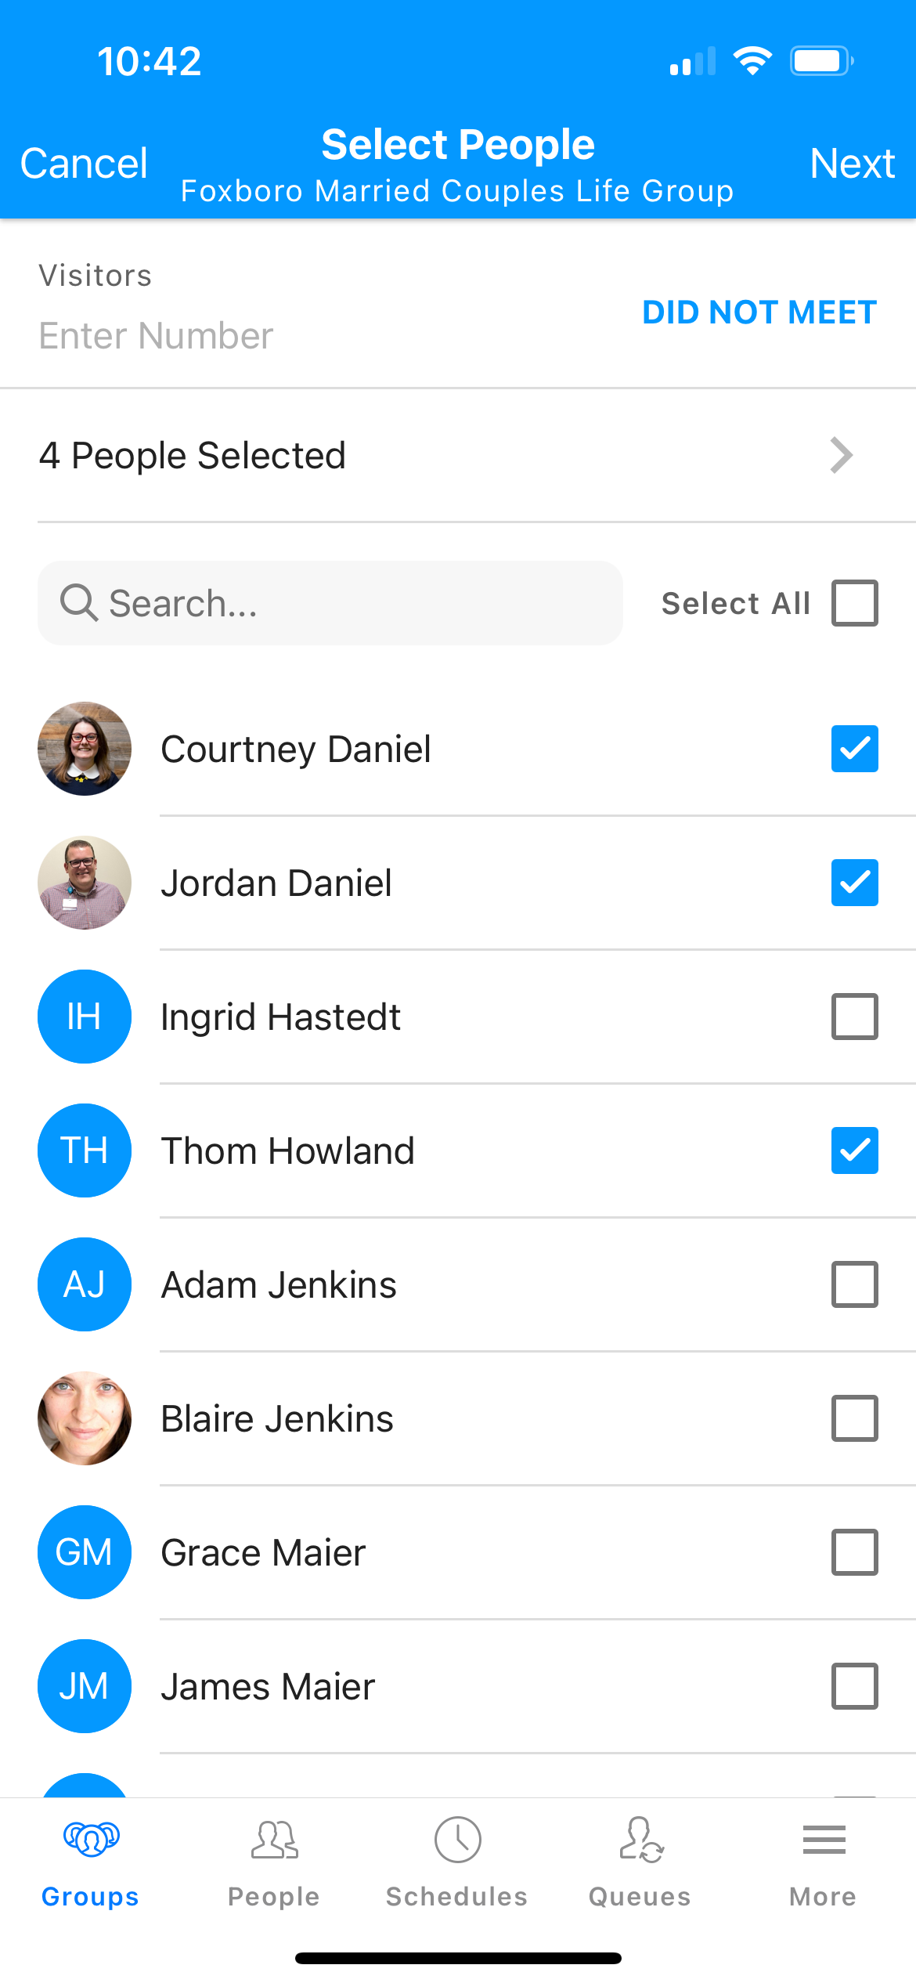
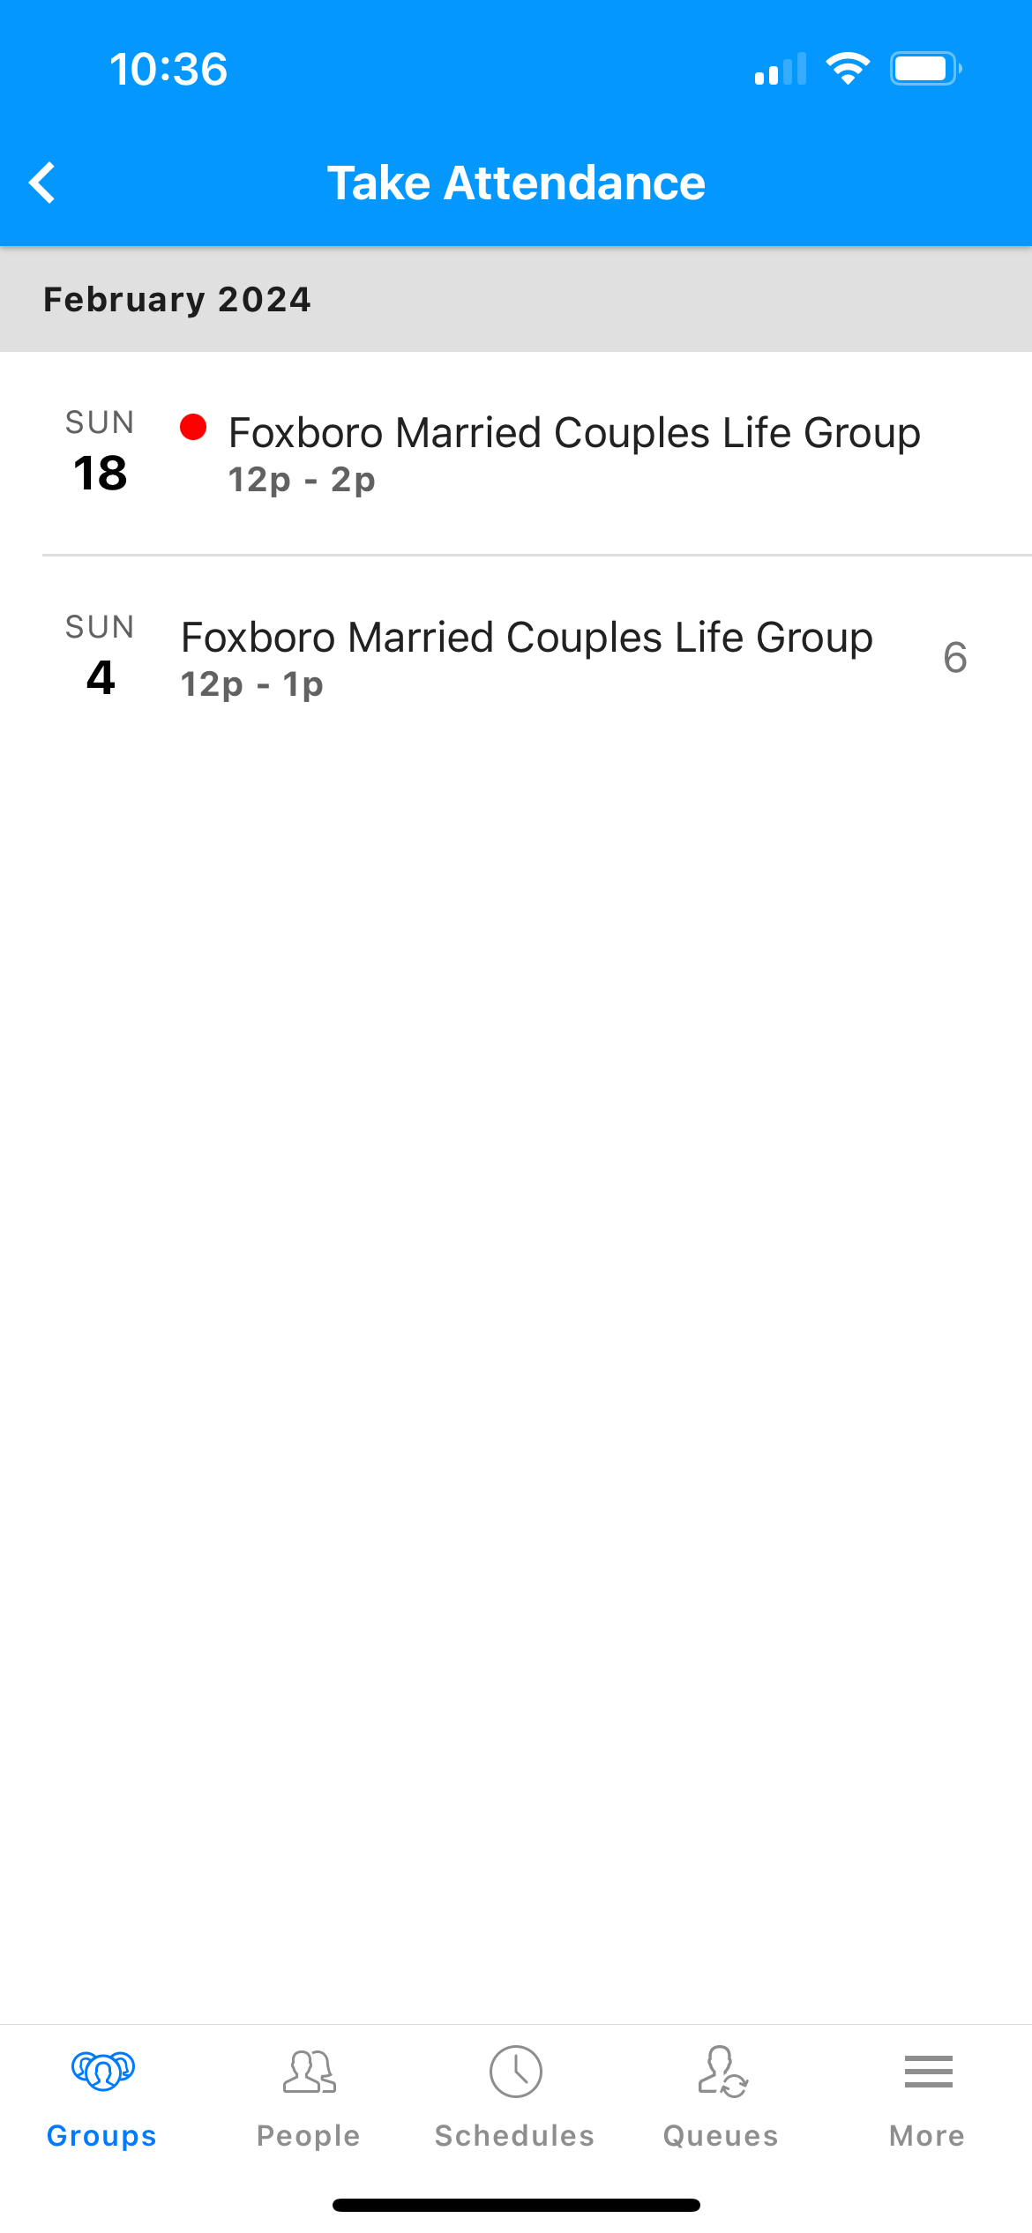
Take Attendance
From your group’s main menu, click “Attendance”
Only past meetings will appear
Click on your most recent meeting date
Check off the people who attended
Click Next

Slide 49
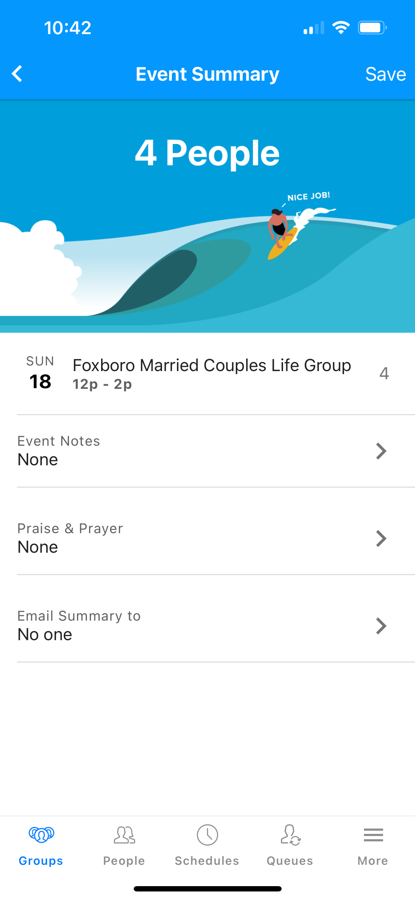
Adding Notes & Prayer Requests
From here, you can add
notes from the meeting
prayer requests
You can then either send the summary & Prayer requests to:
just the leaders
the whole group
Or, no one
Then, Click Save

Slide 50
Communicating with your groups
You can send an email to your whole group or just the group leaders in the Messages section
Click on the + button to create a new message
Note: The Text message feature is not ready for use just yet! This will be available in the future

Slide 51
Other Features
Special Days :
shows you the birthdays and anniversaries of your group members (Day and month).
Needs:
Gives you the ability to add needs for the group to volunteer for.
Ex: do you have a meal together and rotate who provides it? You can add that here.
It will also send them a reminder ☺

Slide 52
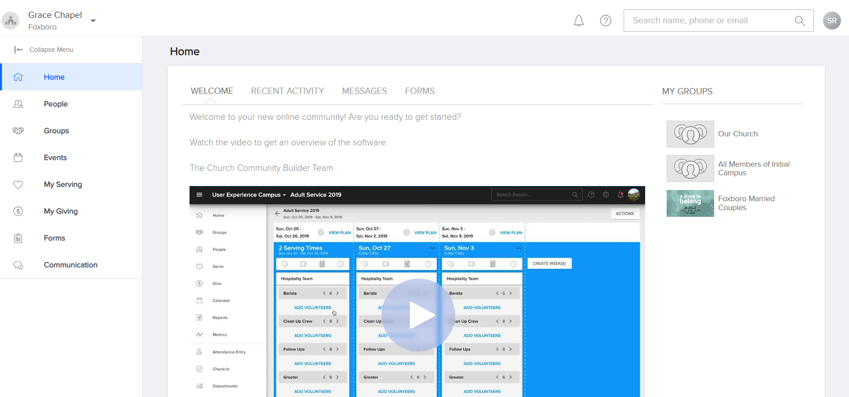
The Desktop Application
Go to www.gracechapelma.ccbchurch.com

Slide 53
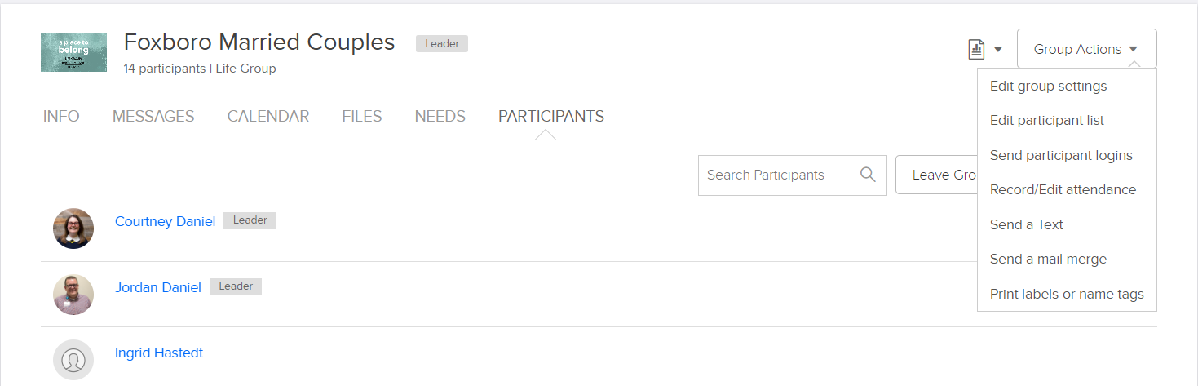
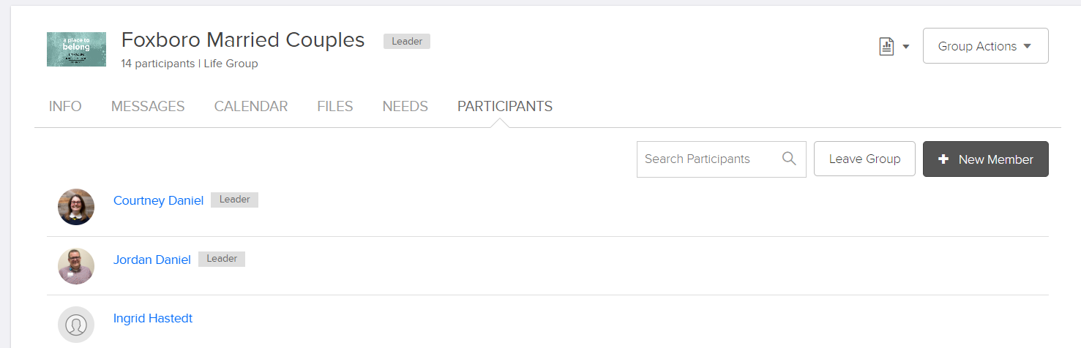
Editing your group

Slide 54
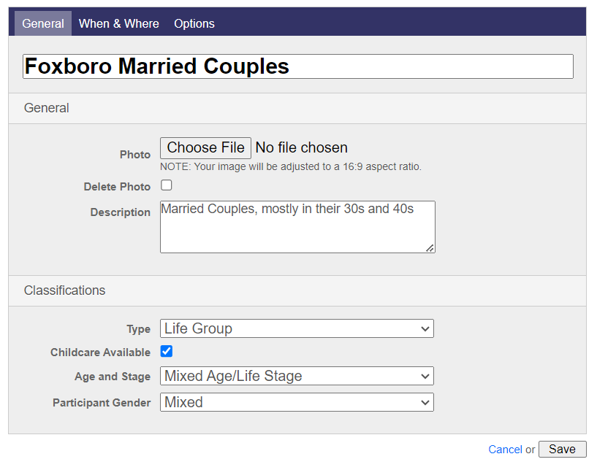
Updating your Group information
Information updated on this page will be reflected on the group finder. Make sure it is correct!
PLEASE DO NOT UPDATE YOUR GROUP NAME
If you would like your group to be activated or deactivated on the group finder, please reach out to your campus admin.
Types of Groups:
Life Group
Life Group Course (ex: Alpha)
Short Term Life Group (ex: Lent series)

Slide 55
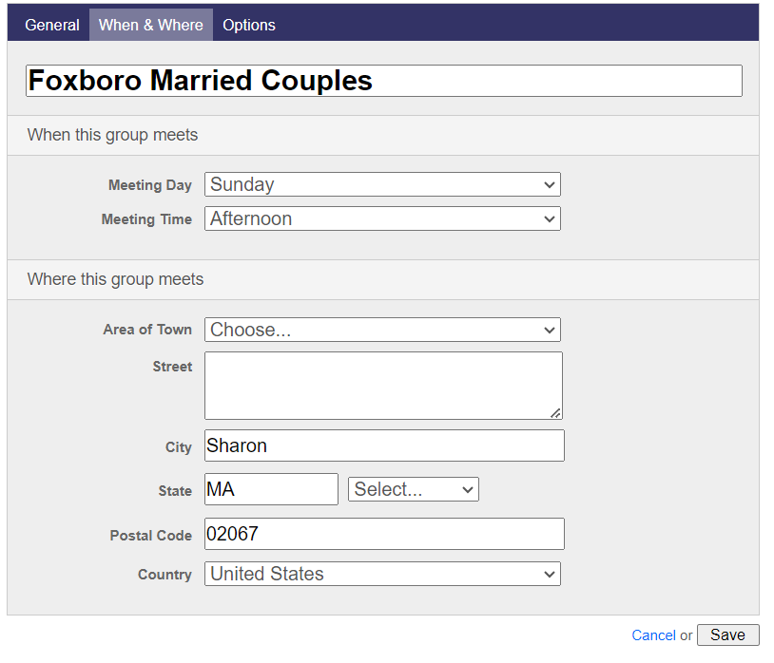
Updating your Group information
Make sure your meeting day & time is correct
Only select area of town if your group meets on a campus or online
Fill in the city, state and zip code (this will help your group be found on the groupfinder)
Please do not adjust any settings on the “Options” tab, unless instructed to do so by a member of staff.

Slide 56
Thank you!
If you have any questions about Groups, please email your Campus admin
If you have any questions or issues with CCB, or the lead app, please email:
CCBquestions@grace.org

Slide 58
CCB Group Leader Training
All you need to manage your groups in the palm of your hand

Slide 59
What is CCB?
CCB is a one stop shop to manage all of your church involvement
Eventually, everyone will have access to their own CCB account
You can log in on your desktop, but most things are easier to do using the “LEAD App”. Today, you will learn:
How to log in
How to schedule your meetings
How to take attendance
How to communicate with your group
How to Update your group

Slide 60
Step 1: Download the App
Go to the app store on your phone
Search for “LEAD CCB”
Download the app with this icon:
Step 2: Activate your Account
Go into your email and find the email from GracechapelMA@ccbchurch.com

Slide 61
Step 3: Log into The Lead App
Search “Near me” or type in Grace Chapel or GraceChapelMA ​and select your campus
Enter your CCB login and password

Slide 62
Now, Find your Group
Click on the Groups Icon
Most of the teams (such as volunteer teams) and groups you are a part of will appear in your list of groups
You can only make actions in groups you are a leader of.
All other Groups or teams will be read only

Slide 63
Next, check your Group Members
Click on Members
Make sure all the right people are on there
Swipe left to remove people from the group
Click the + sign to add new members
*If you see multiple people with the same name, note that and send to
Ccbquestions@grace.org

Slide 64
Adding your Meeting dates
Within your group, go to “Calendar”
Click on the 3 dots (Top right corner)
Click on Create Event
Pick the date of your LAST meeting (most recent meeting day/time) & enter the details
Click “Make this event repeat” and choose the right cadence
Do NOT check “enable check in”
Add location. This will be visible to your group members
Click “Require leader approval or form response to get on the guest list”
Click Save

Slide 65
Take Attendance
From your group’s main menu, click “Attendance”
Only past meetings will appear
Click on your most recent meeting date
Check off the people who attended
Click Next

Slide 66
Adding Notes & Prayer Requests
From here, you can add
notes from the meeting
prayer requests
You can then either send the summary & Prayer requests to:
just the leaders
the whole group
Or, no one
Then, Click Save

Slide 67
Communicating with your groups
You can send an email to your whole group or just the group leaders in the Messages section
Click on the + button to create a new message
Note: The Text message feature is not ready for use just yet! This will be available in the future

Slide 68
Other Features
Special Days :
shows you the birthdays and anniversaries of your group members (Day and month).
Needs:
Gives you the ability to add needs for the group to volunteer for.
Ex: do you have a meal together and rotate who provides it? You can add that here.
It will also send them a reminder ☺

Slide 69
The Desktop Application
Go to www.gracechapelma.ccbchurch.com

Slide 70
Editing your group

Slide 71
Updating your Group information
Information updated on this page will be reflected on the group finder. Make sure it is correct!
PLEASE DO NOT UPDATE YOUR GROUP NAME
If you would like your group to be activated or deactivated on the group finder, please reach out to your campus admin.
Types of Groups:
Life Group
Life Group Course (ex: Alpha)
Short Term Life Group (ex: Lent series)

Slide 72
Updating your Group information
Make sure your meeting day & time is correct
Only select area of town if your group meets on a campus or online
Fill in the city, state and zip code (this will help your group be found on the groupfinder)
Please do not adjust any settings on the “Options” tab, unless instructed to do so by a member of staff.

Slide 73
Thank you!
If you have any questions about Groups, please email your Campus admin
If you have any questions or issues with CCB, or the lead app, please email:
CCBquestions@grace.org

