Slide 1


Slide 2
Sermon on the Mount Background
Probable location
Context
Content
Structure

Slide 3
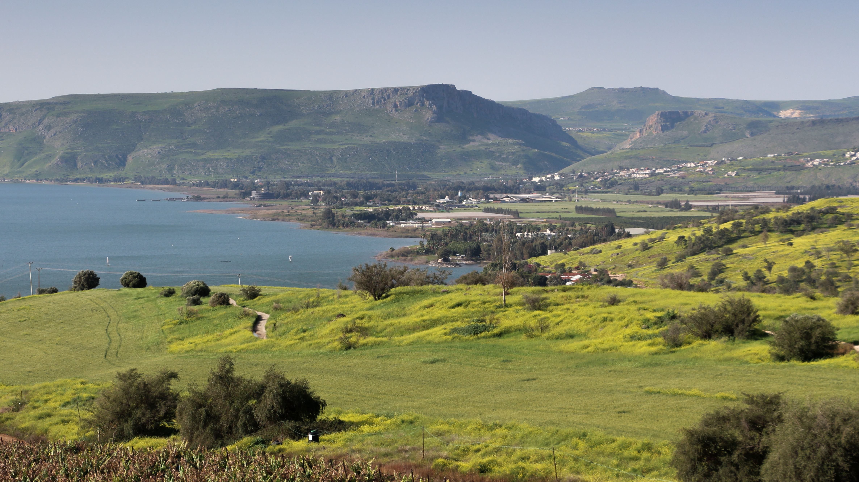

Slide 4
Sermon on the Mount Background
Probable location: a hillside near Capernaum
Context
Content

Slide 5
Sermon on the Mount Background
Probable location: a hillside near Capernaum
Context: first of five discourses; summary of longer teaching?
Content

Slide 6
Sermon on the Mount Background
Probable location: a hillside near Capernaum
Context: first of five discourses; summary of longer teaching?
Content: countercultural values of God’s kingdom; “the radical reality of everyday discipleship lived in the presence and power of the kingdom of God”

Slide 7
Matthew 5
Introduction
  vv. 1-2: Setting
  vv. 3-12: The Beatitudes
  vv. 13-16: Jesus’ Followers (Salt and Light)
  vv. 17-20: The Fulfillment of the Law
First section (“Six Antitheses”)
  vv. 21-26: Murder
  vv. 27-30: Adultery
  vv. 31-32: Divorce
  vv. 33-37: Oaths
  vv. 38-42: Eye for Eye
  vv. 43-48: Love for Enemies

Slide 8
Matthew 5:1-2: Setting
“Now when Jesus saw the crowds, he went up on a mountainside and sat down. His disciples came to him, and he began to teach them.”
mountains as sites of divine revelation (Ex. 19:3)
rabbis sat to teach
crowds, disciples, all of Israel

Slide 9
MT. 5:3-12: The Beatitudes
“Blessed are the poor in spirit…”
the blessings of the Kingdom of God
familiar format from OT (see Psalm 1)
reversal of expectation and of circumstance
those who most need mercy and justice, and those who bring mercy and justice to others
How have you experienced these blessings?

Slide 10
Matthew 5:13-16: Salt & Light
“You are the salt of the earth…You are the light of the world….”
“already but not yet”
salt as a vital necessity for everyday life
“a light to the nations” (Is. 42:6; 49:6)
What does it mean to be “salt and light”? Can you give a concrete example?

Slide 11
MT. 5:17-20: Fulfillment
“Do not think that I have come to abolish the Law or the Prophets; I have not come to abolish them but to fulfill them….”
completing, clarifying, demonstrating God’s purpose/intent in the Scriptures
righteousness from the inside out
the lasting validity of the Hebrew Scriptures

Slide 12
MT. 5:21-48: “Six Antitheses”
“You have heard that it was said…”
“I came not to abolish but to fulfill…”
proactive, positive action
Jesus’s objection is to misuse of the law
Torah = instruction
consistency between attitude and action
internal attitudes, which are the root or source of our sinful behavior

Slide 13
MT. 5:21-48: “Six Antitheses”
addressing the root of the problem
  anger as the root of murder
  lust as the root of adultery
divorce (Deut. 24:1) & oaths
nonretaliation
  “If anyone slaps you on the right cheek…”
  “If anyone forces you to go one mile…”

Slide 14
MT. 5:21-48: “Six Antitheses”
rights vs. responsibilities
love of enemies
  love of neighbors/God’s hatred of evil
  God’s love of all persons
  love of neighbor includes even enemies
What might Jesus be saying to you personally?

Slide 15
Announcements & Reminders
Visitors Week, October 22nd (and 23rd?)
  Invite cards available
  Please feel free to bring treats to share!
Large-group teaching next two weeks
November 5: Global Awareness Week Women’s Groups Event in LEX

Slide 16
Prayer

