Slide 1
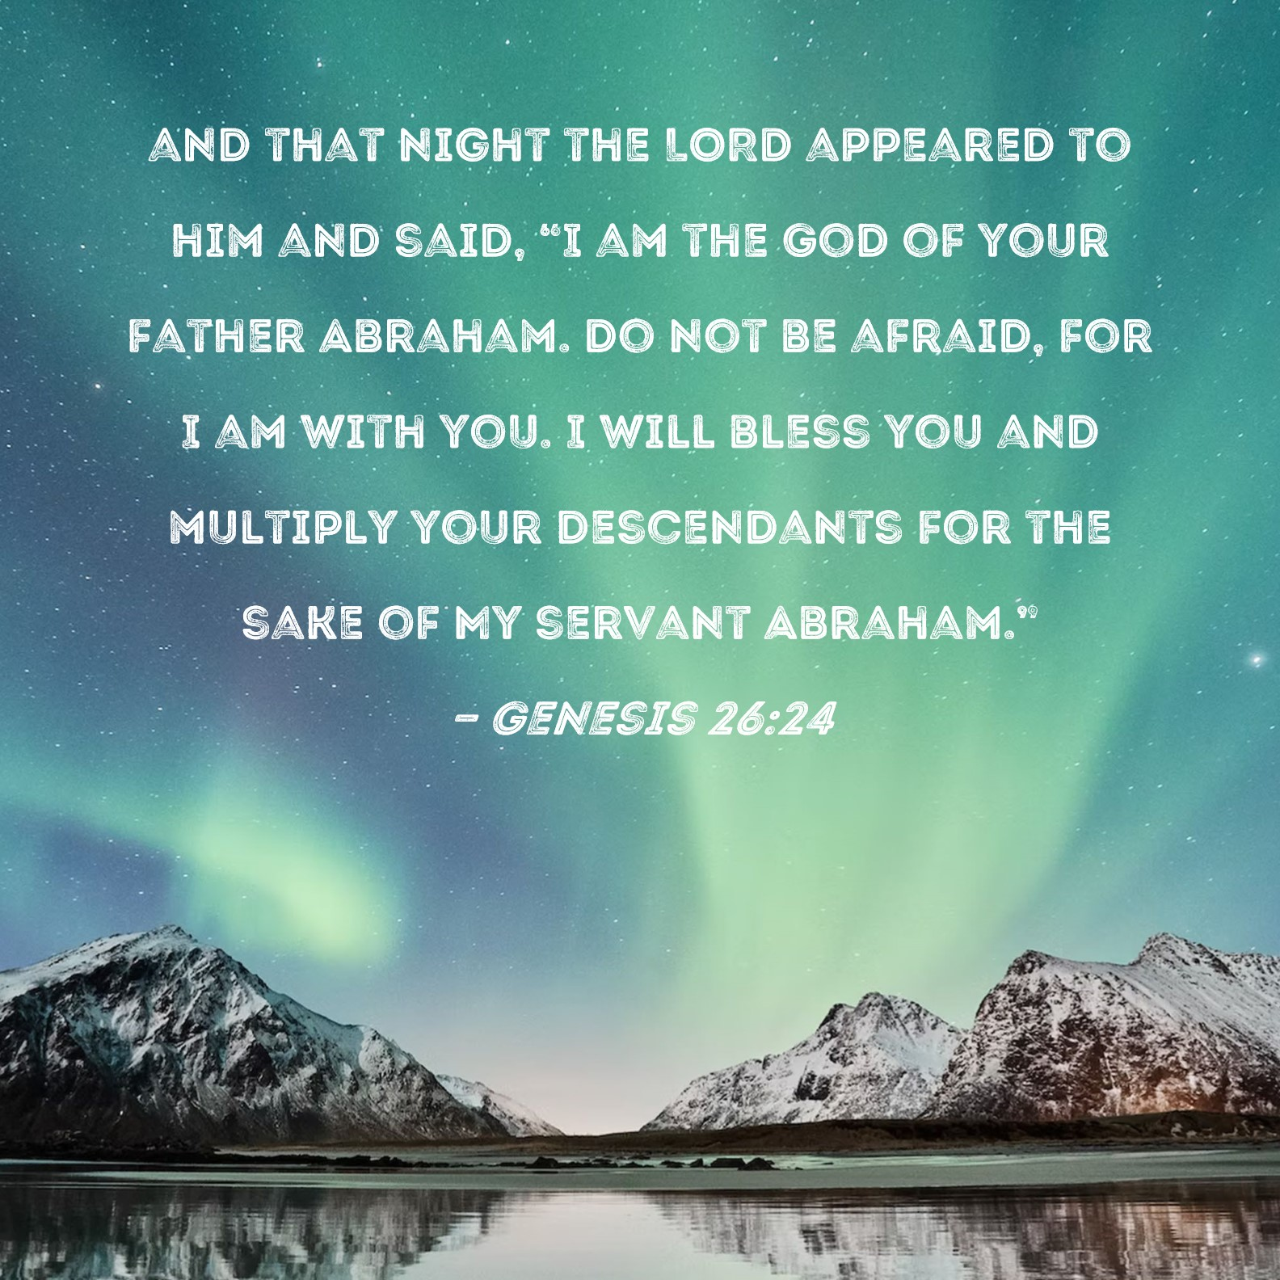

Slide 2


Slide 3
Announcements & Reminders
Women’s Luncheon, Saturday, Nov. 4th.
  10:30am to 1pm
  Cost: $20 per person
  Register at www.grace.org/events

Slide 4
“God of…”
Gen. 9:26: “He also said, ‘Praise be to the LORD, the God of Shem!’”
Gen. 17:7: “I will establish my covenant as an everlasting covenant between me and you and your descendants after you for the generations to come, to be your God and the God of your descendants after you.”
Gen. 24:3: “I want you to swear by the Lord, the God of heaven and the God of earth”

Slide 5
“God of…”
Gen. 26:24: “I am the God of your father Abraham”; Acts 3:13: “The God of Abraham, Isaac and Jacob, the God of our fathers, has glorified his servant Jesus.”
Gen. 31:13: “I am the God of Bethel, where you anointed a pillar and where you made a vow to me. Now leave this land at once and go back to your native land.”

Slide 6
“God of…”
Gen. 31:42: “If the God of my father, the God of Abraham and the Fear of Isaac, had not been with me, you would surely have sent me away empty-handed.”
Ex. 7:6: “The LORD, the God of the Hebrews, has sent me to say to you: Let my people go, so that they may worship me in the wilderness.”

Slide 7
“God of…”
Deut. 10:17: “For the Lord your God is God of gods and Lord of lords, the great God, mighty and awesome, who shows no partiality and accepts no bribes.”
Deut. 26:7: “Then we cried out to the LORD, the God of our ancestors, and the Lord heard our voice and saw our misery, toil and oppression.”; Acts 5:30: “The God of our ancestors raised Jesus from the dead—whom you killed by hanging him on a cross.”

Slide 8
“God of…”
1 Sam. 17:45: “‘You come against me with sword and spear and javelin, but I come against you in the name of the LORD Almighty, the God of the armies of Israel, whom you have defied.’”
Ps. 29:3: “The voice of the LORD is over the waters; the God of glory thunders, the LORD thunders over the mighty waters.”
Ps. 42:8: “By day the LORD directs his love, at night his song is with me—a prayer to the God of my life.”

Slide 9
“God of…”
Ps. 50:6: “And the heavens proclaim his righteousness, for he is a God of justice.”
Is. 41:17: “When the poor and needy seek water, and there is none, and their tongue is parched with thirst, I the LORD will answer them, I the God of Israel will not forsake them.”; Mt. 15:31: “The people were amazed when they saw the mute speaking, the crippled made well, the lame walking and the blind seeing. And they praised the God of Israel.”

Slide 10
“God of…”
Jer. 32:27: “I am the Lord, the God of all mankind. Is anything too hard for me?”
Dan. 3:28: “Then Nebuchadnezzar said, ‘Praise be to the God of Shadrach, Meshach and Abednego, who has sent his angel and rescued his servants!’”
Rom. 15:33: “The God of peace be with you all. Amen.”

Slide 11
“God of…”
2 Cor. 1:3: “Praise be to the God and Father of our Lord Jesus Christ, the Father of compassion and the God of all comfort…”
2 Cor. 13:11: “Finally, brothers and sisters, rejoice! Strive for full restoration, encourage one another, be of one mind, live in peace. And the God of love and peace will be with you.”

Slide 12
“God of…”
Eph. 1:17: “I keep asking that the God of our Lord Jesus Christ, the glorious Father, may give you the Spirit of wisdom and revelation, so that you may know him better.”
1 Pet. 5:10: “And the God of all grace, who called you to his eternal glory in Christ, after you have suffered a little while, will himself restore you and make you strong, firm and steadfast.”

Slide 13
“God of…”
What do all these “God of…” passages reveal to us about God?
  personal and relational
  transcendent
  unchanging

Slide 14
Genesis 24:1-14
Abraham was now very old, and the LORD had blessed him in every way. ² He said to the senior servant in his household, the one in charge of all that he had, “Put your hand under my thigh. ³ I want you to swear by the Lord, the God of heaven and the God of earth, that you will not get a wife for my son from the daughters …

Slide 15
Genesis 24:1-14, cont.
⁶ “Make sure that you do not take my son back there,” Abraham said. ⁷ “The LORD, the God of heaven, who brought me out of my father’s household and my native land and who spoke to me and promised me on oath, saying, ‘To your offspring I will give this land’—he will send his angel before you so that you can get a wife for my

Slide 16
Genesis 24:1-14, cont.
son from there. ⁸ If the woman is unwilling to come back with you, then you will be released from this oath of mine. Only do not take my son back there.” ⁹ So the servant put his hand under the thigh of his master Abraham and swore an oath to him concerning this matter.

Slide 17
Genesis 24:1-14, cont.
¹² Then he prayed, “Lord, God of my master Abraham, make me successful today, and show kindness to my master Abraham. ¹³ See, I am standing beside this spring, and the daughters of the townspeople are coming out to draw water. ¹⁴ May it be that when I say to a young woman, ‘Please let down your jar that I may have a drink,’

Slide 18
Deuteronomy 6:1-19

Slide 19
Deuteronomy 6:1-19
Love the LORD Your God
6 These are the commands, decrees and laws the LORD your God directed me to teach you to observe in the land that you are crossing the Jordan to possess, ² so that you, your children and their children after them may fear the LORD your God as long as you live by keeping all his decrees and commands that I give you, and so…

Slide 20
Deuteronomy 6:1-19
⁴ Hear, O Israel: The LORD our God, the LORD is one. ⁵ Love the LORD your God with all your heart and with all your soul and with all your strength. ⁶ These commandments that I give you today are to be on your hearts. ⁷ Impress them on your children. Talk about them when you sit at home and when you walk along the road, when you lie down and when you get up.

Slide 21
Deuteronomy 6:1-19
⁸ Tie them as symbols on your hands and bind them on your foreheads. ⁹ Write them on the doorframes of your houses and on your gates.
¹⁰ When the LORD your God brings you into the land he swore to your fathers, to Abraham, Isaac and Jacob, to give you—a land with large,

Slide 22
Deuteronomy 6:1-19
flourishing cities you did not build, ¹¹ houses filled with all kinds of good things you did not provide, wells you did not dig, and vineyards and olive groves you did not plant—then when you eat and are satisfied, ¹² be careful that you do not forget the LORD, who brought you out of Egypt, out of the land of slavery.

Slide 23
1 Kings 18:16-39

Slide 24
1 Kings 18:16-39
¹⁷ When he saw Elijah, he said to him, “Is that you, you troubler of Israel?”
¹⁸ “I have not made trouble for Israel,” Elijah replied. “But you and your father’s family have. You have abandoned the Lord’s commands and have followed the Baals. ¹⁹ Now summon the

Slide 25
1 Kings 18:16-39
people from all over Israel to meet me on Mount Carmel. And bring the four hundred and fifty prophets of Baal and the four hundred prophets of Asherah, who eat at Jezebel’s table.”
²⁰ So Ahab sent word throughout all Israel and assembled the prophets on Mount Carmel.

Slide 26
1 Kings 18:16-39
Then they called on the name of Baal from morning till noon. “Baal, answer us!” they shouted. But there was no response; no one answered. And they danced around the altar they had made. . . . ²⁹ Midday passed, and they continued their frantic prophesying until the time for the evening sacrifice. But there was no response, no one answered, no one paid attention.

Slide 27
1 Kings 18:16-39
³⁶ At the time of sacrifice, the prophet Elijah stepped forward and prayed: “LORD, the God of Abraham, Isaac and Israel, let it be known today that you are God in Israel and that I am your servant and have done all these things at your command. ³⁷ Answer me, LORD, answer me, so these people will know that you, LORD, are God, and that you are turning their hearts back again.”

Slide 28
1 Kings 18:16-39
³⁸ Then the fire of the Lord fell and burned up the sacrifice, the wood, the stones and the soil, and also licked up the water in the trench.
³⁹ When all the people saw this, they fell prostrate and cried, “The LORD—he is God! The LORD—he is God!”

Slide 29
Looking ahead: Almighty
Pre-reading question
1 Kings 19:9-18
Psalm 46
Isaiah 14:12-27

