Slide 1


Slide 2
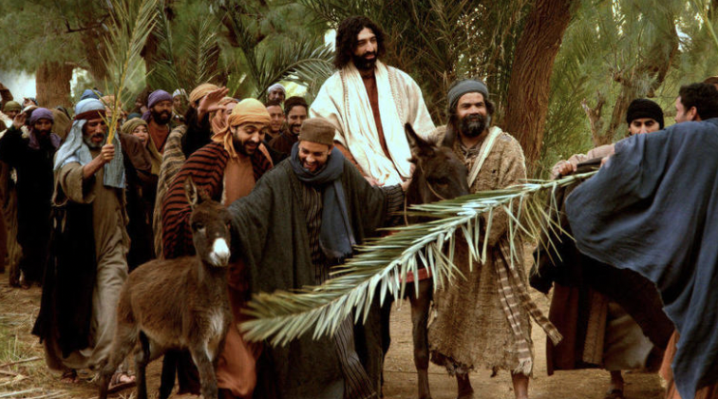

Zechariah 9:9
Rejoice greatly, Daughter Zion!
Shout, Daughter Jerusalem!
See, your king comes to you,
righteous and victorious,
lowly and riding on a donkey,
on a colt, the foal of a donkey.

Slide 3
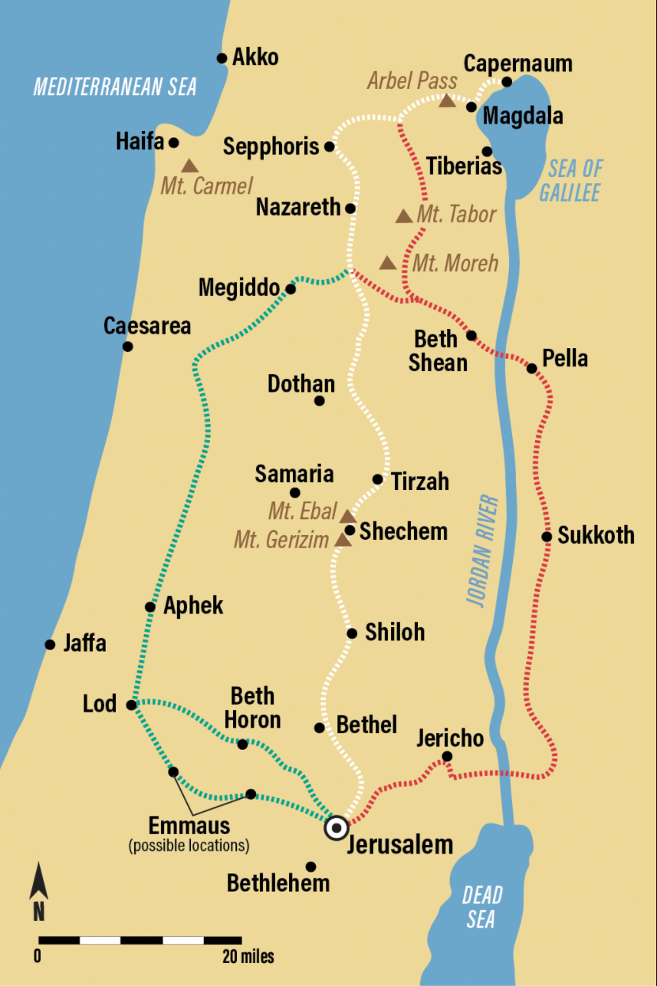
Mark 10:32-34
Jesus Predicts His Death a Third Time
They were on their way up to Jerusalem, with Jesus leading the way, and the disciples were astonished, while those who followed were afraid. Again he took the Twelve aside and told them what was going to happen to him. “We are going up to Jerusalem,” he said, “and the Son of Man will be delivered over to the chief priests and the teachers of the law. They will condemn him to death and will hand him over to the Gentiles, who will mock him and spit on him, flog him and kill him. Three days later he will rise.”

Slide 4
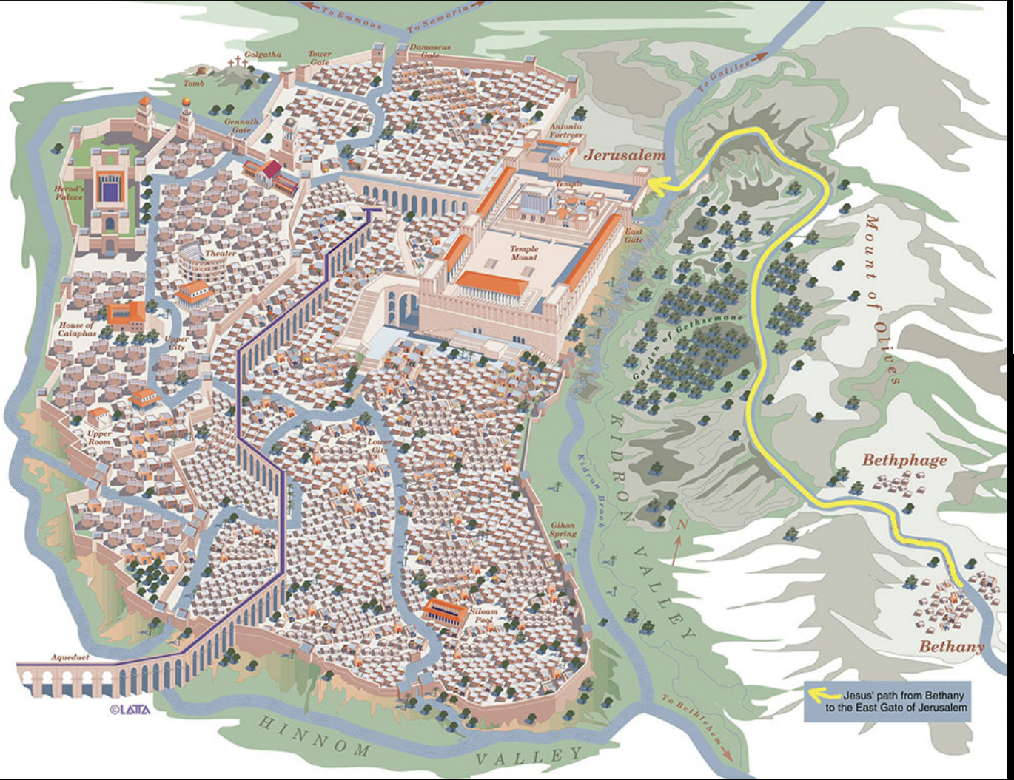

Slide 5
Zechariah 9:9
Rejoice greatly, Daughter Zion!
Shout, Daughter Jerusalem!
See, your king comes to you,
righteous and victorious,
lowly and riding on a donkey,
on a colt, the foal of a donkey.

Slide 6
Harmony of the Events of Holy Week
Day | Event | Matt. | Mark | Luke | John
Friday/ Saturday | Jesus arrives in Bethany |  |  |  | 12:1
 | Mary anoints Jesus |  |  |  | 12:2-8
 | Crowd comes to see Jesus |  |  |  | 12:9-11

Slide 7
Day | Event | Matt. | Mark | Luke | John
Sunday | Triumphal entry into Jerusalem | 21:1–11 | 11:1–10 | 19:28–44 | 12:12–18
 | Some Greeks seek Jesus |  |  |  | 12:20–36
 | Jesus weeps over Jerusalem |  |  | 19:41
 | Jesus enters the temple |  | 11:11
 | Jesus returns to Bethany | 21:17 | 11:11

Slide 8
Day | Event | Matt. | Mark | Luke | John
Monday | Jesus curses the fig tree | 21:18–19 | 11:12–14
 | Clears the temple | 21:12–13 | 11:15–17 | 19:45–46
 | Returns to Bethany with the Twelve |  | 11:19

Slide 9
Day | Event | Matt. | Mark | Luke | John
Tuesday | Disciples see the withered fig tree on way back to Jerusalem | 21:20–22 | 11:20–21
 | Temple controversies in Jerusalem | 21:23–22:45; 23:1-39 | 11:27-33; 12:1-44 | 20:1-47; 21:1-4
 | Olivet Discourse on the return to Bethany | 24:1– 25: 30; 25:31-46 | 13:1–37 | 21:5–36

Slide 10
Day | Event | Matt. | Mark | Luke | John
Wednesday | Jesus continues daily teaching in the temple |  |  | 21:37–38
 | Sanhedrin plots to kill Jesus | 26:3–5 | 14:1–2 | 22:1–2
Wednesday/ Thursday | Preparations for the Passover | 26:17–19 | 14:12–16 | 22:7–13
Thursday | Passover meal/ Last Supper | 26:20–35 | 14:17–26 | 22:14–30
 | Upper Room Discourse |  |  |  | Ch. 13-14; Ch. 15-17
 | Jesus prays in Gethsemane | 26:36–46 | 14:32–42 | 22:39–46

Slide 11
Day | Event | Matt. | Mark | Luke | John
Friday (Part I) | Betrayal and arrest (after midnight?) | 26:47–56 | 14:43–52 | 22:47–53 | 18:2–12
 | Jewish trial:
 | —before Annas |  |  |  | 18:13–24
 | —before Caiaphas and part of the Sanhedrin | 26:57–75 | 14:53–72 | 22:54–65 | 18:19–24
 | —before full Sanhedrin (after sunrise?) | 27:1–2 | 15:1 | 22:66–71

Slide 12
Day | Event | Matt. | Mark | Luke | John
Friday (Part II) | Roman trials:
 | —before Pilate | 27:2–14 | 15:2–5 | 23:1–5
 | —before Herod |  |  | 23:6–12
 | —before Pilate | 27:15–26 | 15:6–15 | 23:13–25 | 18:28–19:16
 | Crucifixion (approx. 9:00 A.M. to 3:00 P.M.) | 27:27–54 | 15:16–39 | 23:26–49 | 19:16–37
 | Burial (evening) | 27:57–61 | 15:42–47 | 23:50–54 | 19:38–42

Slide 13
Day | Event | Matt. | Mark | Luke | John
Sunday | Empty-tomb witnesses | 28:1–8 | 16:1–8 | 24:1–12
 | Resurrection appearances | 28:9–20 | 16:9–20 | 24:13-35; 36-53 | 20:1–21:25

Slide 14
Mark 11
vv. 1-2: “As they approached Jerusalem and came to Bethphage and Bethany at the Mount of Olives, Jesus sent two of his disciples, saying to them, ‘Go to the village ahead of you, and just as you enter it, you will find a colt tied there, which no one has ever ridden. Untie it and bring it here.’”

Slide 15
Mark 11
vv. 9-10: “Those who went ahead and those who followed shouted,
‘Hosanna!’ ‘Blessed is he who comes in the name of the Lord!’ ‘Blessed is the coming kingdom of our father David!’ ‘Hosanna in the highest heaven!’”

Slide 16
Mark 11
vv. 11-14: “Jesus entered Jerusalem and went into the temple courts. He looked around at everything, but since it was already late, he went out to Bethany with the Twelve.
The next day as they were leaving Bethany, Jesus was hungry. Seeing in the distance a fig tree in

Slide 17
Mark 11
leaf, he went to find out if it had any fruit. When he reached it, he found nothing but leaves, because it was not the season for figs. Then he said to the tree, ‘May no one ever eat fruit from you again.’ And his disciples heard him say it.”

Slide 18
Mark 11
vv. 15-17: “On reaching Jerusalem, Jesus entered the temple courts and began driving out those who were buying and selling there. He overturned the tables of the money changers and the benches of those selling doves, and would not allow anyone to carry merchandise through the temple courts. And as he taught them, he said, “Is it not

Slide 19
Mark 11
written: ‘My house will be called a house of prayer for all nations’? But you have made it ‘a den of robbers.’”

