Slide 1
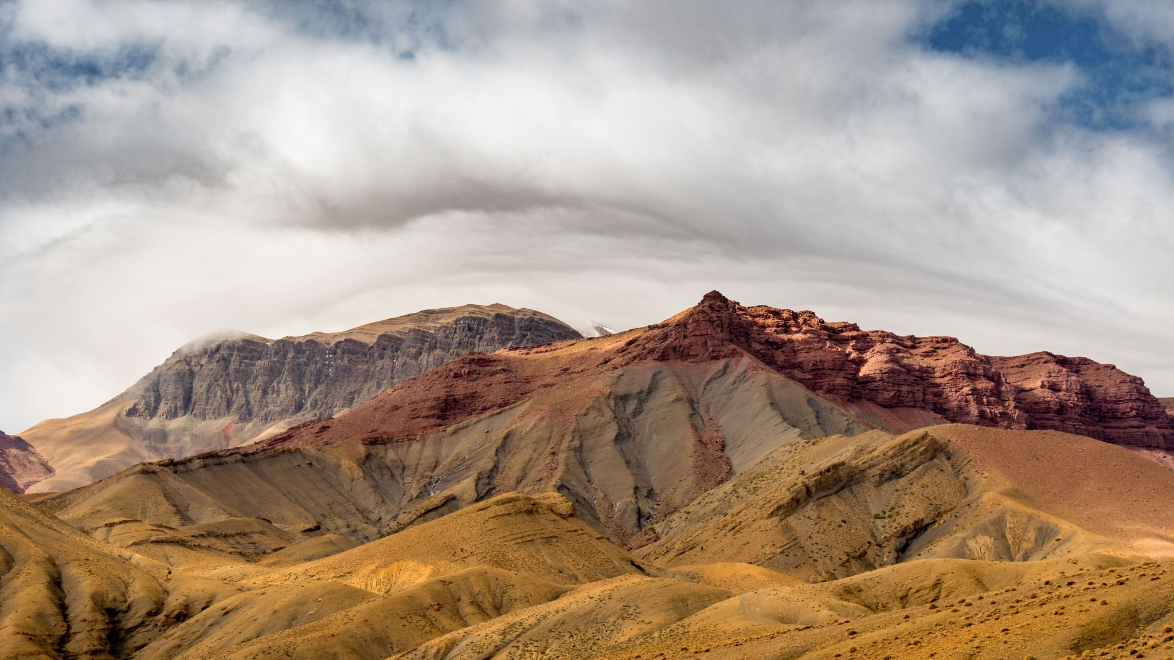
On this mountain he will destroy the shroud that enfolds all peoples,
the sheet that covers all nations;
he will swallow up death forever.
The Sovereign LORD will wipe away the tears from all faces;
he will remove his people’s disgrace from all the earth.
Isaiah 25:7-8
Notes:
https://www.youtube.com/watch?v=yuFozjKk7S8

Slide 2


Slide 3
Announcements & Reminders
Women’s Luncheon, Saturday, Nov. 4th.
  10:30am to 1pm, $20 per person
  www.grace.org/events
Next week:
  Global Awareness Week—potluck treats!
  Food Pantry

Slide 4
Sovereign LORD

Slide 5
Sovereign LORD
“sovereign”
  Noun: “one possessing or believed to possess supreme political power”
  Adjective: “superlative in quality”; “of the most exalted kind” (SUPREME); “possessed of supreme power”; “unlimited in extent” (ABSOLUTE); “enjoying autonomy” (INDEPENDENT)
“Sovereign LORD”

Slide 6
King David
greatest king of Israel, human ancestor of Jesus
shepherd, warrior, king, musician, writer of psalms
united the people of Israel, defeated enemies, conquered land, paved the way for Solomon’s Temple
critical moral failures
1 & 2 Samuel, 1 Kings, 1 Chronicles
Saul and David: jealousy, conflict, war
David becomes king over Israel, conquers Jerusalem, brings the Ark of the Covenant to Jerusalem

Slide 7
2 Samuel 7
After the king was settled in his palace and the Lord had given him rest from all his enemies around him, ² he said to Nathan the prophet, “Here I am, living in a house of cedar, while the ark of God remains in a tent.”
³ Nathan replied to the king, “Whatever you have in mind, go ahead and do it, for the Lord is with you.”
⁴ But that night the word of the Lord came to Nathan…

Slide 8
⁹ “I will make your name great, like the names of the greatest men on earth. . . . The Lord himself will establish a house for you: ¹² When your days are over and you rest with your ancestors, I will raise up your offspring to succeed you, your own flesh and blood, and I will establish his kingdom. ¹³ He is the one who will build a house for my Name, and I will establish the throne of his kingdom forever. ¹⁴ I will be his father, and he will be my son…. ¹⁶ Your house and your kingdom will endure forever before me; your throne will be established forever.’”

Slide 9
2 Samuel 7:18-29
David’s Prayer
¹⁸ Then King David went in and sat before the LORD, and he said:
“Who am I, Sovereign LORD, and what is my family, that you have brought me this far? ¹⁹ And as if this were not enough in your sight, Sovereign LORD, you have also spoken about the future of the house of your servant—and this decree, Sovereign LORD, is for a mere human!

Slide 10
2 Samuel 7:18-29, cont.
²⁰ “What more can David say to you? For you know your servant, Sovereign LORD. ²¹ For the sake of your word and according to your will, you have done this great thing and made it known to your servant.
²² “How great you are, Sovereign LORD! There is no one like you, and there is no God but you, as we have heard with our own ears. ²³ And who is like your people Israel—the one nation on earth that God went out to redeem as a

Slide 11
2 Samuel 7:18-29, cont.
people for himself, and to make a name for himself, and to perform great and awesome wonders by driving out nations and their gods from before your people, whom you redeemed from Egypt? ²⁴ You have established your people Israel as your very own forever, and you, LORD, have become their God.
²⁵ “And now, LORD God, keep forever the promise you have made concerning your servant and his house. Do as

Slide 12
2 Samuel 7:18-29, cont.
you promised, ²⁶ so that your name will be great forever. Then people will say, ‘The LORD Almighty is God over Israel!’ And the house of your servant David will be established in your sight.
²⁷ “LORD Almighty, God of Israel, you have revealed this to your servant, saying, ‘I will build a house for you.’ So your servant has found courage to pray this prayer to you.

Slide 13
2 Samuel 7:18-29, cont.
²⁸ Sovereign LORD, you are God! Your covenant is trustworthy, and you have promised these good things to your servant. ²⁹ Now be pleased to bless the house of your servant, that it may continue forever in your sight; for you, Sovereign LORD, have spoken, and with your blessing the house of your servant will be blessed forever.”

Slide 14
Luke 2:29-32
²⁹ “Sovereign Lord, as you have promised,
you may now dismiss your servant in peace.
³⁰ For my eyes have seen your salvation,
³¹ which you have prepared in the sight of all nations:
³² a light for revelation to the Gentiles,
and the glory of your people Israel.”

Slide 15
Acts 4:23-24
²³ On their release, Peter and John went back to their own people and reported all that the chief priests and the elders had said to them. ²⁴ When they heard this, they raised their voices together in prayer to God. “Sovereign Lord,” they said, “you made the heavens and the earth and the sea,
and everything in them. ²⁵ You spoke by the Holy Spirit through the mouth of your servant, our father David…”

Slide 17
Looking ahead
Next week (11/7-8): Global Awareness Week, Food Pantry
Following week (11/14-15): “Living God” (small groups only)
Two weeks from now: Thanksgiving Week
Three weeks from now (11/28-29): Most High/Mighty One/Holy One

