Slide 1


Slide 2


Slide 3
Announcements & Reminders
Thank you to all who brought items for the Food Pantry
Snow policy reminder
Women’s event on Saturday, February 10th
Notes:
https://www.youtube.com/watch?v=WuZuVhqZv7k

Slide 5
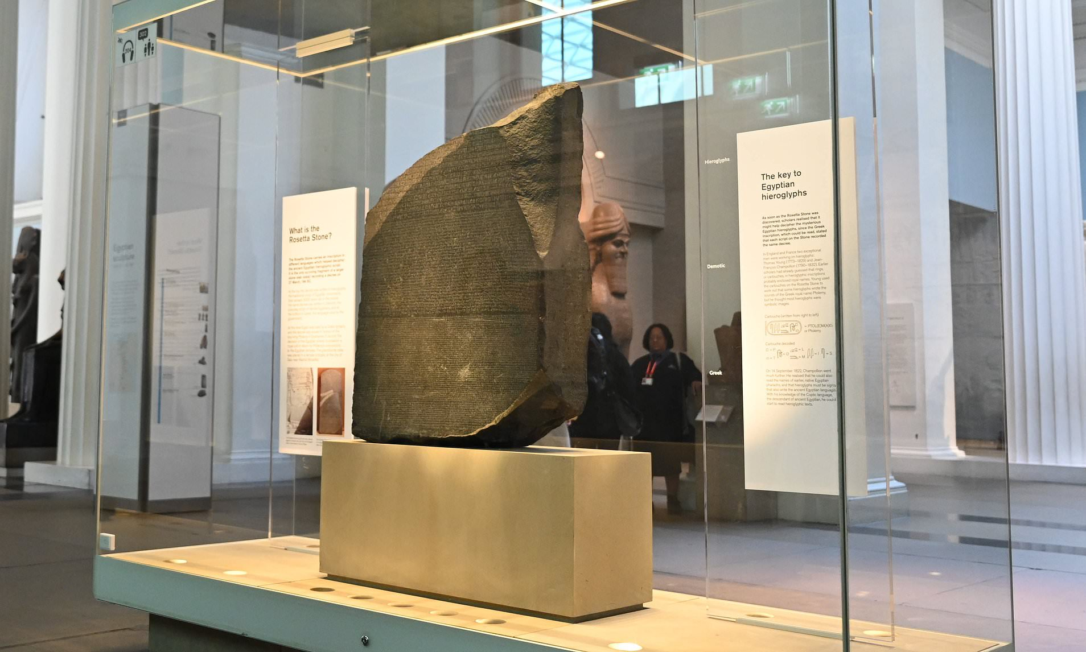

Slide 6
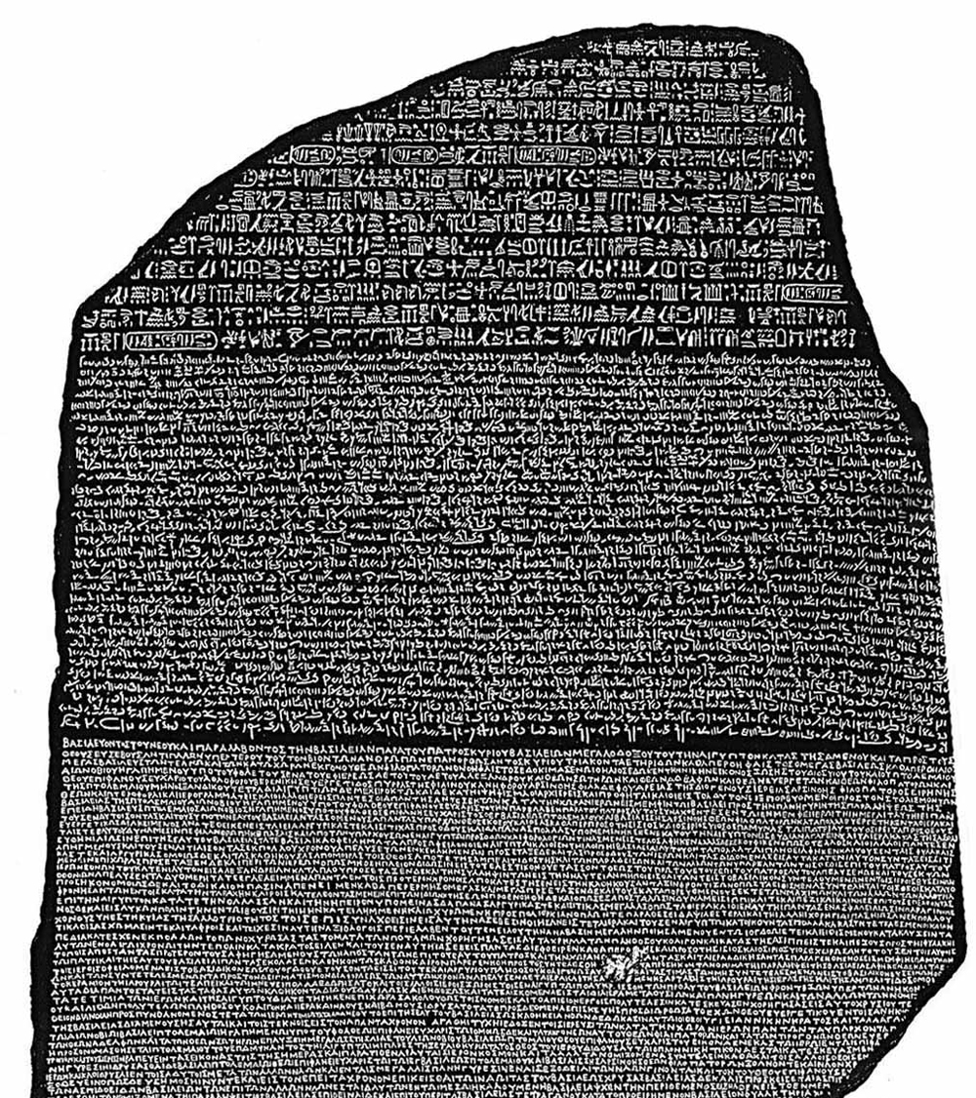

Slide 7
God as our redeemer, rescuer, deliverer, liberator

Slide 8
God as our redeemer, rescuer, deliverer, liberator
an experience of redemption is a key to our faith, a key to our understanding of the Scriptures, a key to understanding who God is

Slide 9
Exodus Background
Title: Exodus = “exit” or “departure”; derived from the word that the Greek OT uses to describe Israel’s release from slavery in Egypt
Author: No direct claims about authorship, but traditionally Moses has been identified as the author of the first five books of the OT
Theme: Fulfillment of God’s promises to the patriarchs
Outline: departure of Israel from Egypt; covenant God made with the people at Sinai

Slide 10
Exodus 6:1-8
Then the LORD said to Moses, “Now you will see what I will do to Pharaoh: Because of my mighty hand he will let them go; because of my mighty hand he will drive them out of his country.”

Slide 11
Exodus 6:1-8, cont.
² God also said to Moses, “I am the LORD. ³ I appeared to Abraham, to Isaac and to Jacob as God Almighty, but by my name the LORD I did not make myself fully known to them. ⁴ I also established my covenant with them to give them the land of Canaan, where they resided as foreigners. ⁵ Moreover, I have heard the groaning of the Israelites, whom the Egyptians are enslaving, and I have remembered my covenant.”

Slide 12
Exodus 6:1-8, cont.
⁶ “Therefore, say to the Israelites: ‘I am the LORD, and I will bring you out from under the yoke of the Egyptians. I will free you from being slaves to them, and I will redeem you with an outstretched arm and with mighty acts of judgment. ⁷ I will take you as my own people, and I will be your God. Then you will know that I am the LORD your God, who brought you out from under the yoke of the Egyptians. ⁸ And I will bring you to the land I swore with uplifted hand to give to Abraham, to Isaac and to Jacob. I will give it to you as a possession. I am the LORD.’”

Slide 13
“Redeem”
gā’al, “to redeem, deliver, avenge, act as a kinsman”
a family member coming to the assistance of a relative in need
guardian-redeemer or kinsman-redeemer: a near relative who was responsible for preserving the integrity, life, property, and family name of his close relative or for executing justice upon his murderer (e.g., Boaz)
“kinsman-redeemer”/“kinsman-avenger”

Slide 14
Exodus 6:1-8, cont.
⁶ “Therefore, say to the Israelites: ‘I am the LORD, and I will bring you out from under the yoke of the Egyptians. I will free you from being slaves to them, and I will redeem you with an outstretched arm and with mighty acts of judgment. ⁷ I will take you as my own people, and I will be your God. Then you will know that I am the LORD your God, who brought you out from under the yoke of the Egyptians. ⁸ And I will bring you to the land I swore with uplifted hand to give to Abraham, to Isaac and to Jacob. I will give it to you as a possession. I am the LORD.’”

Slide 15
Exodus/Redemption in OT
Redemption used in both OT and NT to describe God’s merciful and costly action on behalf of his people
Exodus as paradigm for all other acts of redemption
“I am the Lord your God, who brought you out of Egypt, out of the land of slavery.” (Ex. 20:2/Deut. 5:6)
“He divided the sea and led them through; he made the water stand up like a wall.” (Ps 78:13)
“I brought you up out of Egypt and redeemed you from the land of slavery.” (Micah 6:4)

Slide 16
Exodus/Redemption in NT
“And so was fulfilled what the Lord had said through the prophet: ‘Out of Egypt I called my son.’” (Mt. 2:15)
“Moses and Elijah appeared in glorious splendor, talking with Jesus. They spoke about his departure, which he was about to bring to fulfillment at Jerusalem.” (Lk 9:31)
Last Supper = Passover celebration
Acts 7: Stephen recounts the Exodus story
“You are not your own; you were bought at a price.” (1 Cor. 6:19-20)

Slide 17
Exodus/Redemption in the History of God’s People
“No single symbol captures more clearly the distinctiveness of Afro­American Christianity than the symbol of Exodus.”—Albert J. Raboteau
testimonies of deliverance

Slide 18
Exodus/Redemption in Your Story
When have you experienced God’s strong and mighty arm?
When have you experienced redemption, liberation, freedom?
How has God been a redeemer in your life story?

Slide 20
Looking ahead
Next week (1/16): “Shield/Sword,” extended small-group time
  Deuteronomy 33:26-29
  Psalm 7
  Isaiah 66:14-16

