Slide 1


Slide 2

Reminders
No meeting next week (11/23): Happy Thanksgiving!
Nov. 30: Teaching II (Matthew) (large group)
Recordings and slides can be found at grace.org/lexwomensgroups

Slide 3
Upcoming Service Opportunities
11/20: art gallery reception (dalley@grace.org)
11/30 & 12/7: Cards for Hope for Our Sisters
12/14: Food Bank collection, writing out cards of encouragement
Afghan families: possibilities include donating needed items, helping set up apartments, providing rides, community orientation

Slide 4
Outline for Today
Pastor Jeanette
Bill Henson, Posture Shift
Leslie Engelsen, PEER Servants
Q&A with Bill and Leslie
Break into small groups to hear from partners, ask questions, pray for them

Slide 5
Bill Henson

Slide 6
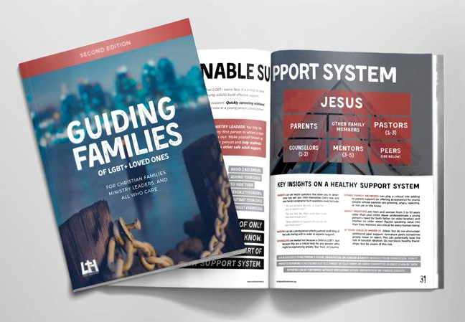

POSTURE SHIFT BOOKS
POSTURESHIFT.COM | coupon: “FALL25”
postureshift.com/resources

Slide 7


Leslie Engelsen

Slide 8
“Seek the peace and prosperity
of the city to which I have
carried you into exile.
Pray to the LORD for it,
because if it prospers,
you too will prosper.”
Jeremiah 29:7

Slide 9
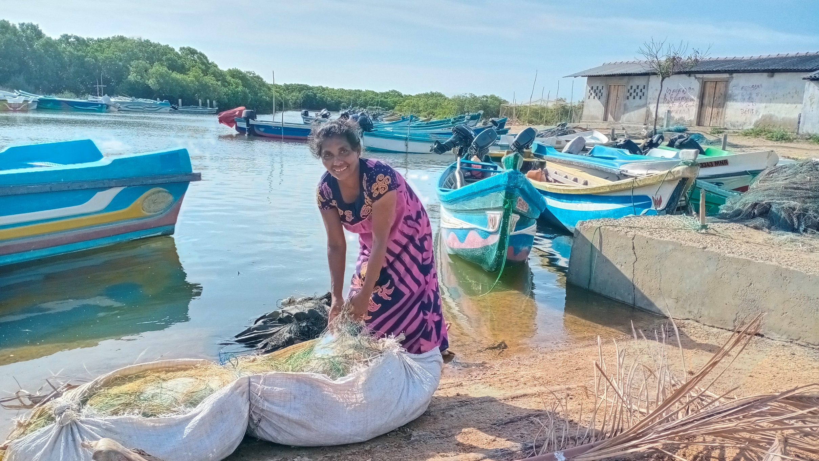
A story of Peace & Prosperity

Slide 10
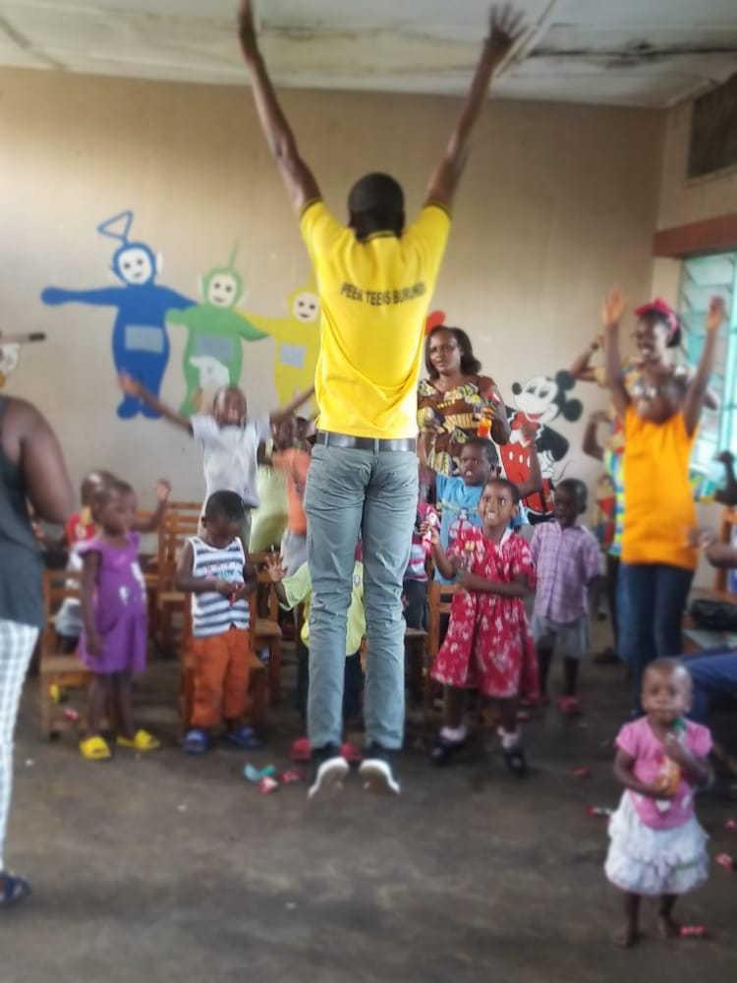
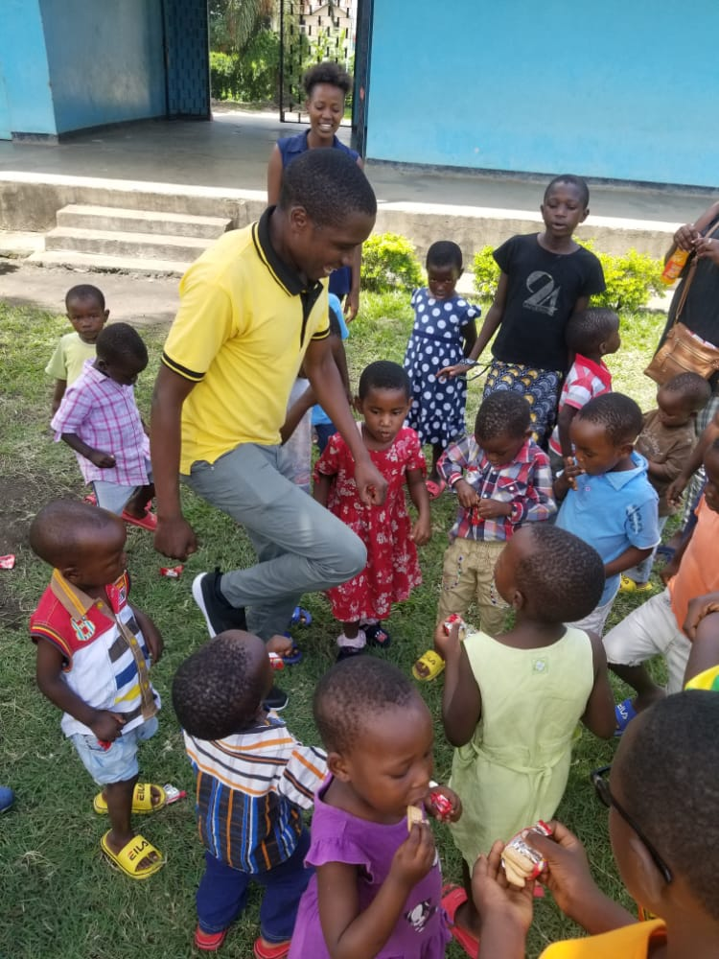
Burundi

Slide 11
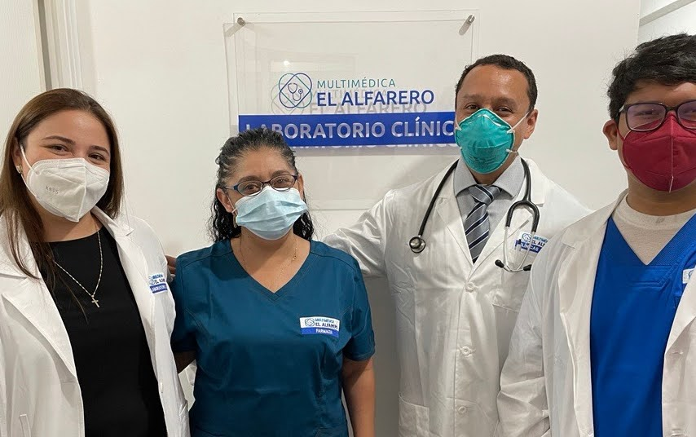

Guatemala

Slide 12
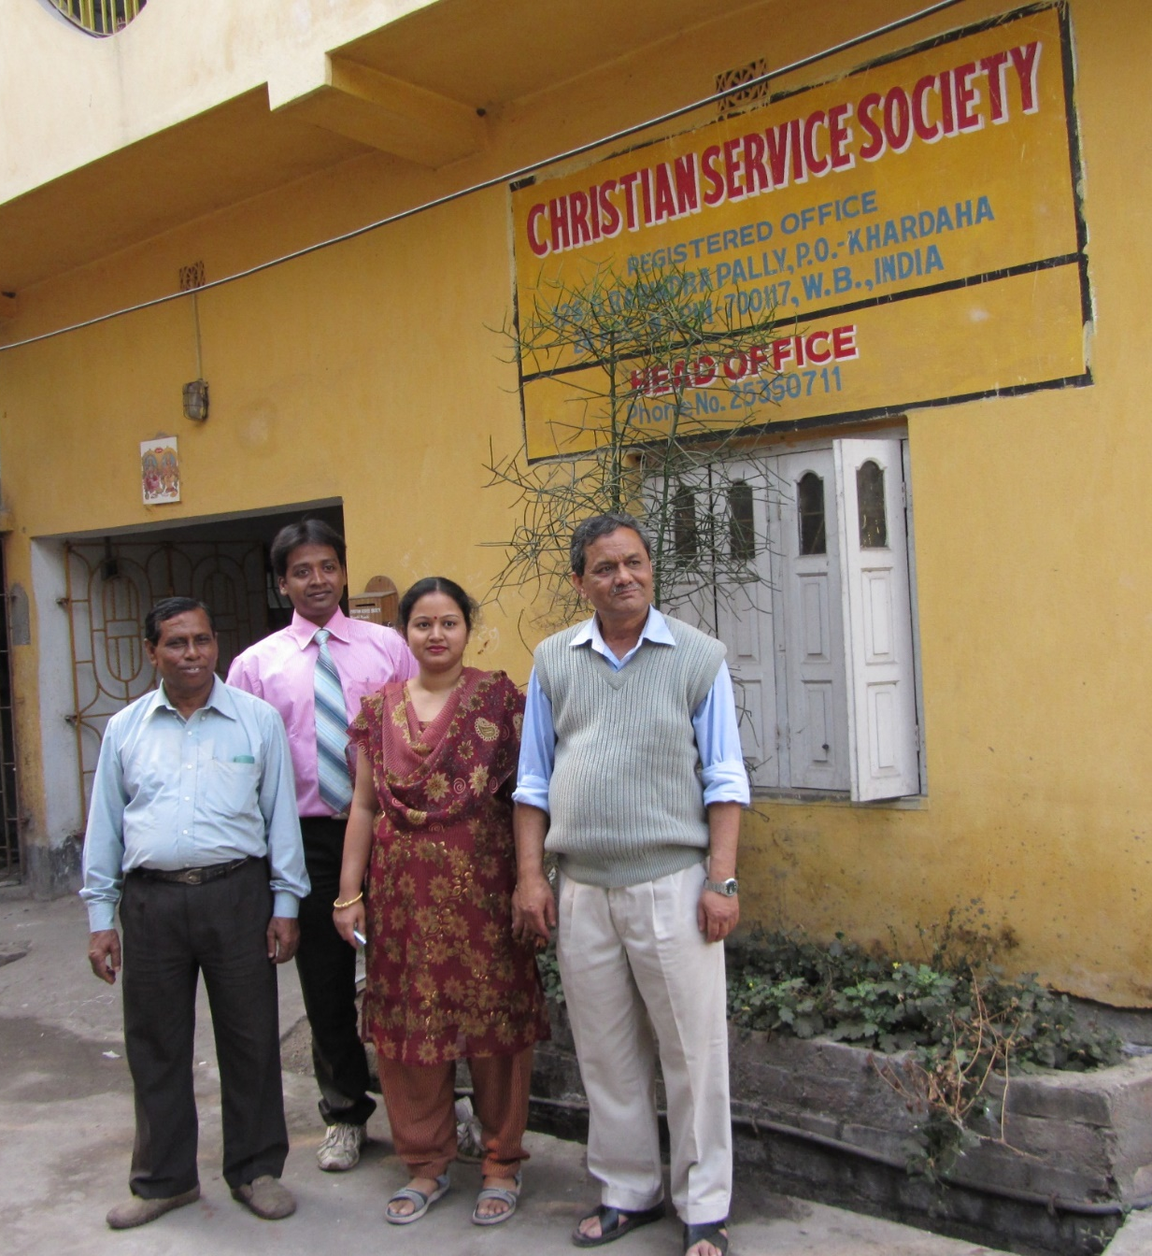
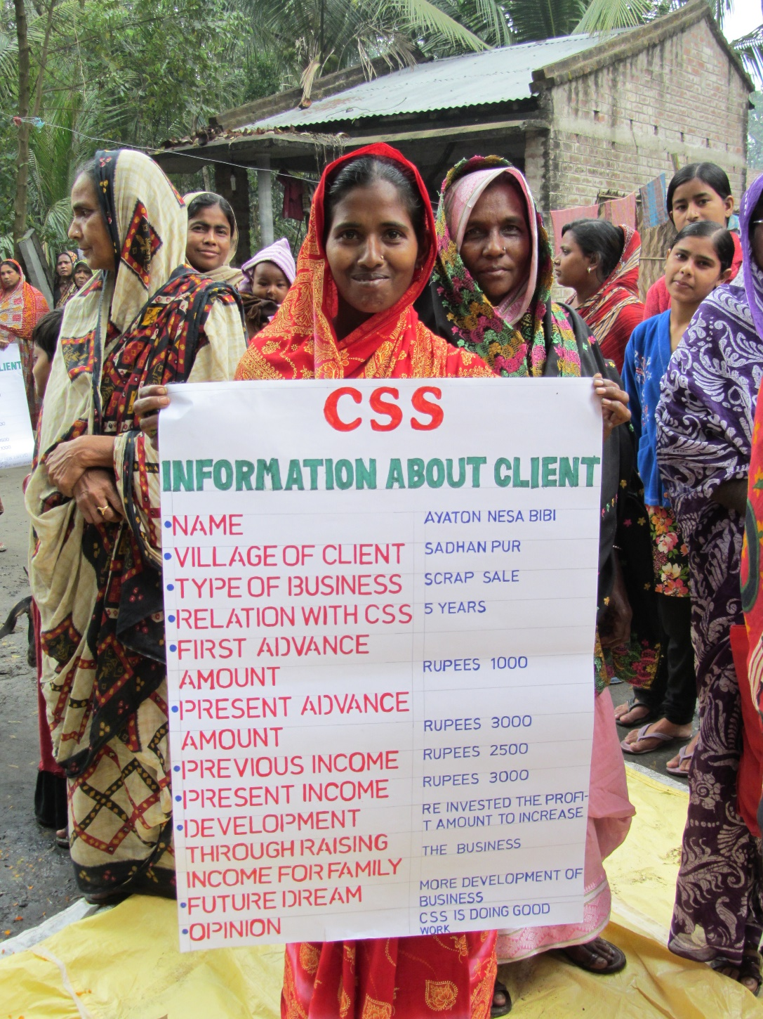
India

Slide 13
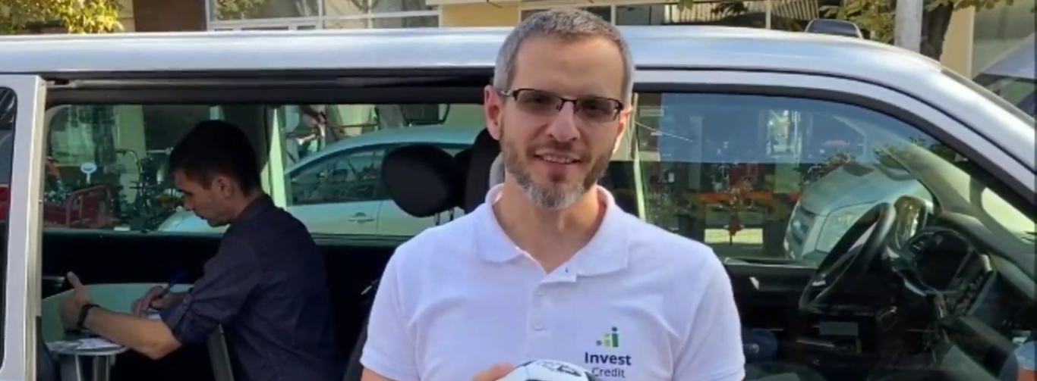
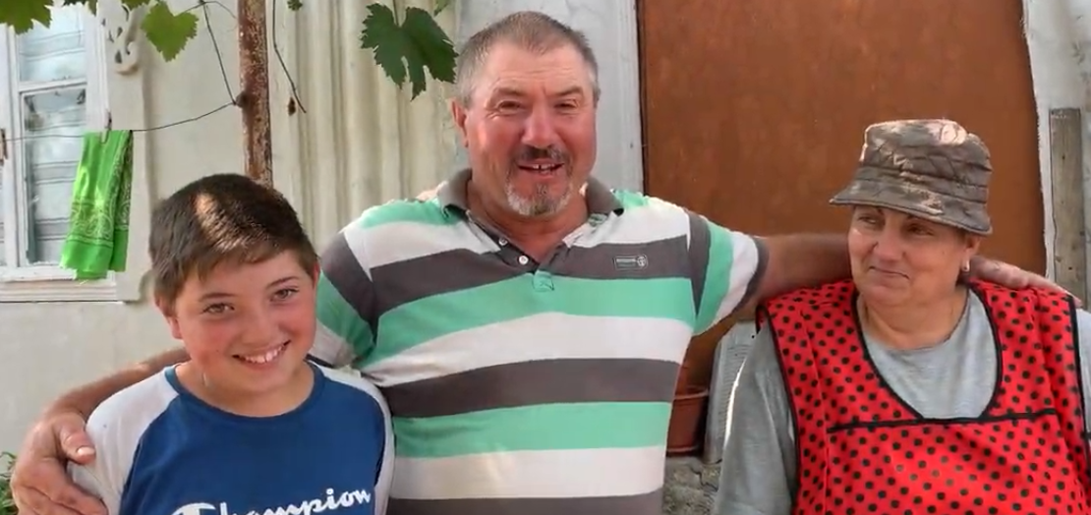
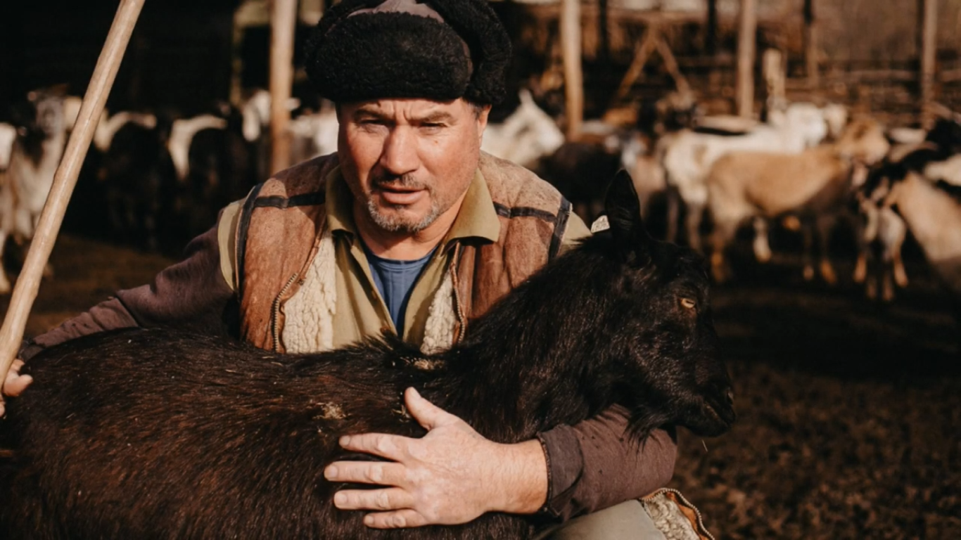
Moldova

Slide 14
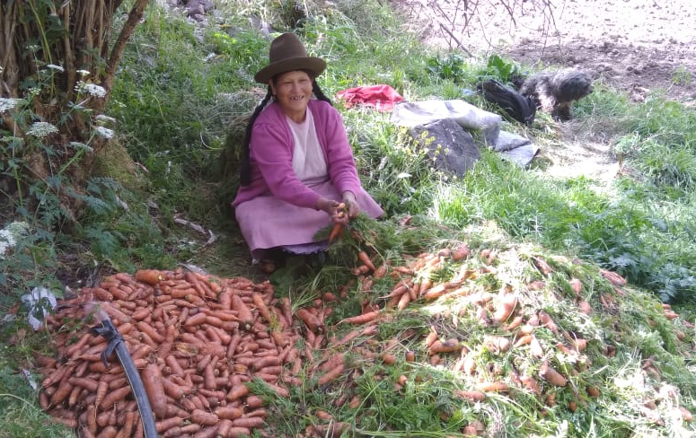
Peru

Slide 15
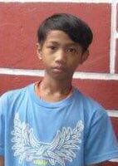
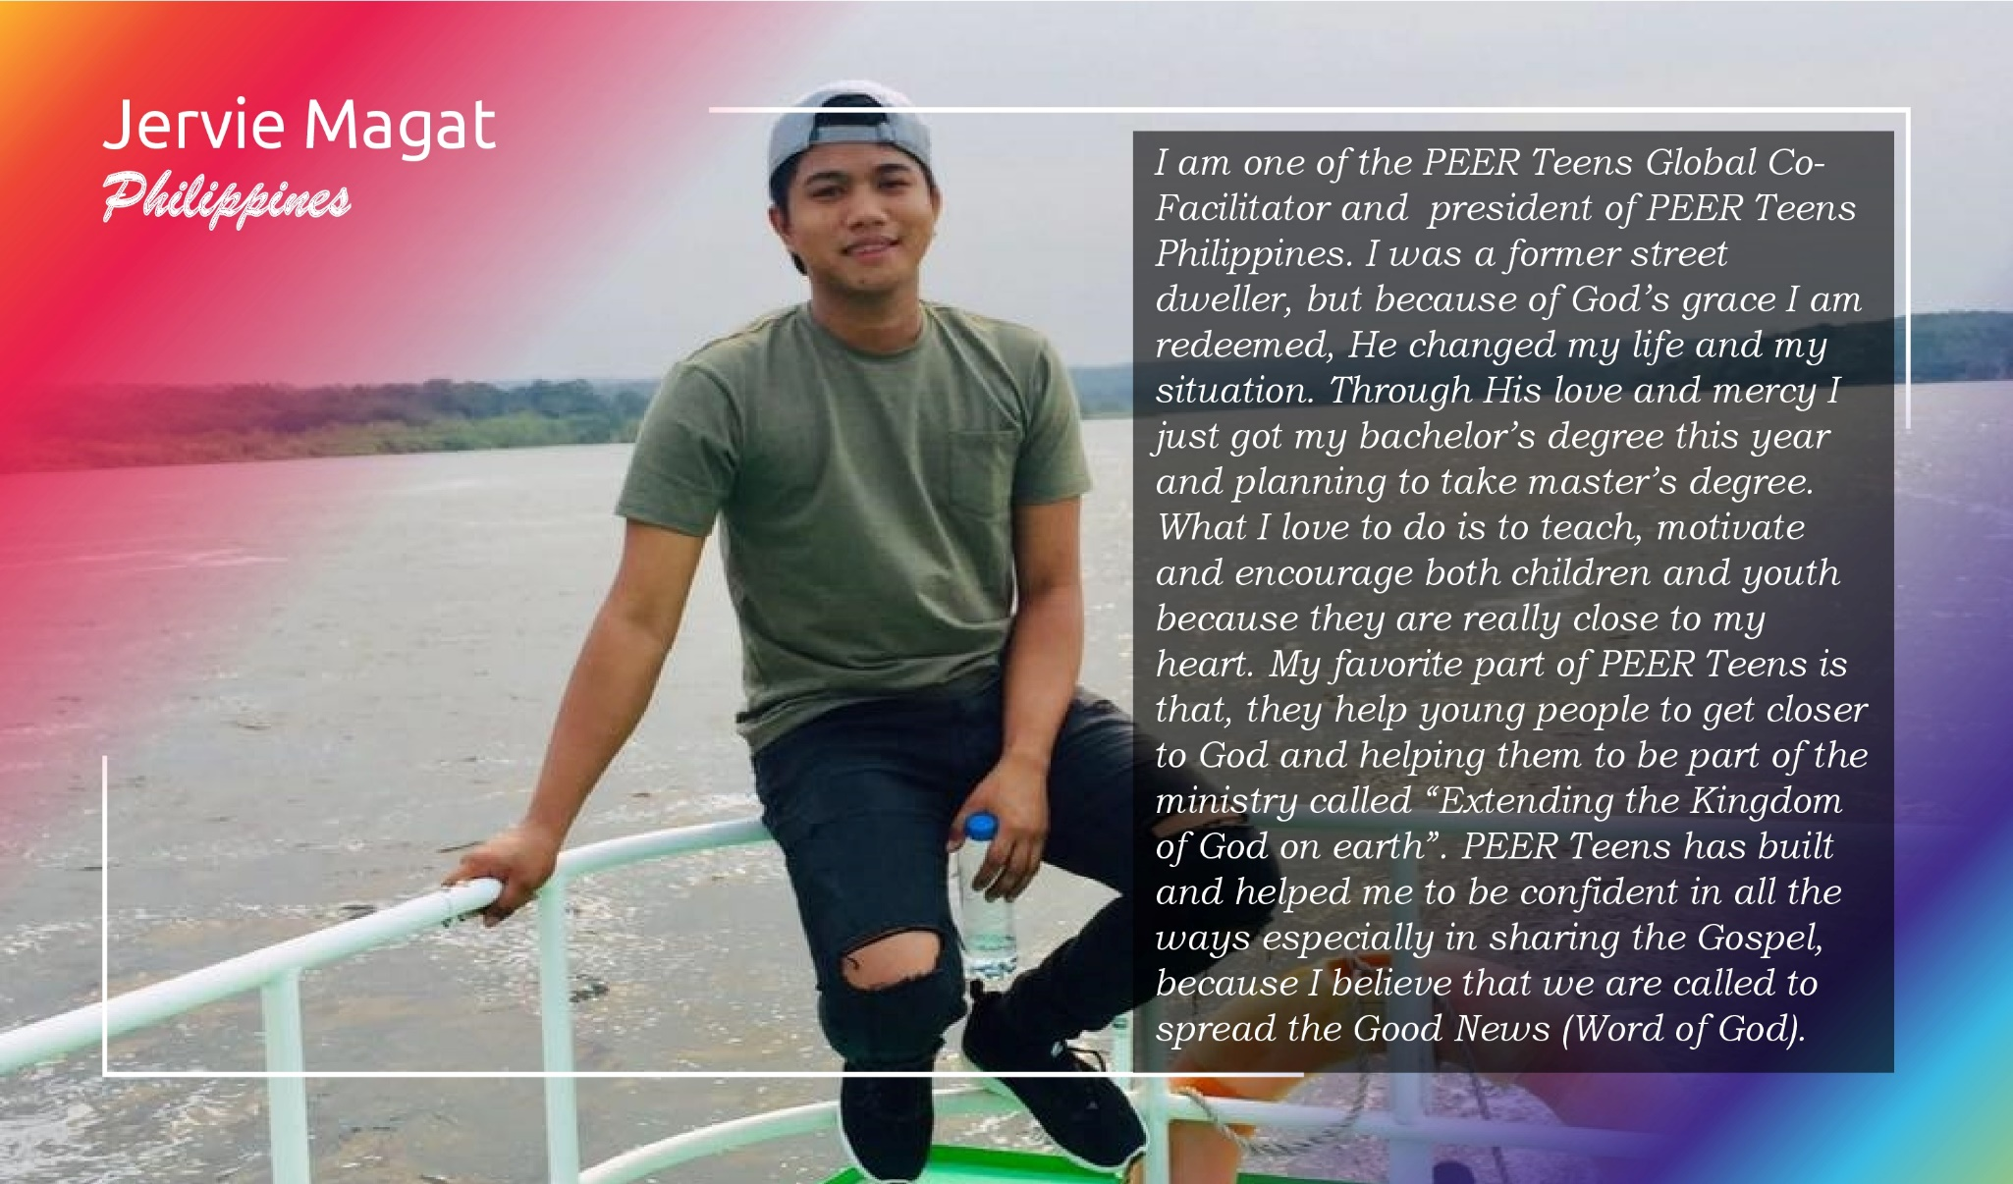
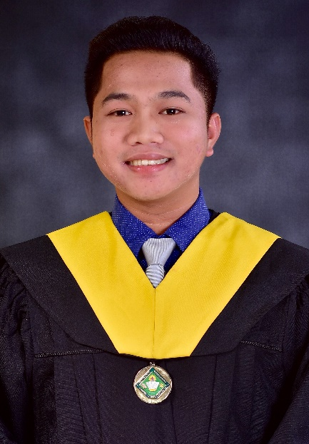

Philippines

Slide 16

South Sudan

Slide 17
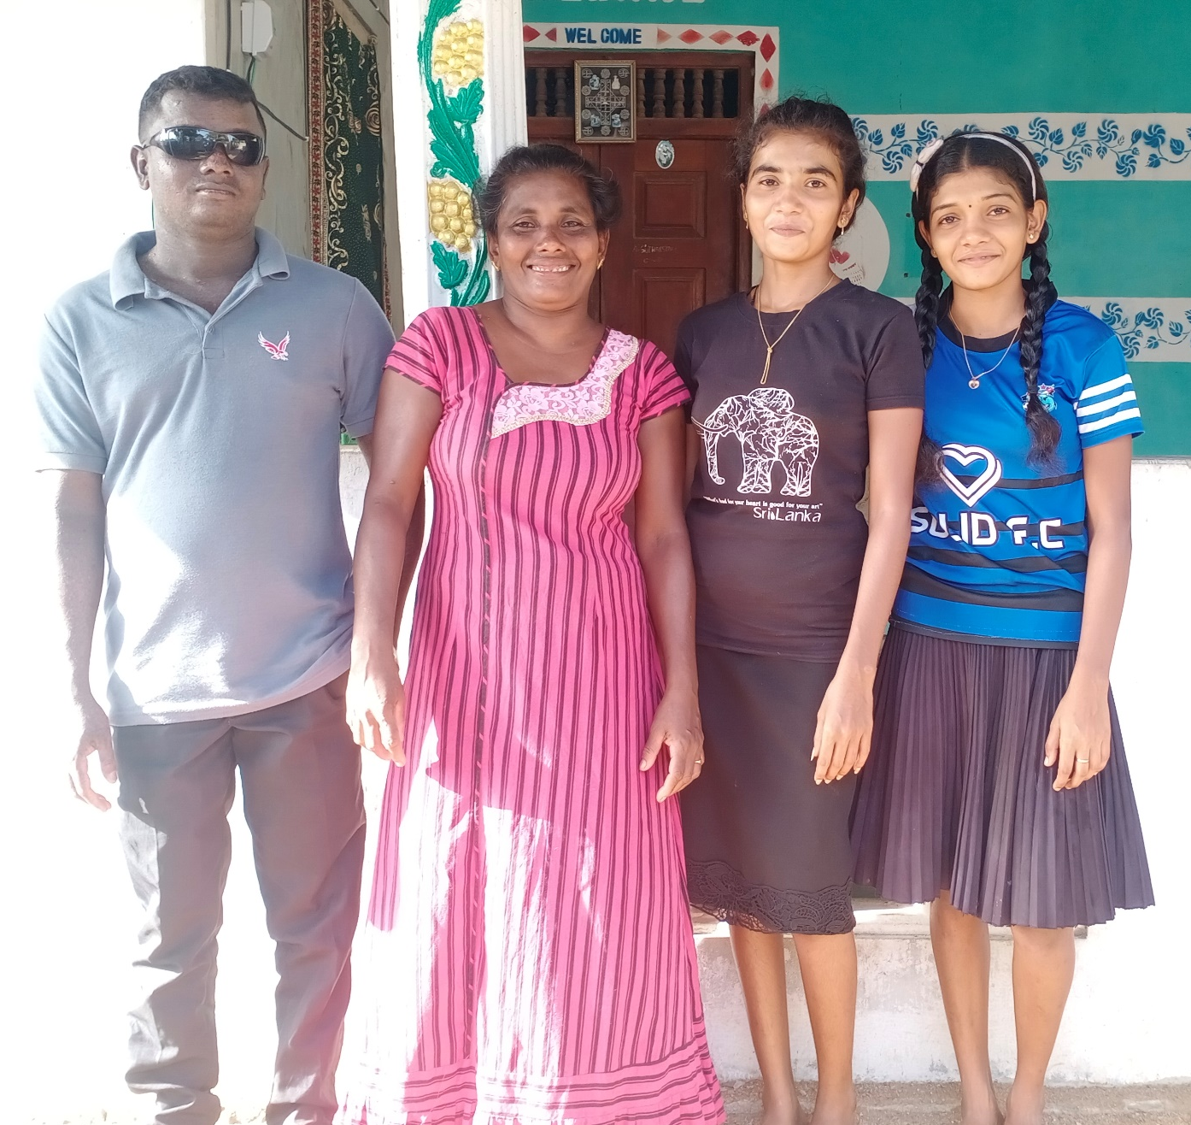
Sri Lanka

Slide 18
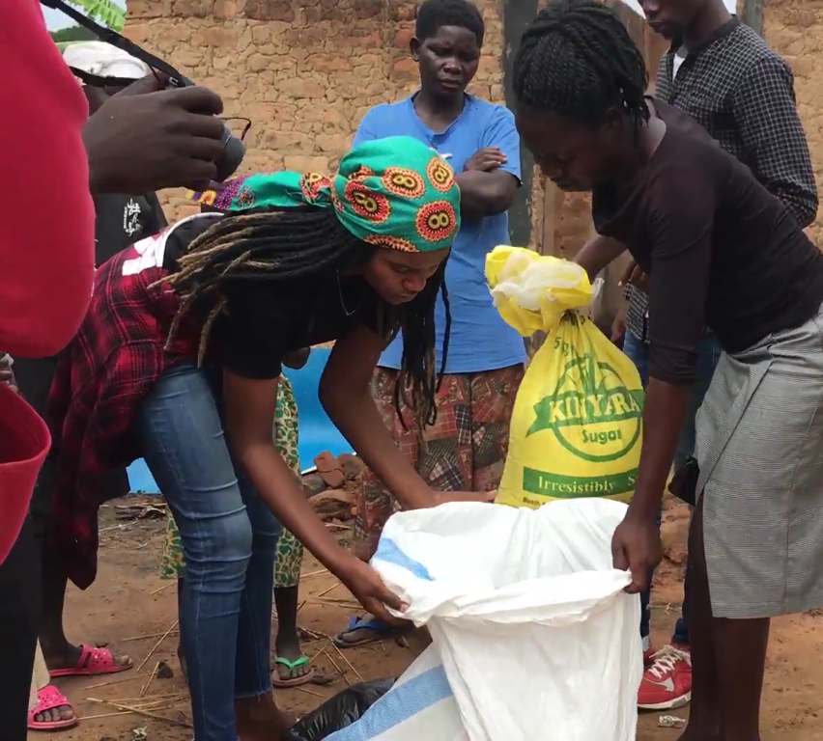
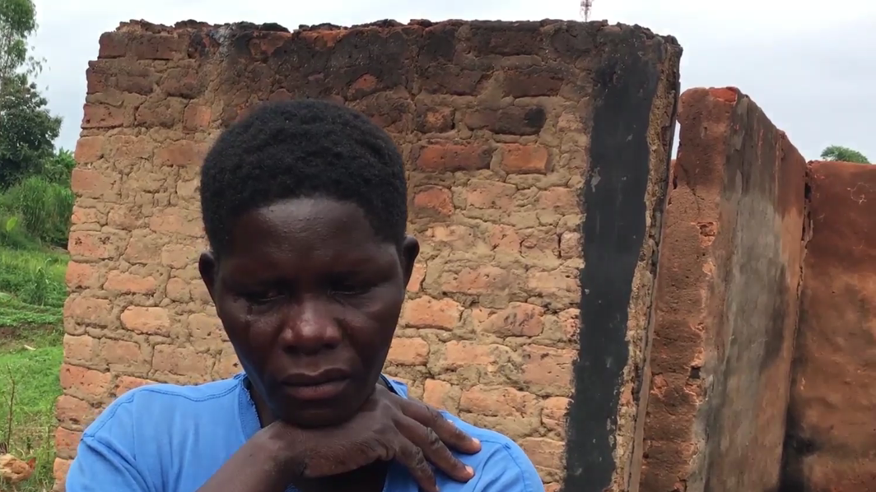
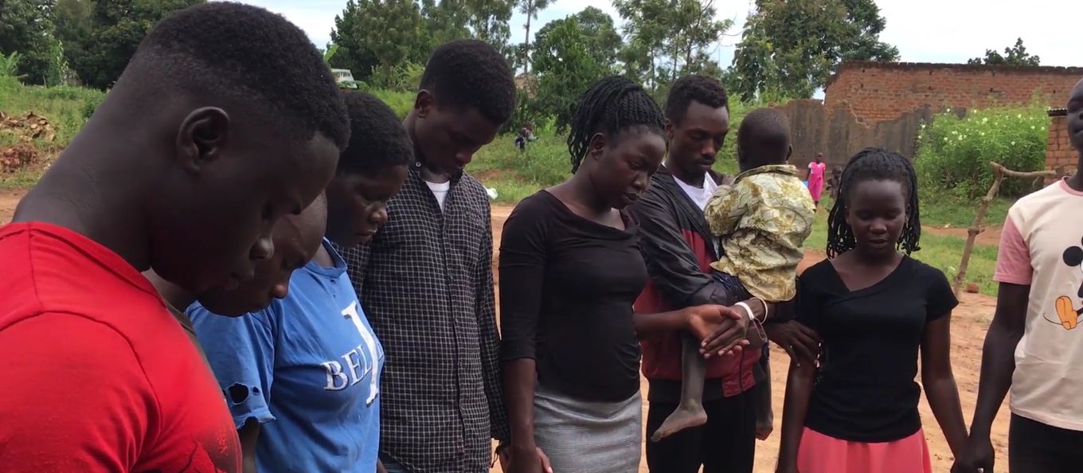
Uganda

Slide 19
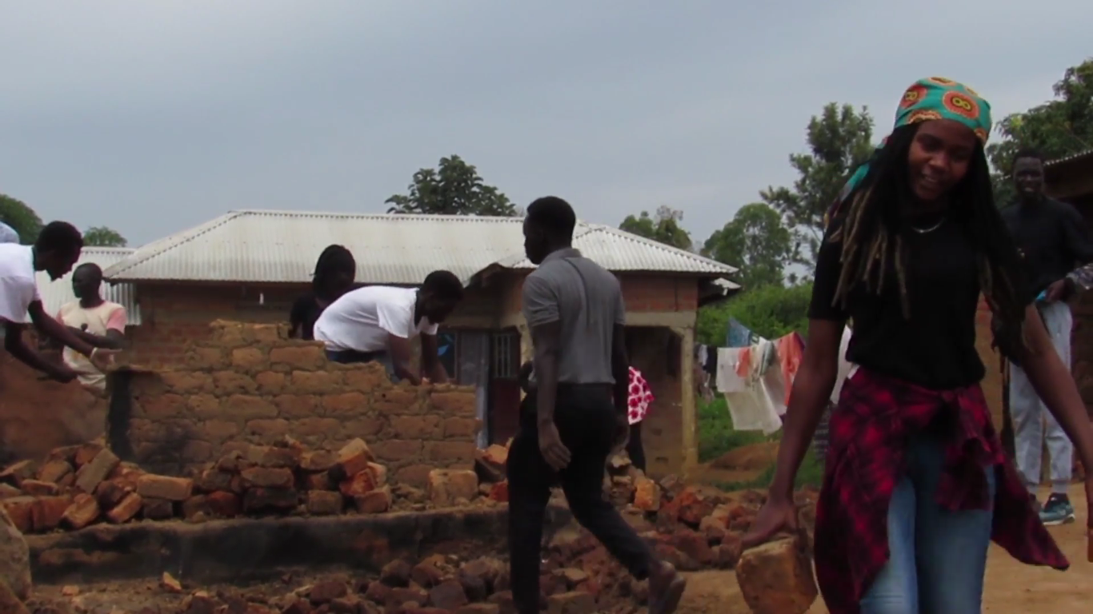
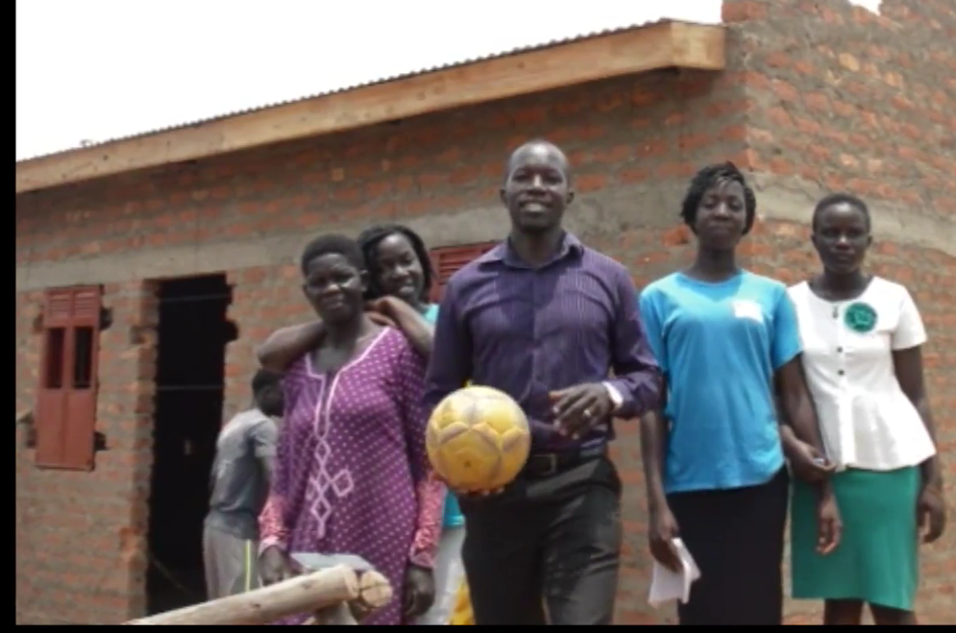
Uganda

Slide 20
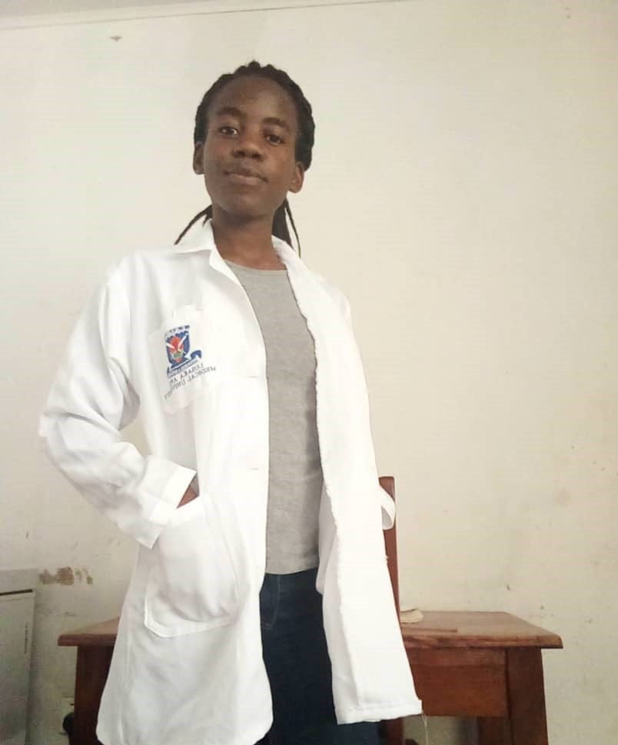
Zambia

Slide 21
“Seek the peace and prosperity
of the city to which I have
carried you into exile.
Pray to the LORD for it,
because if it prospers,
you too will prosper.”
Jeremiah 29:7

