Slide 1
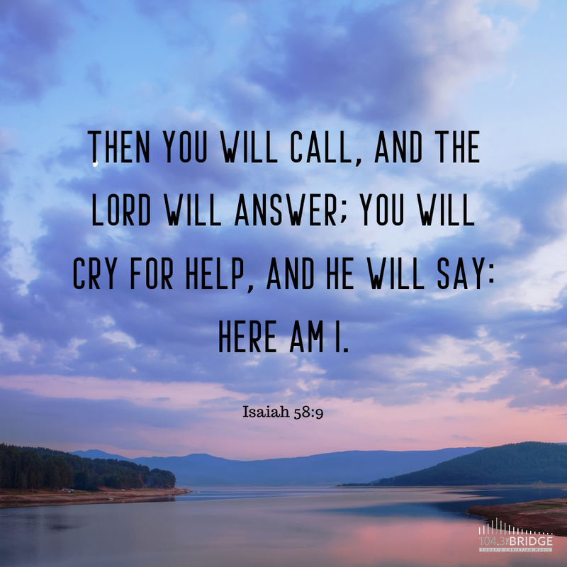

Slide 2


Slide 3
Announcements & Reminders
Thank you to all who wrote cards, donated, and prayed for social workers!
  179 cards written
  ~$1,600 donated
HUGE need for Kidstown volunteers at 11am, especially for Kindergarten and first grade
Spring Thaw, March 22nd, 6:30-8:30pm

Slide 4
God as Defender of the Poor

Slide 5
God as Defender of the Poor
Who do you know who has a heart for the poor, the hurting, the marginalized, or victims of injustice?
How does that person demonstrate their love and concern for these vulnerable people?

Slide 6
Defender of the Poor
gā’al: redeemer, deliverer, avenger; “kinsman-redeemer,” “kinsman-avenger”
nāṣal: to save, deliver, spare, rescue; to free, rescue, protect
dayyān: defender, judge
rîb: to quarrel, contend, plead; bring charges, defend, accuse, rebuke, complain; challenge, dispute, plead; take to court
šāpaṭ: to judge, decide; lead, defend, vindicate; to execute judgment, be brought to trial; to argue a matter, execute judgment, vindicate, decide, administer
judge, protector, champion, advocate, redeemer, deliverer, mighty one

Slide 7
Defender of the Poor
dal: poor, needy, humble; weak, haggard, scrawny, helpless; a class of people with little status, influence, and social value
’ebyôn: poor, needy, a class of people with physical needs, of low status and little political power; oppressed and miserable
ʽānî: needy, poor, afflicted, oppressed; low status, lacking resources; humble, lowly, meek, suffering, weak, wretched
mûk: to become poor
rûš: to be poor, be in poverty, be oppressed; to pretend to be poor
sākan: to be too poor

Slide 8
God as Defender of the Poor

Slide 9
God as Defender of the Poor
Ps. 10:17-18: “You, Lord, hear the desire of the afflicted; you encourage them, and you listen to their cry, defending the fatherless and the oppressed…”
Ps. 68:5: “A father to the fatherless, a defender of widows, is God in his holy dwelling.”
Prov. 23:10-11: “Do not move an ancient boundary stone or encroach on the fields of the fatherless, for their Defender is strong; he will take up their case against you.”

Slide 10
God as Defender of the Poor
How do we know that God cares about the poor?
Why would God take a special interest in defending the poor?
Who are the poor?
What does God do to defend the poor?
What does that mean for us?

Slide 11
How do we know that God cares about the poor?
Deut. 10:17-18: “For the LORD your God … defends the cause of the fatherless and the widow, and loves the foreigner residing among you, giving them food and clothing.”

Slide 12
Psalm 146:7-9:
“[the LORD] upholds the cause of the oppressed
and gives food to the hungry.
The LORD sets prisoners free,
the LORD gives sight to the blind,
the LORD lifts up those who are bowed down,
the LORD loves the righteous.
The LORD watches over the foreigner
and sustains the fatherless and the widow,
but he frustrates the ways of the wicked.”

Slide 13
How do we know that God cares about the poor?
“Realize, then, how significant it is that the Biblical writers introduce God as ‘a father to the fatherless, a defender of widows’ (Psalm 68:4–5). This is one of the main things he does in the world. He identifies with the powerless, he takes up their cause.”—Tim Keller, Generous Justice

Slide 14
why is God interested in defending the poor?
poor people are much more likely to be victims of injustice
Proverbs 31:8: “Speak up for those who cannot speak up for themselves, for the rights of all who are destitute.”

Slide 15
who are the poor?
Zechariah 7:10: “Do not oppress the widow or the fatherless, the foreigner or the poor.”
vulnerability

Slide 16
what does God do to defend the poor?
guidelines to protect the most vulnerable and provide for their needs
  Deut. 24:12: “If the neighbor is poor, do not go to sleep with their pledge in your possession.”
  Deut. 24:19: “When you are harvesting in your field and you overlook a sheaf, do not go back to get it. Leave it for the foreigner, the fatherless and the widow…”

Slide 17
what does God do to defend the poor?
guidelines to address social ineqality
  Deut. 15:1: “At the end of every seven years you must cancel debts.”
  Deut. 15:12: “If any of your people—Hebrew men or women—sell themselves to you and serve you six years, in the seventh year you must let them go free.”

Slide 18
what does God do to defend the poor?
enforces the rights of the poor
  Deut. 15:9: “…They may then appeal to the LORD against you, and you will be found guilty of sin.”
  Deut. 24:15: “Otherwise they may cry to the LORD against you, and you will be guilty of sin.”

Slide 19
what does that mean for us?
“God loves and defends those with the least economic and social power, and so should we.”—Tim Keller, Generous Justice
God loves the poor and wants them to be cared for; when God’s people care for the poor, it brings God glory and honor
Prov. 14:31: “Whoever oppresses the poor shows contempt for their Maker, but whoever is kind to the needy honors God.”

Slide 20
“If you are trying to live a life in accordance with the Bible, the concept and call to justice are inescapable. We do justice when we give all human beings their due as creations of God. Doing justice includes not only the righting of wrongs, but generosity and social concern, especially toward the poor and vulnerable. This kind of life reflects the character of God. It

Slide 21
consists of a broad range of activities, from simple fair and honest dealings with people in daily life, to regular, radically generous giving of your time and resources, to activism that seeks to end particular forms of injustice, violence, and oppression.”—Tim Keller, Generous Justice

Slide 22
what does that mean for us?
2 Cor. 8:9: “For you know the grace of our Lord Jesus Christ, that though he was rich, yet for your sake he became poor, so that you through his poverty might become rich.”

Slide 23
Matthew 25:37-40
“³⁷ …‘Lord, when did we see you hungry and feed you, or thirsty and give you something to drink? ³⁸ When did we see you a stranger and invite you in, or needing clothes and clothe you? ³⁹ When did we see you sick or in prison and go to visit you?’
⁴⁰ “The King will reply, ‘Truly I tell you, whatever you did for one of the least of these brothers and sisters of mine, you did for me.’”

Slide 25
Looking ahead
Next week (March 19th/20th): “Teacher”
  Deuteronomy 5:32-6:3
  **Psalm 19**
  Psalm 25:1-15
Extended small-group time
Following week:
  We DO meet during Holy Week
  Grace Lee teaching on God as Healer!

