Slide 1
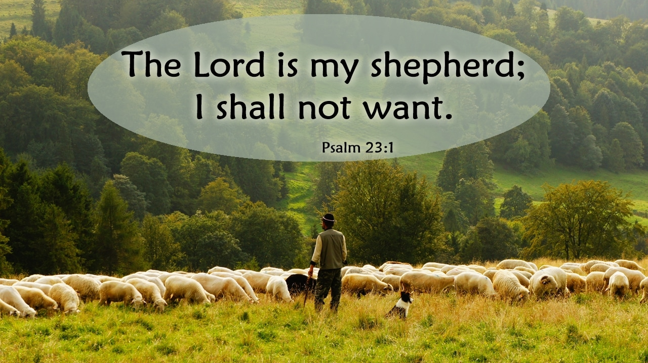

Slide 2


Slide 3
God as Shepherd

Slide 4
Human Shepherds
Shepherd:
  a person who herds, tends, and guards sheep
  a person who protects, guides, or watches over a person or group of people
  a keeper of flocks of animals (goats, cattle, sheep)

Slide 5
Human Shepherds
What do you know about shepherds, ancient or modern?
Do you know anyone who keeps sheep or goats or cows, or anyone who works with animals professionally?

Slide 6
Shepherds in the Bible

Slide 7
Shepherds in the Bible
Gen. 4:2: “Now Abel kept flocks, and Cain worked the soil.”

Slide 8
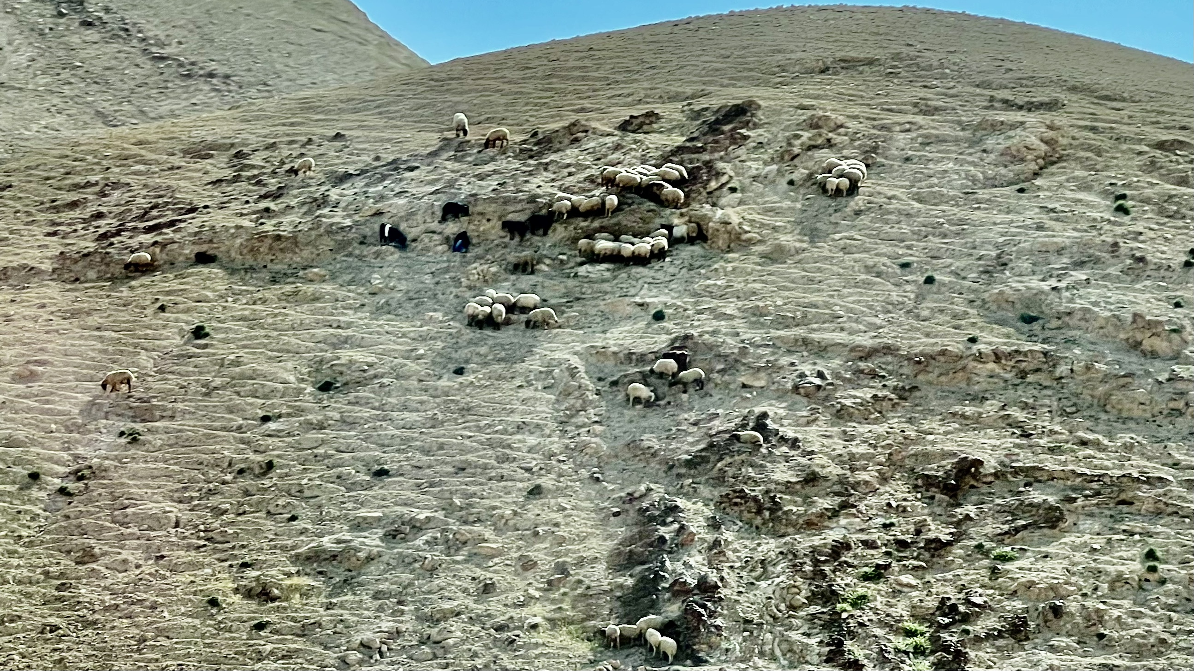

Slide 9
Shepherds in the Bible
Gen. 29:9: “While he was still talking with them, Rachel came with her father’s sheep, for she was a shepherd.”
Gen. 46: 34: “…for all shepherds are detestable to the Egyptians.”

Slide 10
Shepherds’ Role

Slide 11
Shepherds’ Role
Watering (Gen. 29:3: “When all the flocks were gathered there, the shepherds would roll the stone away from the well’s mouth and water the sheep...”)
Feeding (1 Chron. 4:39: “and they went to the outskirts of Gedor to the east of the valley in search of pasture for their flocks.”)

Slide 12
Shepherds’ Role
Resting the sheep (Song of Songs 1:7: “Tell me…where you graze your flock and where you rest your sheep at midday….”)
Keeping watch (Luke 2:8: “And there were shepherds living out in the fields nearby, keeping watch over their flocks at night…”)

Slide 13
Shepherds’ Role
Shearing (Gen. 38:13: “Your father-in-law is on his way to Timnah to shear his sheep…””)
Building pens and folds (2 Chron. 32:28: “…he made stalls for various kinds of cattle, and pens for the flocks.”)

Slide 14
Shepherds’ Role
Breeding (Gen. 31:10: “In breeding season I once had a dream in which I looked up and saw that the male goats mating with the flock were streaked, speckled or spotted…”)

Slide 15
Shepherd as Metaphor
lead and guide; provide and protect; find and save those who are lost or scattered; judge
God gives shepherds to lead his people: Israel’s political and religious leaders
2 Sam. 5:2: “The LORD said to you, ‘You will shepherd my people Israel, and you will become their ruler.’”

Slide 16
Shepherd as Metaphor
Israel becomes known as God’s flock
Psalm 95:7:
“for he is our God
and we are the people of his pasture,
the flock under his care.”

Slide 17
Shepherd as Metaphor
Psalm 78:70-72
70 He chose David his servant
and took him from the sheep pens;
71 from tending the sheep he brought him
to be the shepherd of his people Jacob,
of Israel his inheritance.
72 And David shepherded them with integrity of heart; with skillful hands he led them.

Slide 18
Shepherd as Metaphor
1 Pet. 5:2-4: “Be shepherds of God’s flock that is under your care, watching over them—not because you must, but because you are willing, as God wants you to be; not pursuing dishonest gain, but eager to serve; not lording it over those entrusted to you, but being examples to the flock. And when the Chief Shepherd appears, you will receive the crown of glory that will never fade…”

Slide 19
God as Shepherd

Slide 20
God as Shepherd
Gen. 48:15: “the God who has been my shepherd all my life to this day”
Rev. 7:17: “the Lamb at the center of the throne will be their shepherd; ‘he will lead them to springs of living water.’ ‘And God will wipe away every tear from their eyes.’”

Slide 21
God as Shepherd: Psalm 23
1 The LORD is my shepherd, I lack nothing.
2 He makes me lie down in green pastures,
he leads me beside quiet waters,
3 he refreshes my soul.
He guides me along the right paths
for his name’s sake.
4 Even though I walk through the darkest valley,
I will fear no evil, for you are with me;

Slide 22
God as Shepherd: Psalm 23
your rod and your staff, they comfort me.
5 You prepare a table before me
in the presence of my enemies.
You anoint my head with oil; my cup overflows.
6 Surely your goodness and love will follow me
all the days of my life,
and I will dwell in the house of the Lord forever.

Slide 23
God as Shepherd: Jer. 23
Jer. 23:1-3: “Woe to the shepherds who are destroying and scattering the sheep of my pasture!…Because you have scattered my flock and driven them away and have not bestowed care on them, I will bestow punishment on you for the evil you have done…I myself will gather the remnant of my flock out of all the countries where I have driven them and will bring them back to their pasture…”

Slide 24
God as Shepherd: Jer. 23
v. 4: “You have not strengthened the weak or healed the sick or bound up the injured. You have not brought back the strays or searched for the lost. You have ruled them harshly and brutally.”
v. 8: “my shepherds did not search for my flock but cared for themselves rather than for my flock”
vv. 5-6: “they were scattered” (3x)
v. 10: “I will remove them from tending the flock so that the shepherds can no longer feed themselves.”

Slide 25
God as Shepherd
Ez. 23: 23-24: “I will place over them one shepherd, my servant David, and he will tend them; he will tend them and be their shepherd. I the LORD will be their God, and my servant David will be prince among them. I the LORD have spoken.”
Jer. 23: 5: “The days are coming,” declares the LORD, “when I will raise up for David a righteous Branch, a King who will reign wisely and do what is just and right in the land.”

Slide 27
Looking ahead
Next week (March 5th/6th): “Provider”
  1 Chronicles 29:10-20
  Psalm 145
  Matthew 6:25-34
Extended small-group time
Food Bank Week

