Slide 1


Slide 2


Slide 3
Announcements & Reminders
Thank you to those who responded to the call for Kidstown volunteers at 11am!
Marriage Course:
  Begins this Thursday at 7pm over Zoom
  grace.org/events or grace.org/groups

Slide 4
Hope
What does the word “hope” mean to you?

Slide 5


Slide 6


Slide 7
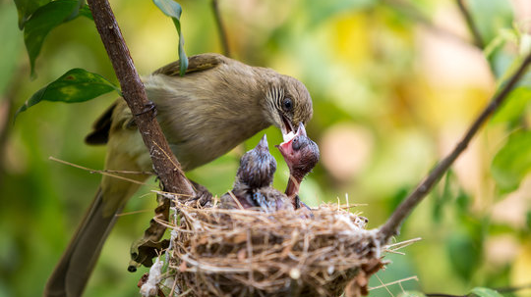

Slide 8
Hope
  Hope is the thing with feathers
  That perches in the soul,
  And sings the tune without the words,
  And never stops at all…
  —Emily Dickinson

Slide 9
Hope
  a feeling of expectation and desire;
  wanting something to happen,
  and thinking or believing it could happen

Slide 10
Hope: The Scriptural Record

Slide 11
Hope: The Scriptural Record
Though he slay me, yet will I hope in him;
I will surely defend my ways to his face.
(Job 13:15)

Slide 12
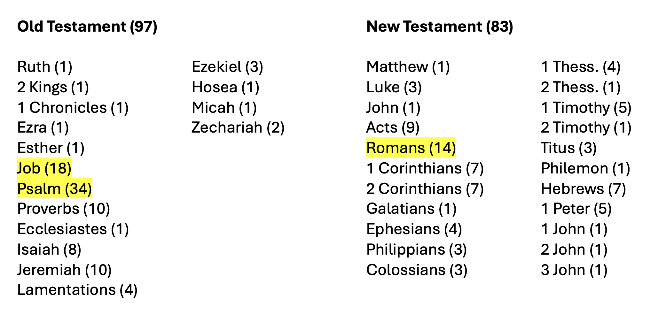

Slide 13
Hope in the Psalms
No one who hopes in you
will ever be put to shame….
Guide me in your truth and teach me,
for you are God my Savior,
and my hope is in you all day long.
(Psalm 25:3, 5)

Slide 14
Hope in the Psalms
But the eyes of the Lord
are on those who fear him,
on those whose hope is in his unfailing love (Psalm 33:18)

Slide 15
Hope in the Psalms
Why, my soul, are you downcast?
Why so disturbed within me?
Put your hope in God,
for I will yet praise him,
my Savior and my God.
(Psalm 42:5)

Slide 16
Hope in the Psalms
For you have been my hope, Sovereign Lord,
my confidence since my youth.
(Psalm 71:5)

Slide 17
Hope in the Prophets
Even youths grow tired and weary,
and young men stumble and fall;
but those who hope in the Lord
will renew their strength.
They will soar on wings like eagles;
they will run and not grow weary,
they will walk and not be faint. (Isaiah 40:30-31)

Slide 18
Hope in the Prophets
A bruised reed he will not break,
and a smoldering wick he will not snuff out.
In faithfulness he will bring forth justice;
he will not falter or be discouraged
till he establishes justice on earth.
In his teaching the islands will put their hope. (Isaiah 42:3-4; Matthew 12:20-21)

Slide 19
Hope in the Prophets
“For I know the plans I have for you,” declares the Lord, “plans to prosper you and not to harm you, plans to give you hope and a future.”
(Jeremiah 29:11)

Slide 20
Hope in the Prophets
But as for me, I watch in hope for the Lord,
I wait for God my Savior;
my God will hear me.
(Micah 7:7)

Slide 21
Hope in the New Testament
“but we had hoped that he was the one who was going to redeem Israel” (Luke 24:21)
“and I have the same hope in God as these men themselves have, that there will be a resurrection of both the righteous and the wicked.”
(Acts 24:15)

Slide 22
Hope in the New Testament
Against all hope, Abraham in hope believed and so became the father of many nations, just as it had been said to him, “So shall your offspring be.”
(Romans 4:18)

Slide 23
Hope in the New Testament
…we boast in the hope of the glory of God. Not only so, but we also glory in our sufferings, because we know that suffering produces perseverance; perseverance, character; and character, hope. And hope does not put us to shame, because God’s love has been poured out into our hearts through the Holy Spirit, who has been given to us. (Romans 5:2-5)

Slide 24
Hope in the New Testament
For in this hope we were saved. But hope that is seen is no hope at all. Who hopes for what they already have? But if we hope for what we do not yet have, we wait for it patiently. In the same way, the Spirit helps us in our weakness. We do not know what we ought to pray for, but the Spirit himself intercedes for us through wordless groans. (Romans 8:24-26)

Slide 25
Hope in the New Testament
May the God of hope fill you with all joy and peace as you trust in him, so that you may overflow with hope by the power of the Holy Spirit. (Romans 15:13)
If only for this life we have hope in Christ, we are of all people most to be pitied. (1 Cor. 15:19)

Slide 26
Hope in the New Testament
I pray that the eyes of your heart may be enlightened in order that you may know the hope to which he has called you (Ephesians 1:18)
God has chosen to make known among the Gentiles the glorious riches of this mystery, which is Christ in you, the hope of glory. (Col. 1:27)

Slide 27
Hope in the New Testament
Paul, an apostle of Christ Jesus by the command of God our Savior and of Christ Jesus our hope
(1 Timothy 1:1)
Let us hold unswervingly to the hope we profess, for he who promised is faithful. (Hebrews 10:23)

Slide 29
1 Peter 1:3-9: Context
Written by the apostle Peter
About 30 years after Jesus’s death and resurrection
To (mostly Gentile) believers in Asia Minor (modern-day Turkey)
Rejecting former pagan customs, facing criticism and persecution

Slide 30
1 Peter 1:3-9: Context, cont.
What Jesus accomplished, what this means for Christians
Live as much as possible in line with culture, while never compromising loyalty to Jesus
Themes: hope and living as exiles
A letter of hope in the midst of suffering
Stand firm in the faith in the face of suffering and persecution

Slide 31
1 Peter 1:3
³ Praise be to the God and Father of our Lord Jesus Christ! In his great mercy he has given us new birth into a living hope through the resurrection of Jesus Christ from the dead,

Slide 32
1 Peter 1:3
doxology praising God for raising Jesus from the dead
new birth (regeneration): identity, citizenship, socioeconomic class, human potential
living hope is specifically resurrection hope
“If only for this life we have hope in Christ, we are of all people most to be pitied.” (1 Cor. 15:19)

Slide 33
1 Peter 1:4-5
⁴ and into an inheritance that can never perish, spoil or fade. This inheritance is kept in heaven for you ⁵ who through faith are shielded by God’s power until the coming of the salvation that is ready to be revealed in the last time.

Slide 34
1 Peter 1:4-5
“inheritance”: promised land → the renewal of all of creation
God keeps this inheritance safe in heaven for the future and guards and protects in the present those who will come to inherit it
“salvation”: not only of individual believers, but all that God will do to redeem creation

Slide 35
1 Peter 1:6-7
⁶ In all this you greatly rejoice, though now for a little while you may have had to suffer grief in all kinds of trials. ⁷ These have come so that the proven genuineness of your faith—of greater worth than gold, which perishes even though refined by fire—may result in praise, glory and honor when Jesus Christ is revealed.

Slide 36
1 Peter 1:6-7
believers are not immune from suffering
professing faith in Christ may even bring about suffering
suffering is sometimes necessary to avoid sinning
suffering because of faith in Christ is evidence that faith is genuine

Slide 37
1 Peter 1:8-9
⁸ Though you have not seen him, you love him; and even though you do not see him now, you believe in him and are filled with an inexpressible and glorious joy, ⁹ for you are receiving the end result of your faith, the salvation of your souls.

Slide 38
Reason for our Hope
1 Peter 3:15: “Always be prepared to give an answer to everyone who asks you to give the reason for the hope that you have.”
“hope has a name”: Jesus
salvation from sin and victory over death
we know the end of the story

Slide 40
Looking ahead
Next week: No meeting
April 23/24
  Relational Images (Friend, Parent, Spouse)
  Passages for this week:
    Exodus 33:7-11
    Isaiah 66:5-13
    Hosea 2:16-23

