Slide 1
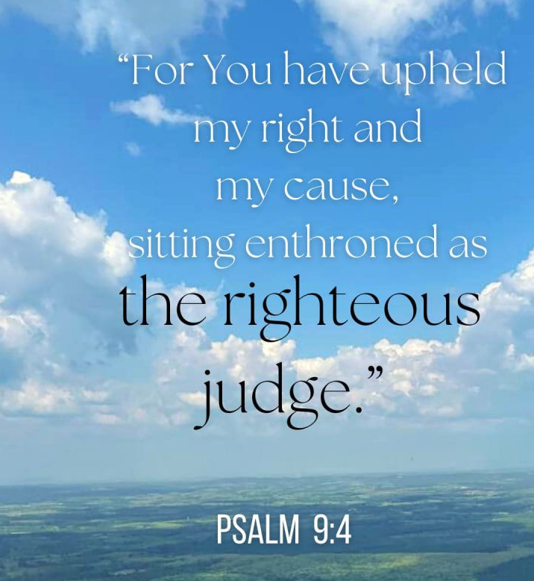

Slide 2


Slide 3
Psalm 9
For the director of music. To the tune of “The Death of the Son.” A psalm of David.
Side A
¹ I will give thanks to you, LORD, with all my heart;
I will tell of all your wonderful deeds.
² I will be glad and rejoice in you;
I will sing the praises of your name, O Most High.

Slide 4
Side B
³ My enemies turn back;
they stumble and perish before you.
⁴ For you have upheld my right and my cause,
sitting enthroned as the righteous judge.

Slide 5
Side A
⁵ You have rebuked the nations and destroyed the wicked;
you have blotted out their name for ever and ever.
⁶ Endless ruin has overtaken my enemies,
you have uprooted their cities;
even the memory of them has perished.

Slide 6
Side B
⁷ The LORD reigns forever;
he has established his throne for judgment.
⁸ He rules the world in righteousness
and judges the peoples with equity.

Slide 7
Side A
⁹ The LORD is a refuge for the oppressed,
a stronghold in times of trouble.
¹⁰ Those who know your name trust in you,
for you, LORD, have never forsaken those who seek
you.

Slide 8
Side B
¹¹ Sing the praises of the Lord, enthroned in Zion;
proclaim among the nations what he has done.
¹² For he who avenges blood remembers;
he does not ignore the cries of the afflicted.

Slide 9
Side A
¹³ LORD, see how my enemies persecute me!
Have mercy and lift me up from the gates of death,
¹⁴ that I may declare your praises
in the gates of Daughter Zion,
and there rejoice in your salvation.

Slide 10
Side B
¹⁵ The nations have fallen into the pit they have dug;
their feet are caught in the net they have hidden.
¹⁶ The LORD is known by his acts of justice;
the wicked are ensnared by the work of their hands.

Slide 11
Side A
¹⁷ The wicked go down to the realm of the dead,
all the nations that forget God.
¹⁸ But God will never forget the needy;
the hope of the afflicted will never perish.

Slide 12
Side B
¹⁹ Arise, LORD, do not let mortals triumph;
let the nations be judged in your presence.
²⁰ Strike them with terror, LORD;
let the nations know they are only mortal.

Slide 13
God as Judge

Slide 14
God as Judge
What do you associate with the word “judge”?
Have you ever met a judge, or seen one in action?
What is the role of a judge in our society?

Slide 15
Gd as Judge
What do you associate with the word “judge”?
Have you ever met a judge, or seen one in action?
What is the role of a judge in our society?
Do you have positive or negative associations with the word “judge”?

Slide 16
What is a Judge?
“A judge’s job is to be a neutral, detached, impartial, and objective individual who hears both sides of a given situation and applies judgment to reach a solution that balances the facts, the law, and the broader impact of the decision.”—Judge Michael Thatcher

Slide 17
What is a Judge?, cont.
“Courts decide what really happened and what should be done about it. They decide whether a person committed a crime and what the punishment should be. They also provide a peaceful way to decide private disputes that people can’t resolve themselves.” —uscourts.gov

Slide 18
Biblical Judgeship
someone who is responsible for the administration of justice and/or the operation of government
human judges, God as judge
human judges:
  “one who governs, dispenses justice, judgment and protection, and as such is the representative of God” (Encyclopedia of the Bible)
  šāpaṭ = leader, ruler, deliverer
God as judge of all the earth

Slide 19
God as Judge
Gen. 16:5: Then Sarai said to Abram, “You are responsible for the wrong I am suffering. I put my slave in your arms, and now that she knows she is pregnant, she despises me. May the LORD judge between you and me.”
Gen. 18:25: “Far be it from you to do such a thing—to kill the righteous with the wicked, treating the righteous and the wicked alike. Far be it from you! Will not the Judge of all the earth do right?”

Slide 20
God as Judge
God is the righteous judge of both peoples and individuals
Isaiah 33:22
For the LORD is our judge,
the LORD is our lawgiver,
the LORD is our king;
it is he who will save us.

Slide 21
God as Judge: Identity
God alone has the righteousness and authority to judge all of creation.
Ensuring that righteousness prevails within the created order is inherent to God’s sovereignty and authority.
“that God will not allow injustice to be the last word… is a central element in the good news of the gospel.” (N.T. Wright, Broken Signposts: How Christianity Makes Sense of the World)

Slide 22
God as Judge: Activity
God decides disputes
God presides in the heavenly court
God judges the earth, every individual, the nations, the rulers of nations, his own people, and the whole of creation
God’s judgment is inescapable, no one can hide from it, God searches human hearts and sees what is done in secret

Slide 23
2 Kings 17
“the Israelites had sinned against the LORD their God…”
“The Israelites secretly did things against the LORD their God that were not right…”
“They did wicked things that aroused the LORD’s anger…”

Slide 24
2 Kings 17, cont.
“The LORD warned Israel and Judah through all his prophets and seers…”
“So the LORD was very angry with Israel and removed them from his presence….”
“Therefore the LORD rejected all the people of Israel; he afflicted them and gave them into the hands of plunderers, until he thrust them from his presence….”

Slide 26
C.S. Lewis on the Psalms
If there is any thought at which a Christian trembles it is the thought of God’s “judgement”. The “Day” of Judgement is “that day of wrath, that dreadful day”. We pray for God to deliver us “in the hour of death and at the day of judgement”. Christian art and literature for centuries have depicted its terrors. This note in Christianity certainly goes back to the teaching of Our Lord Himself; especially to the terrible parable of the Sheep and the Goats. This can leave no conscience

Slide 27
C.S. Lewis on the Psalms, cont.
untouched, for in it the “Goats” are condemned entirely for their sins of omission; as if to make us fairly sure that the heaviest charge against each of us turns not upon the things he has done but on those he never did—perhaps never dreamed of doing.
It was therefore with great surprise that I first noticed how the Psalmists talk about the judgements of God. They talk like this; “O let the nations rejoice and be glad, for thou

Slide 28
C.S. Lewis on the Psalms, cont.
shalt judge the folk righteously”, “Let the field be joyful . . . all the trees of the wood shall rejoice before the Lord, for he cometh, for he cometh to judge the earth”. Judgement is apparently an occasion of universal rejoicing. People ask for it: “Judge me, O Lord my God, according to thy
righteousness”.
The reason for this soon becomes very plain. The ancient Jews, like ourselves, think of God’s judgement in terms of

Slide 29
C.S. Lewis on the Psalms, cont.
an earthly court of justice. The difference is that the Christian pictures the case to be tried as a criminal case with himself in the dock; the Jew pictures it as a civil case with himself as the plaintiff. The one hopes for acquittal, or rather for pardon; the other hopes for a resounding triumph with heavy damages. Hence he prays
“judge my quarrel”, or “avenge my cause”…

Slide 30
C.S. Lewis on the Psalms, cont.
Notice what He [Jesus] means by “an unjust judge”. By those words most of us would mean someone like … the creatures who sat on the benches of German tribunals during the Nazi régime: someone who bullies witnesses and jurymen in order to convict, and then savagely to punish, innocent men. Once again, we are thinking of a criminal trial. We hope we shall never appear in the dock before such a judge. But the Unjust Judge in the parable is quite a different character. There is no danger of

Slide 31
C.S. Lewis on the Psalms, cont.
appearing in his court against your will: the difficulty is the opposite—to get into it. It is clearly a civil action. The poor woman has had her little strip of land—room for a pigsty or a hen-run—taken away from her by a richer and more powerful neighbour …. And she knows she has a perfectly watertight case. If once she could get it into court and have it tried by the laws of the land, she would be bound to get that strip back. But no one will listen to her, she can’t get it tried. No wonder she is anxious for “judgement”.

Slide 32
C.S. Lewis on the Psalms, cont.
Behind this lies an age-old and almost world-wide experience which we have been spared. In most places and times it has been very difficult for the “small man” to get his case heard…. We need not therefore be surprised if the Psalms, and the Prophets, are full of the longing for judgement, and regard the announcement that “judgement” is coming as good news. Hundreds and thousands of people who have been stripped of all they possess and who have the right entirely on their side will at

Slide 33
C.S. Lewis on the Psalms, cont.
last be heard. Of course they are not afraid of judgement. They know their case is unanswerable—if only it could be heard. When God comes to judge, at last it will…
The Divine Judge is the defender, the rescuer. Scholars tell me that in the Book of Judges the word we so translate might almost be rendered “champions”; for though these “judges” do sometimes perform what we should call judicial functions many of them are much more concerned

Slide 34
C.S. Lewis on the Psalms, cont.
with rescuing the oppressed Israelites from Philistines and others by force of arms. They are more like Jack the Giant Killer than like a modern judge in a wig.

Slide 35
C.S. Lewis on the Psalms, cont.
… what alarms us …is the infinite purity of the standard against which our actions will be judged. But then we know that none of us will ever come up to that standard. We are all in the same boat. We must all pin our hopes on the mercy of God and the work of Christ, not on our own goodness…

Slide 37
Looking ahead
Next week (Feb. 13-14): “Love”
  Deut. 7:6-9, Ps. 136; 1 John 4:7-21
Following week, Feb. 20/21, is Break Week
February 27/28: “Shepherd”: Visitors Day!
  Invite a guest! Bring a treat!

Slide 38


Slide 39


Slide 40
Moms in Prayer
https://momsinprayer.org/
Maureen Gaines
  mo.d.gaines@comcast.net
  630-456-3380

