Slide 1

Isaiah week three
Grace Chapel Lexington Women’s Bible Study
September 29, 2020

Slide 2
Isaiah 13-23
“Oracles against the nations”
Judgments against Judah and all of Judah’s neighboring nations
Trying to look at the big picture of these chapters
Three different historical contexts for the Book of Isaiah

Slide 3
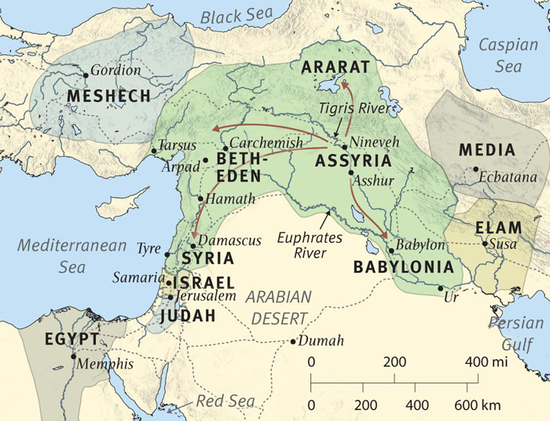

Slide 4
Historical Background
The role of Assyria
  (rulers in this period: Tiglath-Pileser III, Sargon, Sennacherib)
Alliances with foreign nations

Slide 5
Isaiah 10:5-7, 12
“Woe to the Assyrian, the rod of my anger, in whose hand is the club of my wrath! I send him against a godless nation, I dispatch him against a people who anger me, to seize loot and snatch plunder, and to trample them down like mud in the streets. But this is not what he intends, this is not what he has in mind; his purpose is to destroy, to put an end to many nations….”
When the Lord has finished all his work against Mount Zion and Jerusalem, he will say, “I will punish the king of Assyria for the willful pride of his heart and the haughty look in his eyes.”

Slide 6
Oracles against what nations?
Chh. 13:1-14:23: Babylon
Ch. 14:24-27: Assyria
Ch. 14:28-32: Philistia
Chh. 15-16: Moab
Ch. 17:1-3: Damascus
Ch. 17:4-14: Ephraim (Israel)

Slide 7
Oracles against what nations? (cont.)
Chh. 18-20: Cush/Egypt
Ch. 21:1-10: Babylon (again)
Ch. 21:11-12: Edom
Ch. 21:13-17: People of Arabia
Ch. 22: The Valley of Vision (Jerusalem)
Ch. 23: Tyre

Slide 8
Conclusions
Significance of these nations
Trusting in God/Trusting in foreign alliances
Scope of the prophecy in Isaiah 13-23
  “The Lord Almighty will bless them, saying, ‘Blessed be Egypt my people, Assyria my handiwork, and Israel my inheritance.’” (Isa. 19:25).

Slide 9
Conclusions, cont.
Key themes in 13-23:
  Self-reliance and self-salvation projects vs. trusting in God
  The reach of God’s will, judgment, and grace
  The sinfulness of human pride

Slide 10
Prayer: Psalm 19:57-64
You are my portion, Lord;
I have promised to obey your words.
I have sought your face with all my heart;
be gracious to me according to your promise.
I have considered my ways
and have turned my steps to your statutes.

Slide 11
Prayer: Psalm 19:57-64, cont.
I will hasten and not delay
to obey your commands.
Though the wicked bind me with ropes,
I will not forget your law.
At midnight I rise to give you thanks
for your righteous laws.

Slide 12
Prayer: Psalm 19:57-64, cont.
I am a friend to all who fear you,
to all who follow your precepts.
The earth is filled with your love, Lord;
teach me your decrees.

Slide 13
Breakout rooms

