Slide 1
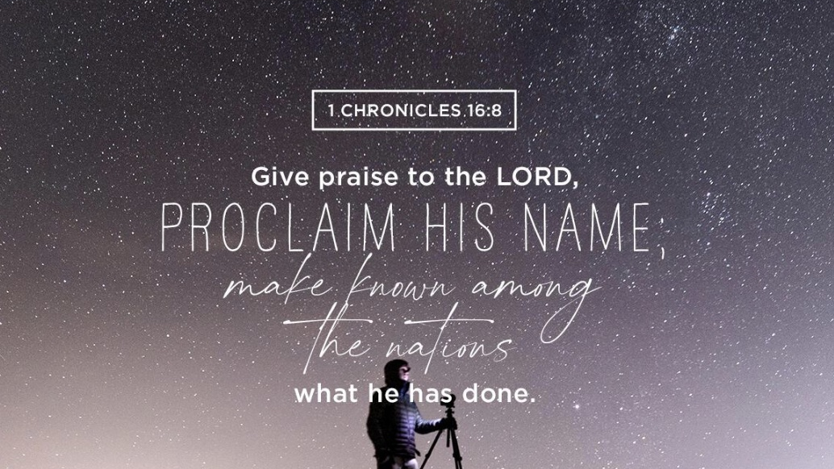

Slide 2


Slide 3
The Divine Name:
God, LORD, YHWH
Background:
  What is God’s name, or what are God’s names?
  How do we address God? What does it mean that there are multiple names for God?
  Who is God? What is God like?
  Who does God reveal himself to be in the Scriptures?

Slide 4
God has a name?
“Few issues are at once so central to biblical faith and yet so perplexing as the name of God.”
—R. Kendall Soulen

Slide 5
The Word “God”
“The very existence of this word is worth considering. …. [W]e do not, of course, mean only the German or English word for ‘God.’ It does not matter if we say Gott in German or Deus in Latin, or El in the Semitic languages or teotl in Mexican and so forth, though it is, of course, a very obscure and difficult question how we can know that all these different words mean the same thing or person… The word ‘God’ exists, and this by

Slide 6
The Word “God,” cont.
itself merits consideration. But the English word ‘God’ (like the German Gott) says nothing about him.…Today, at least, the word sounds like a proper name: what is meant by it must be known from another source.”
—Karl Rahner, SJ

Slide 7
The Word “God”
“But since for monotheists the class it designates is populated by only one being, the word therefore often functions as a proper noun—a name. This ‘name’ quality is especially pronounced when the first letter of the word is capitalized. In such cases, ‘God,’ like ‘William Shakespeare,’ refers to a specific, known individual, that is, the all-powerful creator and sustainer of the world.”—Collin Cornell

Slide 8
Genesis 1:1
In the beginning God created the heavens and the earth.

Slide 9
Genesis 1:1
In the beginning God created the heavens ….
elohim

Slide 10
Genesis 2:4
This is the account of the heavens and the earth when they were created, when the LORD God made the earth and the heavens.

Slide 11
Genesis 2:4
This is the account of the heavens and the earth when they were created, when the LORD God made the earth and the heavens.
Adonai = Hebrew for “Lord"

Slide 12
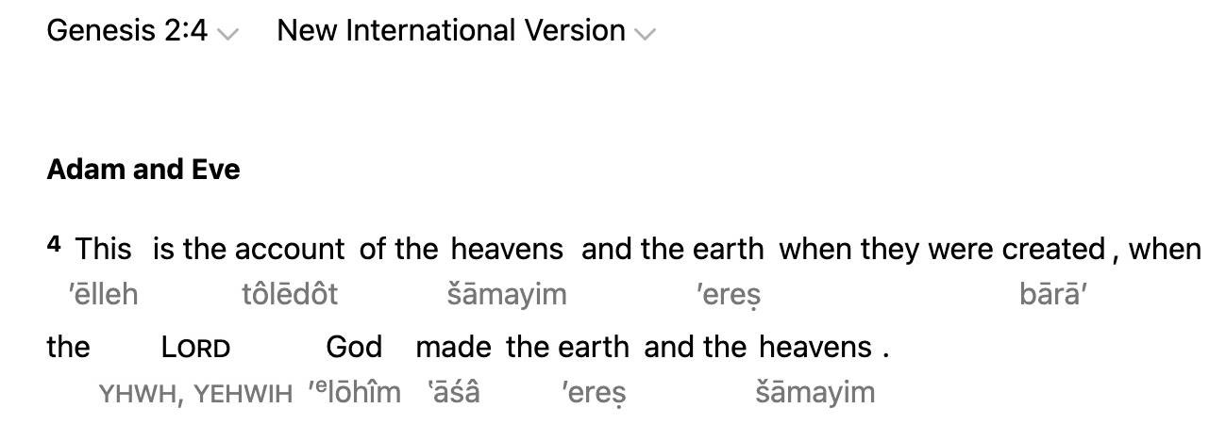

Slide 13
YHWH
Tetragrammaton (Greek for “four letters”)
Yod, He, Waw, He (four consonants)
a form of the Hebrew verb “to be”
possible translations:
  “I Am Who I Am” or
  “I Will Be Who I Will Be”
“LORD” or “the LORD”

Slide 14
Genesis 2:4
This is the account of the heavens and the earth when they were created, when the LORD God made the earth and the heavens.

Slide 15
“YHWH” to “LORD”
reverence for the Divine Name
“Lord” (Adonai in Hebrew, Kyrios in Greek, Dominus in Latin )
LORD/Lord
Ps. 97:5: “The mountains melt like wax before the LORD, before the Lord of all the earth.”
YHWH adon

Slide 16
Exodus 3:1-17
Now Moses was tending the flock of Jethro his father-in-law, the priest of Midian, and he led the flock to the far side of the wilderness and came to Horeb, the mountain of God. ² There the angel of the Lord appeared to him in flames of fire from within a bush. Moses saw that though the bush was on fire it did not burn up.

Slide 17
Exodus 3:1-17, cont.
⁴ When the Lord saw that he had gone over to look, God called to him from within the bush, “Moses! Moses!”
And Moses said, “Here I am.”
⁵ “Do not come any closer,” God said. “Take off your sandals, for the place where you are standing is holy ground.”

Slide 18
Exodus 3:1-17, cont.
⁶ Then he said, “I am the God of your father, the God of Abraham, the God of Isaac and the God of Jacob.” At this, Moses hid his face, because he was afraid to look at God.

Slide 19
Exodus 3:1-17, cont.
⁷ The Lord said, “I have indeed seen the misery of my people in Egypt. …⁹ And now the cry of the Israelites has reached me, and I have seen the way the Egyptians are oppressing them. ¹⁰ So now, go. I am sending you to Pharaoh to bring my people the Israelites out of Egypt.”

Slide 20
Exodus 3:1-17, cont.
¹¹ But Moses said to God, “Who am I that I should go to Pharaoh and bring the Israelites out of Egypt?”
¹² And God said, “I will be with you. ...”

Slide 21
Exodus 3:1-17, cont.
¹³ Moses said to God, “Suppose I go to the Israelites and say to them, ‘The God of your fathers has sent me to you,’ and they ask me, ‘What is his name?’ Then what shall I tell them?”

Slide 22
Exodus 3:1-17, cont.
¹⁴ God said to Moses, “I am who I am. This is what you are to say to the Israelites: ‘I am has sent me to you.’”
¹⁵ God also said to Moses, “Say to the Israelites, ‘The LORD, the God of your fathers—the God of Abraham, the God of Isaac and the God of

Slide 23
Exodus 3:1-17, cont.
Jacob—has sent me to you.’
“This is my name forever,
the name you shall call me
from generation to generation.”

Slide 24
Exodus 3:1-17, cont.
¹⁶ “Go, assemble the elders of Israel and say to them, ‘The Lord, the God of your fathers—the God of Abraham, Isaac and Jacob—appeared to me and said: I have watched over you and have seen what has been done to you in Egypt. ¹⁷ And I have promised to bring you up out of your misery in Egypt into the land of the Canaanites, Hittites, Amorites, Perizzites, Hivites and Jebusites—a land flowing with milk and honey.’

Slide 25
Looking ahead: Creator
Pre-reading question
Genesis 1
Genesis 14:18-24
Isaiah 40:18-31

