Slide 1
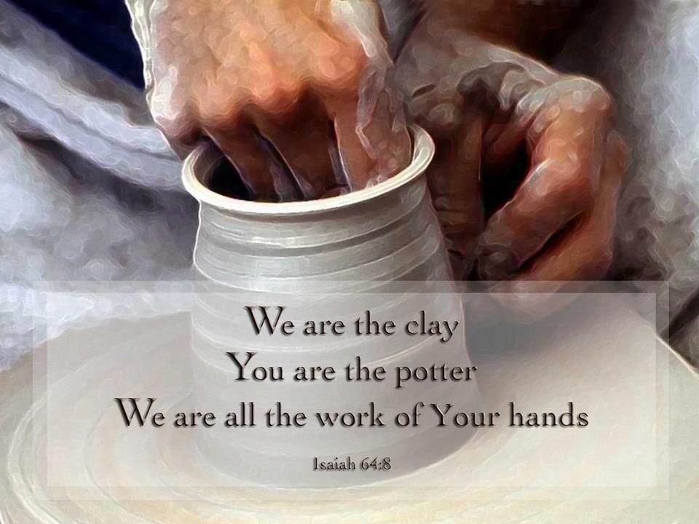

Slide 2


Slide 3

Hosted at Grace Chapel in both Wilmington & Watertown

Slide 4
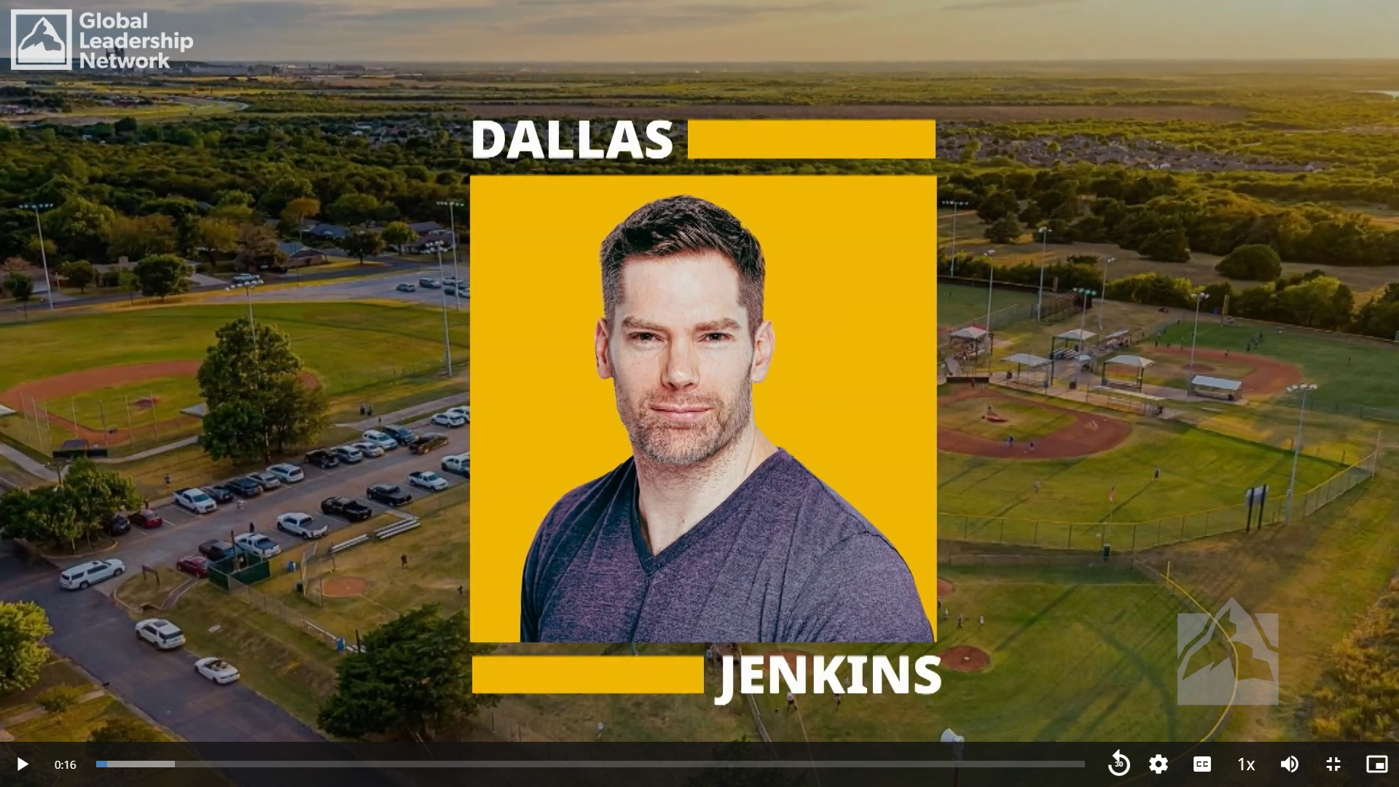
Notes:
https://sc.willowcreek.com/mpa/ussc/#/app/glsSessions?tab=curYear

Slide 5
Discussion questions
Have you ever faced a situation where one of your dreams was dashed?
    How did you handle it at the time?
    Were you eventually able to come to a place of acceptance?
    How long did that take? How does it feel today, after the fact?

Slide 6

What is it?
World-class content; perfect for both individuals & teams
Platform for ongoing discussions & learning
In 2023, over 300,000 people attended from over 100 countries
Community outreach for Grace Chapel
Reduced pricing of $139 per person through May 8
www.grace.org/gls

Slide 8
Potter, Builder, Gardener

Slide 9
Potter, Builder, Gardener
  God’s creativity

Slide 10
Potter, Builder, Gardener
  God’s creativity
  Do you consider yourself a creative person? What creative activities do you enjoy?

Slide 11
God as Gardener

Slide 12
God as Gardener
Genesis 2:8: “Now the LORD God had planted a garden in the east, in Eden; and there he put the man he had formed.”
Genesis 3:8: “Then the man and his wife heard the sound of the LORD God as he was walking in the garden in the cool of the day, and they hid from the LORD God among the trees of the garden.”

Slide 13
God as Gardener, cont.
Isaiah 51:3: “The LORD will surely comfort Zion and will look with compassion on all her ruins; he will make her deserts like Eden, her wastelands like the garden of the LORD. Joy and gladness will be found in her, thanksgiving and the sound of singing.”
Ezekiel: “garden of God” (3x)

Slide 14
God as Gardener, cont.
Luke 13:19: “It is like a mustard seed, which a man took and planted in his garden. It grew and became a tree, and the birds perched in its branches.”
John 20:15: “He asked her, ‘Woman, why are you crying? Who is it you are looking for?’ Thinking he was the gardener, she said, ‘Sir, if you have carried him away, tell me where you have put him, and I will get him.’”

Slide 15
John 15:1-8, Background
John 1-12: Jesus’s public ministry; John 13-17: Jesus’s private ministry to his disciples (“the ministry in the upper room”)
Upper room: Jesus instructs, consoles, encourages, prepares, prays
Vine imagery

Slide 16
O.T. Vine Imagery
“You transplanted a vine from Egypt;
you drove out the nations and planted it.
You cleared the ground for it,
and it took root and filled the land.”
Ps. 80:8-9

Slide 17
O.T. Vine Imagery
Now you dwellers in Jerusalem and people of Judah,
judge between me and my vineyard.
What more could have been done for my vineyard
than I have done for it?
          Isaiah 5:3-4

Slide 18
John 15:1-8
vineyard imagery in New Testament period, Jesus’s parables and teachings
Jesus alone is the true vine, fulfilling God’s original intention for the nation of Israel
God the Father is the gardener

Slide 19
John 15:1-3, The Message
I am the Real Vine and my Father is the Farmer. He cuts off every branch of me that doesn’t bear grapes. And every branch that is grape-bearing he prunes back so it will bear even more. You are already pruned back by the message I have spoken.

Slide 20
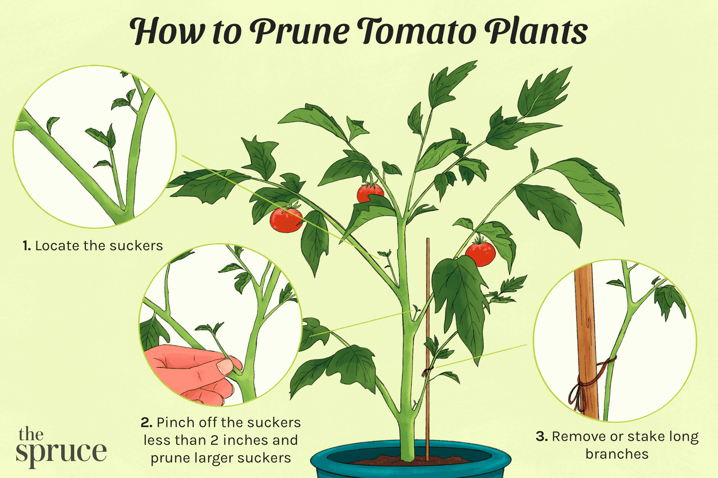

Slide 21
John 15:1-8
⁴ Remain in me, as I also remain in you. No branch can bear fruit by itself; it must remain in the vine. Neither can you bear fruit unless you remain in me.
⁵ “I am the vine; you are the branches. If you remain in me and I in you, you will bear much fruit; apart from me you can do nothing. …

Slide 22
John 15:4-8, The Message
“Live in me. Make your home in me just as I do in you. In the same way that a branch can’t bear grapes by itself but only by being joined to the vine, you can’t bear fruit unless you are joined with me.

Slide 23
John 15:4-8, The Message
“I am the Vine, you are the branches. When you’re joined with me and I with you, the relation intimate and organic, the harvest is sure to be abundant. Separated, you can’t produce a thing. Anyone who separates from me is deadwood, gathered up and thrown on the bonfire.”

Slide 24
For Reflection
In what area of your life do you need the creativity, artistry, and skill of a master Potter, Builder, or Gardener?
Where do you need God to mold you, shape you, build you, or plant or trim or prune something in your life?

Slide 26
Announcements
Do you love gardening? Would you like to see our church family engage our community by creating pockets of beauty?
  Reach out to Akash Ahuja (akash@grace.org) or sign up on the sheet

Slide 27
Looking ahead
Next week: extended small-group time (God as Refuge, Dwelling, Home); Food Bank Week
May 14/15: Father, Son, Spirit
May 21/22: Closing Celebration
  What image of God from this year’s study did you find most striking or surprising?
  What did God reveal to you or remind you through that image?

