Slide 1


Slide 2
Hope and Prayer
That each one of us will come to know God more and grow in our relationship with him this year.

Slide 3
Logistics
Getting in touch:
  Grace: glee@grace.org
  Rachel: rkeeler@grace.org
Books available Week 2
  Zoom pickup
  Additional copies
Sick or traveling days

Slide 4
Logistics, cont.
Schedule, recordings, and slides available at: www.grace.org/lexwomensgroups
Food Bank collection: first Tuesday of each month, starting next week

Slide 5
Inductive Bible Study
Observation: What does the passage say?
Interpretation: What does the passage mean?
Application: What does the passage mean to me? (How does the passage apply to me, to my life, to my walk with God?)

Slide 6
Inductive Bible Study, cont.
Application: What does the passage mean to me?
  Sins to confess or avoid
  Promises to grab hold of
  Examples to follow
  Commands to obey
  Truths to believe

Slide 7
Format: Study Guide
Pre-reading questions
Three main readings (Days One, Two, Three)
  Between two and four questions for each reading
Other verses to pray with
Suggestion for reflection and prayer

Slide 8
Format: Sessions
Alternating weeks
Large-Group Teaching weeks:
  Start with worship (9:35am/7:05pm)
Extended Small Group weeks:
  Balance between study, prayer, and fellowship

Slide 9
“Images of God” Study
1. 9/26-27: Opening Week (LG)
Part 1: Names of God
2. 10/3-4: The Divine Name (LG)
3. 10/10-11: Creator (ESG)
4. 10/17-18: God of… (LG)
5. 10/24-25: Almighty (ESG)
6. 10/31-11/1: Sovereign Lord (LG)
11/7-8: Global Awareness Week

Slide 10
“Images of God” Study, cont.
8. 11/14-15: Living God (ESG)
11/21-22—Thanksgiving Week—No Meeting
9. 11/28-29: Most High/Mighty One/Holy One (LG)
10. 12/5-6: Father (ESG)
Part 2: Images of God
11. 12/12-13: Christmas Celebration/King (LG)
12/19-20, 12/26-27, 1/2-3—Christmas Break
12. 1/9-10/24!: Redeemer/Rescuer/Deliverer (LG)

Slide 11
“Images of God” Study, cont.
13. 1/16-17: Shield/Sword (ESG)
14. 1/23-24: Warrior (LG)
15. 1/30-31: God of Peace (ESG)
16. 2/6-7: Judge (LG)
17. 2/13-14: Love (ESG)
2/20-21—School Break Week—No Meeting
18. 2/27-28: Shepherd (LG)
19. 3/5-6: Provider (ESG)

Slide 12
“Images of God” Study, cont.
20. 3/12-13: Defender of the Poor (LG)
21. 3/19-20: Teacher (ESG)
22. 3/26-27 (Holy Week): Healer (LG)
23. 4/2-3: Comforter (ESG)
24. 4/9-10: Hope (LG)
4/16-17—School Break Week—No Meeting
25. 4/23-24: Relational Images (Friend, Parent, Spouse) (ESG)

Slide 13
“Images of God” Study, cont.
26. 4/30-5/1: Functional Images (Potter, Builder, Gardener) (LG)
27. 5/7-8: Place Images (Refuge, Dwelling, Home) (ESG)
Conclusion: The Triune God
28. 5/14-15: Father, Son, Spirit (LG)
29. 5/21-22: Closing Celebration (LG)

Slide 14
Looking ahead to next week
The Divine Name
  Day 1: Pre-reading questions
  Day 2: Genesis 15:1-6 (Covenant with Abram)
  Day 3: Genesis 17:1-8 (Covenant of Circumcision)
  Day 4: Exodus 3:1-17 (Moses and the Burning Bush)

Slide 15
announcements & reminders
Schedule, recordings, and slides available at: www.grace.org/lexwomensgroups
Food Bank collection next week
Upcoming events
  ALPHA, starts Thursday, 9/28
  The Marriage Course, starts Thursday, 9/28
  Men’s Groups Book Drive, October 7th
  Campus BBQ, October 8th

Slide 16


Slide 17


Slide 18
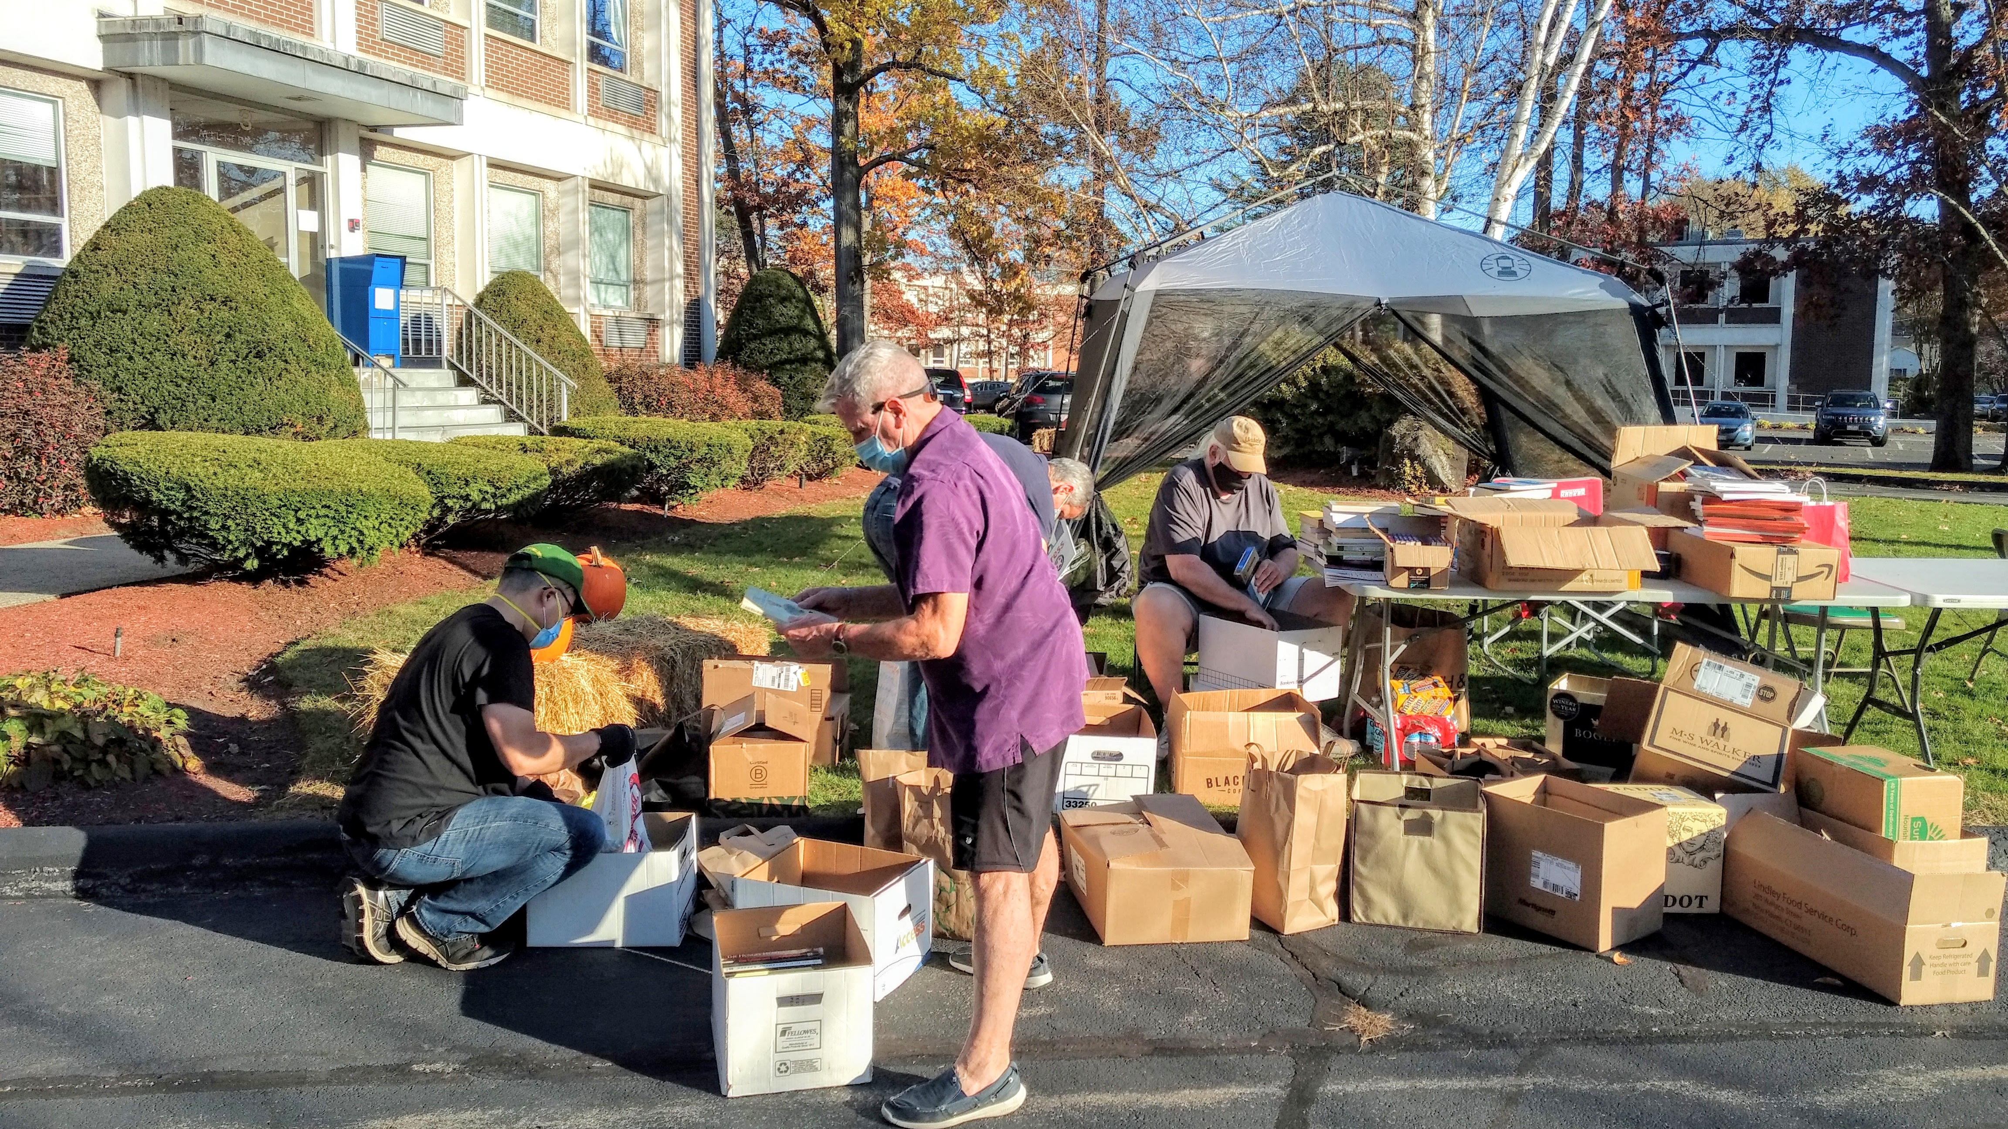

Slide 19


