Slide 1

Isaiah week one
Grace Chapel Lexington Women’s Bible Study
September 15, 2020

Slide 2
Logistics
Schedule
Breakout rooms
Group numbers
Workbooks
Additional background readings

Slide 3
Schedule
Tuesday, September 15
Opening—Large-group teaching
Reading assignment: Isaiah 1-5; Workbook Weeks 1 & 2
Tuesday, September 22
Small-group only
Reading assignment: Isaiah 6-12; Workbook Week 3
Tuesday, September 29
Large-group teaching
Reading assignment: Isaiah 13-23; Workbook Week 4
Tuesday, October 6
Small-group only
Reading assignment: Isaiah 24-27; Workbook Week 5

Slide 4
Why Isaiah?
A community in exile
Isaiah in the New Testament
Isaiah as background to Luke
Prophetic concern for justice

Slide 5
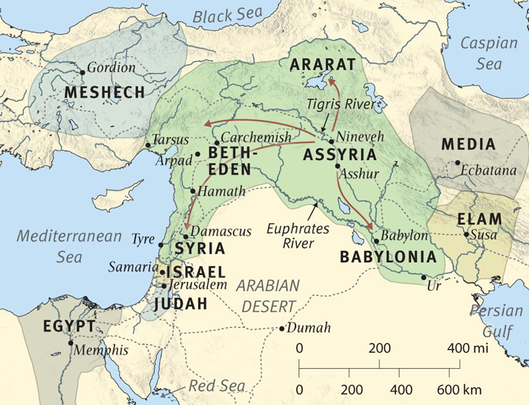
Introduction to Isaiah: Map

Slide 6
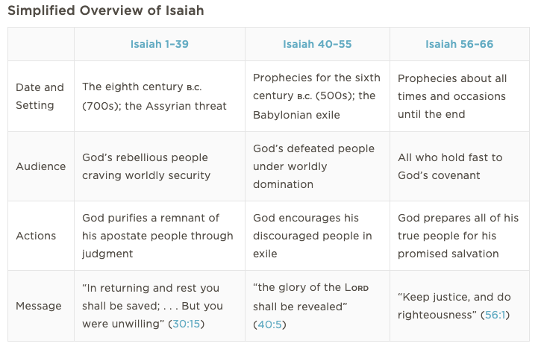
Introduction to Isaiah: Overview

Slide 7
Introduction to Isaiah: Themes
God’s glory, sovereignty, power, faithfulness
the rebellion, purification, restoration, and destiny of God’s people, Israel
sin and judgment, the foolishness of human pride
suffering
justice
exile and restoration
the branch, the Messiah, the suffering servant

Slide 8
Isaiah 5:7
The vineyard of the Lord Almighty
is the nation of Israel,
and the people of Judah
are the vines he delighted in.
And he looked for justice, but saw bloodshed;
for righteousness, but heard cries of distress.

Slide 9
Prayer
Lord, open my heart to hear your word for me today. I ask that you console me, comfort me, and strengthen my trust in your faithful love.
Lord, show me the desert, the wasteland, within me, and help me to trust that you will bring new life and build in me a path to you.

Slide 10
Breakout rooms
Please click “Ask for Help,” or send me an e-mail at rkeeler@grace.org, if you are assigned to the wrong room or have any trouble at all once you are in your breakout rooms.

