Slide 1

Group Leader Vision Training - Fall 2026
“Ready …”
Notes:
Welcome to our connections training! Thank you so much for coming. We are so excited to connect every guest that comes through our doors this Fall. And of course, we could not do it without you.

Slide 2
Talk to Each Other :)
Optional Ice-Breaker Questions:
- This is what I/we did this summer …
- Something I am truly excited about is …
- I don’t want to talk about the Pats but I just want to say this …
- Pastor Tim was right … Chocolate Peanut Butter Cup ice cream
is the best but here’s the second best …
- You should check out this book, podcasts, etc. …

Slide 3
The What and Why of Group Life
Group Life Vision:
“Small groups of people practicing the way of Jesus together.”
Group Life Values:
Spiritual Formation
Strengthening Relationships
Missional Living

Slide 4
“Ready…”
Group Leader Vision Training – Fall 2026

Slide 5
Be Ready …
Be ready to adapt.
Be ready to change.
Be ready to jump in.
Be ready to help those who are struggling, or upset, or confused.
Be ready for what God has in store for us next …

Slide 6
Hinderances to Readiness for God:
Our own agenda (stops us from being united and aligned)
Our lingering frustration, anger, or doubt
Our reliance on competing influences/powers over the Holy Spirit.
Our lack of spiritual formation

Slide 7
Ready, Pray, …
Pray to get ready for what the Lord has for us next.

Slide 8
“A rich, vibrant, consoling, hard-won prayer life is the one good that makes it possible to receive all other kinds of goods rightly and beneficially. [Paul] does not see prayer as merely a way to get things from God but as a way to get more of God himself.”
Tim Keller (From Prayer: Experiencing Awe and Intimacy With God)

Slide 9
Questions to Pray Through:
“What is God telling me?
“What do I need to surrender?”
“Where do I need to trust Him more?”
“What practice could help me become more attentive to God?”
“Who is God asking me to love?”
“What is God inviting me to do?”

Slide 10
Ready, Pray, Grow …

Slide 11
Growing
Sometimes we grow at the mountain-top of God’s blessing.
Sometimes we grow in the valley of suffering (where God is as well)
We always have an opportunity to grow when we seek Jesus in obedience, worship, community, and mission.

Slide 12
“Some journeys take us far from home.
Some adventures lead us to our destiny.” – C.S. Lewis

Slide 13

www.grace.org/jrl
Journey Resource Library

Slide 14
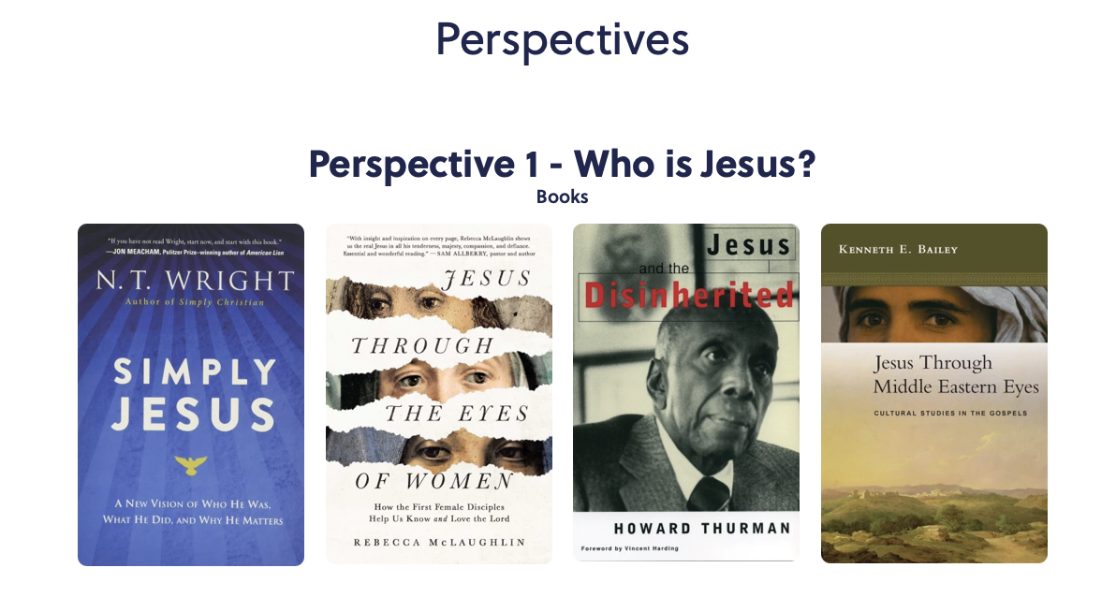
www.grace.org/jrl
Journey Resource Library

Slide 15
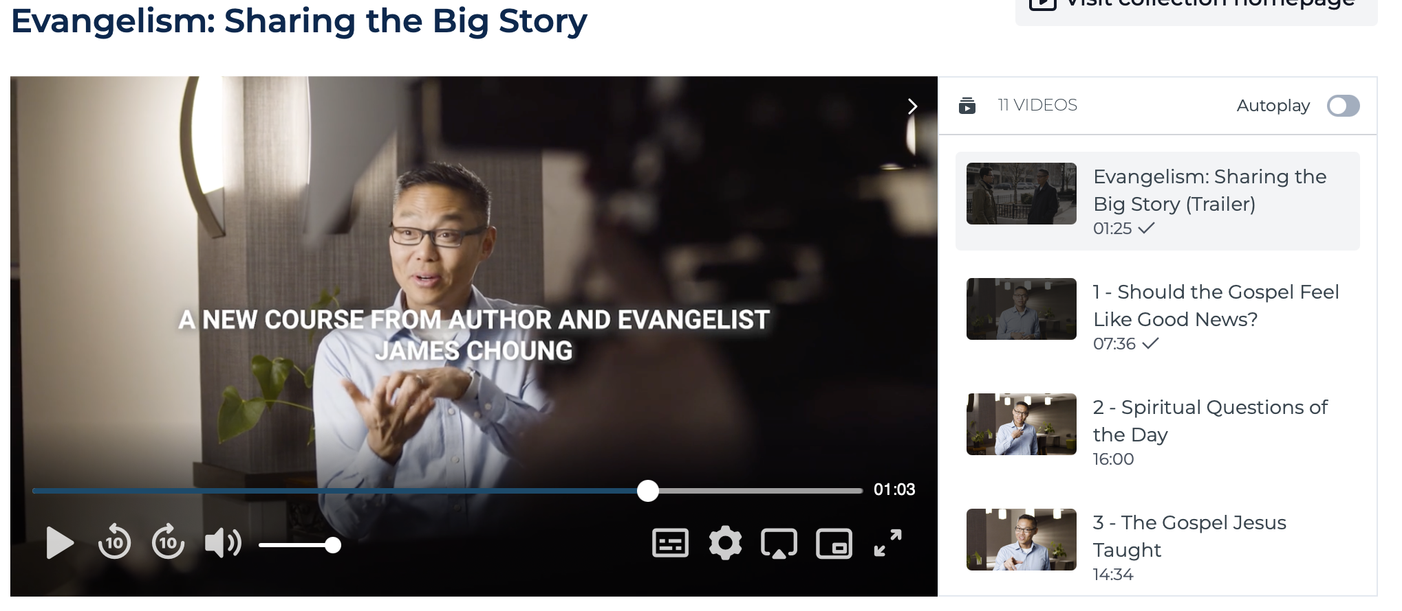
Evangelism: Sharing the Big Story
with Dr. James Choung - (Right Now Media)

Slide 16
Ready, Pray, Grow … and … Go!

Slide 17
Go Prayers Include …
Where is God already sending us?
Who has God already placed around us?
Where is our group already connected?
Where do we already have influence?
Where is there a need that God may be inviting us to meet?

Slide 18
Ready, Pray, Grow … and … Go!

Slide 20
https://grace.org/groupleaders
- Training
- Content
- Leader Development
- More
Notes:
https://www.grace.org/groupleaders/

Slide 21
www.grace.org/jrl
Journey Resource Library

Slide 22
Tracking Our Engagement …
The Why:
Faithfulness and Integrity
A Tool for Shepherding
Understanding our Trends and Creating Ministry for our Context

Slide 23
Where we finished, Where we began …
Campus Groups Sep June'26
Campus | # of Groups | Total Average # of People Attending Groups
Lex | 101 | 578
Cen | 9 | 156
Wil | 22 | 132
Wat | 17 | 68
Fox | 4 | 50
Onl | 6 | 27
Total | 159 | 860
Campus Groups Sep 2025
Campus | # of Groups | Total Average # of People Attending Groups
Lex | 94 | 509
Cen | 4 | 13
Wil | 18 | 132
Wat | 14 | 45
Fox | 6 | 31
Onl | 6 | 30
Total | 142 | 785

Slide 24
https://grace.org/groupleaders
- Training
- Content
- Leader Development
- More
Notes:
https://www.grace.org/groupleaders/

Slide 25
https://grace.org/groupleaders https://grace.org/jrl https://grace.org/studyguide kmorris@grace.org tghali@grace.org
Notes:
https://www.grace.org/groupleaders/

Slide 26

Q & A

