Slide 1
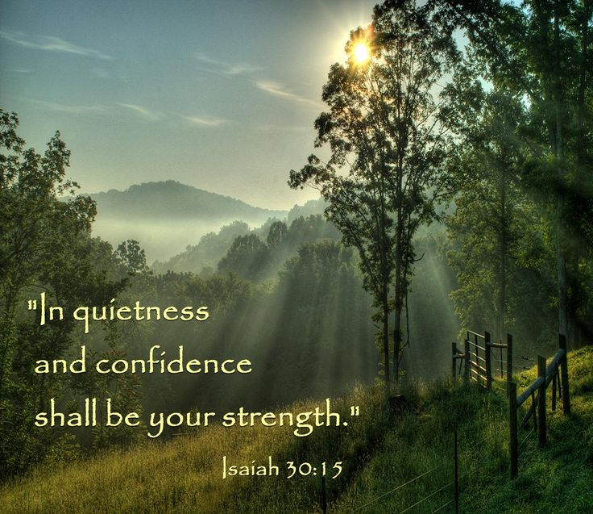

Slide 2


Slide 3
Announcements & Reminders
Tuesday, 12/5: Food Pantry
Saturday, 12/9: Jingle Jam
Tuesday, 12/12: Christmas Celebration/God as King
No meetings December 19, December 26, January 2

Slide 4
Most High
Mighty One
Holy One

Slide 5
Most High
“Blessed be Abram by God Most High,
Creator of heaven and earth.
²⁰ And praise be to God Most High,
who delivered your enemies into your hand.”
(Gen 14:19-20)

Slide 6
Most High
“Blessed be Abram by God Most High,
Creator of heaven and earth.
²⁰ And praise be to God Most High,
who delivered your enemies into your hand.”
(Gen 14:19-20)
1 Samuel 2:10: “The Most High will thunder from heaven.”

Slide 7
Most High
’ēl ʽelyôn: God Most High
ʾēl šadday: God Almighty
ʾēl ʿôlām: the Eternal God

Slide 8
Most High
“But love your enemies, do good to them, and lend to them without expecting to get anything back. Then your reward will be great, and you will be children of the Most High” (Luke 6:35)
“When he saw Jesus, he cried out and fell at his feet, shouting at the top of his voice, ‘What do you want with me, Jesus, Son of the Most High God? I beg you, don’t torture me!’” (Luke 8:28)

Slide 9
Most High – Luke 1:31-35
³¹ You will conceive and give birth to a son, and you are to call him Jesus. ³² He will be great and will be called the Son of the Most High. The Lord God will give him the throne of his father David, ³³ and he will reign over Jacob’s descendants forever; his kingdom will never end.”
³⁴ “How will this be,” Mary asked the angel, “since I am a virgin?”
³⁵ The angel answered, “The Holy Spirit will come on you, and the power of the Most High will overshadow you. So the holy one to be born will be called the Son of God.

Slide 10
Mighty One
Genesis 49:24: “But his bow remained steady, his strong arms stayed limber, because of the hand of the Mighty One of Jacob, because of the Shepherd, the Rock of Israel…”

Slide 11
Mighty One
Joshua 22:22: “The Mighty One, God, the LORD! The Mighty One, God, the LORD! He knows! And let Israel know! If this has been in rebellion or disobedience to the LORD, do not spare us this day.”

Slide 12
Mighty One – Ps. 42:1, 4
As the deer pants for streams of water,
so my soul pants for you, my God. . . .
4 These things I remember
as I pour out my soul:
how I used to go to the house of God
under the protection of the Mighty One
with shouts of joy and praise
among the festive throng.

Slide 13
Mighty One – Lk. 1:46-49
⁴⁶ And Mary said:
“My soul glorifies the Lord
⁴⁷ and my spirit rejoices in God my Savior,
⁴⁸ for he has been mindful
of the humble state of his servant.
From now on all generations will call me blessed,
⁴⁹ for the Mighty One has done great things for me—
holy is his name.

Slide 14
Holy One
Isaiah 40:25: “‘To whom will you compare me? Or who is my equal?’ says the Holy One.”
Psalm 71:22: “I will praise you with the harp for your faithfulness, my God; I will sing praise to you with the lyre, Holy One of Israel.

Slide 15
“Holy”
“dedicated or consecrated to God or a religious purpose; sacred”

Slide 16
“Holy”
“dedicated or consecrated to God or a religious purpose; sacred”
“The moral excellence of God that unifies his attributes and is expressed through his actions, setting him apart from all others.”

Slide 17
“Holy”
“dedicated or consecrated to God or a religious purpose; sacred”
“The moral excellence of God that unifies his attributes and is expressed through his actions, setting him apart from all others.”
“The quality of God that sets him utterly apart from his world, especially in terms of his purity and sanctity. …. Believers are called upon to become like God in his holiness.”

Slide 18
“Holy”
“The decisive element in the Old Testament concept of the holy is not so much the awesome divine power. Rather, through certain places, objects, or occasions, people enter into direct contact with the divine power. The basic idea is not that of separation, but the positive thought of encounter, which inevitably demands certain modes of response.”

Slide 19
Holy One
2 Kings 19:21-22: “Who is it you have ridiculed and blasphemed? Against whom have you raised your voice and lifted your eyes in pride? Against the Holy One of Israel!”
Isaiah 30:15: “This is what the Sovereign LORD, the Holy One of Israel, says:
‘In repentance and rest is your salvation,
in quietness and trust is your strength,
but you would have none of it.’”

Slide 21
Looking ahead
Next week (12/5): Food Pantry, small groups only, God as Father:
  Deut. 32:3-12
  Hosea 11:1-4
  Matthew 6:5-14
Following week (12/12): Christmas Celebration/God as King
No meetings Dec. 19, Dec. 26, Jan. 2

