Slide 1

Group Leader Winter Training 2025
Welcome Group Leaders!

Slide 2
Talk to Each Other :)
Optional Ice-Breaker Question:
- Growing up, I thought my job would be … but I do/did this ….
- I am predicting that we get this many more snow storms.
- I will cheer against the Chiefs this Super Bowl and here’s why
- I will cheer against the Eagles this Super Bowl and here’s why

Slide 3
The What and Why of Group Life
Group Life Vision:
“Small groups of people practicing the way of Jesus together.”
Group Life Values:
Spiritual Formation
Strengthening Relationships
Missional Living

Slide 4
”What Group Leaders Can Learn From Kingdom Conversation Principles”
----------
Shelton Oakley-Hersey
Spiritual Director, Facilitator, & Kingdom Pastor

Slide 5
Tracking Our Engagement …
The Why:
Faithfulness and Integrity
A Tool for Shepherding
Understanding our Trends and Creating Ministry for our Context

Slide 6
What We Are Learning From Tracking Our Engagement
134 Total Groups Across All Our Campuses
1421 Unique Individuals on our Group Rosters
243 Leaders (In all their forms, etc.)

Slide 7
How many folks attend more than 50% of the time?
61% of People
- Lexington-68%
- Wilmington-57%
- Watertown-43.16%
- Foxboro- 54.40%
- Central- 63.92%
- Online- 81.81%
How many sign up but never attend?
About 15%

Slide 8
Average Attendance Overall Per Month
September-56%
- 933 participants in 58 groups
October-62%
- 1017 participants in 62 groups
November-52%
- 1034 participants in 64 groups
December-50%
- 943 participants in 58 groups

Slide 9
Let’s Keep Learning …
Post Lent Update
End of Ministry Year Update (June)

Slide 10
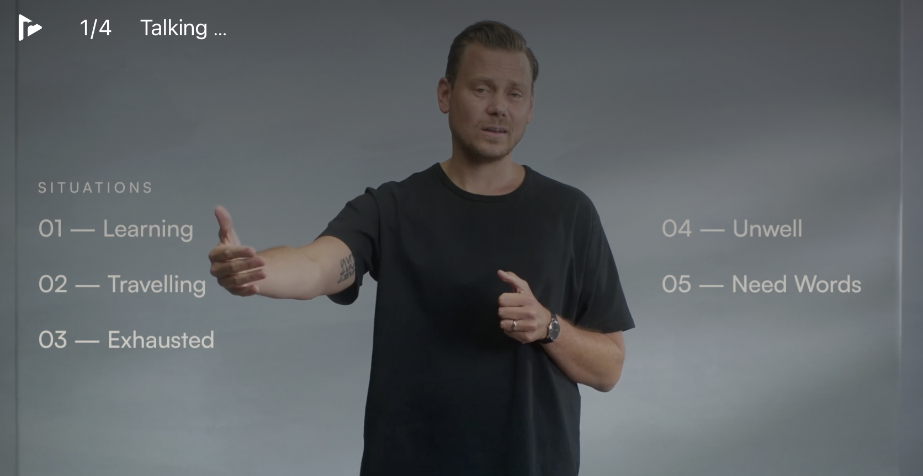
LENT 2025
The Prayer Practice Course
- Taught my John Mark Comer
- 4 Week Video Course with Discussion Guides
- Available for Free on Right Now Media and Practicing the Way

Slide 11

Church Nominations for GC Positions: www.grace.org/nominations

Slide 12


Slide 13
https://grace.org/groupleaders
- Training
- Content
- Leader Development
- More
Notes:
https://www.grace.org/groupleaders/

Slide 14


Slide 15

www.grace.org/jrl

Slide 16
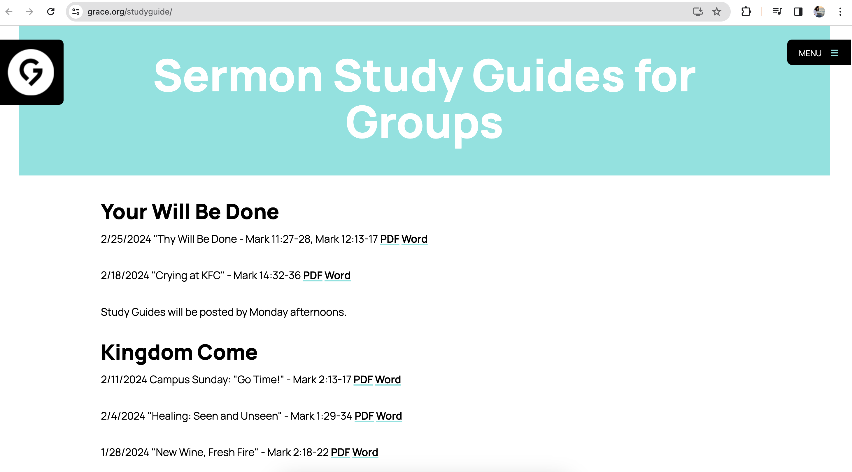
www.grace.org/studyguide

Slide 17
https://grace.org/groupleaders https://grace.org/jrl https://grace.org/studyguide
Notes:
https://www.grace.org/groupleaders/

Slide 18
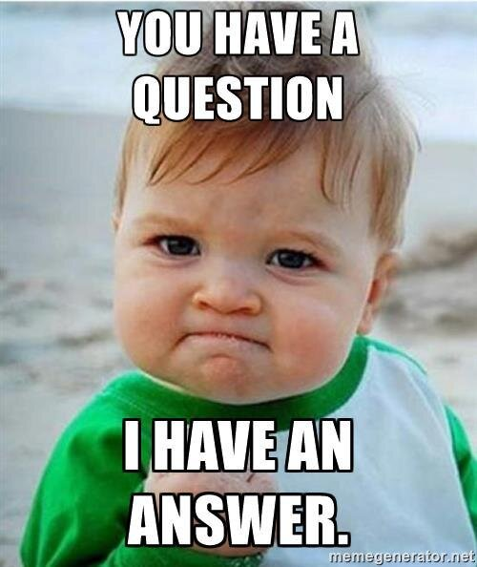
Q & A

