Slide 1
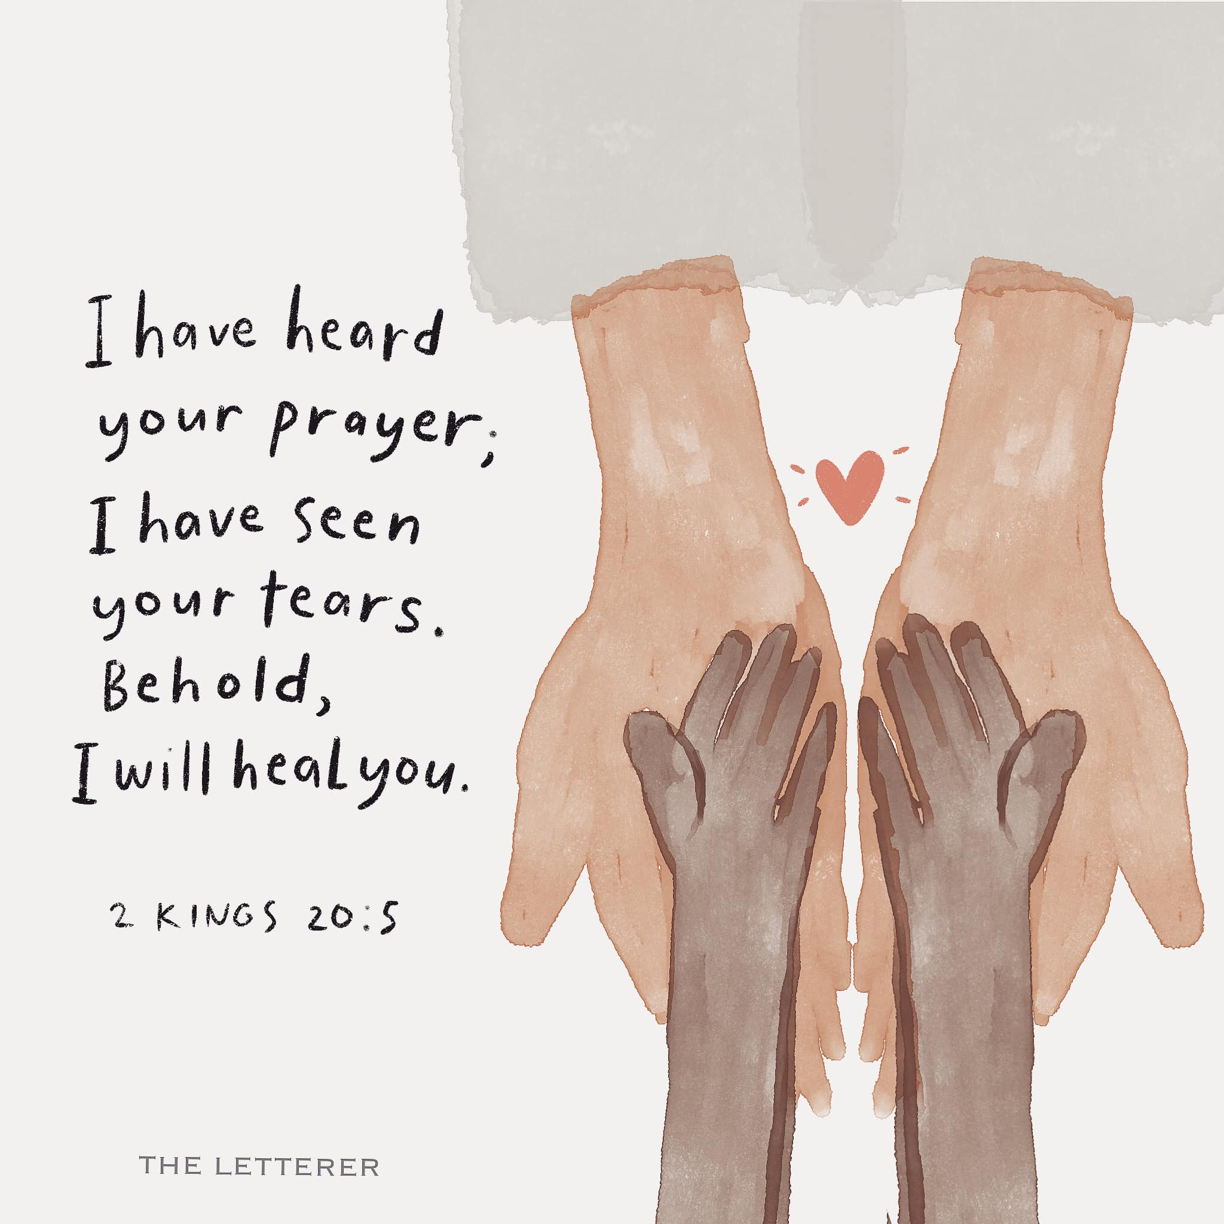
Healer
Grace Lee
Women’s Bible Study
March 26, 2024

Slide 2


Slide 3


Slide 4
Resources
Books
Power Healing by John Wimber (Christian author and pastor; founding member of Vineyard Movement and other charismatic congregations) ***Recommended Read
The Wounded Healer by Henri Nouwen (Dutch priest and professor at Yale and Harvard, writer, theologian; lived in community with people with mental/physical disabilities)
The Seven Wounds of Christ by Fred Hartley III (Founder and President of College of Prayer)
Articles
“5 Psalms for when you’re sick” by Sarah Garone https://bustedhalo.com/ministry-resources/5-psalms-for-when-youre-sick#:~:text=Psalm%2041%20contains%20perhaps%20the,this%20psalm%20testifies%20to%20the
“According to the Bible, why do people get sick? Divine Healing – Question 16” by Don Stewart https://www.blueletterbible.org/Comm/stewart_don/faq/divine-reading/16-why-do-people-get-sick.cfm

Slide 5
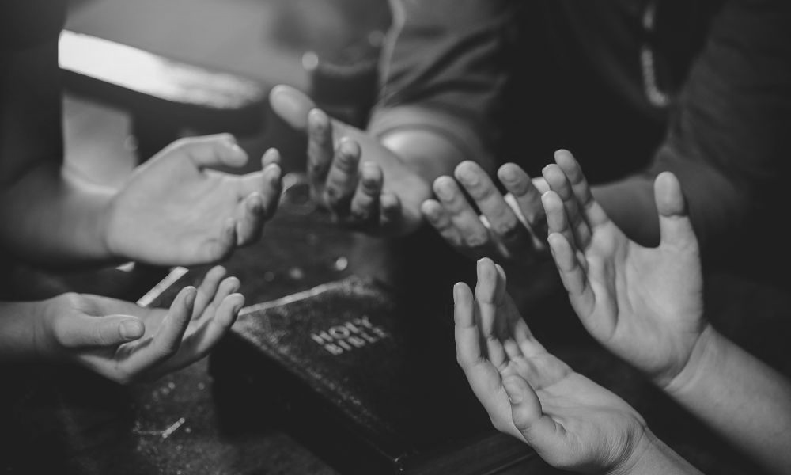

Slide 6

In the beginning
God created us as integrated whole beings…

Slide 7
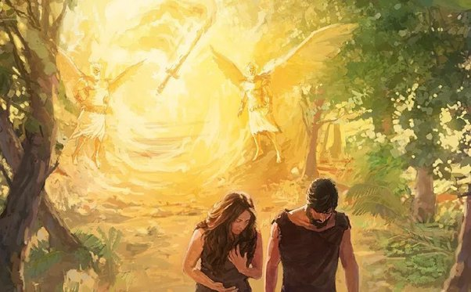
Romans 5:12 Therefore, just as through one man sin entered the world, and death through sin, and thus death spread to all men.”

Slide 8
Effect of the Fall
Sin: affects every part of our human nature
  Physical, Psychological, Emotional, Intellectual, Sexual, Social, Spiritual
Physical death (Hebrews 9:27)
Sickness

Slide 9
God did not create sickness.
Bible never says sickness is a sin.
God’s healing is available for the whole person.

Slide 10
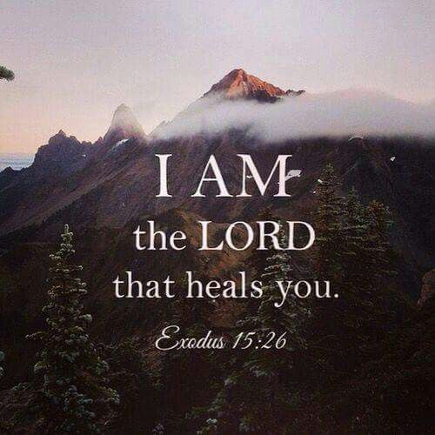
Healer in the Old Testament
Introducing the Divine Name

Slide 11
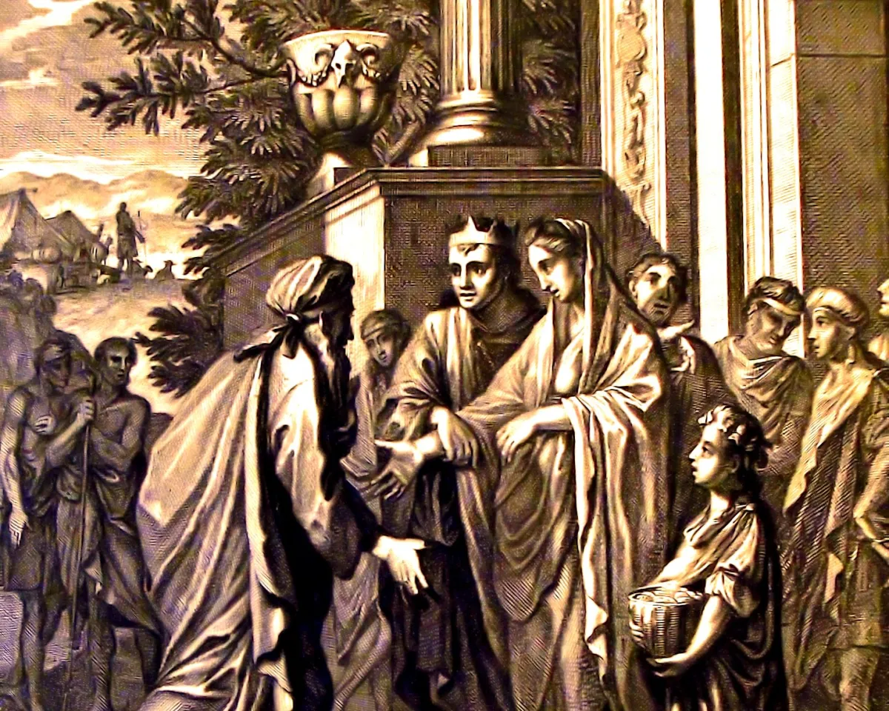
רָפָא rāp̄ā'
Verb: “to heal, make healthful” (Blue Letter Bible)
Genesis 20:17 Then Abraham prayed to God (Elohim), and God (Elohim) healed Abimelech, and also healed his wife and female slaves so that they bore children.

Slide 12
Divine Name: the LORD who heals
saying, “If you will diligently listen to the voice of the Lord your God, and do that which is right in his eyes, and give ear to his commandments and keep all his statutes, I will put none of the diseases on you that I put on the Egyptians, for I am the Lord (YHWH), your healer.”
Exodus 15:26

Slide 13
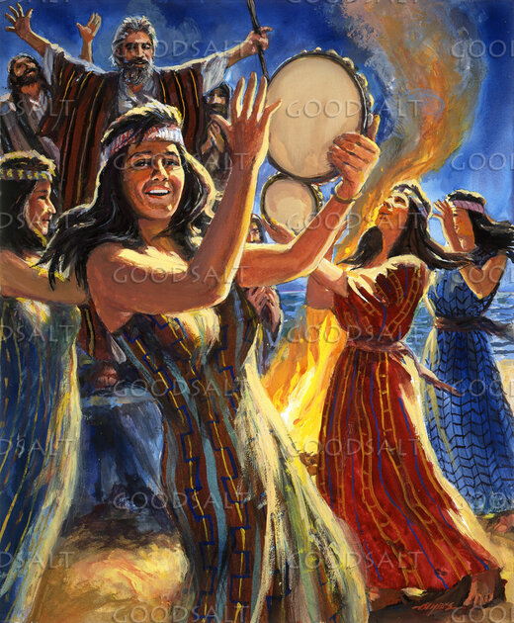
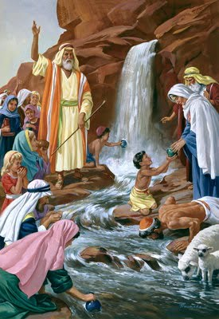
Context of Exodus 15
Exodus 15:1-5 The Song of Moses
Exodus 15:6-10 You have overthrown those who rose against You
Exodus 15:11-13 Who is like You, O LORD, among the gods?
Exodus 15:14-18 The people will hear and be afraid
Exodus 15:19-21 Miriam leads women in worship
Exodus 15:22 Three days into the wilderness
Exodus 15:23-25a Bitter waters made sweet at Marah
Exodus 15:26b-27 The testing of Israel

Slide 14
Jehovah (YHWH)-Rapha: the LORD who heals
saying, “If you will diligently listen to the voice of the Lord your God, and do that which is right in his eyes, and give ear to his commandments and keep all his statutes, I will put none of the diseases on you that I put on the Egyptians, for I am the Lord, your healer.”
Exodus 15:26
Under the Old Covenant, physical health connected to obedience.

Slide 15
Jehovah (YHWH)-Rapha: the LORD who heals
saying, “If you will diligently listen to the voice of the Lord your God, and do that which is right in his eyes, and give ear to his commandments and keep all his statutes, I will put none of the diseases on you that I put on the Egyptians, for I am the Lord, your healer.”
Exodus 15:26
  ⁵⁸ “If you are not careful to do all the words of this law that are written in this book, that you may fear this glorious and awesome name, the Lord your God, ⁵⁹ then the Lord will bring on you and your offspring extraordinary afflictions, afflictions severe and lasting, and sicknesses grievous and lasting. ⁶⁰ And he will bring upon you again all the diseases of Egypt, of which you were afraid, and they shall cling to you. ⁶¹ Every sickness also and every affliction that is not recorded in the book of this law, the Lord will bring upon you, until you are destroyed. Deuteronomy 28:58-61

Slide 16
Jehovah (YHWH)-Rapha: the LORD who heals
saying, “If you will diligently listen to the voice of the Lord your God, and do that which is right in his eyes, and give ear to his commandments and keep all his statutes, I will put none of the diseases on you that I put on the Egyptians, for I am the Lord, your healer.”
Exodus 15:26
Under the Old Covenant, physical health connected to obedience.
Wimber observes that almost every illness recorded in the OT was a result of sin and disobedience.
The people knew God could and did heal.

Slide 17
The people knew God could and did heal (cont’d)
Job 5:18
For he wounds,
but he binds up;
he shatters,
but his hands heal.
Deuteronomy 32:39
“‘See now that I, even I, am he, and there is no god beside me;
I kill and I make alive;
I wound and I heal;
and there is none that can deliver out of my hand.

Slide 18
The people knew God could and did heal (cont’d)
  Jeremiah 17:14 Heal me, O Lord, and I shall be healed; save me, and I shall be saved, for you are my praise.
  Psalm 41:3 The Lord sustains him on his sickbed;
  in his illness you restore him to full health.
  Psalm 103:1-5 Bless the Lord, O my soul, and forget not all his benefits, who forgives all your iniquity, who heals all your diseases,

Slide 19
God’s Healing in the Old Testament (Old Covenant)
Physical healing for individuals
Numbers 12:13
And Moses cried to the Lord, “O God, please heal her—please.”
2 Kings 20:5
“Turn back, and say to Hezekiah the leader of my people, Thus says the Lord, the God of David your father: I have heard your prayer; I have seen your tears. Behold, I will heal you. On the third day you shall go up to the house of the Lord…
Figurative healing for Israel – favor and forgiveness
  Hosea 6:1
  Come, let us return to the LORD; for he has torn us, that he may heal us; he has struck us down, and he will bind us up.
  Jeremiah 30:17
  Behold, I will bring to it health and healing, and I will heal them and reveal to them abundance of prosperity and security.

Slide 20
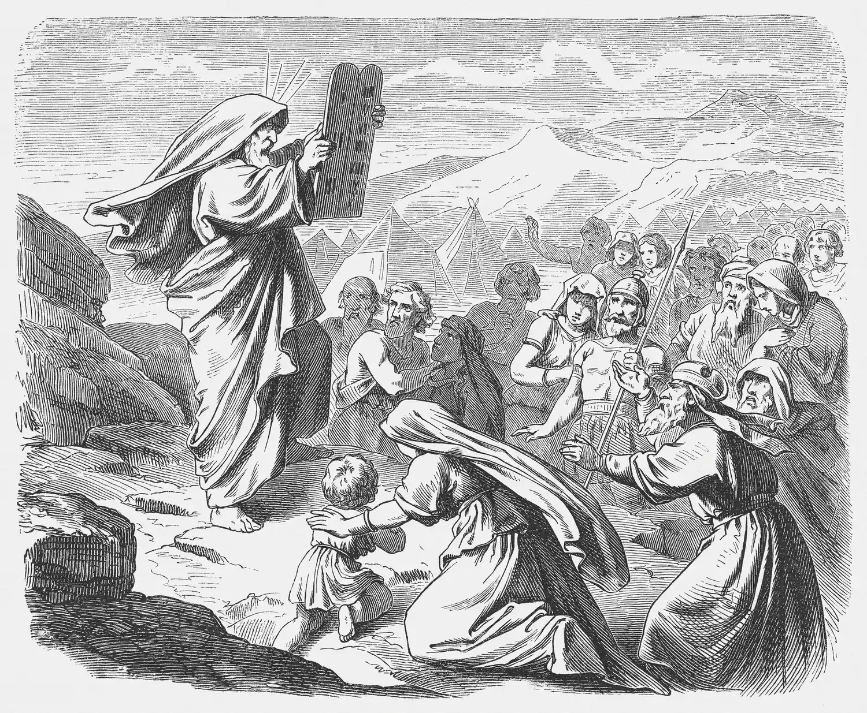

Slide 21
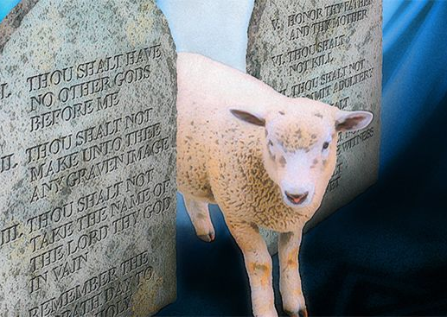
“His name points to the hope of the new covenant in which the coming of Jesus brings the fullness of God’s mercy and healing power.”
- John Wimber

Slide 22
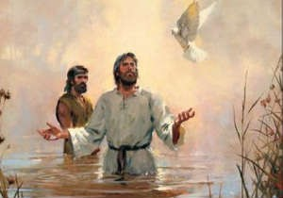
Jesus
Healing in the New Testament

Slide 23
³⁵ In the synagogue there was a man with an evil spirit. Jesus drove out the evil spirit.
³⁸⁻³⁹ Jesus then left the synagogue and went to the house of Simon Peter. Simon’s mother-in-law was suffering with a high fever. Those in the house asked Jesus to help her and he bent over her and rebuked the fever. She got up at once and began to wait on them.
Luke 4:35, 38-39

Slide 24
¹⁴ And when Jesus entered Peter's house, he saw his mother-in-law lying sick with a fever. ¹⁵ He touched her hand, and the fever left her, and she rose and began to serve him. ¹⁶ That evening they brought to him many who were oppressed by demons, and he cast out the spirits with a word and healed (therapeuo) all who were sick. ¹⁷ This was to fulfill what was spoken by the prophet Isaiah: “He took our illnesses and bore our diseases.”
Matthew 8:14-17

Slide 25
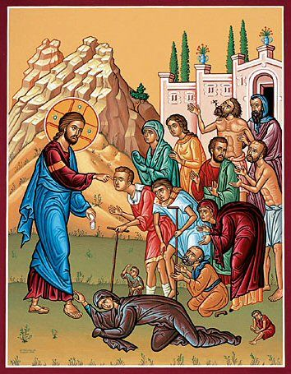
Healing in the New Testament
Observe Jesus combined healing with proclaiming the Kingdom of God (Mark 1:15)
Compared to the Old Testament, we read more individual healing accounts.
These healing accounts are often associated with repentance from sin or being delivered from Satan/demonic attacks.

Slide 26
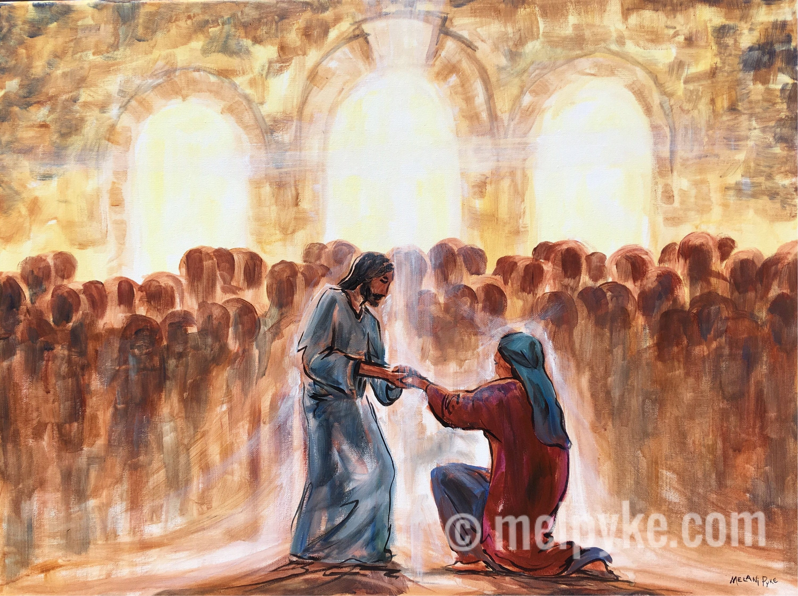
“Jesus understood sickness as an enemy of men and women. Its source was evil and from Satan’s kingdom. The deepest sickness is sin, and all other consequences of sin, including physical sickness and poverty, are subordinated to that.
This does not mean that every sick person who is prayed for will be healed in this life; but it does mean that forgiveness of sins is available to all, and for many there will be physical healing.
In the age to come, there will be complete healing of all who turn to Christ: the eradication of all disease and poverty, hatred, and sin.”
- John Wimber, Power Healing p.16

Slide 27
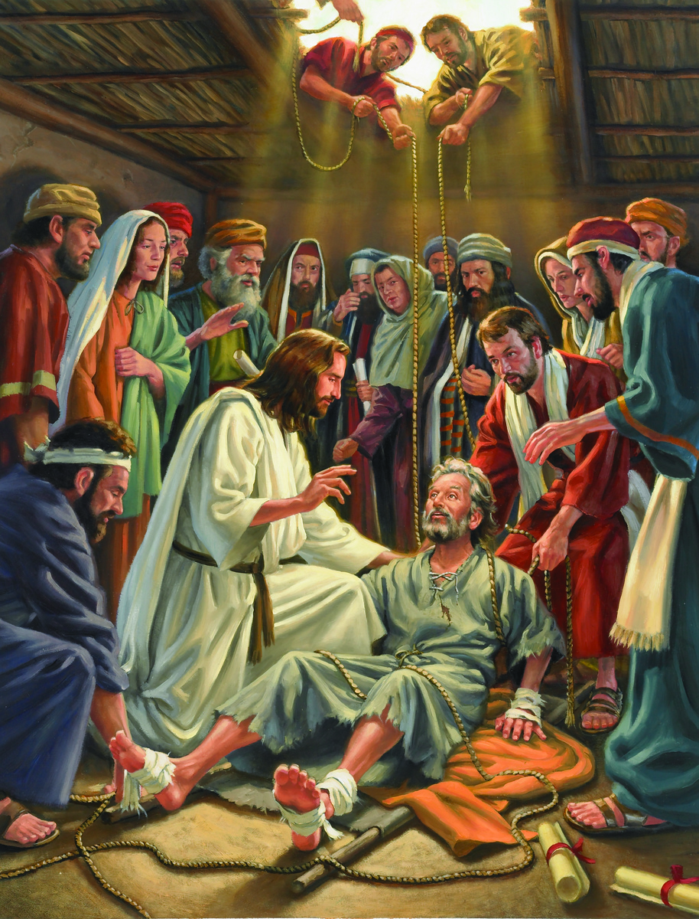
⁸ When the crowd saw this, they were filled with awe; and they praised God, who had given such authority to man. Matthew 9:8

Slide 28
Different reactions to Jesus’ healing
John 12:37-40
Though [Jesus] had done so many signs before them, they still did not believe in him, so that the word spoken by the prophet Isaiah might be fulfilled: “Lord, who has believed what he heard from us, and to whom has the arm of the Lord been revealed?” Therefore they could not believe. For again Isaiah said, “He has blinded their eyes and hardened their heart, lest they see with their eyes, and understand with their heart, and turn, and I would heal them.”
2 Corinthians 5:17
Therefore, if anyone is in Christ, the new creation has come: The old has gone, the new is here!

Slide 29
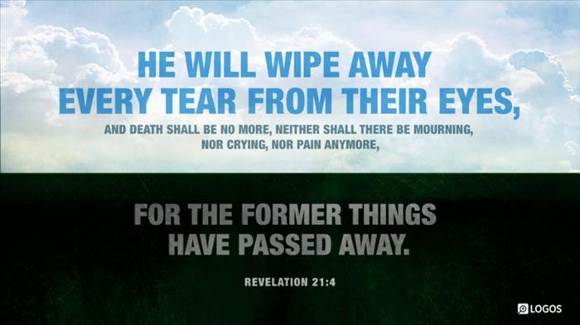

Slide 30
“Pain insists upon being attended to. God whispers to us in our pleasures, speaks in our conscience, but shouts in our pain: it is his megaphone to rouse a deaf world.” – C.S. Lewis

Slide 31
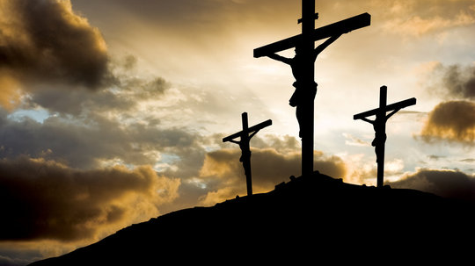
²⁴ He himself bore our sins in his body on the tree, that we might die to sin and live to righteousness.
By his wounds you have been healed.
²⁵ For you were straying like sheep, but have now returned to the Shepherd and Overseer of your souls.
1 Peter 2:24-25

Slide 32

Healing for Today

Slide 33
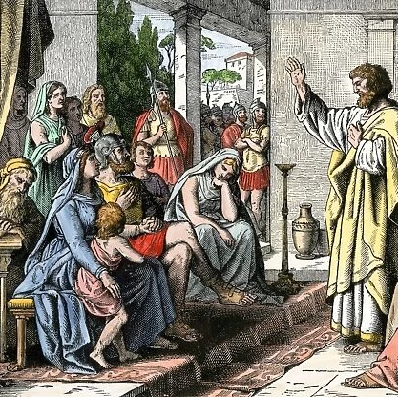
Peter’s message to the Gentiles
³⁸ how God anointed Jesus of Nazareth with the Holy Spirit and with power. He went about doing good and healing (iaomai) all who were oppressed by the devil, for God was with him.
Acts 10:38

Slide 34

And the prayer of faith will save the one who is sick, and the Lord will raise him up. And if he has committed sins, he will be forgiven. Therefore, confess your sins to one another and pray for one another, that you may be healed. The prayer of a righteous person has great power as it is working.
James 5:15-16

Slide 35
Closing Song
Notes:
Don Moen, I am the God that healeth Thee

Slide 36
I am the God that healeth thee
I am the Lord your Healer
I sent My Word and healed your disease
I am the Lord your Healer

Slide 37
You are the God that healeth me
You are the Lord my Healer
You sent Your Word and healed my disease
You are the Lord my Healer

Slide 38
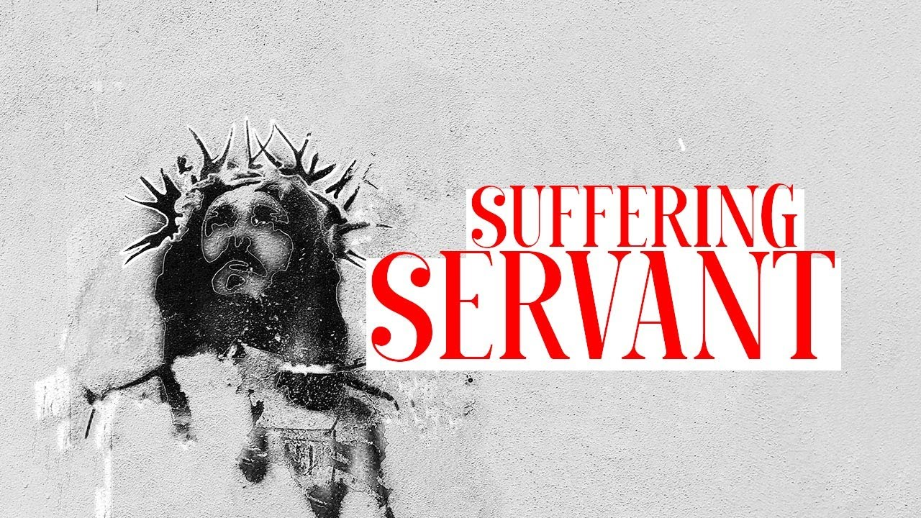
Isaiah’s Prophecy about the Suffering Servant

Slide 39
The Atoning Suffering of the Servant of the Lord
(1-3) How man saw the suffering Messiah
(4-6) The Servant of the LORD bears our sin.
(7-9) The suffering and death of the Servant of the LORD
The Victory of the Servant of the LORD
(10-11) The Messiah’s satisfaction
(12) The Messiah’s work and reward
Outline provided in The Enduring Word Bible Commentary by David Guzik

